Slide 1


How to be more Pythonic
Python for intermediates
By Herman van der Veer

Slide 2
Preparation
Laptop with Python (3.9) installed
An IDE (I suggest PyCharm)
Clone my repository
Git clone https://github.com/aufbakanleitung/pythonic.git
Join the slack channel
pythonic_course

Slide 3
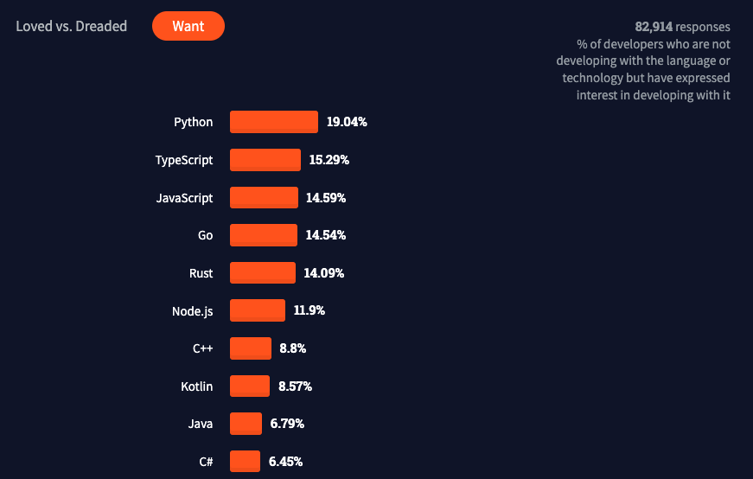
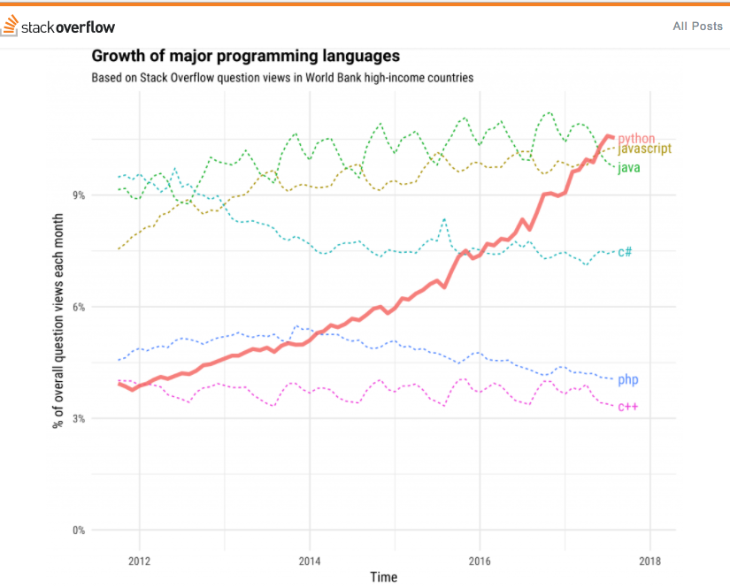
Why Python?
https://insights.stackoverflow.com/survey/2021

Slide 4
Assignment 1 - unique
Create a function that counts all numbers that contains only unique numbers

Slide 5
Learnings 1
Sets contain only unique values
Compare a list to a set to test for duplicates

Slide 6
Assignment 2 - Cipher
Create a function that encrypts text by moving each letter 2 positions higher in the alphabet
Example: ”Example text” becomes ”Gzcorng vgzv”

Slide 7
Learnings 2
What did we learn?
Convert letters to their ASCII value with ord()
Convert them back with chr()

Slide 8
Assignment 3 - rocket equation
If you launch a something into space you need fuel. The higher the mass the more fuel you need. To find the fuel for this assignment take its mass, divide by three, round down, and subtract 2.
Example: For a mass of 1969, the fuel required is 654
However the fuel also has mass itself, which requires fuel to get it in the air. So the total you need is:
654 + 216 + 70 + 21 + 5 = 966 fuel
What is the sum of the fuel requirements in the list?

Slide 9
Learnings 3
Recursive functions return func(x)
Integer division //
list comprehension [x for x in y]

Slide 10
Assignment 4 - Timer
Time how fast assignment 3 runs

Slide 11
Learnings timer
Function wrappers def func(): def wrapper(*y):
Variable nr of arguments *args **kwargs
Round using f-strings :.2f
Decorators @func
Import function import timer
Why use __main__

Slide 12
Assignment 5 – Walrus operator
The walrus operator allows you to both assign and return a variable in the same expression (:=)
print(ipa_price := 5,50)
Refactor assignment 5 with the :=

Slide 13
PRinting
Zero padding print(f’{num:05}’)
Avoiding line-breaks print(‘tekst’, end=‘’)

Slide 14
Agenda
Comparing lists
Ordinals
Integer division
Printing
Function decorators
List comprehension
Short-circuiting
Regex

