Slide 1


Al-azhar university faculty of engineering & information technology department of software engineering
HUMAN-COMPUTER INTERACTION Google Schooler Project
Prepared by
Haytham akram salama 20191016
Yusuf nafez abu msabeh 20190508
Oday mazen abu mettleq 20192015
Mohammednader ahed al ghussin 20191138
Anas adel ouda 20191582
Supervised By
Dr. SHADI M S HILLES

Slide 2
Introduction
This report aims to analyze the human-computer interaction (HCI) of Google Scholar. In order to do so, we ask participants to complete a questionnaire about their experience with Google Scholar. Our five-part questionnaire includes questions about the usefulness of Google Scholar, the ease of use of Google Scholar, how efficient they expect Google Scholar to be, how easy it would be to learn to use Google Scholar, and whether they trust Google Scholar.

Slide 3
Problem Space Objective

Slide 4
Data Collection
Responses
Since there are 25 questions and 34 responses for each question, the response table is too large. We attached the CSV file of the responses that we directly downloaded from the questionnaire on Blackboard with this document.
Graph Results

Slide 5
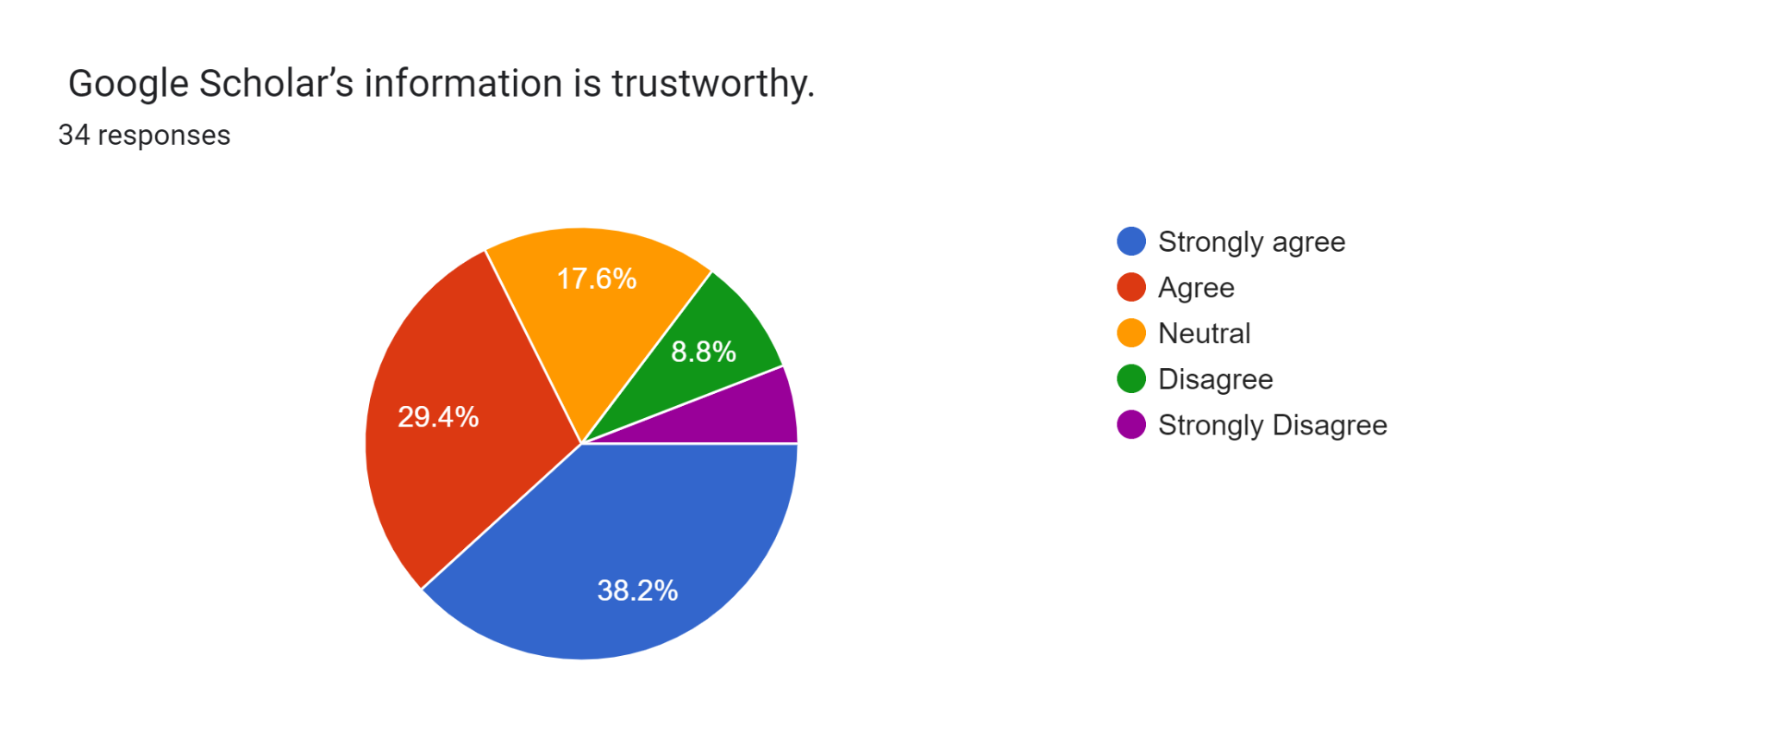
Data Collection
Trust

Slide 6
Result And Discussion
Perceived Usefulness | Mean | Mode | Median
Q1 | 3.529411765 | 4 | 4
Q2 | 3.852941176 | 4 | 4
Q3 | 3.235294118 | 2 | 3.5
Q4 | 3.529411765 | 2 | 4
Q5 | 3.152941176 | 2 | 3.5
Perceived Ease of Use | Mean | Mode | Median
Q1 | 2.529411765 | 2 | 3
Q2 | 2.823529412 | 2 | 3
Q3 | 2.529411765 | 4 | 3
Q4 | 3.294117647 | 2 | 3.5
Q5 | 2.823529412 | 4 | 3

Slide 7
Result And Discussion
Efficiency expectation | Mean | Mode | Median
Q1 | 3.411764706 | 2 | 4
Q2 | 3.147058824 | 2 | 3
Q3 | 3.382352941 | 2 | 4
Q4 | 3.441176471 | 4 | 4
Q5 | 3.705882353 | 2 | 4
Learnability | Mean | Mode | Median
Q1 | 3.5 | 4 | 4
Q2 | 3.323529412 | 2 | 3.5
Q3 | 3.5 | 2 | 4
Q4 | 3.588235294 | 2 | 3.5
Q5 | 2.852941176 | 2 | 3

Slide 8
Result And Discussion
Trust | Mean | Mode | Median
Q1 | 3.676470588 | 2 | 4
Q2 | 3.088235294 | 2 | 3
Q3 | 3.617647059 | 4 | 4
Q4 | 2.970588235 | 4 | 3.5
Q5 | 2.970588235 | 4 | 4

Slide 9
Conclusion
To summarize our study, the questionnaire we conducted with 34 people showed us the followings:
Most users found Google Scholar GUI beautiful.
Most users found Google Scholar useful to search for articles.
Most users found Google Scholar easy to create an account and configure it.
Most users found Google Scholar easy to create an account and configure it.
Most users found Google Scholar easy to search to get related results.
Users are happy and satisfied with the results
Most users found that the alert function is working well and as expected
Users are happy with the learnability of Google Scholar and find it simple.
Google Scholar’s simple interface made a huge difference in making the website more learnable.
Most users trust the information provided by Google Scholar
80% of the users feel confident enough for Google Scholar to take actions beyond them.

