Slide 1
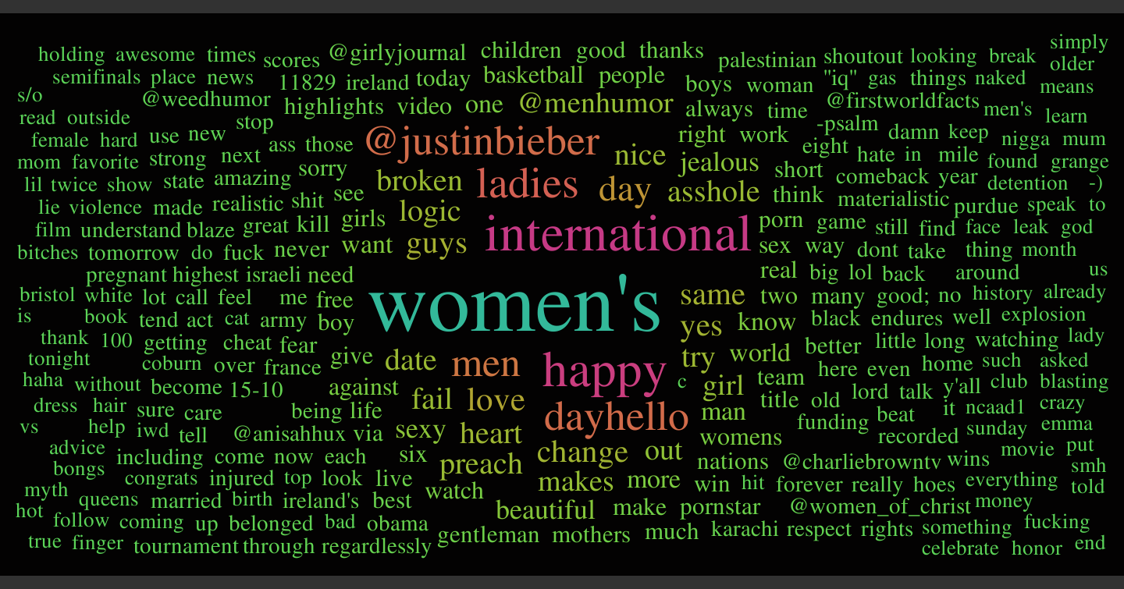
Most Frequent Words in a Twitter Search for “Women”

Slide 2
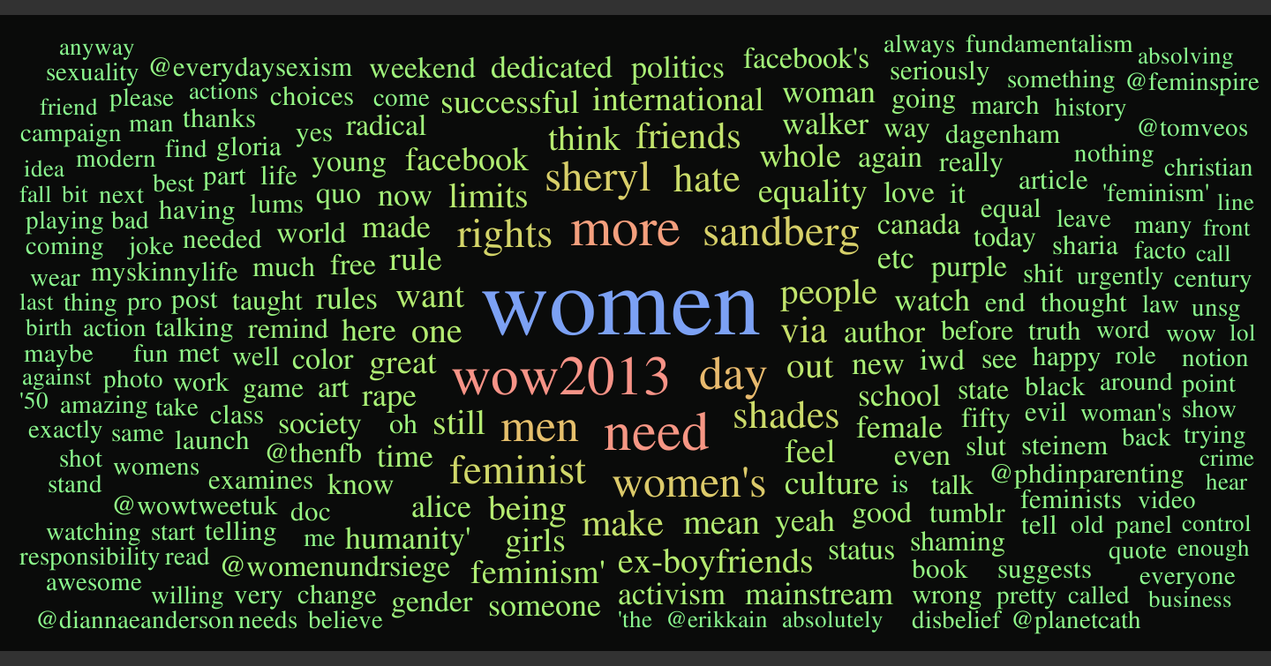
Most Frequent Words in a Twitter Search for “Feminism”

Slide 3
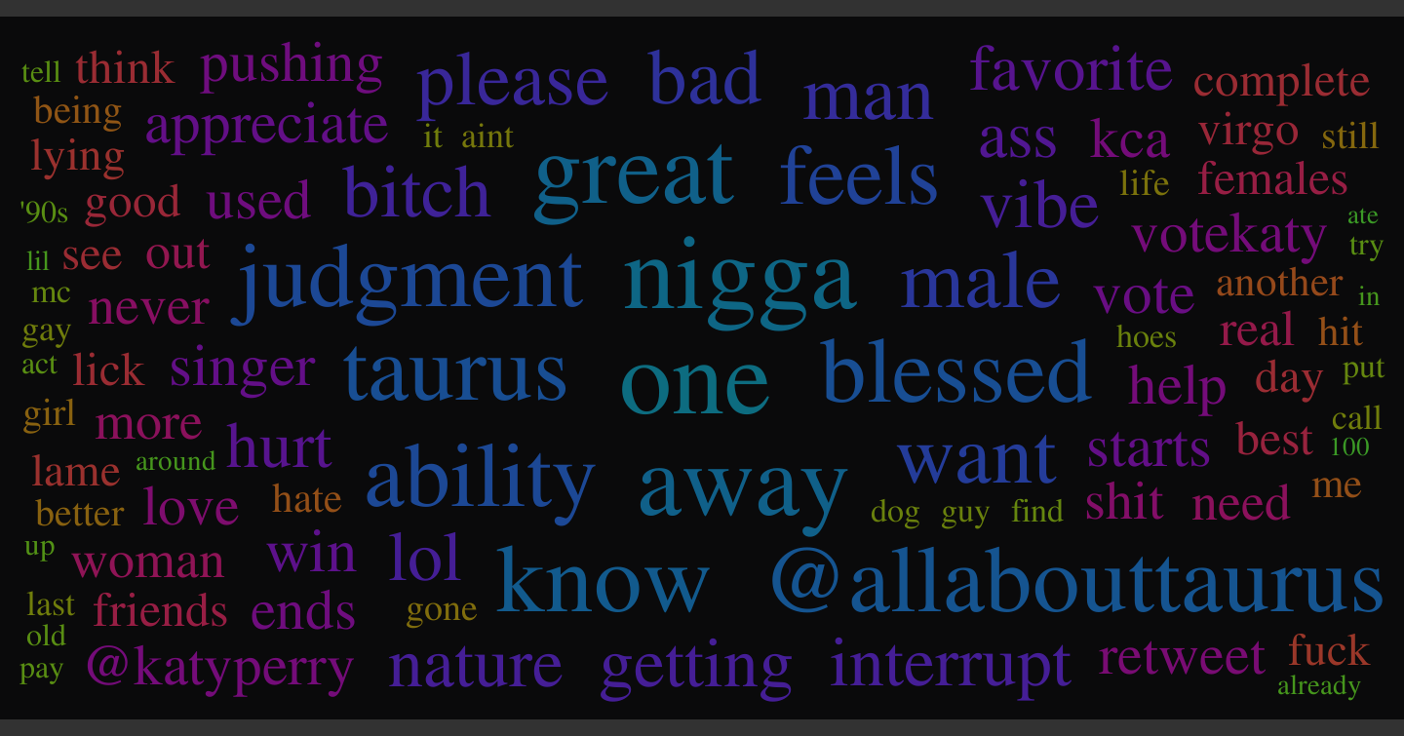
Most Frequent Words in a Twitter Search for “Female”

Slide 4
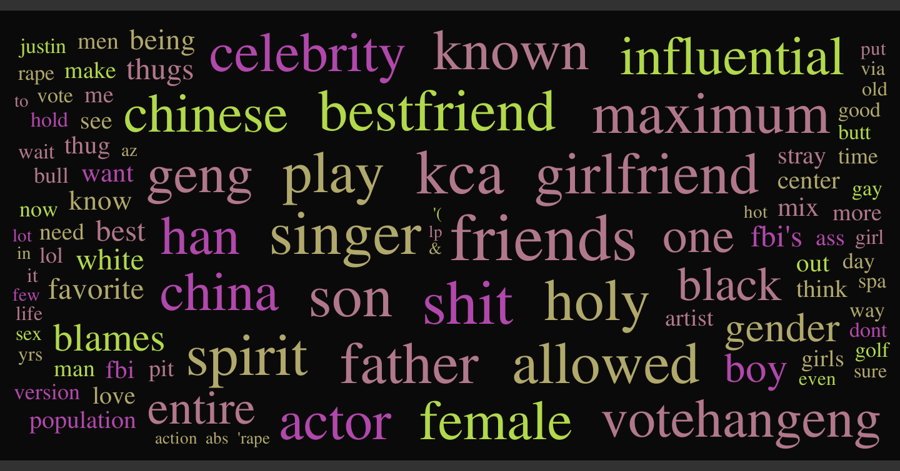
Most Frequent Words in a Twitter Search for “Male”

Slide 5
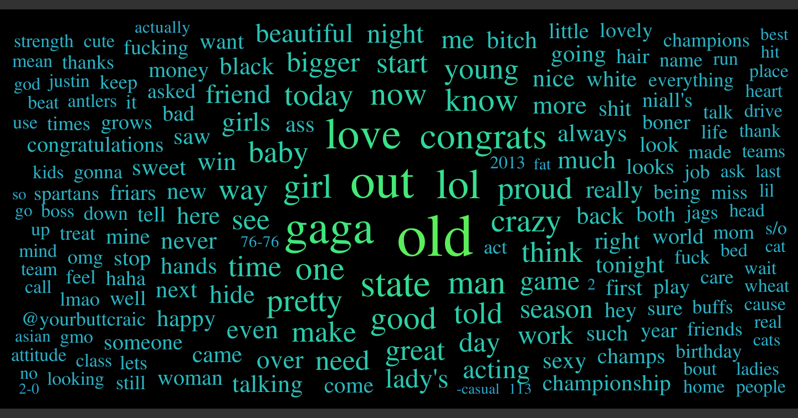
Most Frequent Words in a Twitter Search for “Lady”

Slide 6
Classifying Tweets
Woman
loved | 156 tweets
happy woman's good life women's takes alive | 50 tweets
happy mothers down watching black beautiful breaking @emmapaige @jo_age @megkatrose @mylesterrey @grace_brookes | 37 tweets
needs @wethinkforgirls back make want right | 31 tweets

Slide 7
Classifying Tweets
Feminism
women 'feminism' culture tumblr international rape rights shaming slut taught working | 36 tweets
culture post blog find here honour christian oxymoron today (re)defining @danahoule @msszeeusman african against backlash bottom burrow follow good http//tco/wfmpqrhetn know march mostly reading remember resurrected wrote | 13 tweets
need woman's make @n_triton fuck give till weekend | 13 tweets
hate facebook sheryl feminists sandberg mensrights@reddit successful @everydaysexism @mensrightsrdt chan equality issue mission | 11 tweets
women need again photo remind klitoris quotes yeah feminspire denna haha homofest lite pants photography smyger wear | 9 tweets
mean friend rules wolf answer barn ex-boyfriends girls handikapp limits naomi nästan takes tron tv-fläsket åldringsvård återfår | 9 tweets

Slide 8
Classifying Tweets
Lady
gaga | 64 tweets
look good ladies great season stay tonight hair | 17 tweets
love proud state came much watching basketball pretty team @orderinda_court antlers cougars flavor soooooo support | 17 tweets
want bitch girl night attitude better child class” enough mind voice wait woman | 14 tweets
start fucking shit crazy buffs hide mustangs shut still | 13 tweets
baby making imagine snow bawl hoptown lake nursery play scenes such sweet whatoncedoesright | 13 tweets

Slide 9
Classifying Tweets: k-Means + Map-Reduce
Generate n random clusters. (Random lists of words in the corpus)
tweet
Mapper → (nearest cluster, tweet)
tweet
Mapper → (nearest cluster, tweet)
Reducer → (new centroid)
tweet
Mapper → (nearest cluster, tweet)
Reducer → (new centroid)
tweet
Mapper → (nearest cluster, tweet)
“Nearest” tweet? -Jaccard distance:
1 -
Tweet U centroid
Tweet ∩ centroid

