Slide 1
Theory of Computation
Theory of Computation Peer Instruction Lecture Slides by Dr. Cynthia Lee, UCSD are licensed under a Creative Commons Attribution-NonCommercial-ShareAlike 3.0 Unported License. Based on a work at www.peerinstruction4cs.org.

Slide 2
Turing Machine Transition Function
Continuation of Tuesday’s lecture

Slide 3
More Transition Function
(a) TRUE
(b) FALSE
x0q₁11y yields x0q₂11y can never happen in any Turing Machine
Notes:
TRUE, it can never happen. Traditional version must go L or R, cannot stay in place. Today we’ll talk about variants that allow that kind of thing. What’s interesting is that our variants (unlike adding 2nd PDA tape) do not seem to ever change the power of TM to be something more powerful.

Slide 4
TM VARIANTS 3.2
Variety is the spice of life

Slide 5
TM that can stay in place
New transition function:
δ: Q x Γ -> Q x Γ x {L,R,S}
Can we prove that “it does not change the power!”?
Given: the transition diagram for a TM with {L,R} Want to show: construct an equivalent TM that only uses {L,R}
Proof idea/example:
Notes:
Blue text is highlighted because that is the recurring theme for the day, and I make a big deal out of it.

Slide 6
Multi-tape TM

Slide 7
Multi-tape TM
What should the transition function for a k-tape TM look like?
δ: Q x Γ -> Q^{k} x Γ^{k} x {L,R,S}^{k}
δ: Q^{k} x Γ^{k} -> Q^{k} x Γ^{k} x {L,R,S}^{k}
δ: Q x Γ^{k} -> Q x Γ^{k} x {L,R,S}^{k}
I don’t understand this at all
Notes:
This is on some level just review of mathematical notation for functions.
C
We are only ever in one control state, but we read something from each tape, we write something to each tape, and each tape head can move in its own direction (or stay in place)

Slide 8
Multi-tape TM: Same power as single-tape
Remember how adding a second stack to PDA made it more powerful?
Turns out you can add as many tapes as you want (!) to a TM, and it does not change the power!
Theorem 3.13 in your book
Proof: Simulate a k-tape TM using a 1-tape TM.
(Similar proof concept to how we simulated NFA in a DFA to show that nondeterminism does not change the power of finite automata.)

Slide 9
Multi-tape TM: They make your life easier, not harder!
Q: When would you want to use a multi-tape TM?
A: When you want to have several work spaces without them interfering with each other
For example, you want to leave the input completely untouched, while working on a scratch version of it elsewhere
You can do it on a single tape, of course, but when you need to specify a TM for L to show that L is decidable (for example), it can be easier for you if you don’t have to worry about workspaces interfering

Slide 10
Nondeterministic TM: Same power as deterministic
Turns out you can add nondeterminism to a TM, and it does not change the power!
Theorem 3.16 in your book
Proof: Simulate a nondetermistic TM using a 3-tape deteministic TM (which we know is equivalent to a 1-tape determistic TM).

Slide 11
Nondeterministic TM: They make your life easier, not harder!
Q: When would you want to use a nondeterministic TM?
A: When you want to test multiple different cases, and accept if any of them accepts
For example, showing a language of the form “{w | w [some condition] OR w [some other condition]}” is decidable by constructing a TM for it
You can do it without nondeterminism, of course, but it can be easier for you if you don’t have to worry about combining the two cases, or having to decide which case applies before you start doing tests for each case

Slide 12
Infinite Loops “Are We there YET?”
Before we continue with Enumerators, which are another TM variant, we’re going to go on a flashback to your first intro programming class:

Slide 13
A Given Turing Machine M, run on a given string w, has 3 possible outcomes:
M(w) accepts
M(w) rejects
M(w) loops forever
Why do we have this 3rd behavior now, but didn’t with DFAs, NFAs nor PDAs?

Slide 14
Infinite Looping
(a) TRUE
(b) FALSE
If the input string is finite, then at some point, the TM has to be able to finish reading it. Therefore, infinite looping can only happen when the input takes up the whole TM tape (which is infinitely long).
Notes:
(B) FALSE
Unlike DFA, we don’t just march forward through the input, we can go back and forth. Also, it is part of the definition of our TM model that the input is finite.

Slide 15
Prove that there exists a TM that loops forever no matter what the input
Just explain what it does in words
Notes:
“No matter what you read, write an X and move the tape to the Right” is one possibility.

Slide 16
Languages and Models
If a DFA/NFA recognizes a language, it is
Regular
If a PDA recognizes a language, it is
Context-free
What about TMs? Two kinds:
Turing-decidable languages
Turing-recognizable languages

Slide 17
Smart Printers Enumerators

Slide 18
3.18. Show that a language is decidable iff some enumerator enumerates the language in lexicographic order
How do we prove “iff” statements?
Recall that “iff” is shorthand for “if and only if”
Note: we’re going to do this proof by just writing out an algorithm (like pseudocode, or English words description)
Will not mention tape, read/write head, etc.
Church-Turing thesis allows us to justify leaving out the details! We’ll talk about Church-Turing thesis in just a moment…
Notes:
Remind students that to prove iff, you prove one direction, then the other direction. To prove an implication statement is true, you assume the LHS part is true, then use that to show the RHS part must also be true.

Slide 19
Lexicographic ordering
Like alphabetic ordering, except:
All shorter strings precede all longer ones
Alphabetic ordering:
All the ‘a’ words in the dictionary come before any of the ‘b’ words
a, aa, aaa, aaaa, aaaaa, … b, bb, bbb, …
Lexicographic ordering:
All the length 0 strings come before length 1 strings come before length 2 strings
Within each length, strings are alphabetical
ε, a, b, ab, ba, bb, aaa, aab, etc… (for alphabet {a,b})

Slide 20
3.18. Show that a language is decidable iff some enumerator enumerates the language in lexicographic order
If a language is decidable then some enumerator enumerates it in lexicographic order
If some enumerator enumerates a language in lexicographic order, then it is decidable

Slide 21
3.18. Show that a language is decidable iff some enumerator enumerates the language in lexicographic order
If a language is decidable then some enumerator enumerates it in lexicographic order

Slide 22
3.18. Show that a language is decidable iff some enumerator enumerates the language in lexicographic order
If a language is decidable then some enumerator enumerates it in lexicographic order
If some enumerator enumerates a language in lexicographic order, then it is decidable

Slide 23
3.18. Show that a language is decidable iff some enumerator enumerates the language in lexicographic order
If a language is decidable then some enumerator enumerates it in lexicographic order
Given: Decidable language L and a TM M that decides L.
Want to show: an enumerator E that enumerates L in lexicographic order.
E:
s = “”
While (true):
Run M(s), if M accepts, then output the string
s = Lexicographically “next” possible string of the alphabet
Notes:
Remind students that it is often useful in proofs—
And legal!—to simulate running one TM inside another.

Slide 24
3.18. Show that a language is decidable iff some enumerator enumerates the language in lexicographic order
If a language is decidable then some enumerator enumerates it in lexicographic order
If some enumerator enumerates a language in lexicographic order, then it is decidable
Given: An enumerator E that enumerates a language L in lexicographic order
Want to show: a TM M that decides L
M(w): //w is a string
Run E until one of the following happens:
E outputs w, then accept
E outputs a string that comes after w in lexicographic order, then reject
(left like this it would assume that there is a way to know that the enumerator is done—but we can sidestep that issue because if it can be “done,” then L was finite, in which case L is regular, therefore L is decidable)

Slide 25
Lexicographic ordering
Does our proof work for alphabetic ordering, instead of lexicographic ordering? (i.e., make the theorem and the proof all refer to alphabetic instead of lexicographic)
YES
NO
Other
Notes:
NO
It does not work because you keep printing out a strings:
a
aa
aaa
aaaa
aaaaa
….
So you can never print, for example, “car”

Slide 26
Can the enumerator ever print “car”?
Students often seem to not really believe that in lexicographic order, “car” will be printed (as will all possible strings of the alphabet, eventually), but in alphabetic order, “car” will never be printed, not even after an infinite amount of time.
So I coded it up for you.
Notes:
At this point, I run the python code for the lex and alpha versions in class and let them see the output for many iterations until they get the idea of what is happening. Python code is available on the peerinstruction4cs.org website.

Slide 27
Can the enumerator ever print “car”?
Do you believe it now?
It’s obvious!
I didn’t get it at first, but after seeing it, I get it now
I guess I believe it, but I still don’t quite get it
I don’t believe it!

Slide 28
Famous People Biographies

Slide 29
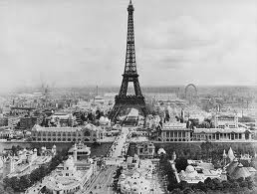
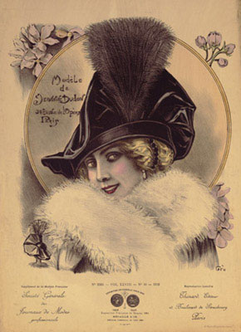
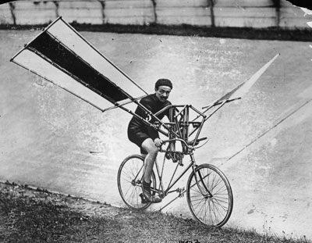
Turn-of-the-century mood
1880-1910 a time of immense optimism and faith in humanity
Nothing can go wrong in the coming century!*
Notes:
The asterisk is for, among other things, WWI and WWII.

Slide 30
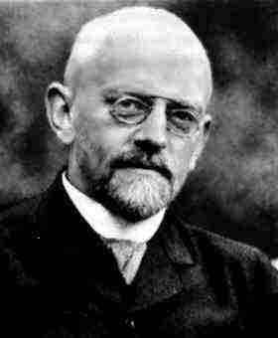

David Hilbert (1862-1943)
Spoke at the International Congress of Mathematicians in 1900 in Paris
Outlined 23 open problems in mathematics
Foundation of much of the next century of math research
“We must know! We will know!”
“No one shall expel us from the Paradise Cantor created!”

Slide 31
Mechanizing Hilbert’s Theorem-Proving Program
A major part of Hilbert’s program (#2 on the list of 23) was to formalize all of math into:
A finite set of axioms
A system for proving all mathematical statements true or false from those axioms
Alonzo Church, Alan Turing, and others, set to work on ways that this theorem-proving could be systematically implemented, even automated
Imagine an enumerator that prints out every mathematical truth!
Soon all truth and knowledge will just flow effortlessly into humanity’s hands…

Slide 32
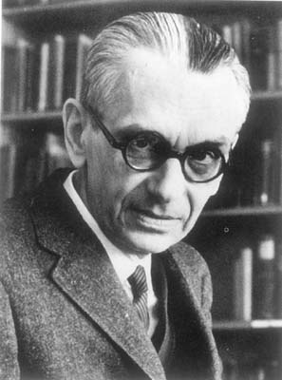
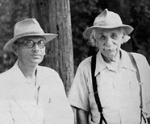
Kurt Gödel (1906-1978)
Just months after Hilbert declares, “We must know! We will know!”…
Gödel decimates Hilbert’s program with his Incompleteness Theorems
There will always be true statements about numbers that can’t be proved within the system of axioms
The system cannot demonstrate its own consistency
Gödel with Einstein (Princeton, 1950)
Notes:
Diagonalization!

Slide 33
Church-Turing Thesis
To implement Hilbert’s theorem-proving:
Church and Turing, without knowledge of each other, independently prove that a mechanized algorithm or computer approach to computation cannot calculate all numbers
Alonzo Church devised a λ-calculus definition of algorithm
Alan Turing proposed a Turing Machine definition of algorithm
‘Reject’ false theorems, ‘Accept’ true theorems
It is shown that these two independent approaches are equivalent in power

Slide 34
How Does the Story End?
Too bad Gödel proved that the whole thing is a waste because Church and Turing’s models could never fulfill mathematicians’ desire for a complete, consistent theoretical framework.
Nobody ever cared about Turing Machines ever again.
THE END.
No! We found a way to cast a limitless supply of things humans want to do as math problems that TMs can solve
Netflix streaming, Facebook, iTunes, Angry Birds, Toy Story and Finding Nemo, Skype, etc, etc—all just mathematical calculations on 0’s and 1’s!

