Slide 1
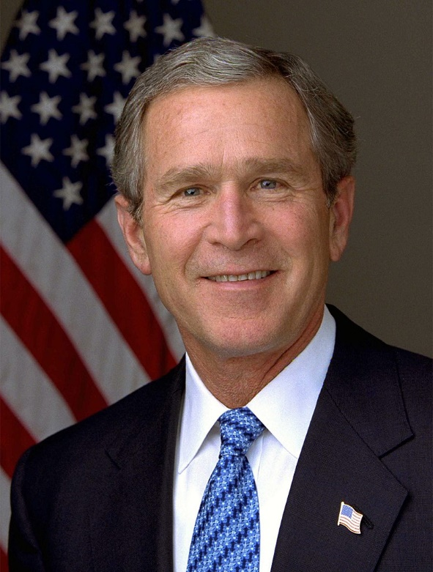
George Bush Jr
Presentation made by:
Augustas Arcišauskis

Slide 2
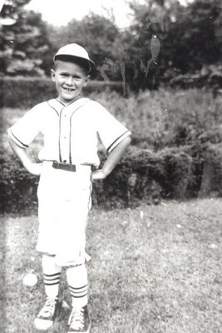
Early life
George Walker Bush was born on July 6, 1946, in New Haven, Connecticut. He was the first child of George Herbert W. Bush and his wife, Barbara Pierce. He was raised in Midland and Houston, Texas, with four siblings, Jeb, Neil, Marvin and Dorothy. His interests include oil painting, golf, bicycling and baseball.

Slide 3
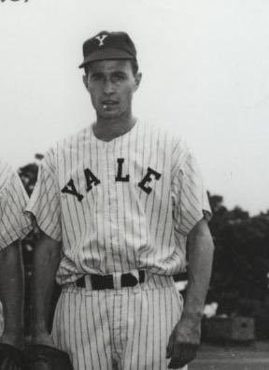
School life
Young George spent most of his childhood in Midland, attending school there until the 7th grade. The family moved to Houston in 1961, and George W. Bush was sent to Phillips Academy in Andover. There he was an all-around athlete, playing baseball, basketball and football. He was a fair student and had a reputation for being an occasional troublemaker. Despite this, family connections helped him to enter Yale University in 1964.

Slide 4
Studies
Attended Yale University (1964–1968), graduating with Bachelor of Arts degree in history;
In May 1968, Bush was commissioned into the Texas Air National Guard. He was honorably discharged from the Air Force Reserve on November 21, 1974.
Entered Harvard Business School (1973–1975), graduating with MBA (Master of business administration).

Slide 5
First business ideas and marriage
After graduating from Harvard Bussiness School he then returned to Midland and entered the oil business, working for a family friend, and later started his own oil and gas firm. In 1977, at a backyard barbeque, Bush was introduced by friends to Laura Welch, a school teacher and librarian. After a quick three-month courtship, he proposed, and they were married on November 5, 1977. The couple settled in Midland, Texas, where Bush continued to build his business.

Slide 6
Businessman life
After several years George Bush struck out on his own and founded Arbusto Energy in 1977. The company focused on low-risk but low-return wells, and it discovered a relatively profitable gas field that kept it afloat. The money was funded from other investors, including Dorothy Bush, Lewis Lehrman, Salem bin Laden. The company was succeeded by Bush Exploration, which later merged with Spectrum 7 in 1984. From his experience in the oil business, where his father had also succeeded, Bush learned many valuable lessons. He wrote in A Charge to Keep: “I learned how to manage, how to set clear goals and work with people to achieve them. I learned the human side of capitalism. I felt responsible for my employees and tried to treat them fairly and well.”

Slide 7
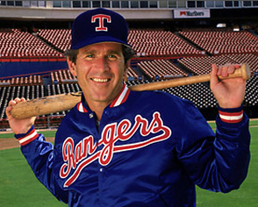
In 1986 Spectrum 7 lost revenue and was merged into Harken Energy Corporation, with Bush becoming a director of Harken. In April 1989, Bush arranged for a group of investors to purchase a controlling interest in the Texas Rangers baseball franchise for $89 million and invested $500,000 himself to start. He then served as managing general partner for five years. He actively led the team's projects and regularly attended its games, often choosing to sit in the open stands with fans. Bush's sale of his shares in the Rangers in 1998 brought him over $15 million from his initial $800,000 investment.

Slide 8
Political involvement
Governor of Texas (1995–2000) (focused on welfare, crime reduction, and education improvement.)
President of USA (2001–2009)

Slide 10
Internet sources:
https://www.biography.com/us-president/george-w-bush
https://en.wikipedia.org/wiki/Professional_life_of_George_W._Bush https://millercenter.org/president/gwbush/life-before-the-presidency
https://whowhatwhy.org/2011/10/24/the-texas-rangersand-how-they-made-george-bush-presidential/
https://www.khanacademy.org/humanities/us-history/modern-us/us-after-2000/a/george-w-bush-as-president

