Slide 1
GEOG788P Project Update
Guimin Zhu
11/02/2020

Slide 2
Project Updates
So far, I have been working on the data collecting and processing part and had a few preliminary results for my Research Question #1: What are the spatiotemporal patterns of the COVID-19 pandemic in Maryland?
Data collection
COVID-19 related data
Cases and confirmed deaths by county, age, gender, race and ethnicity. Daily testing volume and total population tested. Source: Maryland Department of Health
Maryland political boundaries
County level, zip code level, and census tract level. Source: Maryland’s Open Data Portal and Maryland’s GIS Data Catalog
Maryland statistics
Populations, age, gender, race/ethnicity, income and poverty, housing, education, and employment. Source: 2019 American Community Suevey

Slide 3
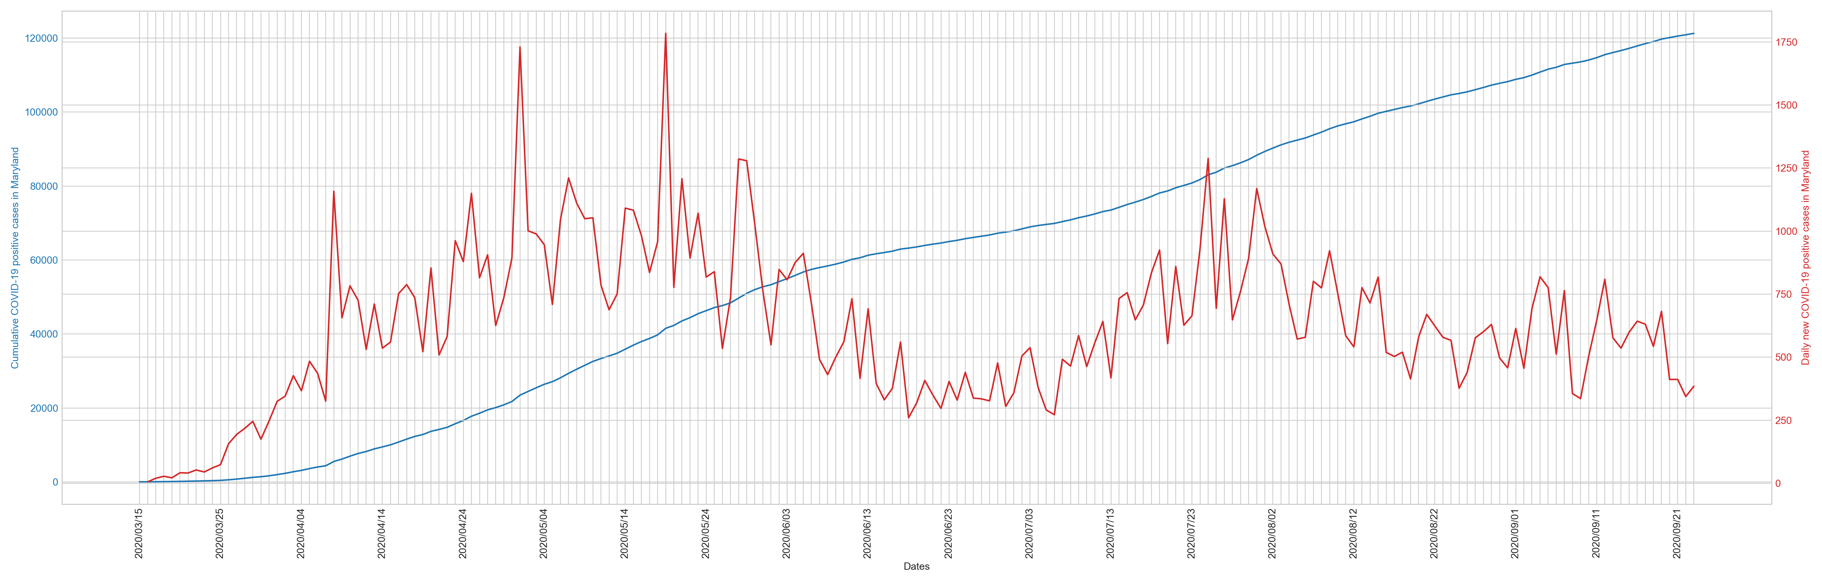
Preliminary Results
Maryland cumulative COVID-19 positive cases (blue) and daily new cases(red), 03/15 – 08/31
Notes:
Cases: the flat curve during the mid-June to mid-July period indicates low increases, but after that, the situation seems to be getting worse. The August period seems to be the second wave (and we are currently in the third wave).
The lockdown measures were effective to constrain the spread of COVID-19, until the stay-at-home order was lifted.

Slide 4
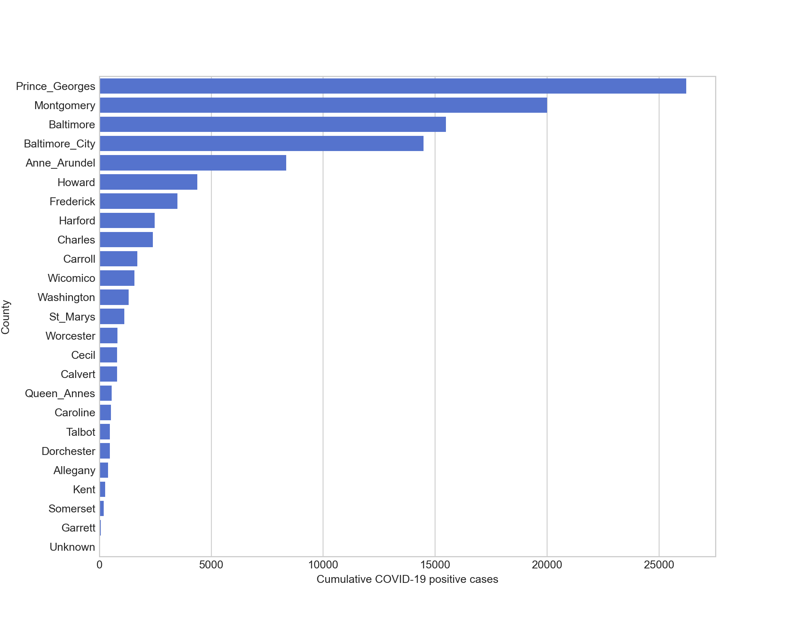
Maryland cumulative COVID-19 positive cases rankings by county (as of 08/31)
Notes:
No wonder Prince George’s county ranks at the top, followed by Montgomery county.

Slide 5
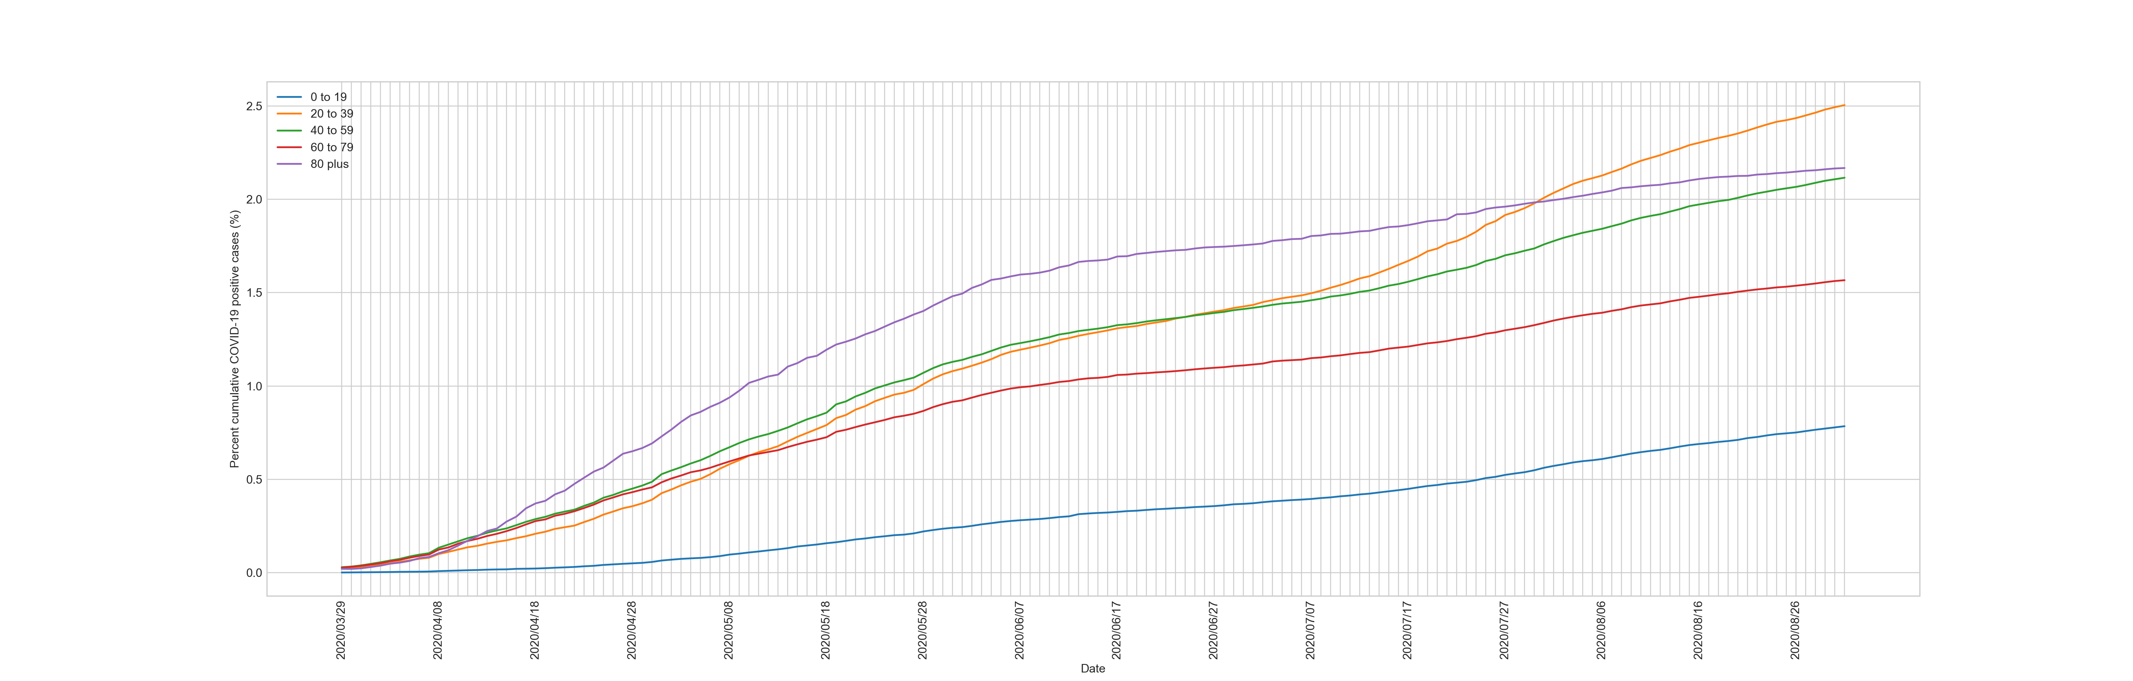
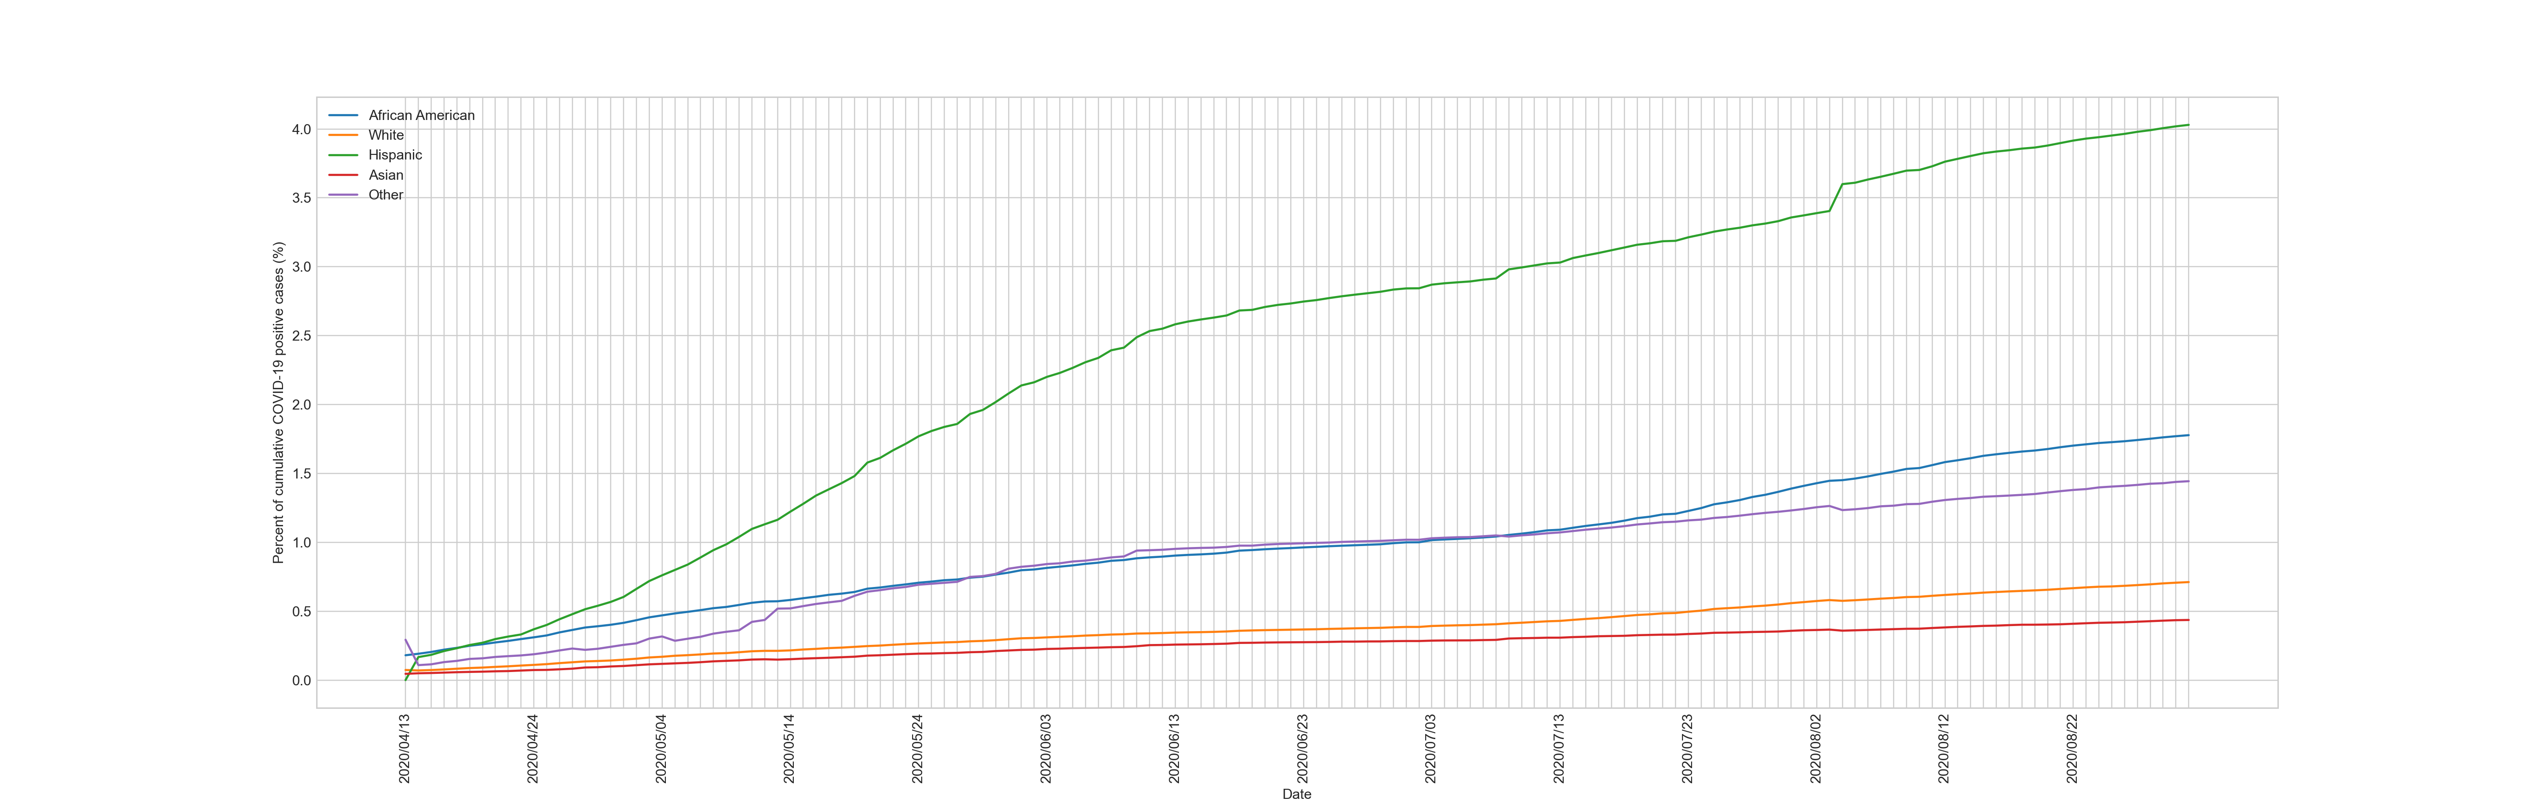
Age group
Race/ethnicity
Notes:
Age: surprisingly, the 60-79 has a lower infection rate. And the orange line (20-39) exceeds all other lines, indicating the young people are getting more infections (maybe because they are tired of self quarantines).
Race/ethnicity: green line (Hispanic), blue line and purple line (African Americans and Other), and orange line and red line (White and Asian).

Slide 6
Notes:
An animation of how the cases at county level evolved, starting from 03/15 and using 14 days as intervals.

Slide 7
Challenges
Spatial units
Currently, the spatiotemporal visualization and analysis are performed at county level. But there are only 24 counties, which is a really small number of observations.
I have COVID-19 cases and deaths data at county level, and COVID-19 cases data available at zip code level. But the ACS data are only available at county level and census tract level.
Time period selection
The COVID-19 data is available from 03/15 to 08/31. Which time period (maybe 1 moth or 2 months, or a specific date) should I use?
Spatial analysis
For the GWR, what explanatory variables should I use? Are there any other possible variables?
Notes:
Small number of observations: difficult to do regressions.
Crosswalk: aggregate to census tract level (make more sense)

Slide 8
Tentative Timeline
Week #10 (11/02)
Project Updates
Question and solutions
Week #11,12
Modified spatiotemporal analysis
Spatial analysis (GWR) Python coding and debugging
Week #13 (11/23)
Project Updates
Wee #14, 15
Other possible spatial analysis, e.g. hot spot, clustering, etc.
Week #16 (12/14)
Presentation and final report

Slide 9
Thanks
Q&A

