Slide 1
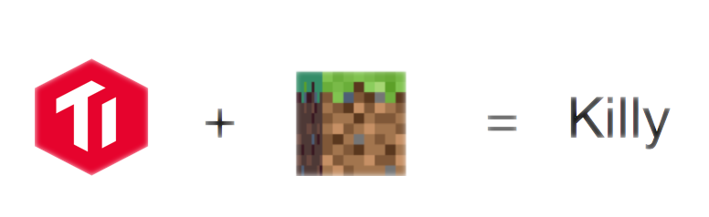
@hawkingrei
@gaocegege
@codeworm96

Slide 2
Play TiDB in Minecraft!
受 Dockercraft 启发实现的 Minecraft Server
显示 TiDB TiKV PD 实例的状态与负载
进行 SQL 查询
显示数据库表结构与记录

Slide 3
Demo

Slide 4
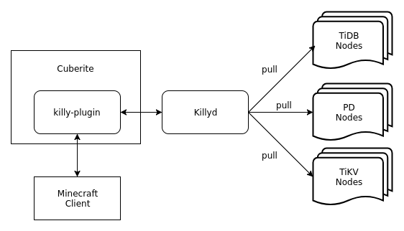
Architecture

Slide 5
Why Go?
Concurrency
Productivity
Performance

Slide 6
VR Ops
Dockercraft + Dronecraft + Killy = Operation in Minecraft
Operation in Minecraft + VR = VR Ops
Job Requirements for Game Ops Engineer
熟练掌握 Minecraft 各项启动参数
了解 Minecraft 常用的服务器指令
能搭建简单的红石电路实现自动化运维
1-3 年 Minecraft 经验

Slide 7
Just for Fun
github.com/prism-river/killy
如有雷同，纯属巧合

Slide 8
Thanks for Your Time

