Slide 1
Askari Platform
By The Seven Musketeers

Slide 2
Refugees faces many problems in Australia.

Slide 3
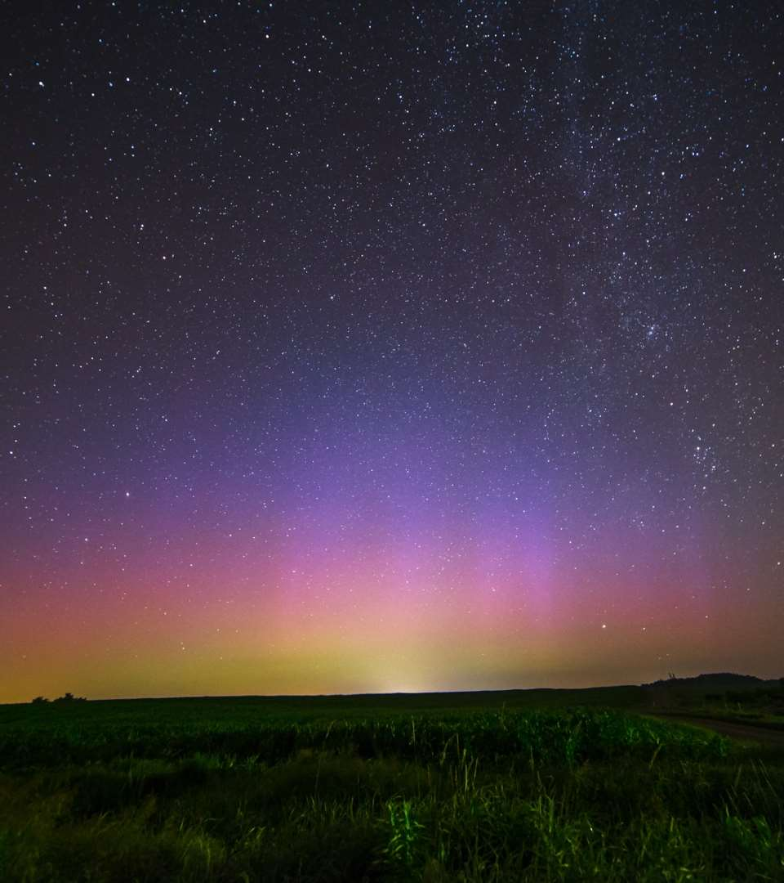
Employment is one of the top issue.

Slide 4
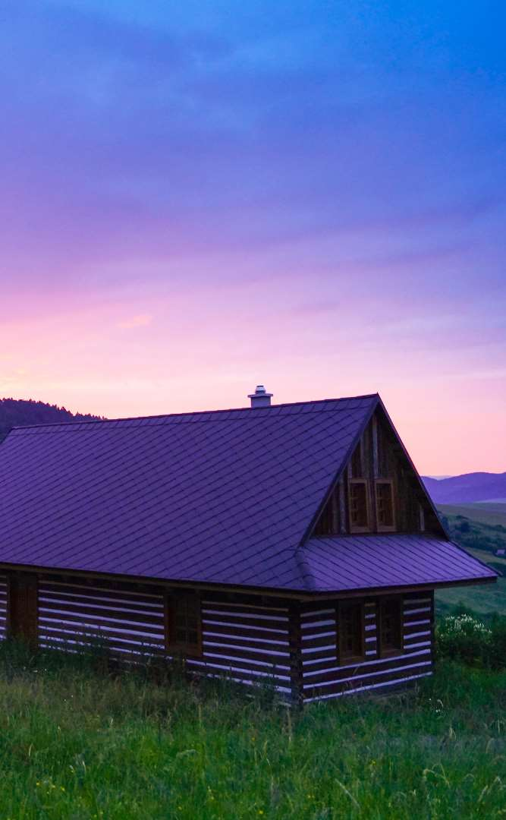
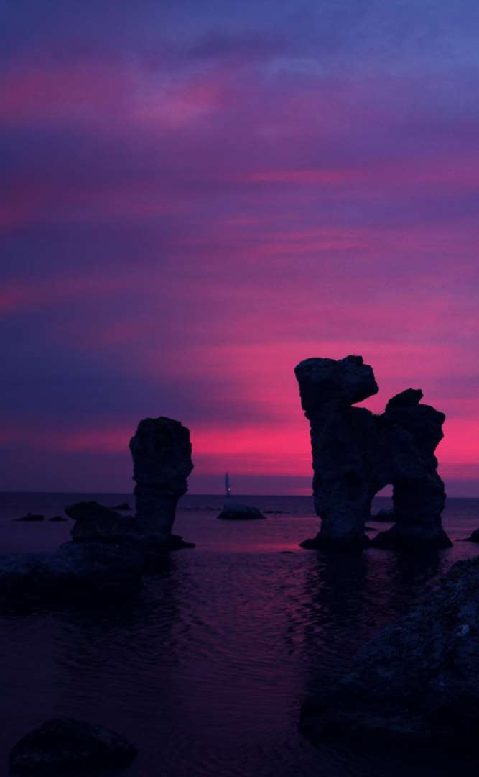

Introducing Askari.xyz website

Slide 5

Enter Askari App

Slide 6
Awesome features
Register as Mentee or Mentor
Connect with Awesome People
Help each other to thrive

Slide 7
Growth strategy
1
2
3
4
5
Approached PwC corporate
Approach other corps
Use RedCross and Ames network
Professional service orgs
Government and NGOs

Slide 8
Introducing Askari API – Backend as a Service
Specialize in matching
Forget the server and databases
Scalable and reliable
Build your own mentee-mentor matching platform in half the cost and time using our API
We handle the backend server, database, hosting and security so you don’t have to
Infinitely and easily scalable using the AWS cloud platform

Slide 9
Market Sizing
$36b
$12b
$2b
Total World Market
Total US Market
Total FR Market
Source : source.io
Source : source.io
Source : source.io

Slide 10
Market Size over Time
Market Sizing (in €billions)

Slide 11
Market on Map
$1b
$2b

Slide 12
Why Now ?
Mobile Internet Usage

Slide 13


Customer Profiles
Young adults
25-35 years old
Students
15-20 years old

Slide 14
Competitors

Slide 15
AXIS 2
Your company
competitor
competitor
AXIS 1
AXIS 1
competitor
competitor
competitor
competitor
AXIS 2

Slide 16
 | YOUR COMPANY | COMPETITOR 1 | COMPETITOR 2 | COMPETITOR 3
feature 1
feature 2
feature 3
feature 4
feature 5
feature 6

Slide 17
Metrics
800
97%
94%
Paying users
Margin
Recurring users
$150,000
85,000
54
Monthly Recurring
Revenue
Users growing 45% per month
API Integrations

Slide 18
Conversion Rate
0,27%

Slide 19
Split Budget

Slide 20
Split Budget
75%
69%
30%
29%
29%
Marketing
Research
Sales
Design
Hiring

Slide 21
Forecast

Slide 22
Financial Table
 | 2016 | 2017 | 2018 | 2019 | 2020
Sales | 0 | 50 | 400 | 1000 | 3000
Revenue | - | $100 000 | $800 000 | $2 000 000 | $6 000 000
Gross Margin (%) | - | 49% | 51% | 53% | 58%
Expenses | - | $128 000 | $450 000 | $800 000 | $1 200 000
Net Profit | - | $-28,000 | $350 000 | $1 200 000 | $4 800 000
Profit Margin (%) | - | -28% | 44% | 60% | 80%

Slide 23
Outstanding Founders
Dave Lopper CTO
Come Mertial CEO
Tran Zition
CPO
Google
Facebook
Stanford
Microsoft
SalesForce
HEC Paris
Uber
Awwwards
MIT Media Lab

Slide 24
Advisors and Directors
Jérémy Vestiaire
Financial Advisor
Goldman Sachs
Jey Bestelgram
Product Advisor
Amazon
Oudam Dadam
Machine Learning Enthousiast
SpaceX
Tomy Lamousse
PR Advisor
Mashable
Lam Ontarelle
UX Contributor
Slidor
Renaude Yorella
Board Member
Sequoia Capital
Laurence Marc
Board Member
Accel Partners
Vince Lacluze
UI Director
Snapchat

Slide 25
Roadmap
02/2016
04/2016
06/2016
Market Overview
Pre-Release
Launch
01/2016
03/2016
05/2016
Introduction
Partnerships
Beta

Slide 26
Say you want to make the world a better place

Slide 27
Icons

Slide 28
Icons

Slide 29
Social

Slide 30
Red
Pink
Purple
Deep Purple
Indigo
Blue
Light Blue
Cyan
Teal
Green
Light Green
Lime
Yellow
Amber
Orange
Deep Orange
50
50
50
50
50
50
50
50
50
50
50
50
50
50
50
50
100
100
100
100
100
100
100
100
100
100
100
100
100
100
100
100
200
200
200
200
200
200
200
200
200
200
200
200
200
200
200
200
300
300
300
300
300
300
300
300
300
300
300
300
300
300
300
300
400
400
400
400
400
400
400
400
400
400
400
400
400
400
400
400
500
500
500
500
500
500
500
500
500
500
500
500
500
500
500
500
600
600
600
600
600
600
600
600
600
600
600
600
600
600
600
600
700
700
700
700
700
700
700
700
700
700
700
700
700
700
700
700
800
800
800
800
800
800
800
800
800
800
800
800
800
800
800
800
900
900
900
900
900
900
900
900
900
900
900
900
900
900
900
900
A100
A100
A100
A100
A100
A100
A100
A100
A100
A100
A100
A100
A100
A100
A100
A100
A200
A200
A200
A200
A200
A200
A200
A200
A200
A200
A200
A200
A200
A200
A200
A200
A400
A400
A400
A400
A400
A400
A400
A400
A400
A400
A400
A400
A400
A400
A400
A400
A700
A700
A700
A700
A700
A700
A700
A700
A700
A700
A700
A700
A700
A700
A700
A700

Slide 31
Gradient 1

Slide 32
Gradient 2

Slide 33
Gradient 3

Slide 34
Gradient 4

Slide 35
Gradient 5

