Slide 1
Neural Latents Benchmark with PyTorch Lightning
Chris Versteeg / Andrew Sedler
NLB 2022
02/27/2022

Slide 2

Goal: Code a submission to NLB using PyTorch Lightning
What is PyTorch?
Why PyTorch Lightning?
Overview of PyTorch Lightning
Submitting your PTL model to NLB competition

Slide 3
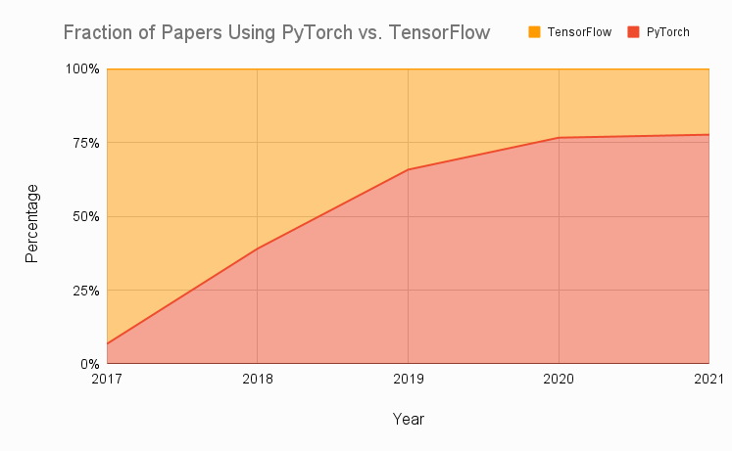
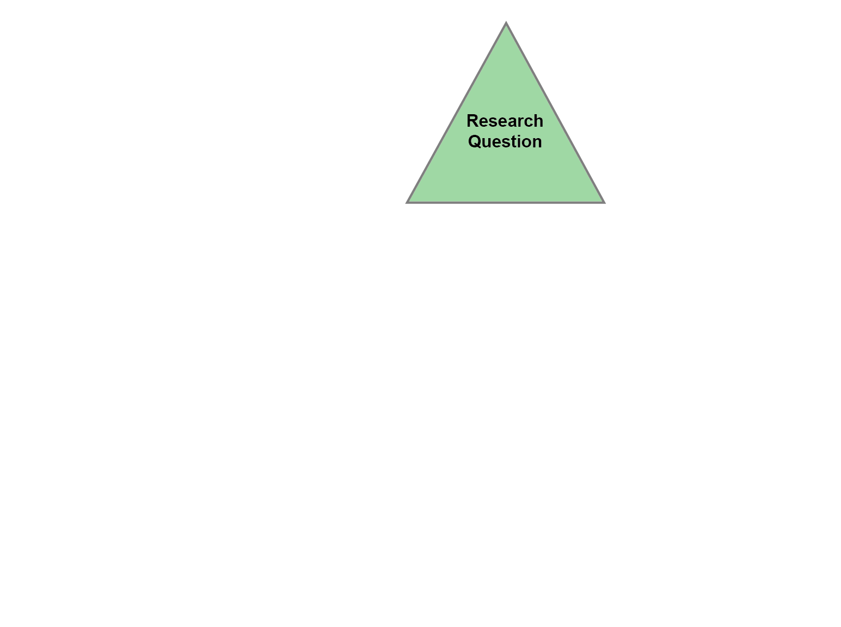
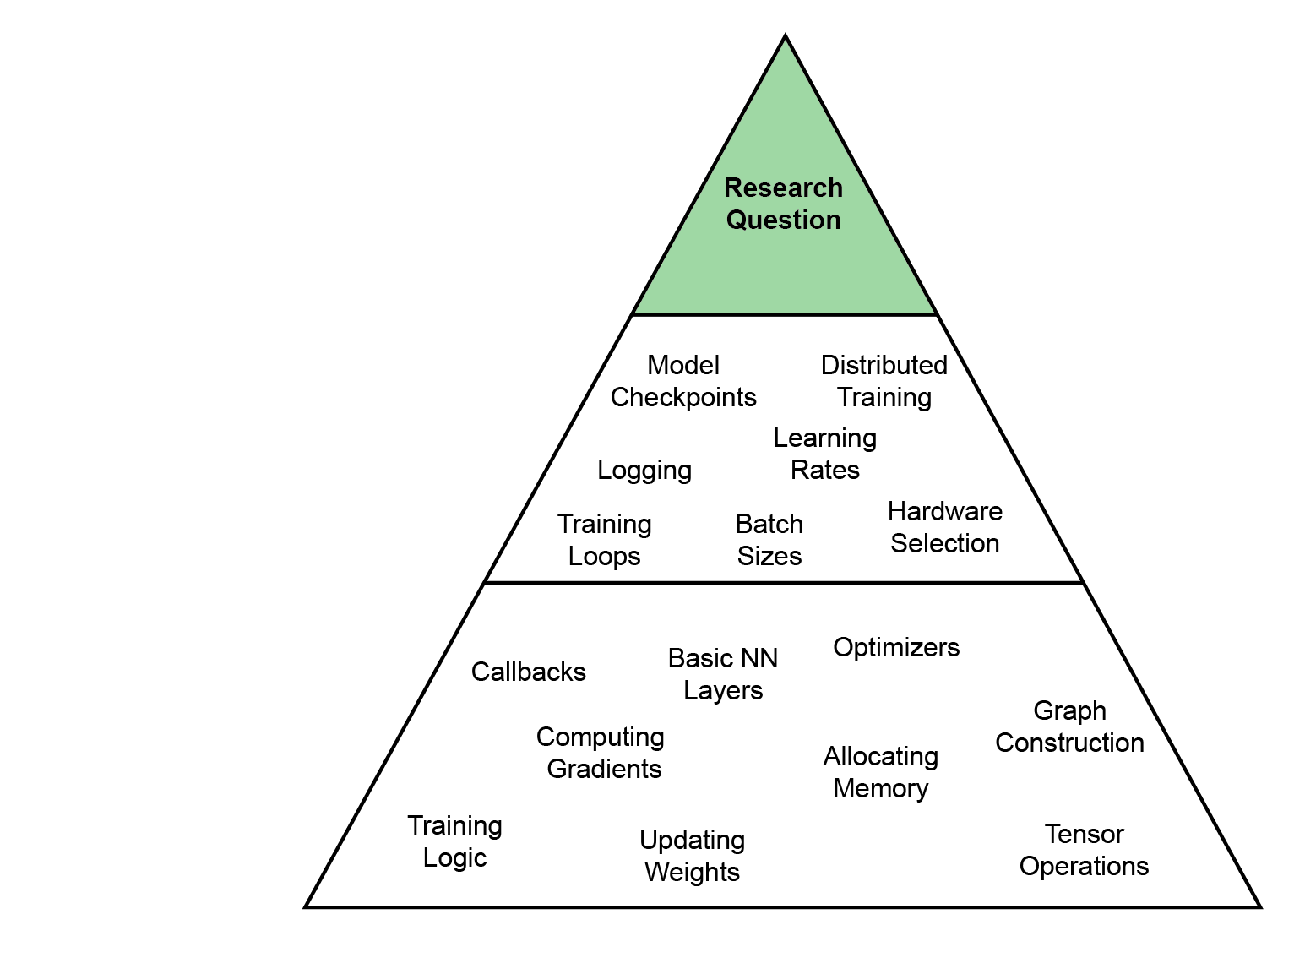
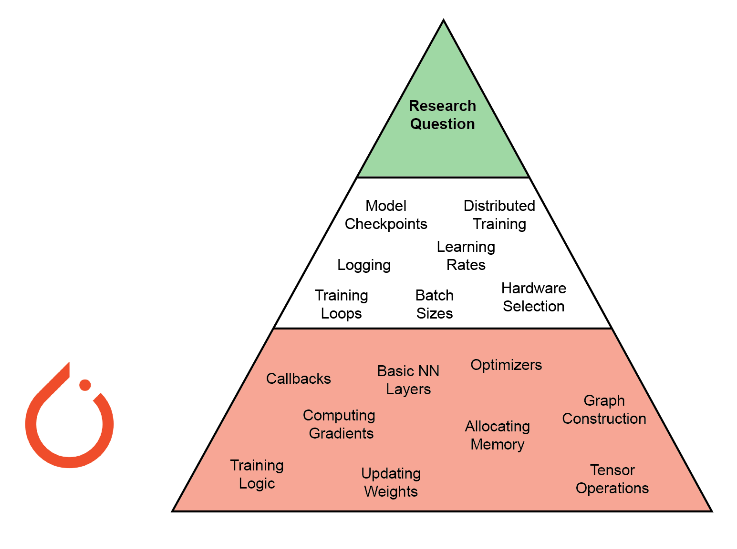
PyTorch: Modern deep learning framework for python
The goal of deep learning research is to answer a question.
But you need to be able to build models!
Most researcher don’t need to concern themselves with the complex implementation details
PyTorch abstracts away low-level engineering so you can focus on your research question.
Alternatives: TensorFlow, etc.
https://www.assemblyai.com/blog/pytorch-vs-tensorflow-in-2022/

Slide 4
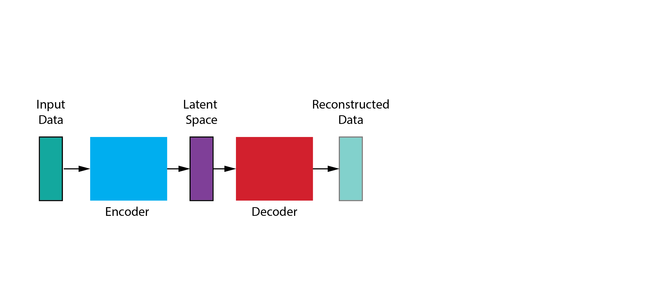
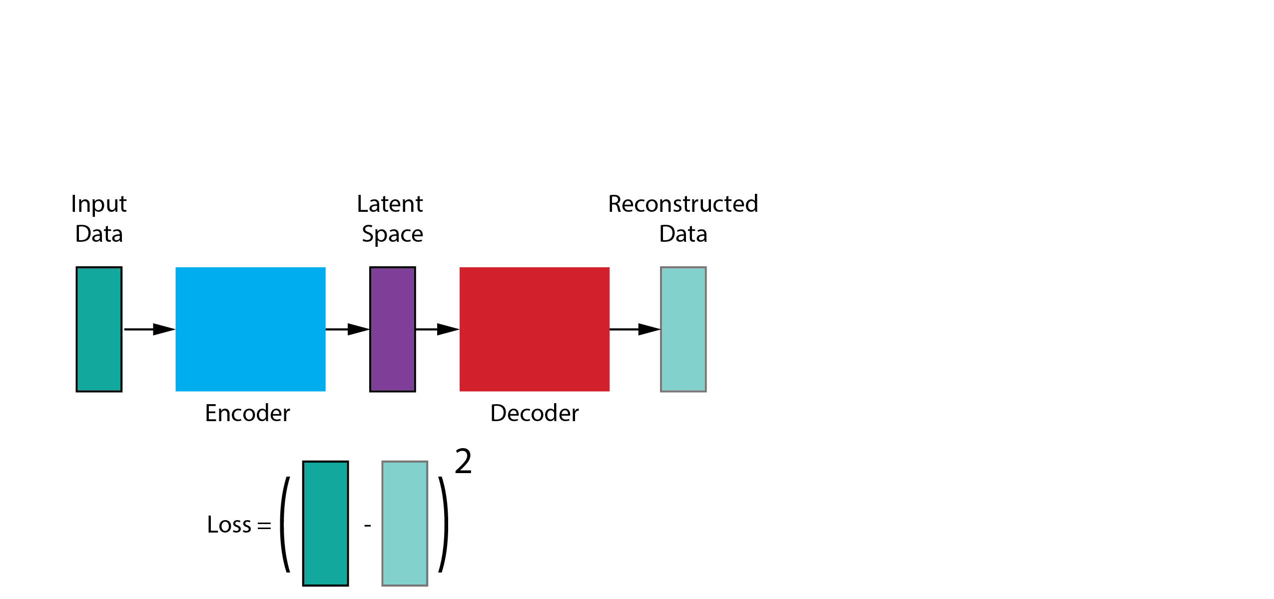
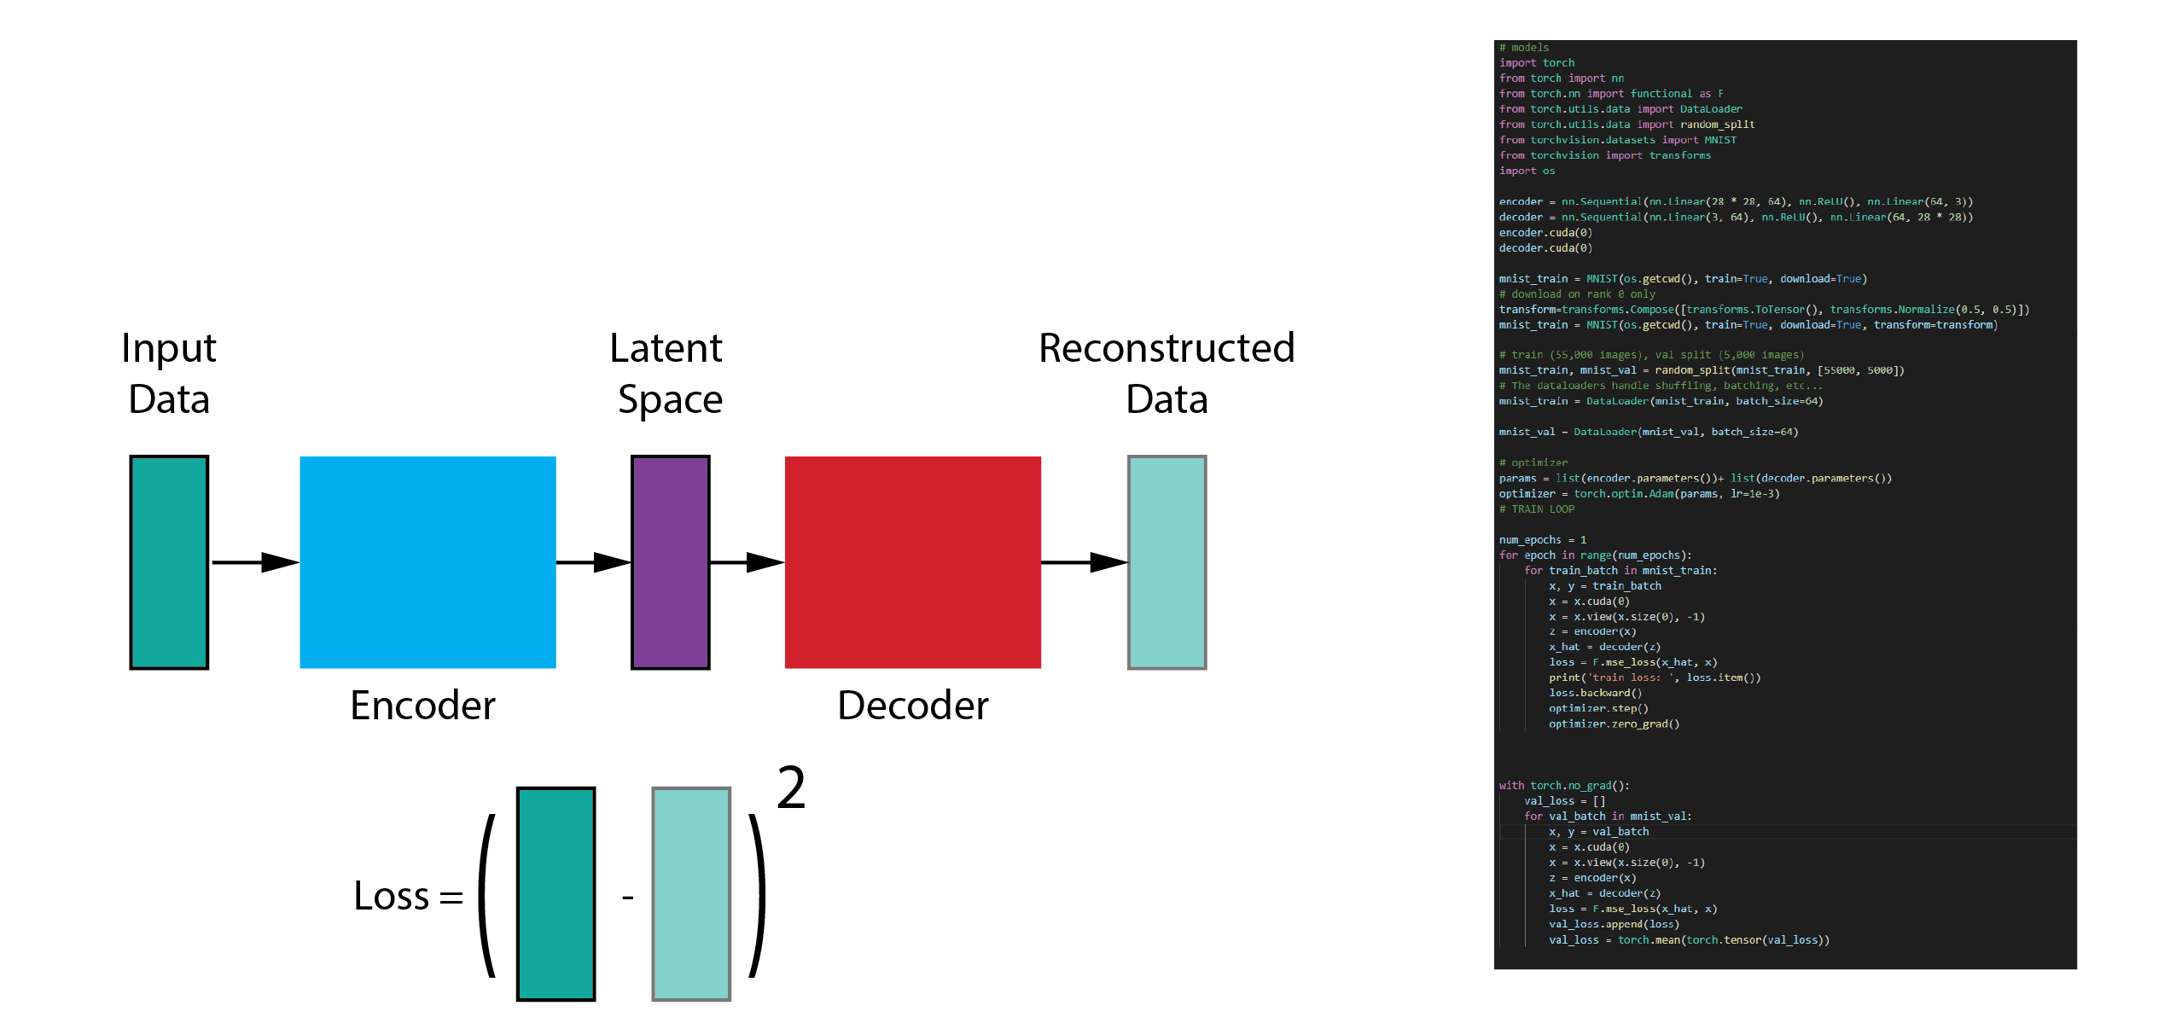
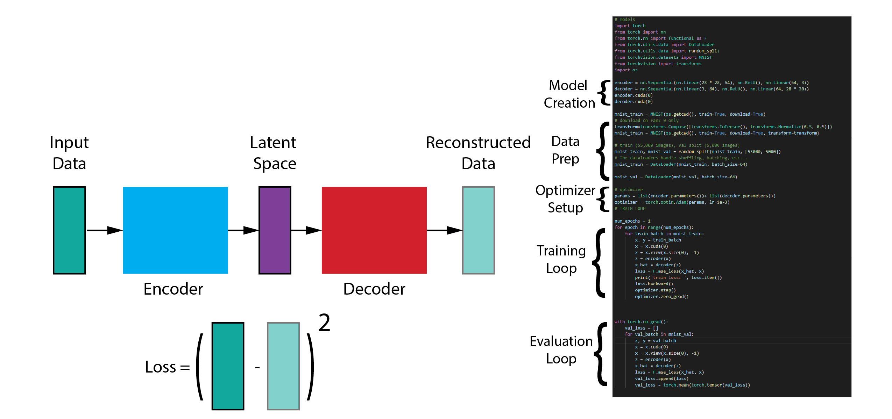

Example: Building an autoencoder with Vanilla PyTorch
Problem: Code is spread across the main function, so it isn’t readily modular, reproducible or shareable.

Slide 5
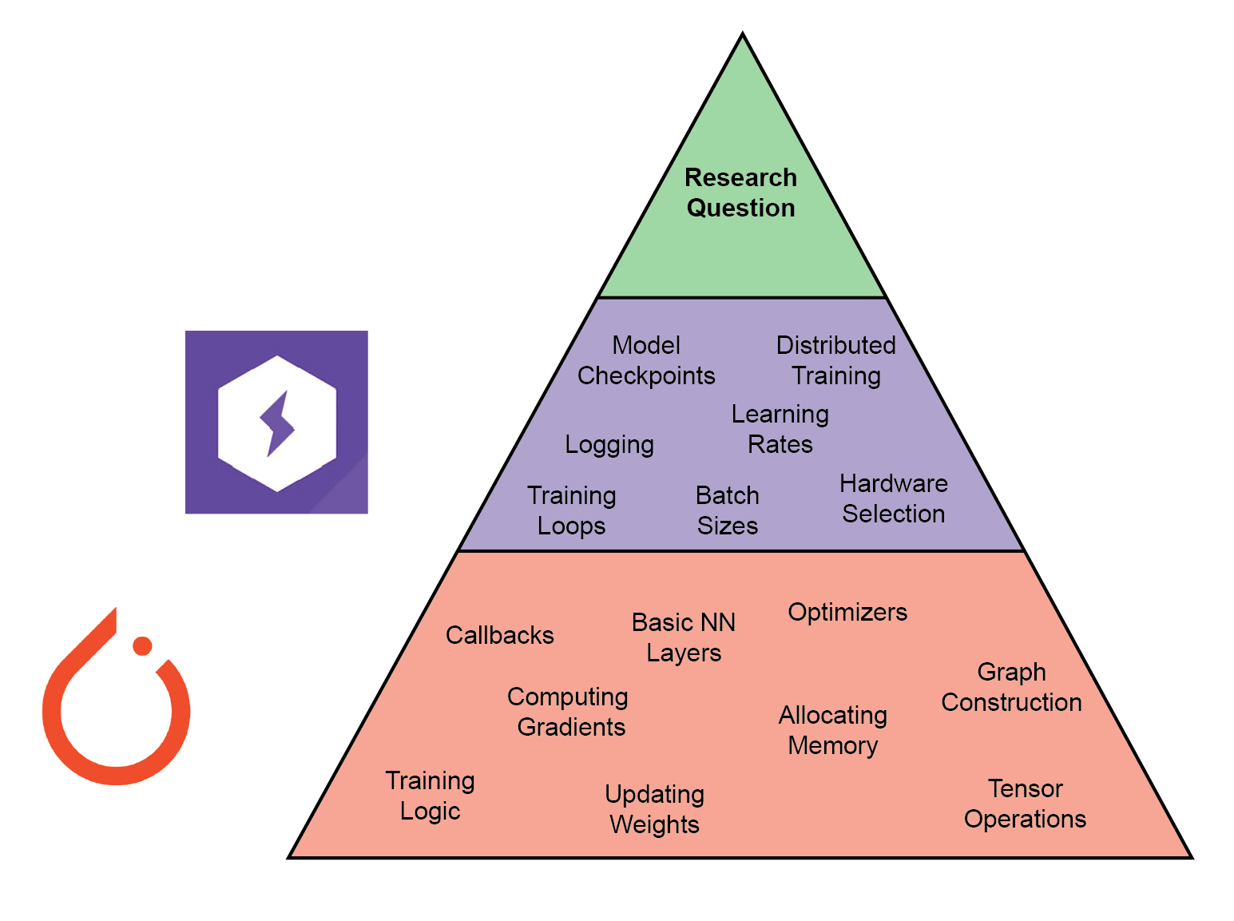
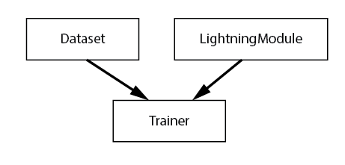
PyTorch Lightning extends PyTorch
Additional abstraction
Training/ Validation Loops
Switching to/from GPUs
Setting training flags
Allows you to focus on your research question, not the engineering!
Object-oriented development framework
All methods needed to train and test a model combined into a single object
Three components
LightningModule
Dataset
Trainer

Slide 6
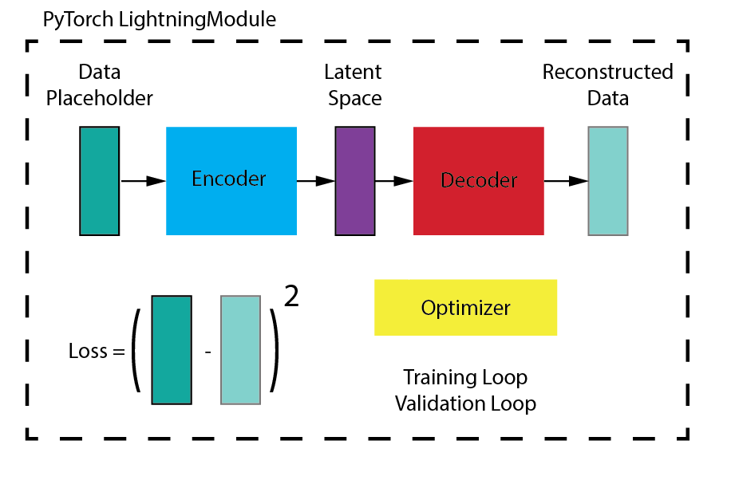
LightningModule
Inherits from nn.Module
Inside:
Model architecture
Loss function
Optimizer
Training/ Validation loops
To train, simply pass LightningModule and Dataset into Trainer!

Slide 7
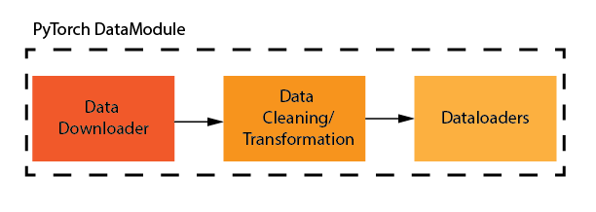
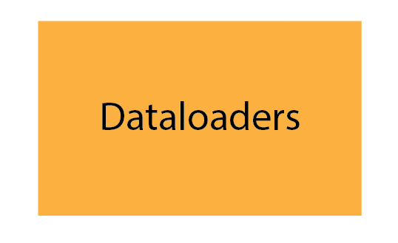
Dataset
Potential forms:
PyTorch DataLoader
LightningDataModule
LightningDataModule
Preprocesses data
Splits, transforms, augmentation
Modularity and reproducibility!

Slide 8

Trainer
Object in PTL module
Takes in training parameters
GPU/CPU settings
Numerical precision
Gradient accumulation/clipping
Automated batching
Loggers/ Callbacks
More!
Abstracts:
Gradient handling
Running training, test, val
Callbacks
Device handling

Slide 9
Building your own NLB submission

Slide 10
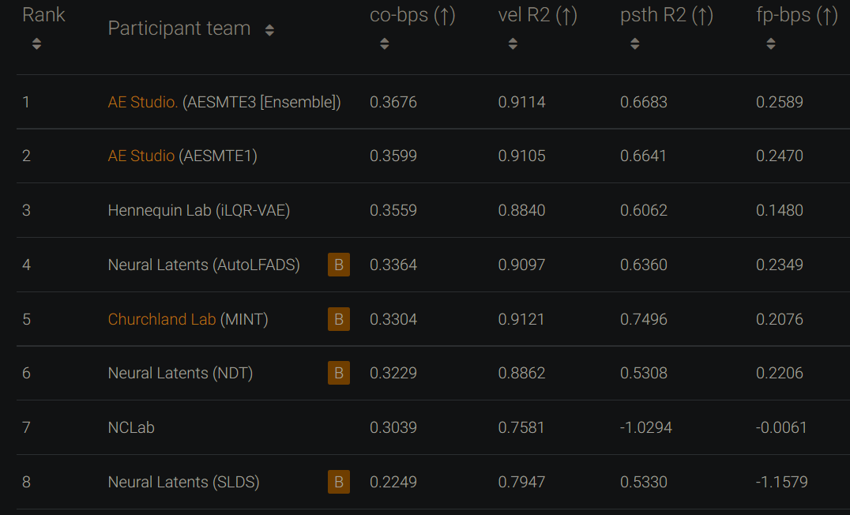
Example submission to NLB with PyTorch Lightning
https://github.com/arsedler9/nlb-lightning
Steps:
Download data
Set up environment
Run “preprocess.py” to generate dataset
Run “train_sae.py” to train model
Upload submission-{phase}.h5 to EvalAI!

Slide 11
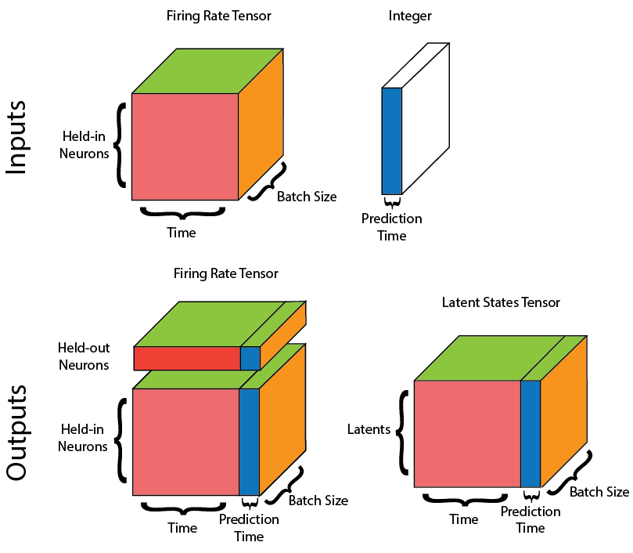
Requirements to train your own model (pt 1)
To use nlb-lightning your model must inherit from LightningModule
Forward() must have
Two inputs
Two outputs

Slide 12
Requirements to train your own model (pt 2)
Validation step should expect training tensors in order
heldin
heldin_forward
heldout
heldout_forward
behavior
Test step should only expect heldin
See train_sae.py for a useful template!

Slide 13
Questions?
See us at the poster session!

