Slide 1
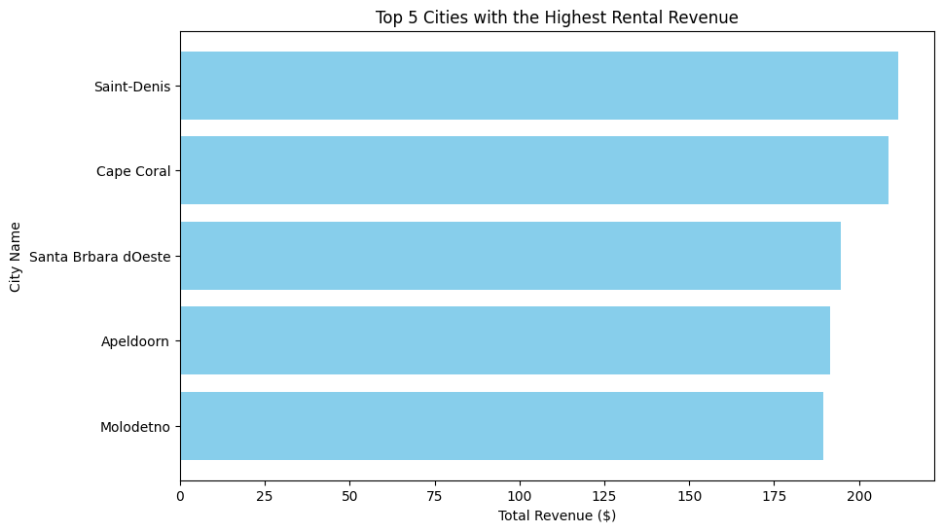
Q1: What are the top 5 cities with highest total rental revenue?
isualization>
The top 5 cities contribute the most to overall rental revenue. City Saint-Denis leads significantly, indicating a potential focus area for business operations.

Slide 2
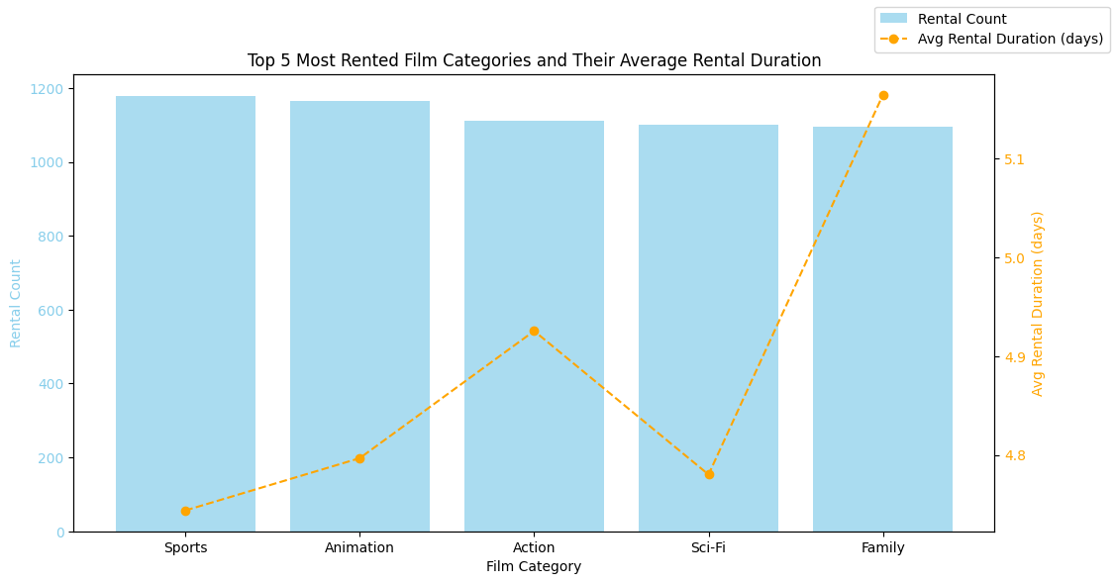
Q2: What are the top 5 most rented film categories?
Sports and Animation categories have the highest rental counts, indicating strong customer preferences. Average rental durations for all categories remain consistent, between 4-5 days

Slide 3
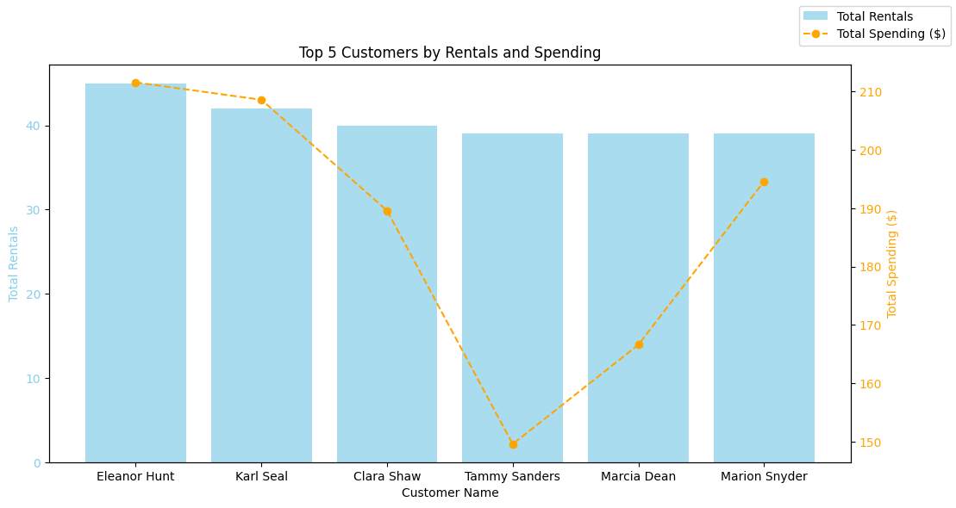
Q3: Which customers have rented the most films?
The top 5 customers contribute significantly to both rentals and total spending, with spending ranging between $150 and $210.

Slide 4
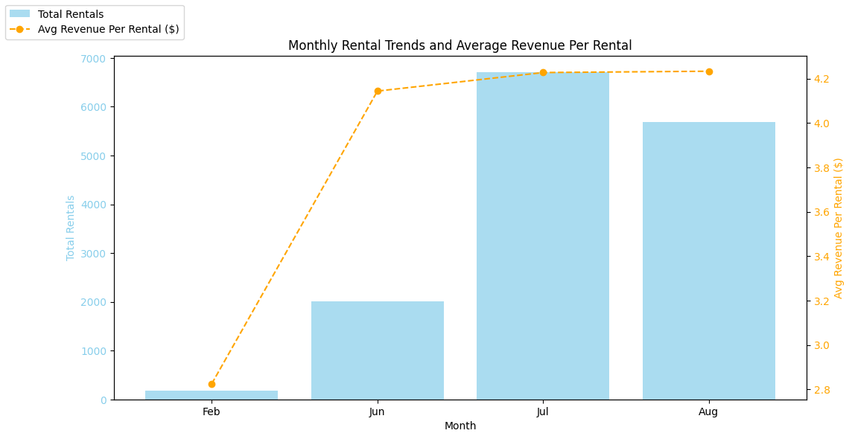
Q4: Which months have highest average per rental, and how do total rentals compare across these months?
Some months generate a higher average revenue per rental, indicating either premium rentals or longer rental durations. Total rentals peak during the summer months.

