Slide 1
System Operation Flow Diagram
System parameter Initialization
Capture Button
Clicked?
No
Yes
Object
Detected
Yes
Object
Type
Known?
Yes
Activate
Grasping
No
No
Grasp
complete?
No
Yes

Slide 2
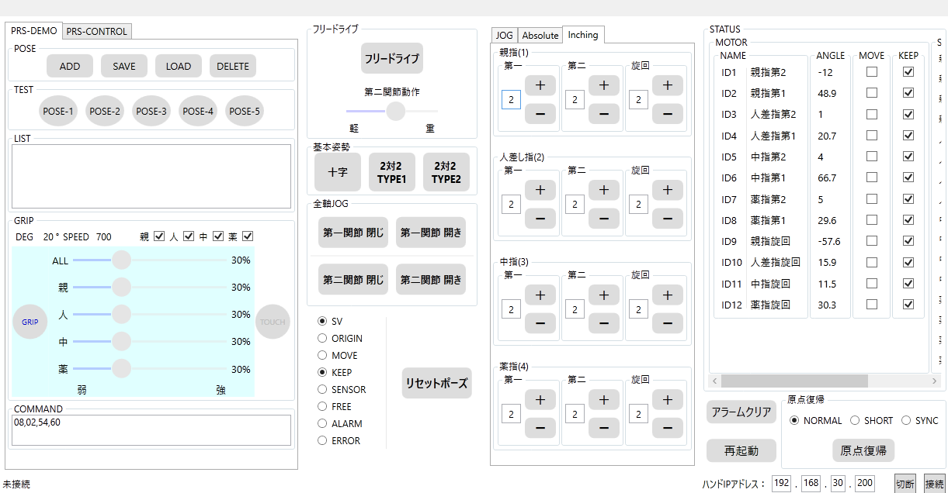
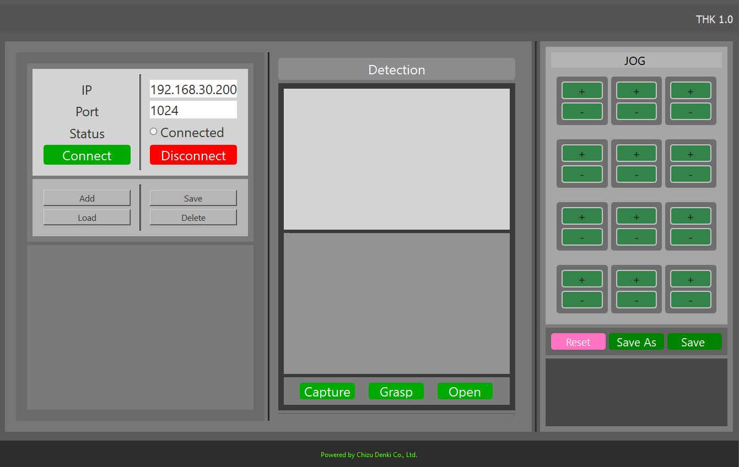
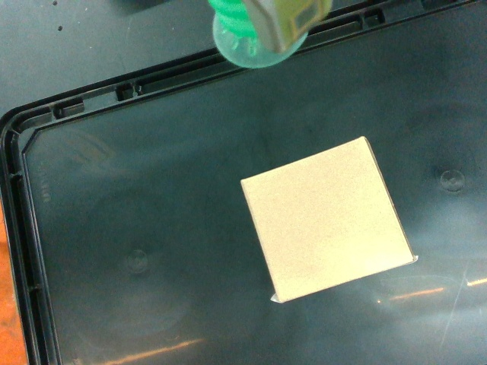
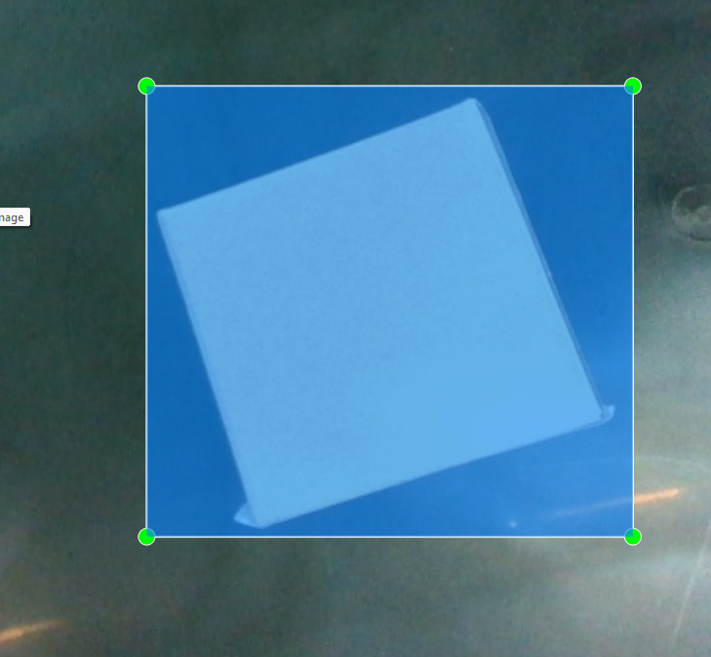
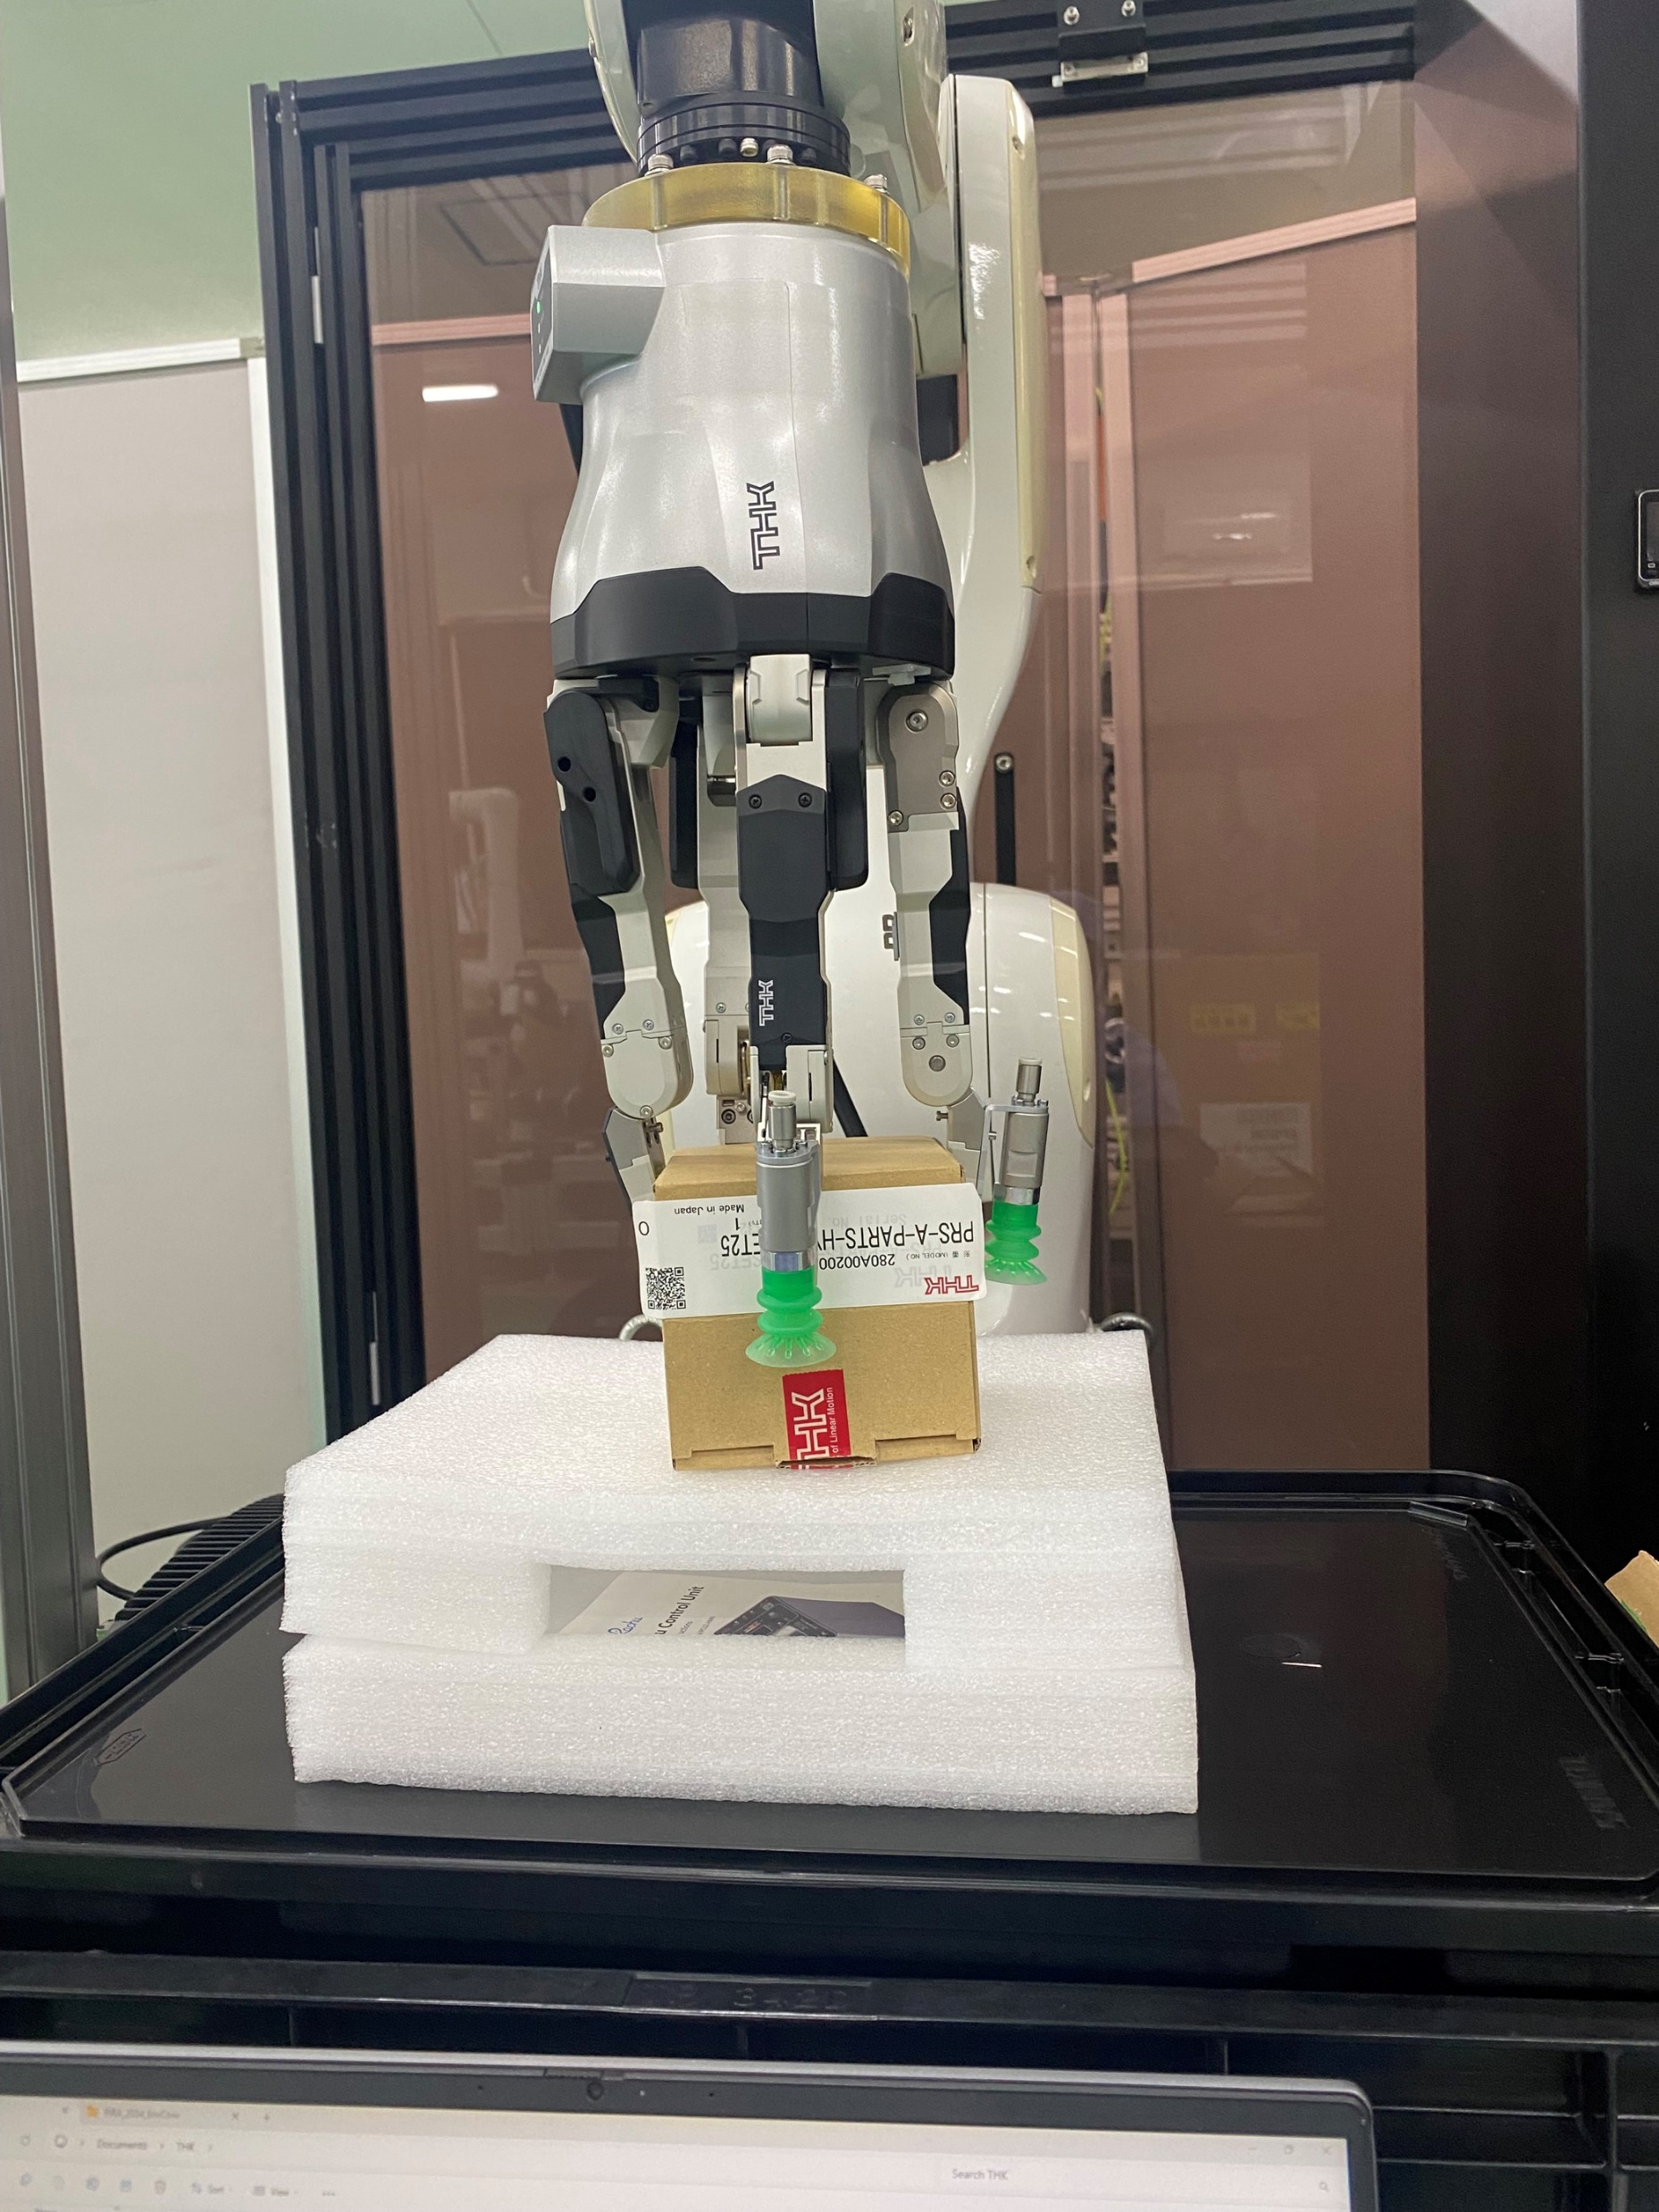
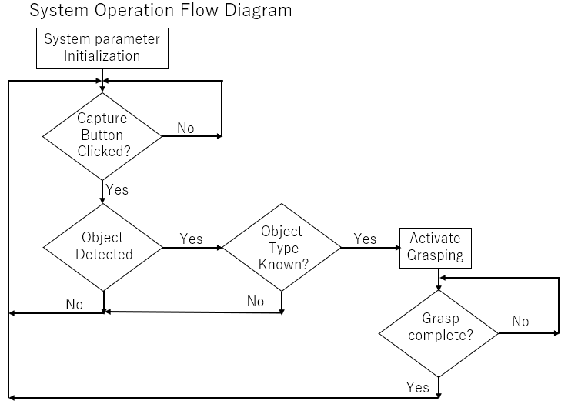
Old UI
New GUI and functions

