Slide 1
IS 517 Final Project: Predicting NBA Win/Loss
Yunzhe Qi, Augustine Xu, and Abhi Vadali
Notes:
Abhi

Slide 2
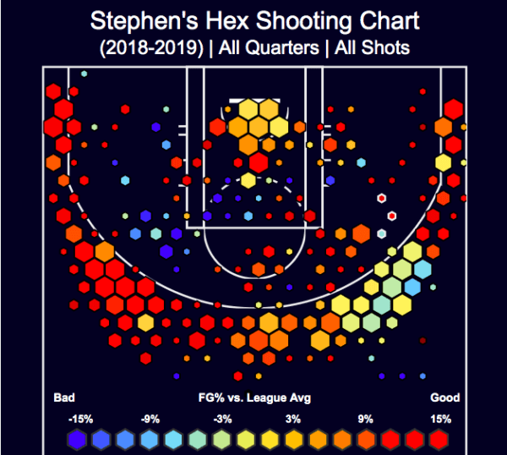
Application
The way the game is played in the NBA has vastly evolved since its inception in the 1940’s
More specifically, nearly every single decision made by the thirty teams in the league today is fueled by data
A few applications of data in today’s game:
Predicting and understanding when/where players injuries occur and how to avoid it
Scouting
Game strategy (the biggest application): what type of shots the teams should take, what defensive philosophy the team should follow, and which players are most important to the team (etc.)
Notes:
Abhi

Slide 3
Problem
Most of the NBA media and the NBA itself tend to designate awards to and place extra importance on the starters:
Strategy (starters are most often on the court at the end of games)
Salary (starters are generally paid a higher salary on average than bench players)
Often overlooked are bench players, who are valuable to each team...the contributions of bench players to winning has not been widely explored
Notes:
Abhi

Slide 4

Problem (continued)
This problem is important because:
The winners of the NBA Finals each year bring in over tens of millions of revenue each year (both players and teams), so it is important to gain as much of a strategic advantage over other teams as possible
NBA teams would benefit from this project because they would have a stronger quantitative understanding of which players and positions from the bench (and overall) are most valuable to their team, allowing them to adjust rotations accordingly
Notes:
Abhi

Slide 5
Research Questions
For each of the thirty teams’ benches, which positions (PG, SG, SF, PF, C) are most predictive of winning?
For each of the thirty teams’ starters, which positions (PG, SG, SF, PF, C) are most predictive of winning? How does the starters’ predictiveness compare to the bench players’?
Out of all the players in the league, which positions (PG, SG, SF, PF, C) are most predictive of winning?
Notes:
Augustine
There are commonly five positions in basketball games which are PG stands for Point guard, SG for Shooting guard, SF for Shooting forward, PF for Power forward and C for center. By our definition, the starters and benches are basically defined by minutes. The top 6 players in minutes for each team would be considered as starters and the six man.
So our first research question is that we are trying to find out the most predictive position among bench players based on teams. We want to see what type of bench player contributing to the victory most.
The second one is focusing on the starters including 6th man. And we are still looking for the position with most contribution to predict the win-lose. And then comparing the models of benches with the starters .
Finally, we find the best position through the league for all players.

Slide 6
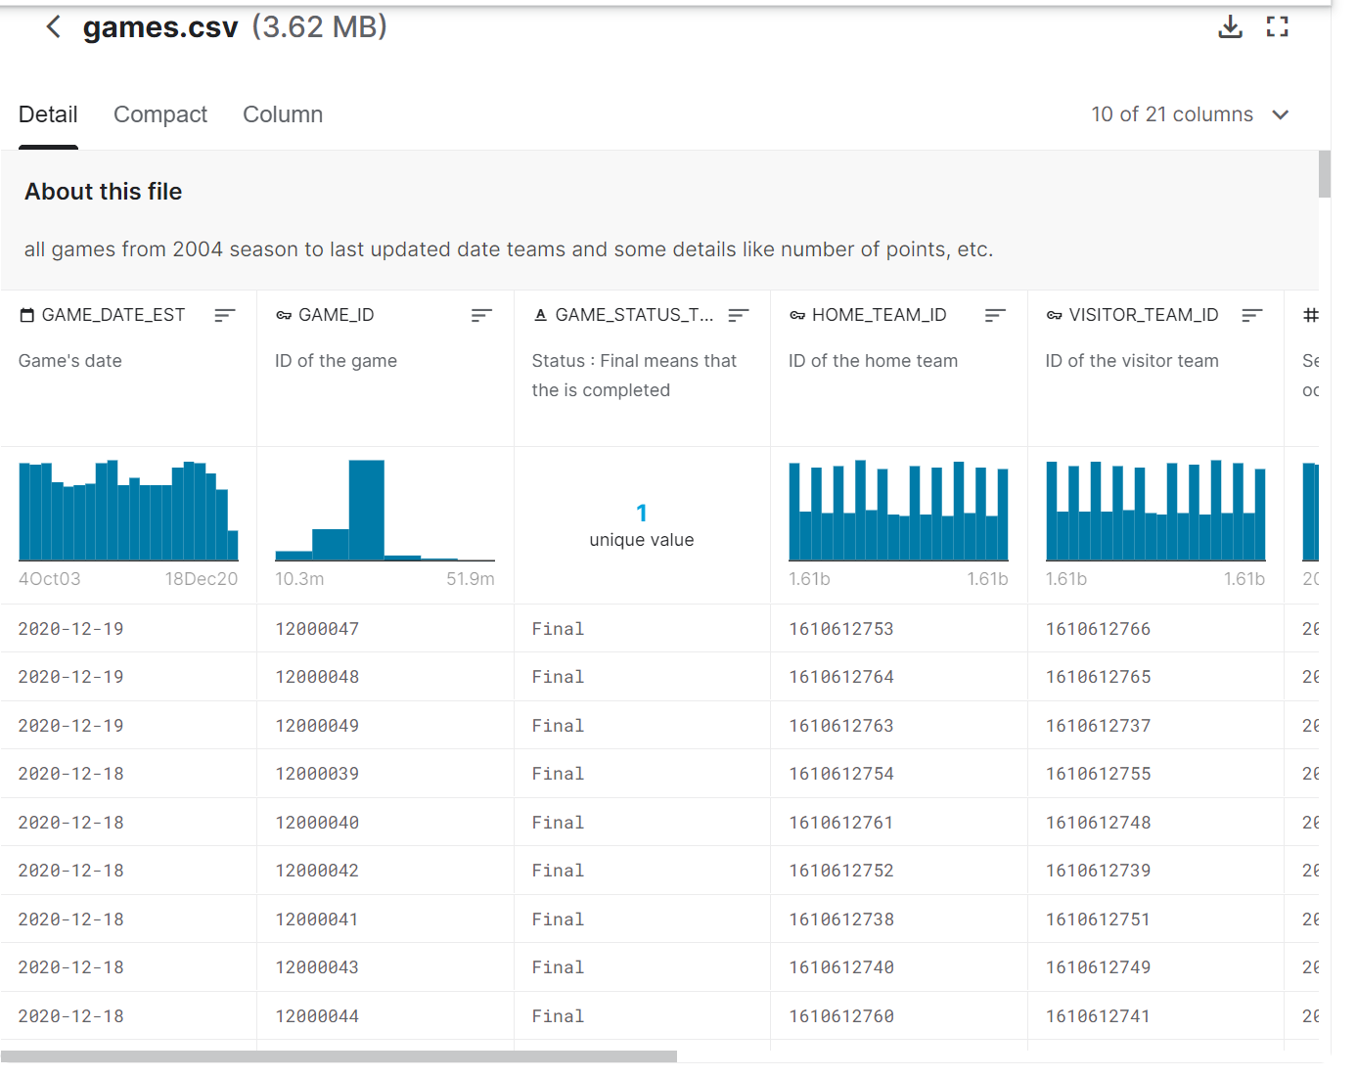
Datasets (original)
From Kaggle Competition “NBA games data”
1241 total games for 2019-20 season
All the stats for starters & bench players
Response variable HOME_TEAM_WINS
Notes:
Augustine
We use the same datasets from proposal which is from Kaggle competition named “NBA game data”. It has detailed stats for each player in every game. We are only using the games for 2019 and 2020 season. However, we did some cleaning and processing in order to analyze. The original response variable is HOME-TEAM_WINS.

Slide 7
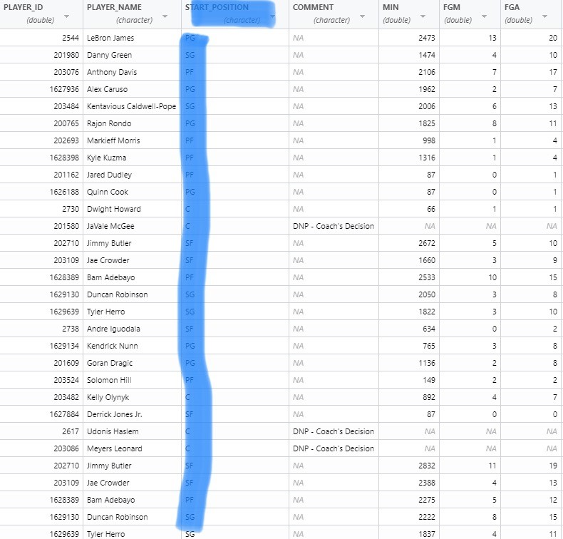
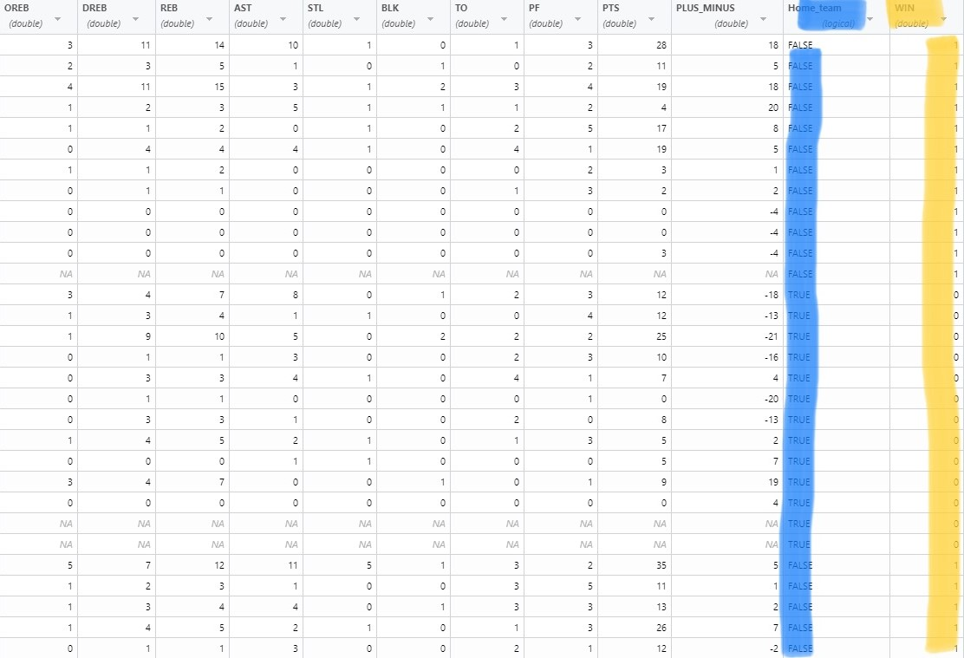
Datasets(revised)
Filled START_POSITION column
New column Home_team&WIN
Split the ‘starter’ set & ‘bench’ set
Notes:
Augustine
Here is our revised or annotated dataset. The original set has only start_position for the starters and only in three type which are G, F and C. So we filled the positions for every player in every game with the specific positions. And there are two new variables which are home_team and WIN. Home_team basically tells if the players played at home court. The WIN is the response variable we are using in this project. 1 stands for win and 0 stands for lose. The stats would be the predictors in our case. They are 21 in total including min and home_team. We also have two more subsets which one is for starters and another one is for benches. 32k obersvations in total.

Slide 8
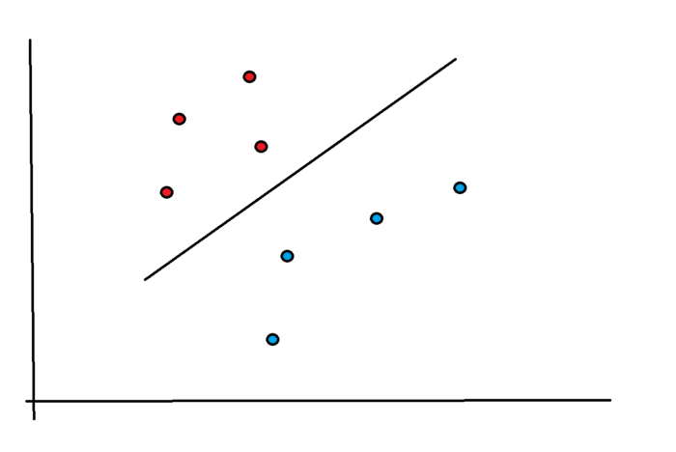
Models & Analysis Methods
Task: Binary classification (Win / Lose)
Selected methods
Logistic Regression
Linear: Simple to train & decent interpretability with coefficients
Offer a baseline for comparison
Random Forest
Just consider partial predictors (player stats)
Deal with overfitting problem
Good at handling large datasets with high dimensionality
Support Vector Machine (radial kernel)
Non-linear model: leverage the representation power of non-linear kernels
Also does well with high dimensionality
Performs well even when the data is non-separable
Notes:
Yunzhe

Slide 9
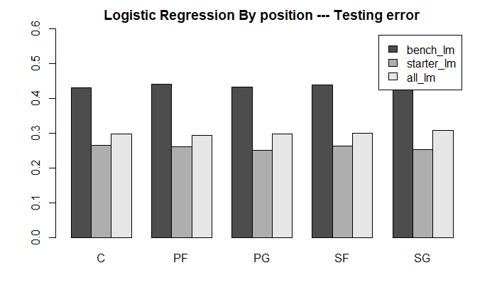
Logistic Regression
The test error rates for all five positions
was between 0.4 and 0.5 for bench
players and between 0.2 and 0.3 for starters
Had the best performance out of all the models
Notes:
Yunzhe

Slide 10
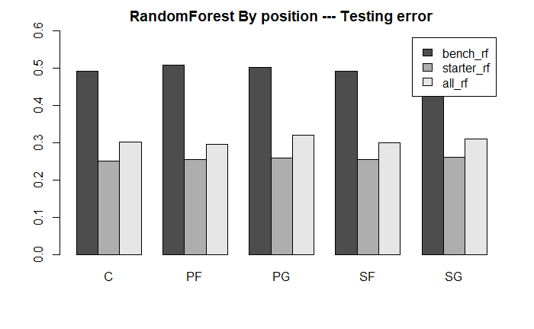
RandomForest
The test error rates for all five positions
was around 0.5 for bench
players and between 0.2 and 0.3 for the starters
Performed worse than the linear model
The increased model complexity could have placed too much weight on training set features
Notes:
Yunzhe

Slide 11
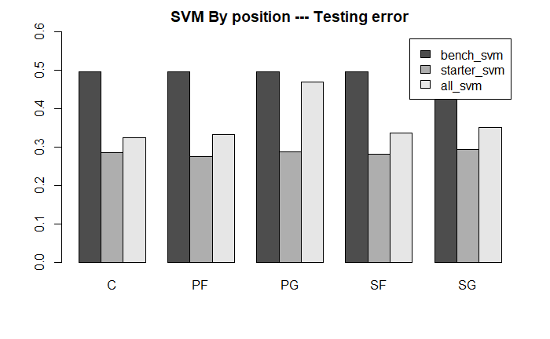
Support Vector Machine(SVM)
The test error rates for all five positions
was around 0.5 for bench
players and between 0.2 and 0.3 for starters
Performed worse than the linear model
SVM’s are prone to overfitting at times, so this could explain this gap in performance
Notes:
Augustine
The last method we tried here is Support Vector Machine. Here is the results for SVM test errors for five positions. As you guys can see, result is pretty similar to previous methods logistic regression and randomforest. The starter has the lowest test error which is between 20% and 30%. While the model for benches is as high as 50%. We were assuming SVM would be effective since our data is in high dimension. Howevr, The SVM is worse than other models. It might be caused that SVM is prone to overfitting.

Slide 12
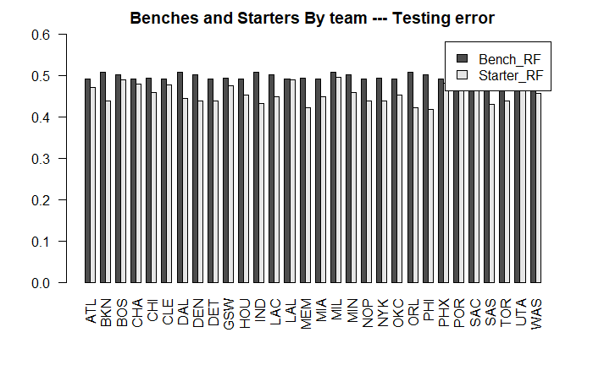
Notes:
Augustine
We also run some models for Both benches and starters by teams. Each team has two models, one for benches and another one for starters. This plot is the testing error of randomForest method. As we can see, the stater models are obviously has lower test errors than benches. The models vary for teams as well. Orlando Magic has the largest difference in test error while the Los Angeles Lakers has almost the same test errors.

Slide 13
Findings
Ultimately, we found that, out of all the five positions, there was not a significant difference between any of their predictiveness of winning
This holds true for bench players, starters, and generally all players in the league
Though, guards and small forwards did perform very slightly better than power forwards and centers
In addition, we found that starters were much more predictive of winning than bench players were, in fact, bench players were not very predictive of winning at all
Notes:
Abhi

Slide 14
Recommendations
If you’re an NBA team, you should not focus on acquiring talent in one particular position over another, rather the numbers defend building a more balanced team
There are ongoing claims in the NBA media that today’s game is “position-less”, meaning that players can adapt and adjust to playing so many different positions that these position designations are starting to carry less weight: our project backs up this theory
Finally, the starters are so much more predictive than the bench players that NBA teams should continue to invest more in these players
Notes:
Abhi

Slide 15
Future Extensions
Given that we have all the statistical data for each player for each game, it would be worthwhile to investigate which statistics are most important in the prediction of win/loss for starters, and perhaps bench players, across the league
If we extrapolate the bench players’ statistics up to the same level of minutes that the starters play, would the starters still be more predictive of winning?
Notes:
Yunzhe

Slide 16
Sources
https://digital.hbs.edu/platform-digit/submission/how-data-analytics-is-revolutionizing-the-nba/#:~:text=Value%20creation%20through%20use%20of,avoiding%20player%20injury%2C%20and%20scouting
https://www.sun-sentinel.com/news/fl-xpm-2013-05-26-fl-heat-nba-championship-worth-20130526-story.html
Notes:
Yunzhe

Slide 17
Thank you, any questions?
Notes:
Yunzhe

