Slide 1
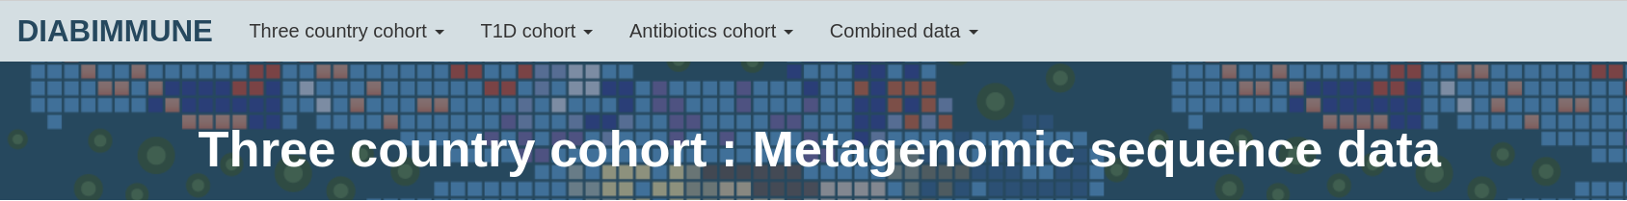
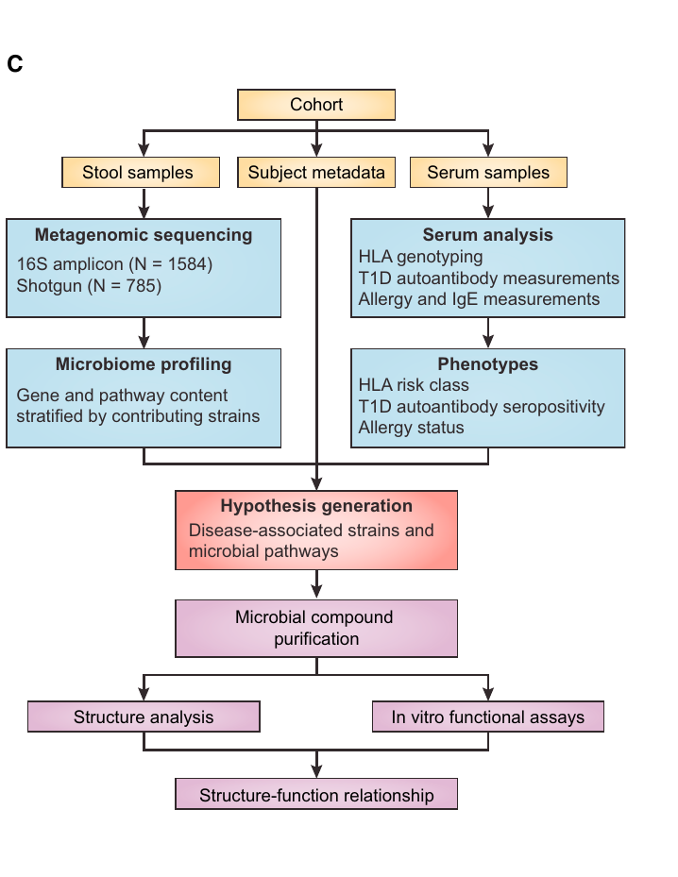
Data Base Overview
https://pubs.broadinstitute.org/diabimmune/three-country-cohort/resources/metagenomic-sequence-data
This data set is used

Slide 2
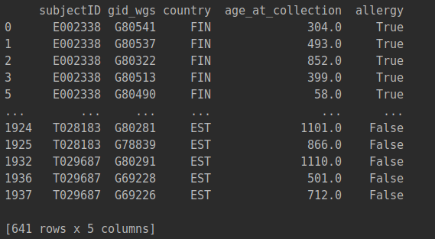
Input Data structure
Metadata
['subjectID', 'SampleID', 'age_at_collection', 'collection_month',
'delivery', 'gest_time', 'gender', 'country',
'Exclusive_breast_feeding', 'Breast_feeding_end', 'Regular_formula',
'hydrosylated_formula', 'partly_hydrosylated_formula',
'Any_baby_formula', 'Fruits_and_berries', 'Corn', 'Rice', 'Wheat',
'Oat', 'Barley', 'Rye', 'Cereal', 'Other_grains', 'Root_vegetables',
'Vegetables', 'Eggs', 'Soy', 'Milk', 'Meat', 'Fish', 'Other_food',
'Other_than_BF', 'bf_length', 'num_abx_treatments',
'num_abx_first_year', 'abx_first_year', 'after_abx',
'num_preceeding_abx', 'hla_risk_class', 'seroconverted', 'num_aabs',
'totalige', 'totalige_log', 'allergy_milk', 'allergy_egg',
'allergy_peanut', 'allergy_dustmite', 'totalige_high', 'allergy_cat',
'allergy_dog', 'allergy_birch', 'allergy_timothy', 'gid_wgs',
'mgx_reads', 'mgx_pool', 'mgx_reads_filtered', 'read_count_16S',
'sequencing_PDO_16S', 'gid_16s'],
Column lables
Processing
Processing

Slide 3
Metadata processing
Add an "allergy" column, where it indicates "TRUE" if the sample comes from a subject who is allergic to egg, milk, or peanuts, and "FALSE" otherwise.
There are several columns in the metadata file, the final one that is being used by the network should have: SubjectID, gid_wgs, country, timepoints, and allergy.
Remove all the samples without a food allergy class label
discrepancies:
732 samples with 195 subjects VS 731 samples
4. Remove samples from subjects with less than 3 timepoints
discrepancies:
My code: 641 samples with 137 subjects.
VS
In the paper: 658 samples with 148 subjects.
Mentioned in the private email
Country | Sample No. Form my code | VS | Sample No. from the paper
EST | 197 |  | 197
FIN | 281 |  | 281
RUS | 254 |  | 253
Mentioned in the paper

Slide 4
Metadata processing
5. Draw 215 genera from the TOU Table

Slide 5
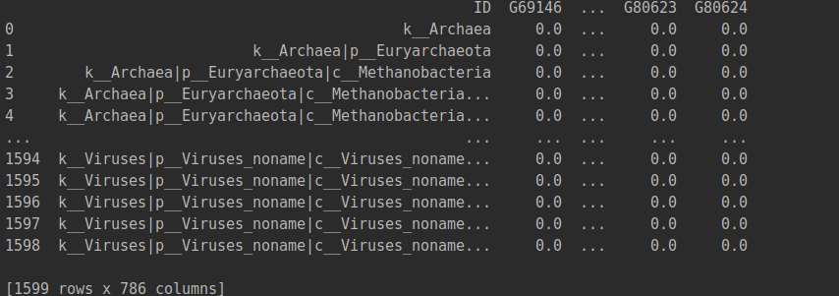
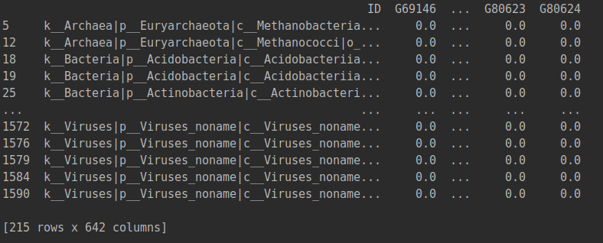
Data structure
OTU table
Processing
The column lables, such as G69146, represents the sample ID.
Each row is a taxonomic path to the genus level. 215 genera.

Slide 6
https://github.com/aametwally/FoodAllergyPredictor/blob/master/src/lstm_diabimmune.py Discrepancies
1.Data processing part:
In line 382-389,
for i in subjects:
if (len(timepoints[i]) < 3):
ctr = ctr +1
df = df.drop(timepoints[i], axis=1)
meta = meta.drop(meta[meta.subjectID == i].index)
timepoints.pop(i, None)
subjects.remove(i)
If you remove a item in the list, the folowingt item's index will decrease by 1, so in the next iteration, this followint item won't be called/checked.
Some subjects with less than 3 samples are instill in the dataset after filteration, for example:
print('E003393' in subjects)
print(timepoints['E003393'])
2. Training part
In line 159,161
testFoldSizeAllergy = round(0.1 * len(subjAll))
testNonAllergy = subjNonAll[0: testFoldSizeNonAllergy]
In line 194,196
validateFoldSizeAllergy = round((1 / numFold) * len(subjAll))
validateFoldSizeNonAllergy = round((1 / numFold) * len(subjNonAll))
(numFold=2)
But in the paper,' we divided the data into test set (20%) and performed 10-fold cross-validation on the remaining 80% of the dataset'
(numFold=10)
Notes:
3. getbatch
if(idx + batch_size >= len(subjects)):
batch_size = len(subjects) - idx
? what is this for?

Slide 7
Results
1. LSTM with raw features
Average AUC = 0.55, Average MCC = 0.09
Elapsed time = 328.87 Seconds
Notes:
3. getbatch
if(idx + batch_size >= len(subjects)):
batch_size = len(subjects) - idx
? what is this for?

