Slide 1


Slide 2


Slide 3
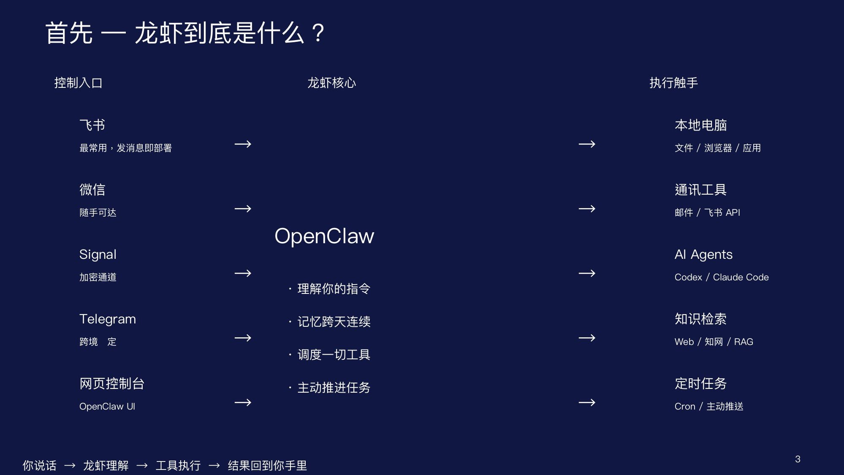

Slide 4
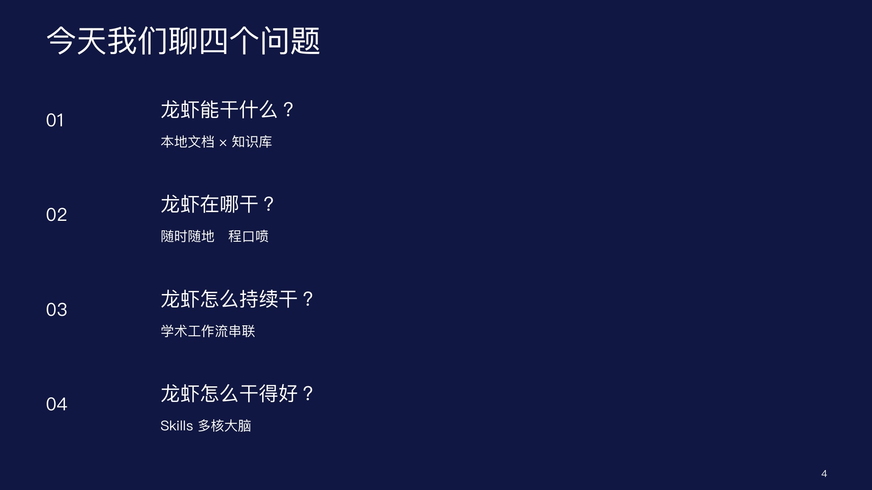

Slide 5


Slide 6
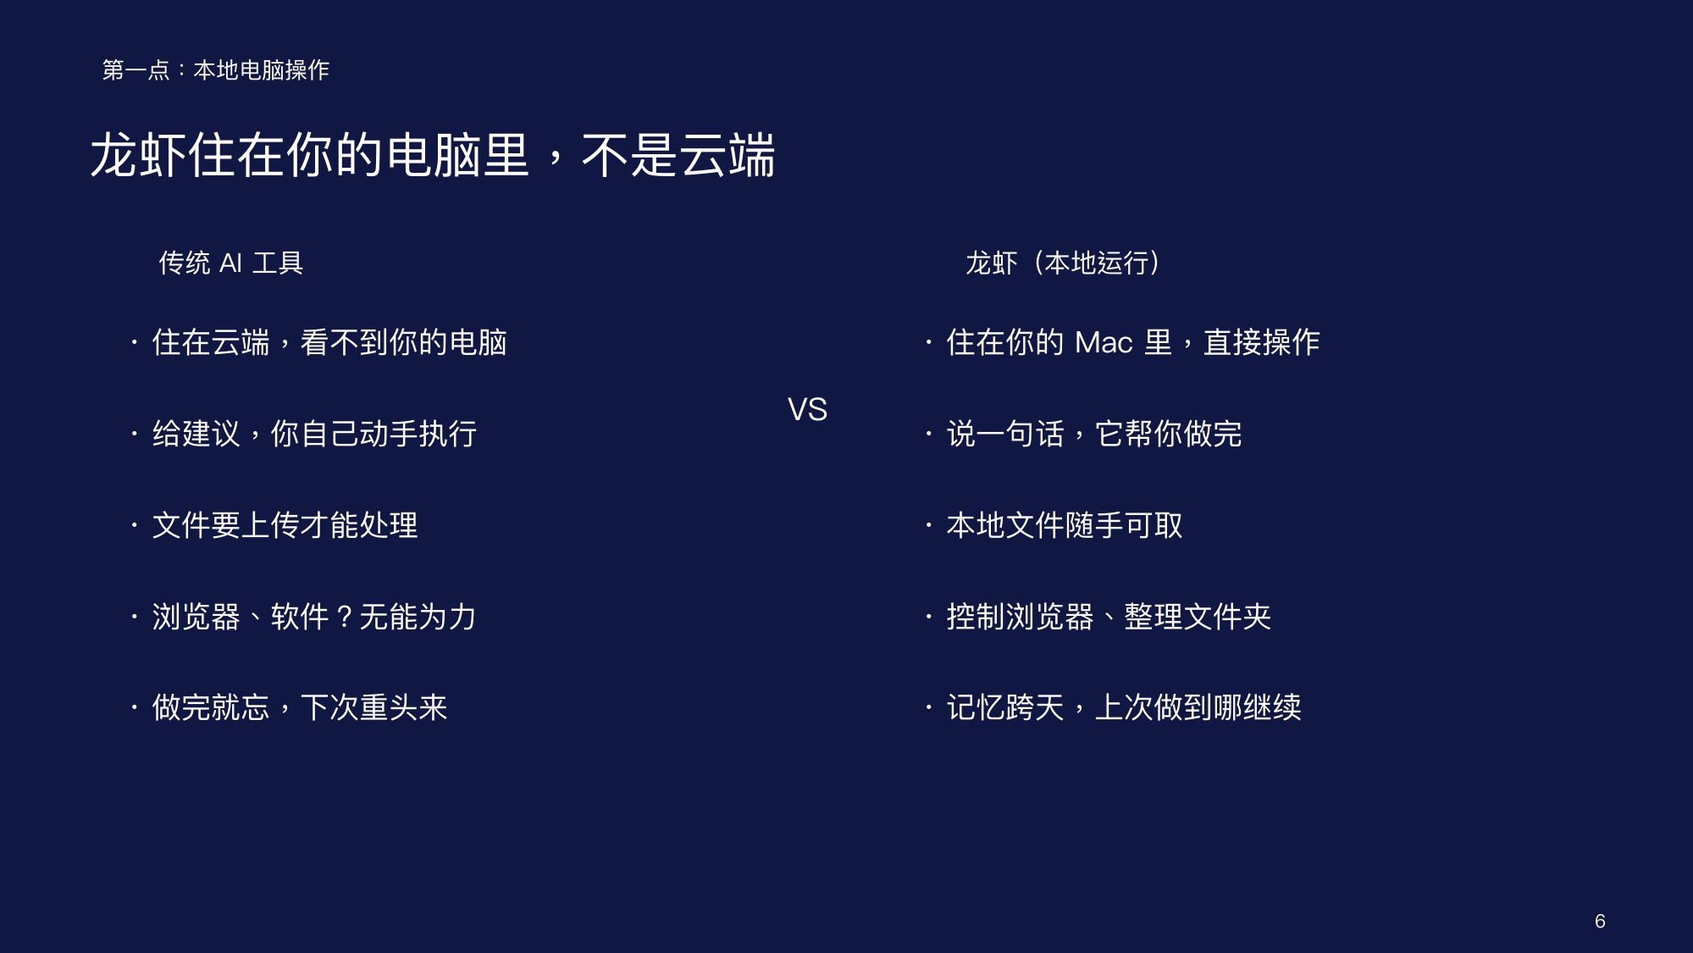

Slide 7
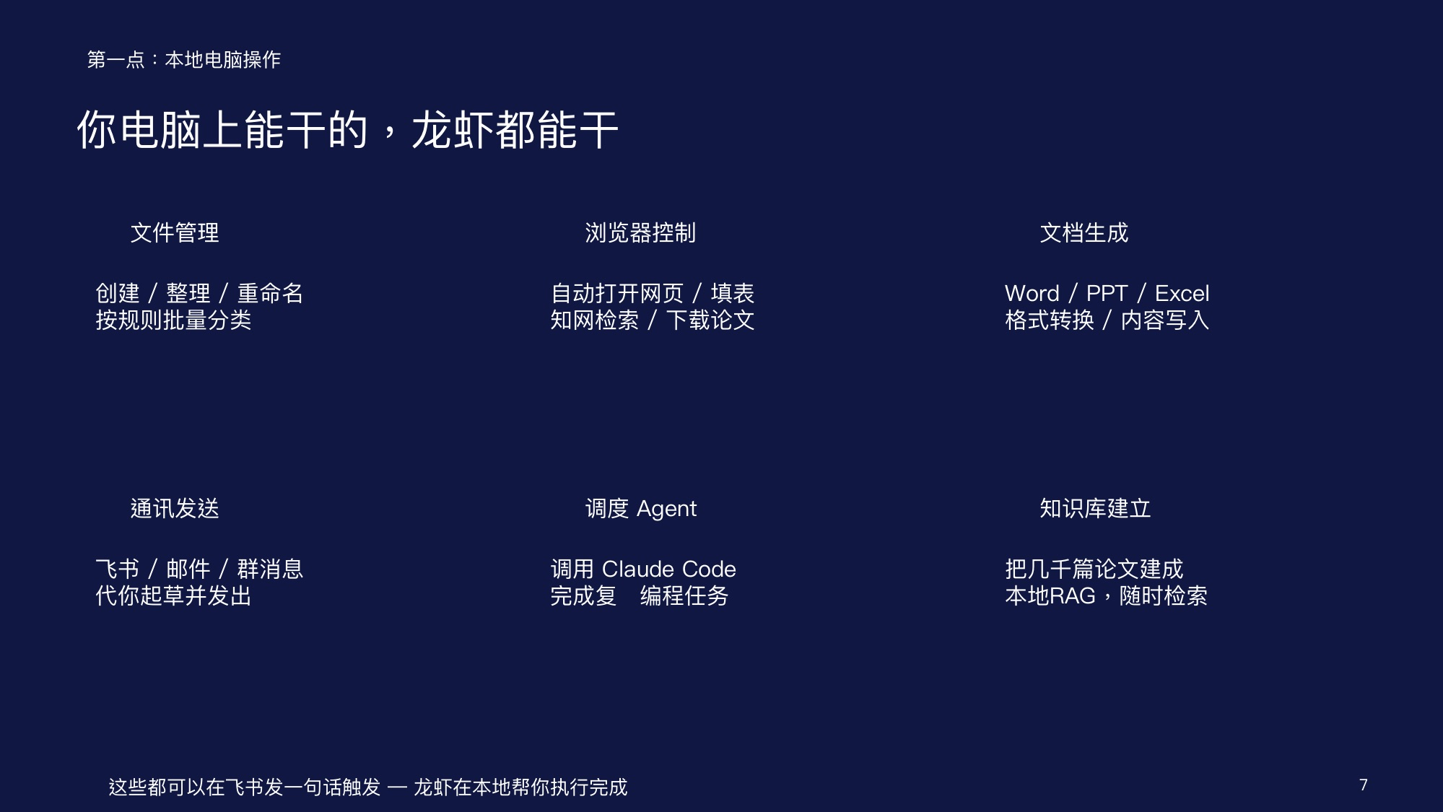

Slide 8


Slide 9
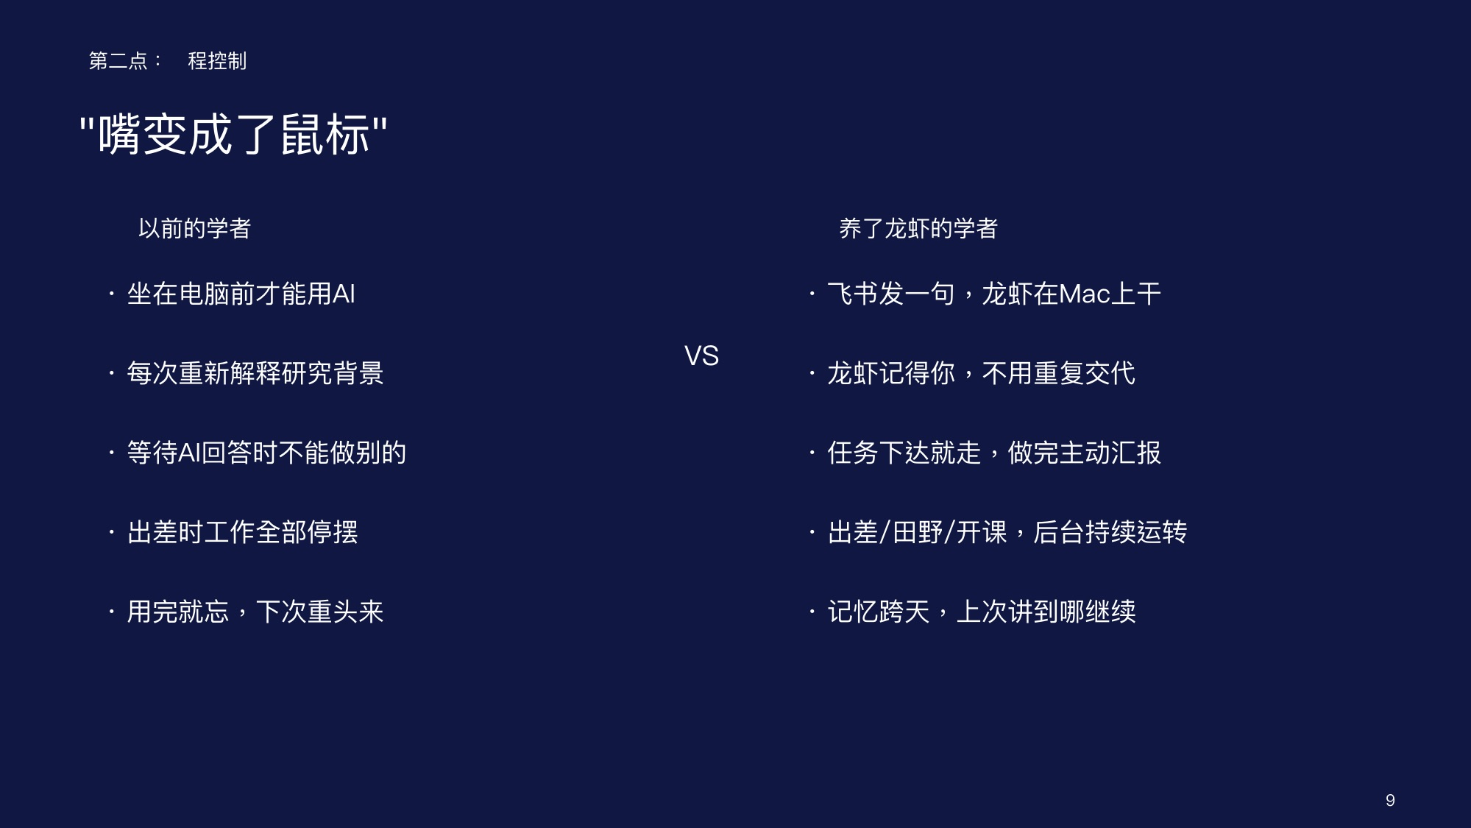

Slide 10
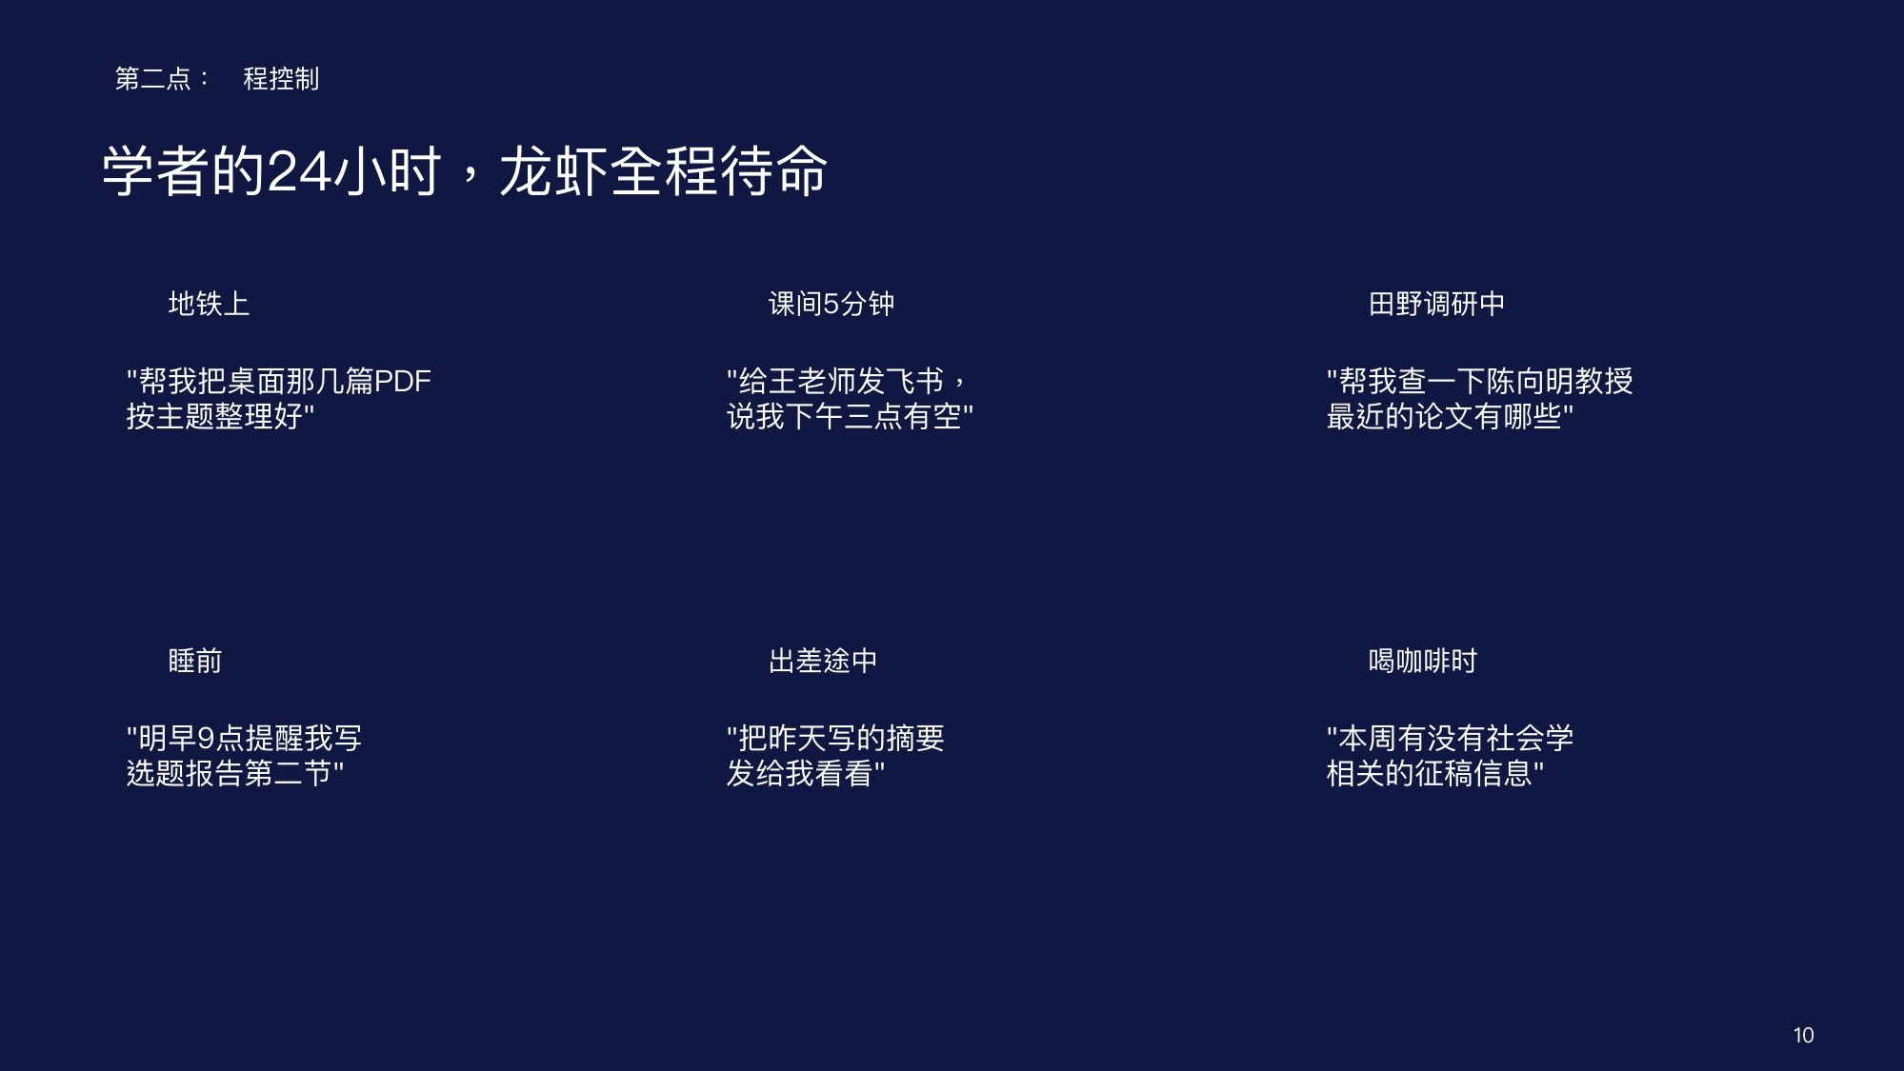

Slide 11


Slide 12
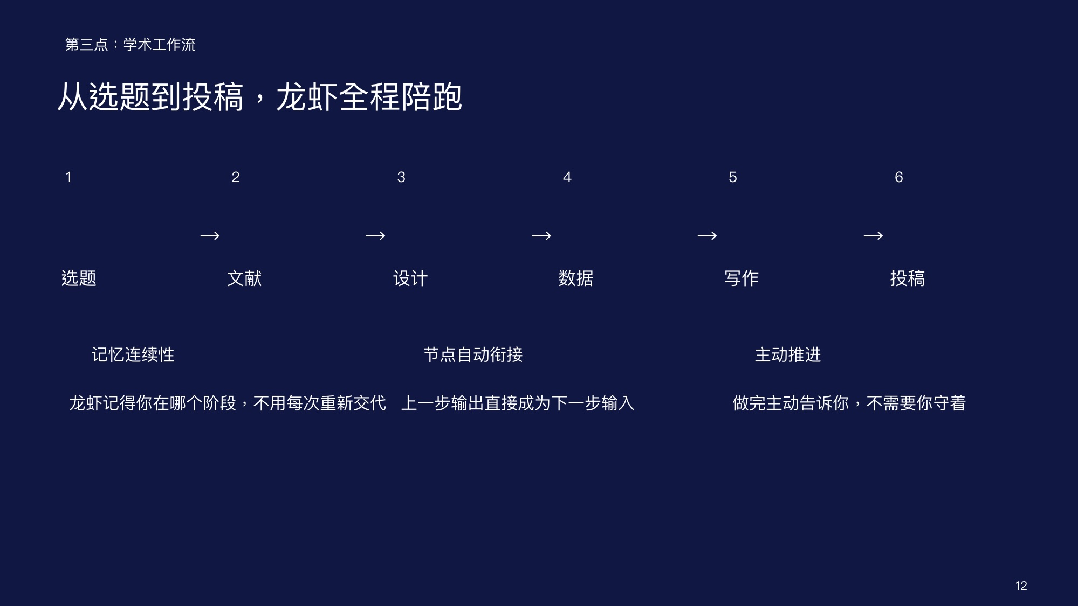

Slide 13


Slide 14


Slide 15
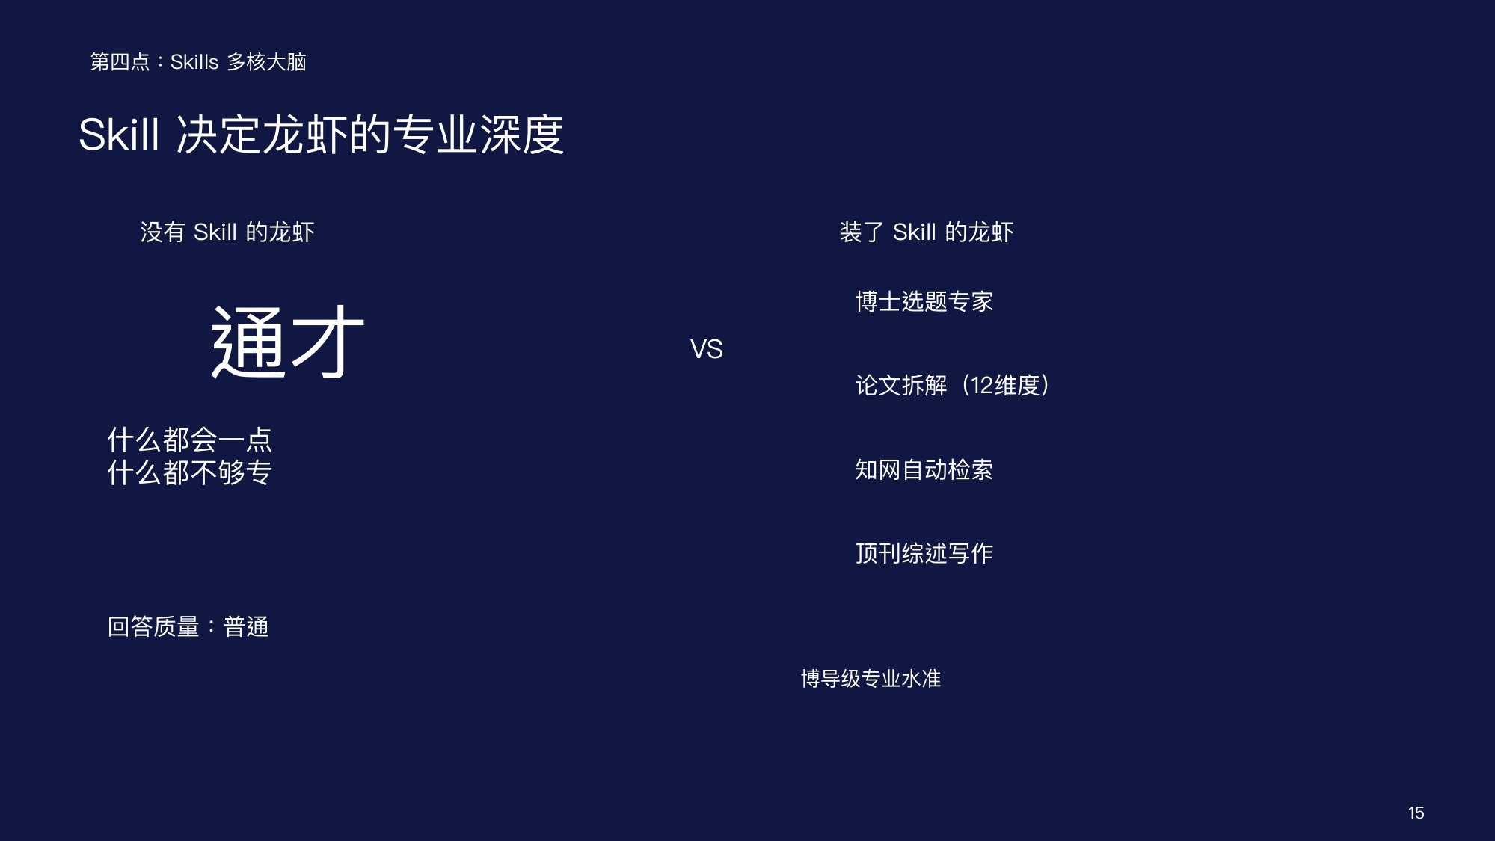

Slide 16
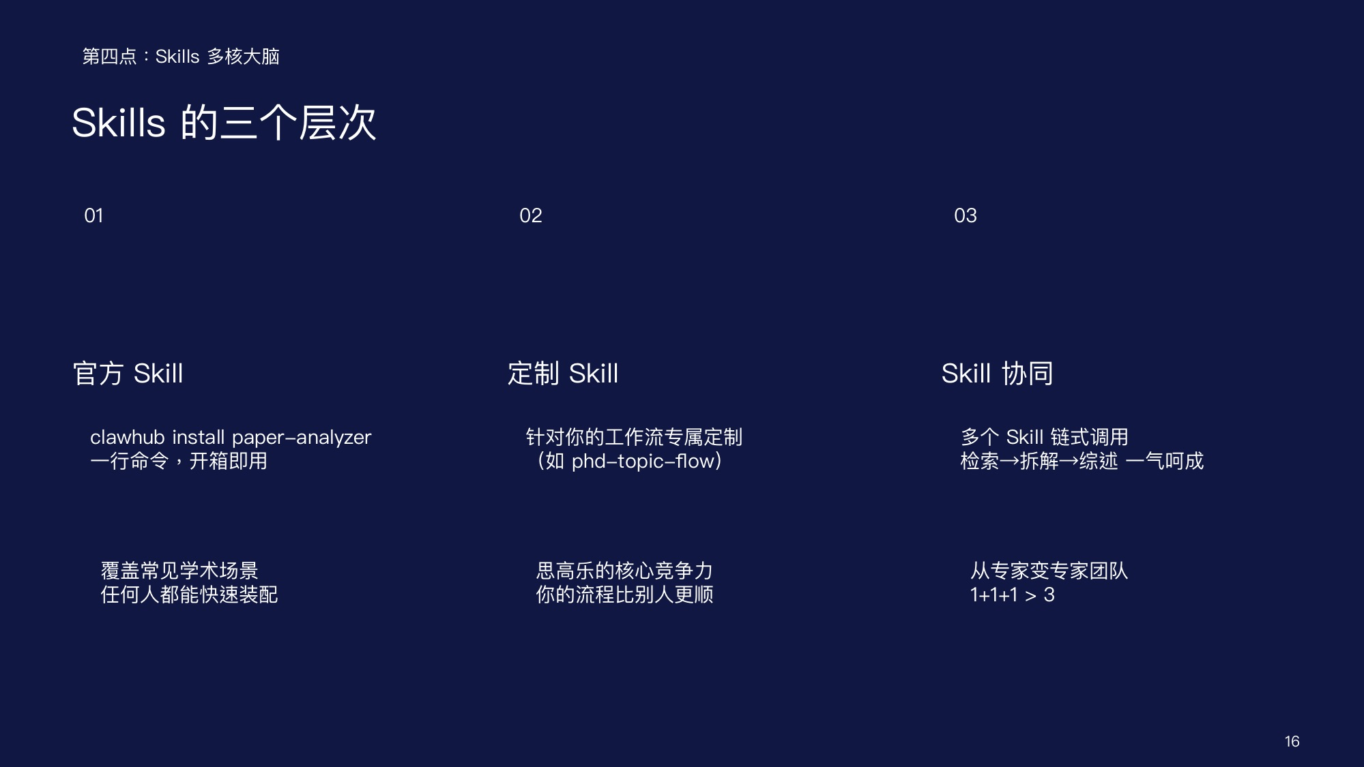

Slide 17
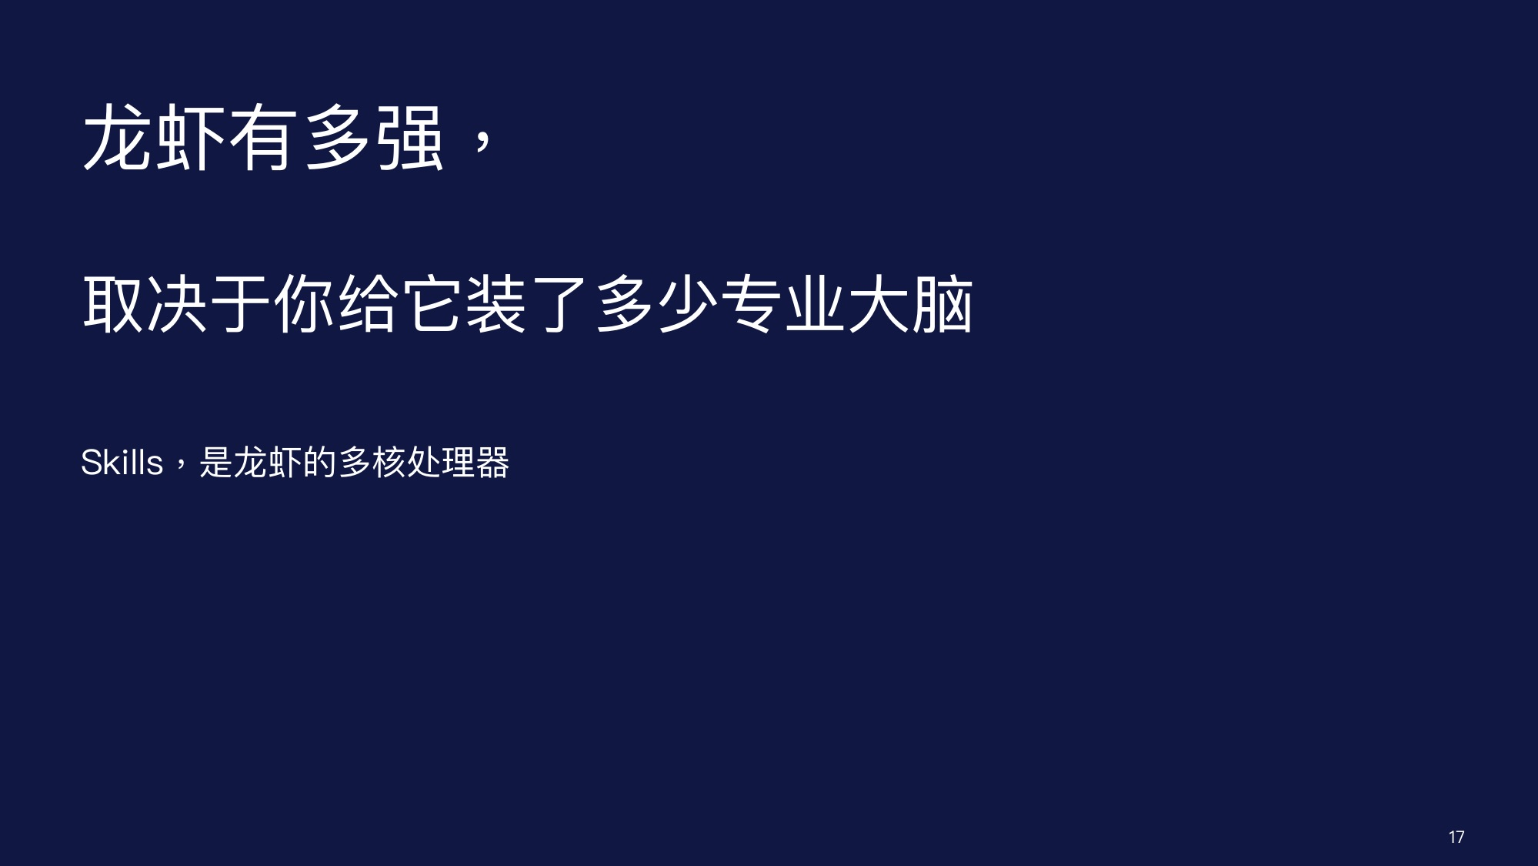

Slide 18
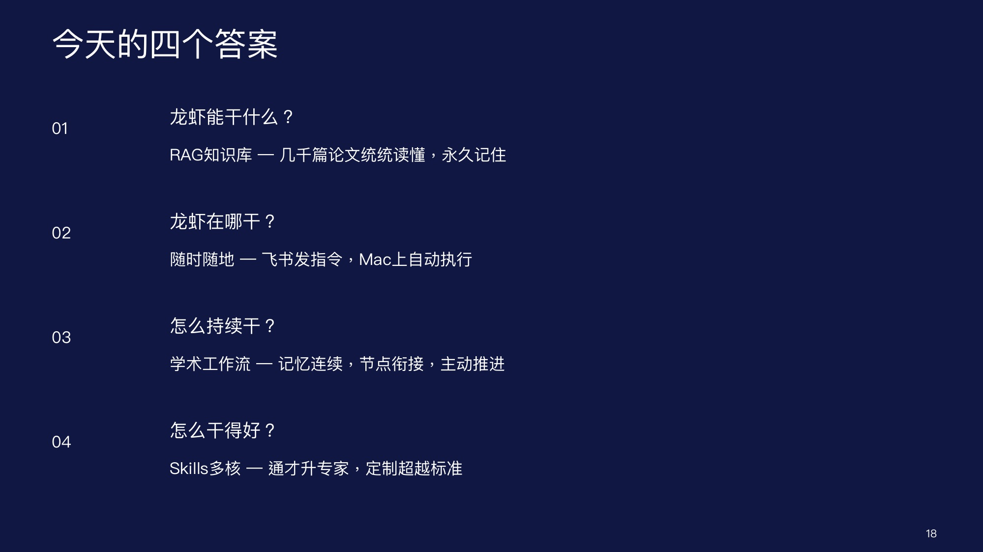

Slide 19
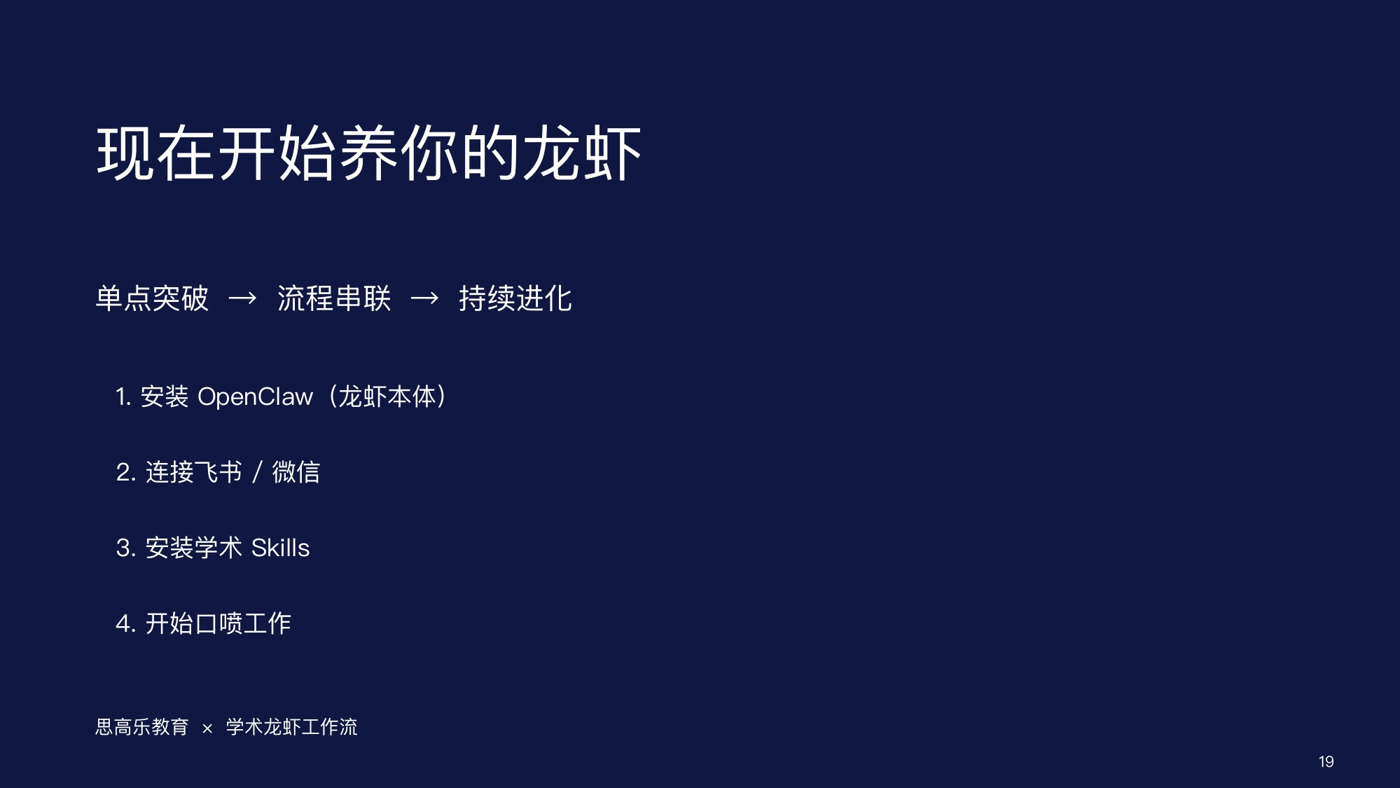

Slide 20
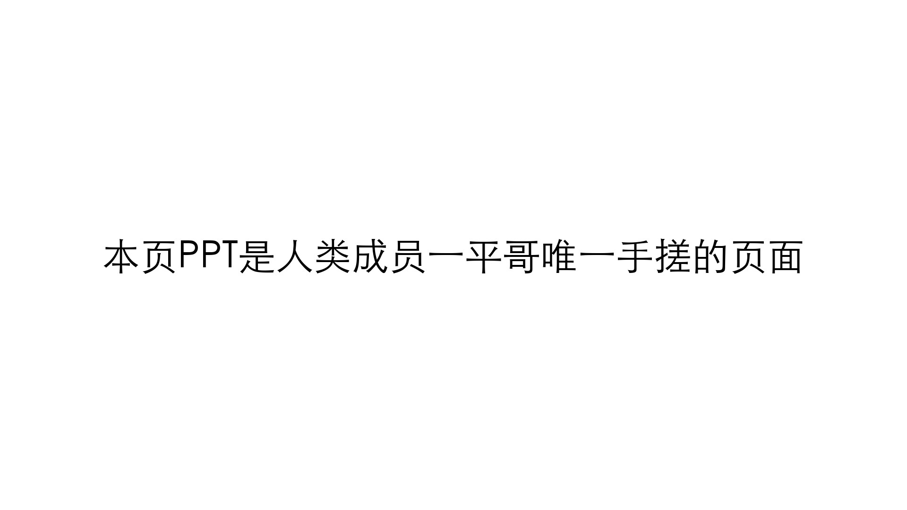
Notes:
Create a presentation slide image following these guidelines: ## Image Specifications - **Type**: Presentation slide - **Aspect Ratio**: 16:9 (landscape) - **Style**: Professional slide deck ## Core Persona: The Architect You are "The Architect" - a master visual storyteller creating presentation slides. Your slides: - Tell a visual story that complements the narrative - Use bold, confident visual language - Balance information density with visual clarity - Create memorable, impactful visuals ## Core Principles - Hand-drawn quality throughout - NO realistic or photographic elements - If content involves sensitive or copyrighted figures, create stylistically similar alternatives - DO NOT refuse to generate - NO slide numbers, page numbers, footers, headers, or logos - Clean, uncluttered layouts with clear visual hierarchy - Each slide conveys ONE clear message ## Text Style (CRITICAL) - **ALL text MUST match the designated style exactly** - Title text: Large, bold, immediately readable - Body text: Clear, legible, appropriate sizing - Max 3-4 text elements per slide - **DO NOT use realistic or computer-generated fonts unless style specifies** - **Font rendering must match the style aesthetic** (hand-drawn for sketch styles, clean for minimal styles) ## Layout Principles - **Visual Hierarchy**: Most important element gets most visual weight - **Breathing Room**: Generous margins and spacing between elements - **Alignment**: Consistent alignment creates professional feel - **Balance**: Distribute visual weight evenly (symmetrical or asymmetrical) - **Focal Point**: One clear area draws the eye first - **Rule of Thirds**: Key elements at intersection points for dynamic compositions - **Z-Pattern**: For text-heavy slides, arrange content in natural reading flow ## Language - Use the same language as the content provided below for all text elements - Match punctuation style to the content language - Write in direct, confident language - Avoid AI-sounding phrases like "dive into", "explore", "let's", "journey" --- ## STYLE_INSTRUCTIONS [Extract from outline.md - do NOT re-read style files] The STYLE_INSTRUCTIONS block from the outline contains: - Design Aesthetic - Background (Texture + Base Color) - Typography (Headlines + Body descriptions) - Color Palette (with hex codes) - Visual Elements - Density Guidelines - Style Rules (Do/Don't) Copy the entire `<STYLE_INSTRUCTIONS>...</STYLE_INSTRUCTIONS>` block from the outline here. --- ## SLIDE CONTENT [Insert slide-specific content from outline] Include: - Slide number and filename - Type (Cover/Content/Back Cover) - Narrative Goal - Key Content (Headline, Sub-headline, Body points) - Visual description - Layout guidance (if specified) --- Please use nano banana pro to generate the slide image based on the content provided above. --- Generate a simple slide: - Background: pure white (#ffffff) - Centered text: "本页PPT是人类成员一平哥唯一手搓的页面" - Text color: pure black (#000000) - Font: clean, bold sans-serif - Text size: large enough to be easily readable - No other elements, minimal design

