Slide 1
Self introduction
Zhiqing Zhong

Slide 2
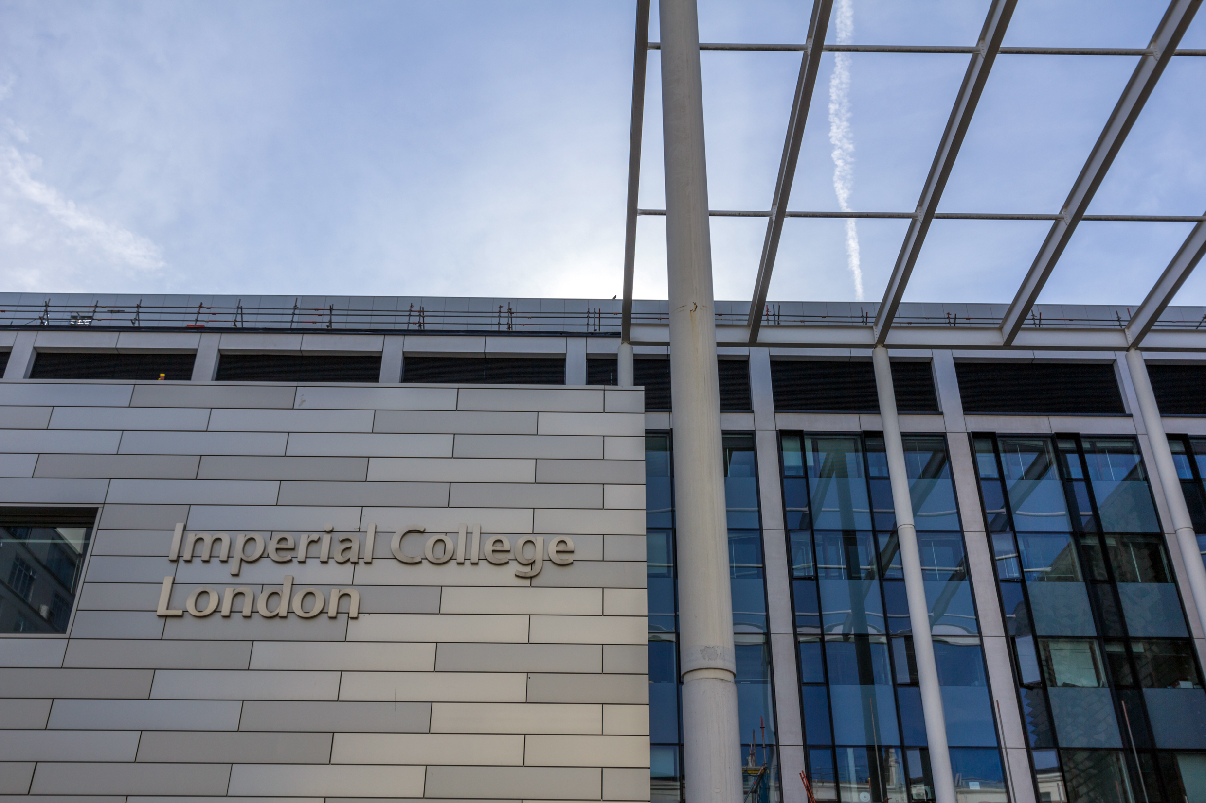
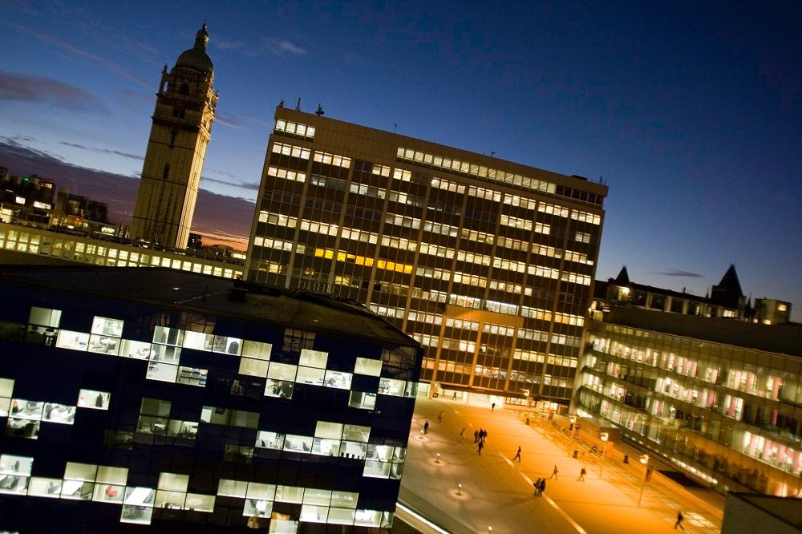
Education background
BENG studying in the Imperial College London;
Electronic and Information Engineering;
First year students;
Large interests on mathematics and algorithms;
Learned extra linear algebra and basic machine learning courses online

Slide 3
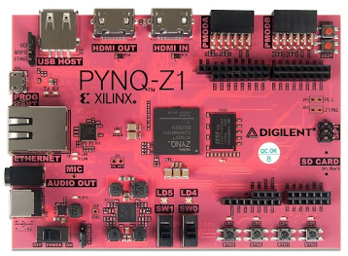
Research project
FPGA working experience;
Edge detection;
RGB and Open CV;
Writing in high level language in vivado hls and explore the file by using vivado;
Combination of algorithms and hardware;
More on the optimizations;

Slide 4
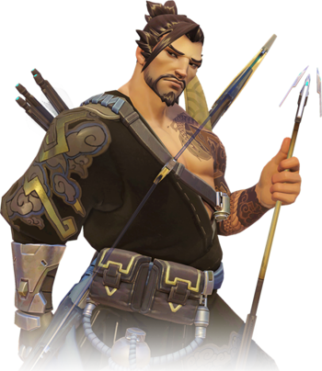
Personal interests
Reading books on Chinese original cultures;
Video games(overwatch);
Basketball;

Slide 5
contacts
Email: zz8317@ic.ac.uk
Phone:+447410364868
Wechat : augustuszzq
Facebook: augustuszzq

