Slide 1

Project 2: Top 100 movies
Web Design, Data Conversion (HTML/CSS/BootStrap/Javascript): Helen Au
Visualization (D3/Plotly): Bassam Aziz
Aidan McMurry
Web Scraping, Data Cleaning, *Interactive Visualization* (BeautifulSoup/Plotly): Bryan Alcazar
QinQin Zha

Slide 2

Purpose/Questions
1. What genre scores the highest Star Rating?
2. What duration(in minutes) does each genre typically have?
3.Is there a correlation between Star Ratings and Film Ratings?
4. Does the duration of the movie influence their Star Rating?
5. Is there a correlation between Gross Value and the year it was released?
6. What duration(in minutes) earns the highest Meta Rating?
7. What Meta Rating earns the highest Gross Value?

Slide 3
Programs used/Flow Chart
Pandas
BeautifulSoup
Plotly
HTML
CSS
Javascript
Bootstrap
D3

Slide 4
ELT Process/ Cleanup
We collected our dataset from the OMBD website by web scraping their best 100 films from 2000-2020. After extraction, the dataset was further processed by converting it into a Pandas data frame to remove or add any missing information, delete unwanted characters, and transform data to its proper data type. Lastly, the final product was exported as a CSV for data analysis.

Slide 5
Findings
Is there a specific genre that often produces box-office hits?
Does the release year have any affect on the ratings?
Was there a year that a specific genre was popular?
Does the director influence movie ratings?

Slide 6
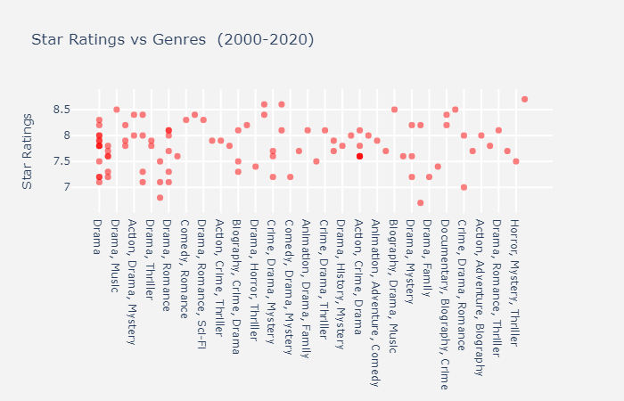
The highest rated film from our list is a Documentary with a Star Rating of 8.7
Human(2015)
Drama movies show more Star Ratings of 8.

Slide 7
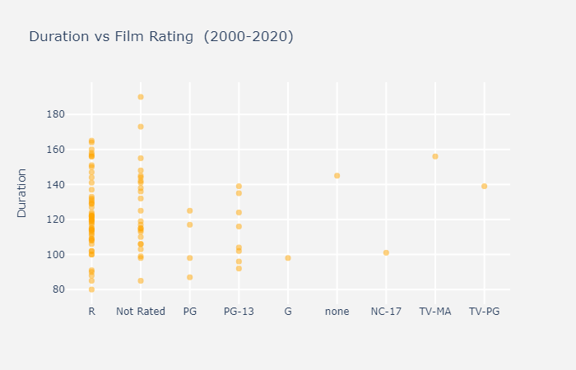
Our most significant correlation shows that R-rated movies generally last close to 120 minutes on average.

Slide 8
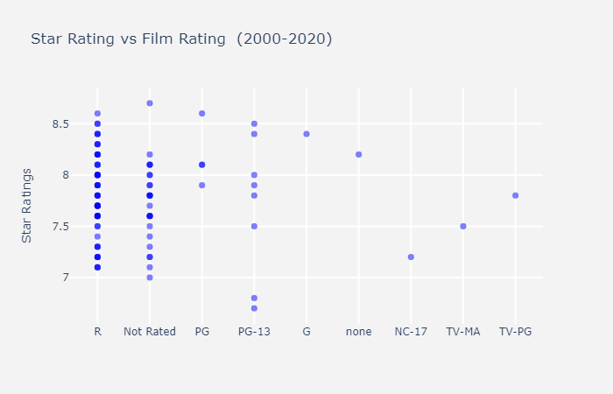
The Star Ratings has a correlation with R-rated movies; therefore, showing that generally, R-rated movies have strong Star Ratings.

Slide 9
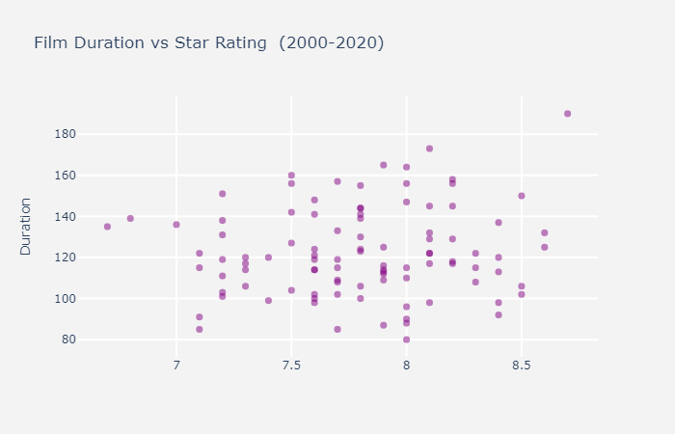
The highest-rated movie is in the Documentary genre with a duration of more than 180 minutes and it scored a Star Rating of 8.7.
Generally, most of our movie plots lie in the bottom right quadrant. This finding shows that movies can earn a good Star Rating if the duration of the movie falls between 100-140 minutes.

Slide 10
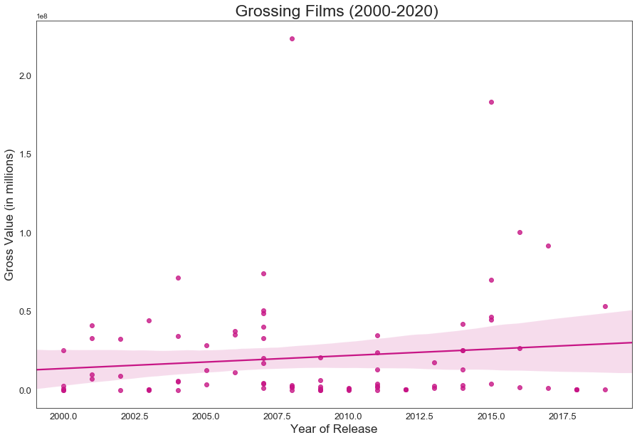
There doesn’t seem to be a correlation between the Gross Value and the Year of Release.

Slide 11
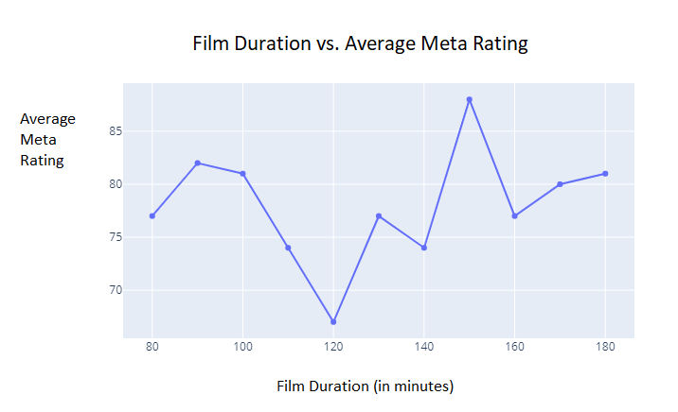
Is there a specific genre that often produces box-office hits?
Does the release year have any affect on the ratings?
Was there a year that a specific genre was popular?
Does the director influence movie ratings?
At a 140-160 minute duration, it shows the most amount of movies with Meta Ratings of more than 85.

Slide 12
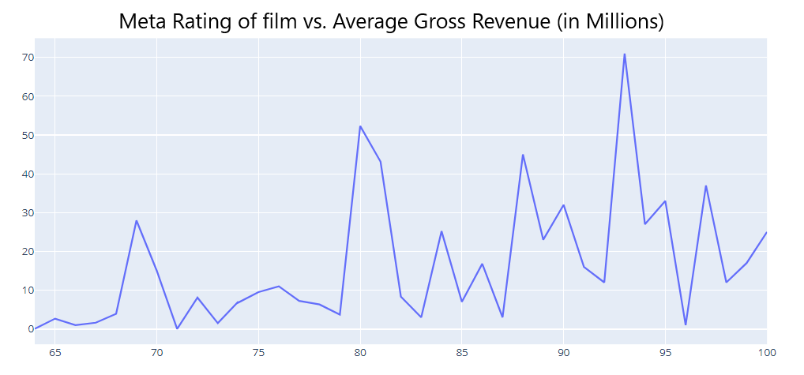
Is there a specific genre that often produces box-office hits?
Does the release year have any affect on the ratings?
Was there a year that a specific genre was popular?
Does the director influence movie ratings?
X-axis = Meta Rating; Y-axis = Gross (in millions)
We conclude that movies with a Meta Rating of about 93 have the highest Gross Value.
Movies that score a high Meta Rating that have a low Gross Value may be considered classic movies by movie critics, but not as popular with the viewers.

Slide 13
The End

