Slide 1

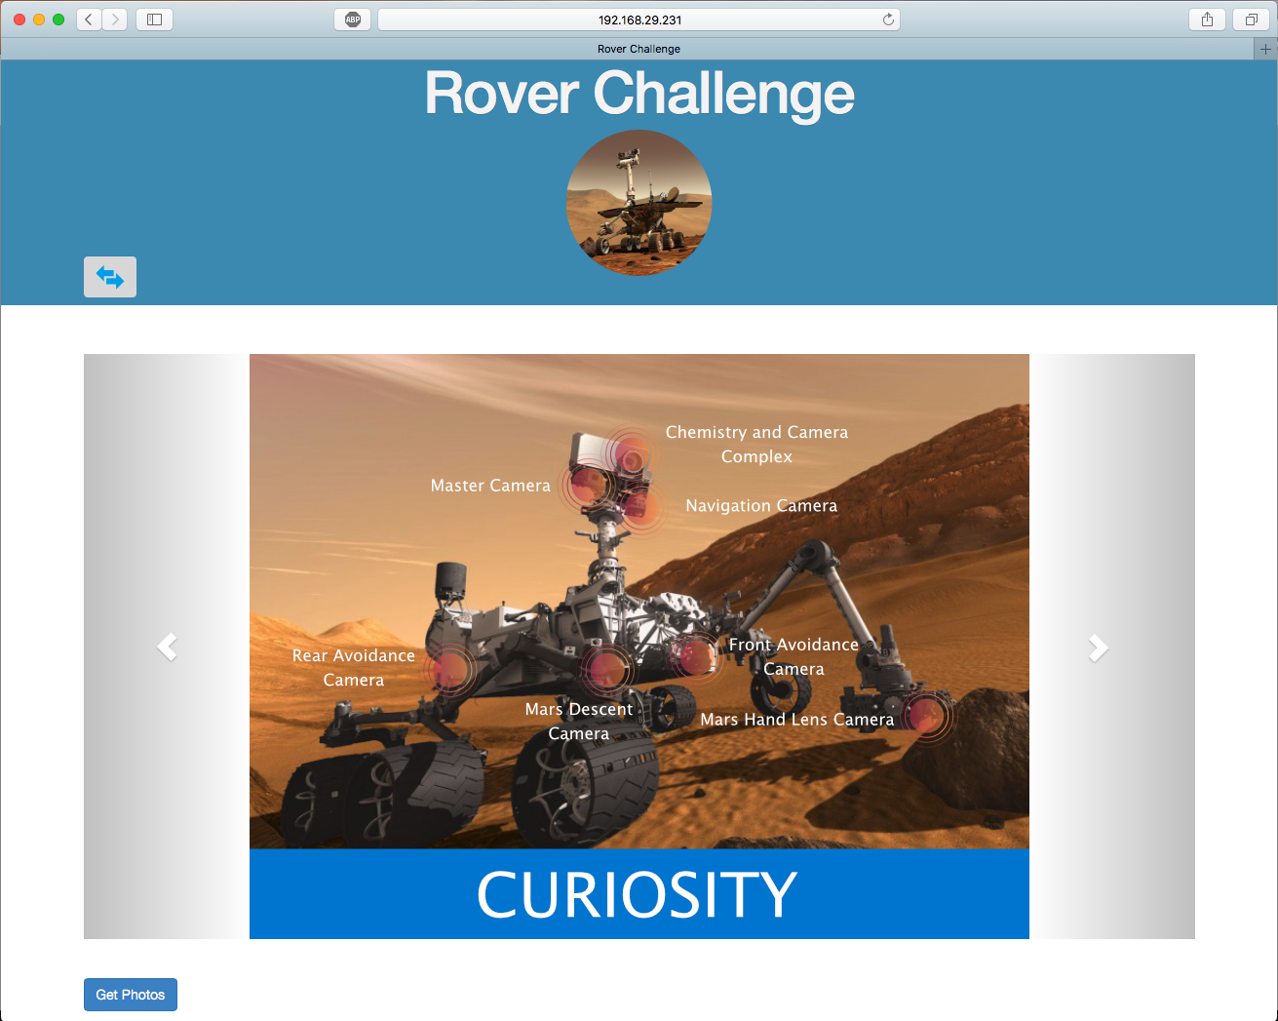
GraduateTigers
TECHNOLOGIES USED:
MEAN Stack, BootStrap, Postman
FINAL DESIGN AND VALUE-ADDS:
Single-Page web application.
Cross-platform and responsive design.
Handled all the positive and negative test cases.
Ability to switch between different views to use the application.
Ability to choose between Martian date and Earth date.
Ability to view images in grid and individually.
Smart and intuitive design for selecting rover information.
Sumeet Wilkhu - Moayad Almohaishi

