Slide 1
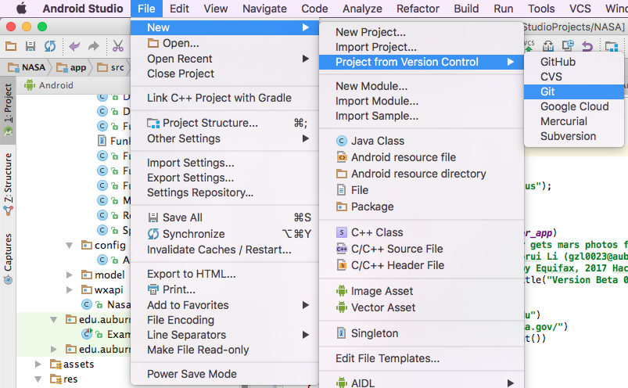
How to…
Install Android Studio.
File -> New -> Project from Version Control -> Git
Paste our github repo address: https://github.com/LeeGerry/NASA.git
Compile and run.
OR
Download apk file from: https://drive.google.com/file/d/0B5lDqW9grSfhYTJ5bzhCTk5nS1k/view?usp=sharing, install it on your Android phone.
Have fun with our app.

