Slide 1
NFT PRICE PREDICTION
USABLE ARTIFICIAL INTELLIGENCE
Abhijit Nayak
Andrea Chung
INDIANA UNIVERSITY BLOOMINGTON

Slide 2
Content
Introduction
Dataset
Method
Result
Conclusion

Slide 3
Introduction
What is Non-Fungible Token (NFT)?
What are key attributes that make prediction model better?
What types of algorithms/models are suitable for building predictive model?
Notes:
NFT is a digital property used to represent objects such as arts, collectibles, and in-game items. It has become a popular means for creators to sell their artistic content as a means of investments. NFT pricing is largely driven by speculations so, its marketplace is characterized to be unpredictable with highly skewed and uncertain returns. Due to its volatiliy, the task of predicting future values of NFT has become important for investor’s financial security and their investments.
With the rise of social media, such as Twitter, NFT holders utilize the grounds to navigate and form public opinion on NFTs. The social media attributes can play important role in carrying out analysis and creating prediction models of NFT market.
To carry out the project, there were initial questions that we asked such as
What are the key attributes that make prediction model better?
What types of algorithms/models are suitable for building predictive models?
How does social media data effect the performance of prediction ability of the model?
To what precision can we predict the value or price of NFTs based on their selected attributes and social media activity?

Slide 4
Dataset
Dataset from https://bitgrit.net/competition/17
4 Datasets
Collections.csv
Collections_twitter_stats.csv
Nfts_train.csv
Nfts_predict.csv

Slide 5
Approach
Preprocessing
Feature Engineering
Feature Engineering
K-fold implementation
3 Regression Model: CatBoost, XGBoost, and LightGBM
Bayesian Optimization
Modelling
Hyperparameter Tuning
Prediction

Slide 6
Models
Models | RMSE | Prediction Score
CatBoost | 8.778 | 0.378
XGBoost | 9.240 | 0.472
LightGBM | 10.187 | 0.746

Slide 7
Results
Selected Model: CatBoost Regression Model

Slide 8
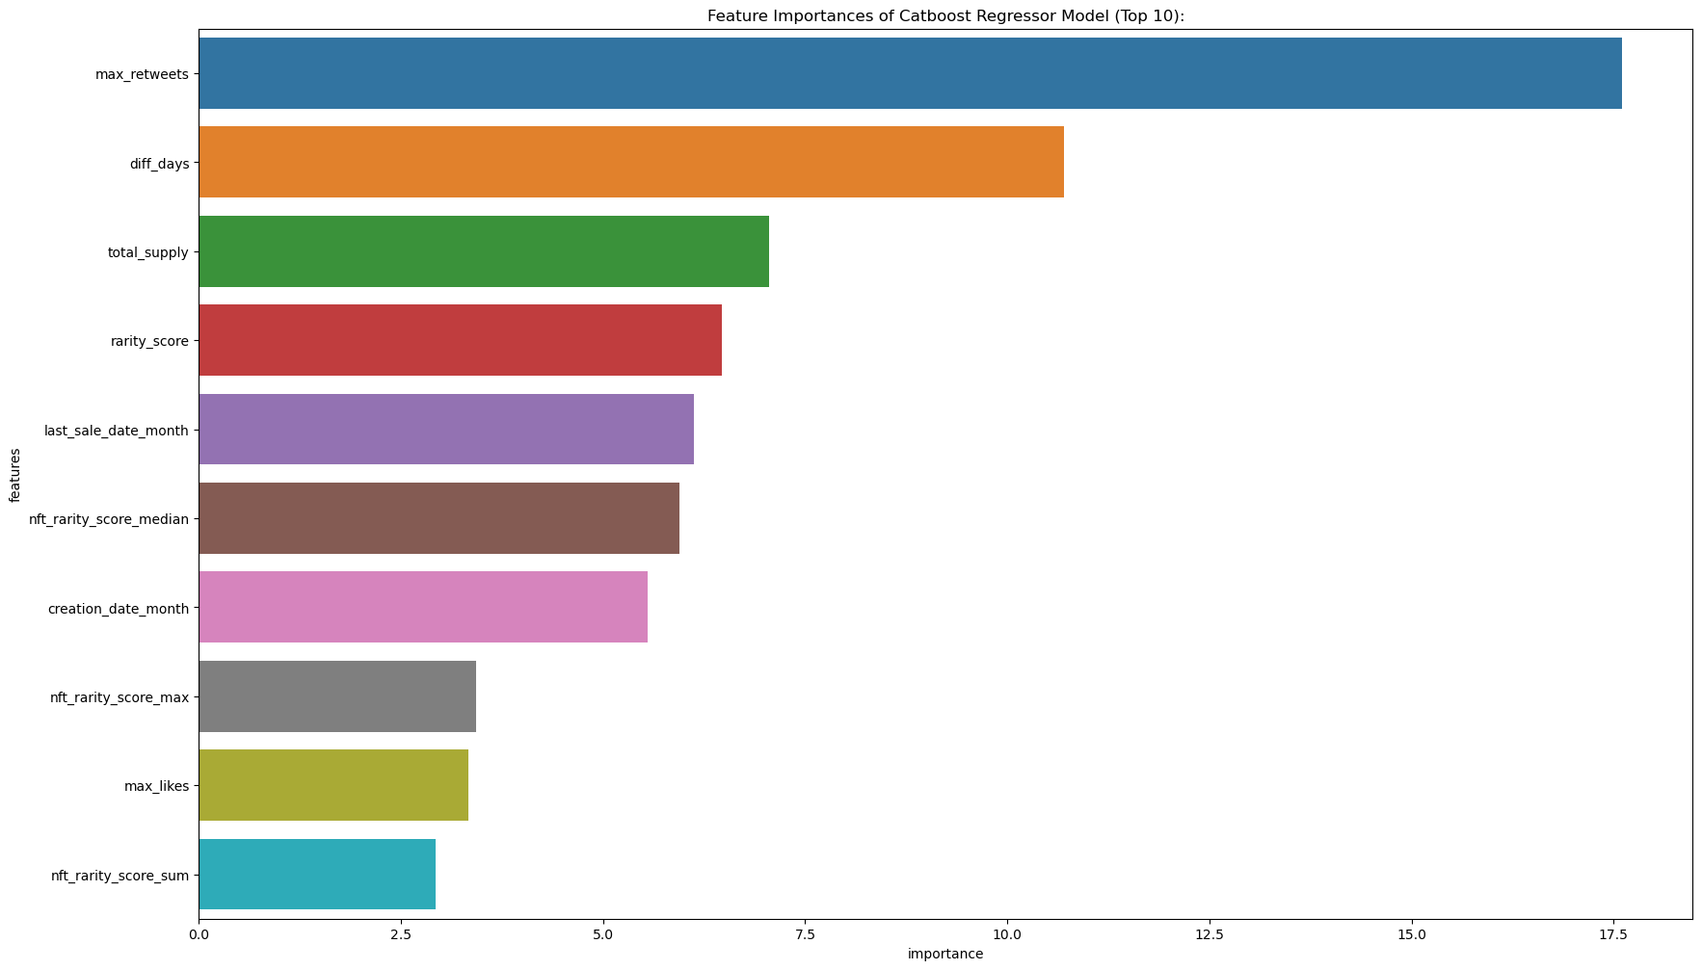
Results
Feature Importance
Max Retweets
Difference from Creation Date to Last Sale Date
Total Supply
Rarity Score
Month of Last Sale Date

Slide 9
THANK YOU

