Slide 1







Company Presentation
2019

Slide 2
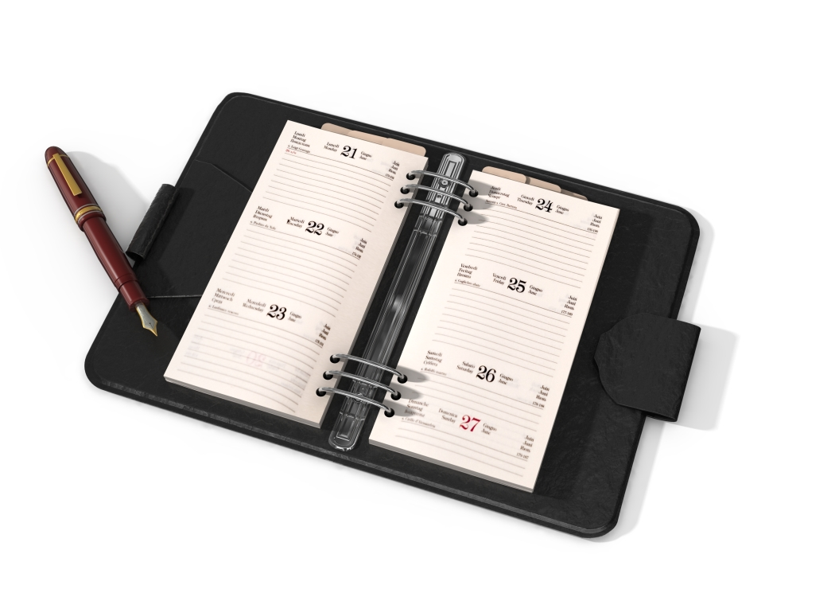
Agenda
Ι Company Profile
ΙΙ Courses Offered
ΙΙI Students & Rooms
Regulation

Slide 3
Ι. Company Profile:
1. Vision
2. Mission
3. Core Values
4. Organizational Structure

Slide 4
Vision
SLDM COLLEGES OF QUEZON CITY INC.,
A God-Loving Educational Institution envisioned to provide Excellence in Education.
Vocational Technical and Development of man’s potentialities imbued with social consciousness with a missionary spirit, service oriented, professionally and world class citizenry.

Slide 5
Mission
To promote the Vision of the Institution; It aims to
1. Promote a learning environment that enhances the values of academic excellence responsibility, service and accountability in partnership with stakeholders and the community.
2. Enhance the core values and potentials of the students so as to equip him with right skills aligned to the requirement of the industry partners.

Slide 6
Mission
To promote the Vision of the Institution; It aims to
3. Provide more equitable access of different government and private sectors thru scholarships for the poor but academically deserving students.
4. Encourage participation of faculty in continuously upgrading learning materials, facilities and academic accreditation of the institution.

Slide 7
Core Values
1. GOD-LOVING – We uphold to the life and service to mankind of St. Louise De Marillac.
2. INTEGRITY – We firmly believe on honesty, accountability and fairness in the performance of our task.
3. EXCELLENCE – We are task as one team to continuously upgrade our resources to produce globally competitive graduates.

Slide 8
Organizational Structure
OFFICIALS
1. ENGR. PETER V. MENDOZA – President/CEO - Graduated 1987, Bachelor of Science in Mechanical Engineering, University of the East, Licensed AM and TM, SMAW NC II, MACHINING NC II holder. A contractor. Engineer, consultant in Metal Fabrication and Aggregates.
2. DR. MELINDA B. MENDOZA – Executive Vice-President/COO - Graduated 1986, Bachelor of Science in HRM, Master of Science in Hotel and Restaurant Management 1992 both at Philippine Women’s University Taft Manila, Doctor in Business Administration at Pamantasan ng Lungsod ng Maynila

Slide 9
Organizational Structure
OFFICIALS
2008, with 20 years Administrative and Teaching working experience in Universities/Colleges, 7 years exposures in Hospitality and Tourism Industry local and abroad.
3. DR. MELODY B. DIGAO – Vice President for Sales and Marketing – Graduated 1990, Bachelor of Science in Commerce major in Marketing, San Sebastian College, Recto Master in Business Administration, licensed Real Estate Broker, Consultant, Trainer, Bread and Pastry Production NC II, Food Beverage Services NC II, Housekeeping NC II holder, Licensed AM and TM.

Slide 10
Organizational Structure
STAFF
1. Ms. MARIFE V. ANSANO – Property Custodian
2. Sir Elisha P. Bacleg – Processing Officer
3. Sir CHARLIE S. DY – Maintenance/Liaison Officer
4. Ms. RIZZA MAY M. PELAYO – Computer Operator/Data Encoder

Slide 11
Organizational Structure
TRAINERS
1. Ms. TYVELEE D. OCAMPO – Bread and Pastry Production NC II Trainer
2. Ms. MELODY B. DIGAO – Bread and Pastry Production NC II Trainer
3. Ms. CHOLETA A. CASTILLO – Bread and Pastry Production NC II Trainer
4. Ms. MARIFE V. ANSANO – Bread and Pastry Production NC II Asst. Trainer
5. Ms. DANICA ROSE M. ESCAÑO – Food and Beverage Services NC II Trainer

Slide 12
Organizational Structure
TRAINERS
6. Ms. Graciela M. Buenaventura – Housekeeping NC II Trainer
7. Sir Ervin G. Carretero – Computer Systems Servicing NC II Trainer
8. Ms. Rizza May M. Pelayo – Computer Systems Servicing NC II Trainer
9. Sir Romeo S. Espera – Web Development Level II Trainer
10. Sir Charlie S. Dy – Web Development Level II Asst. Trainer
11. Sir Francis T. Polo – Creative Web Design Level II Trainer

Slide 13
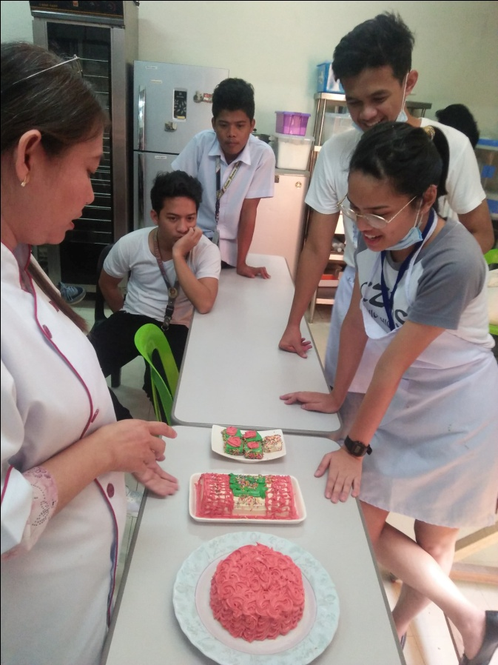
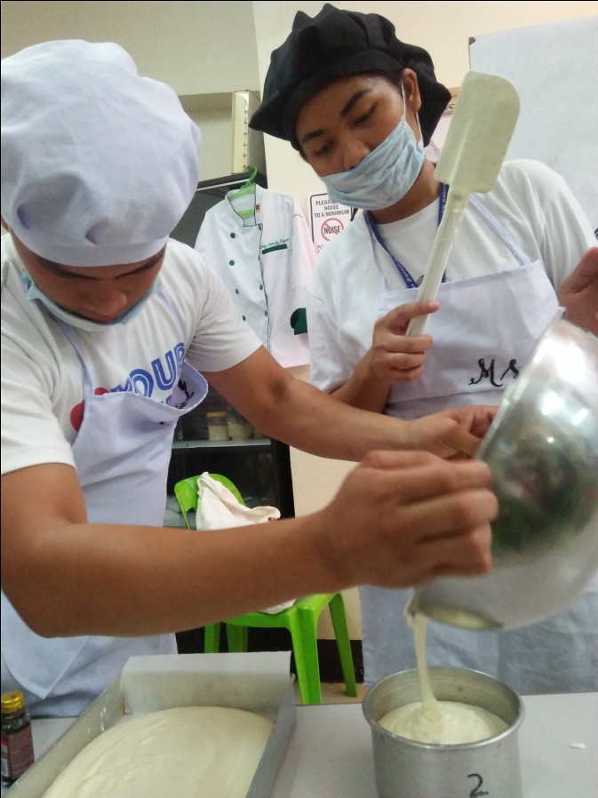
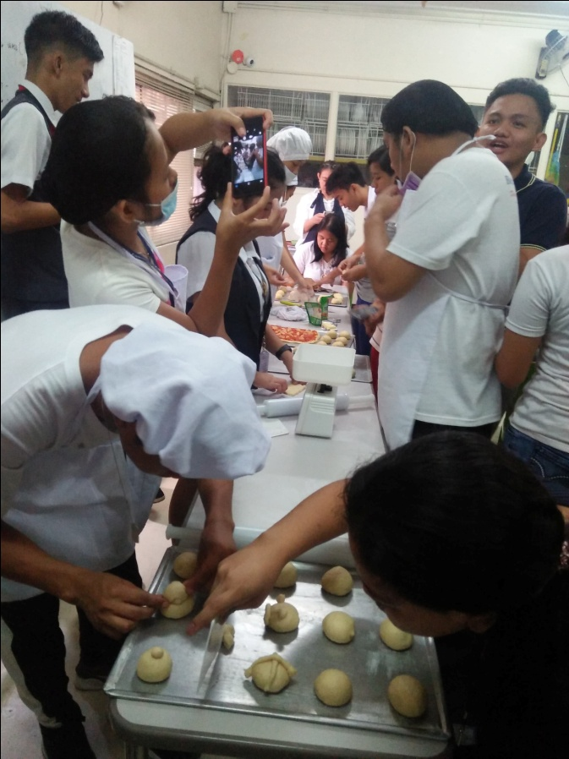
Courses Offered
1. Bread and Pastry Production NC II – 141 hours

Slide 14
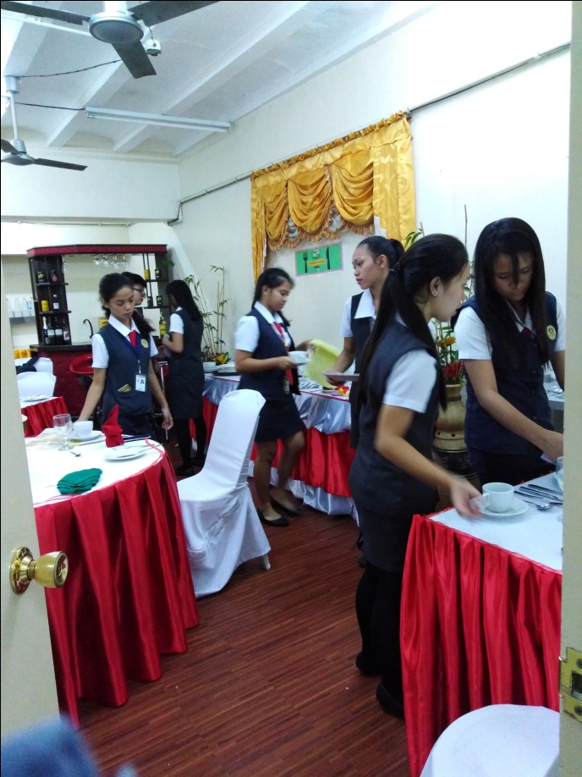
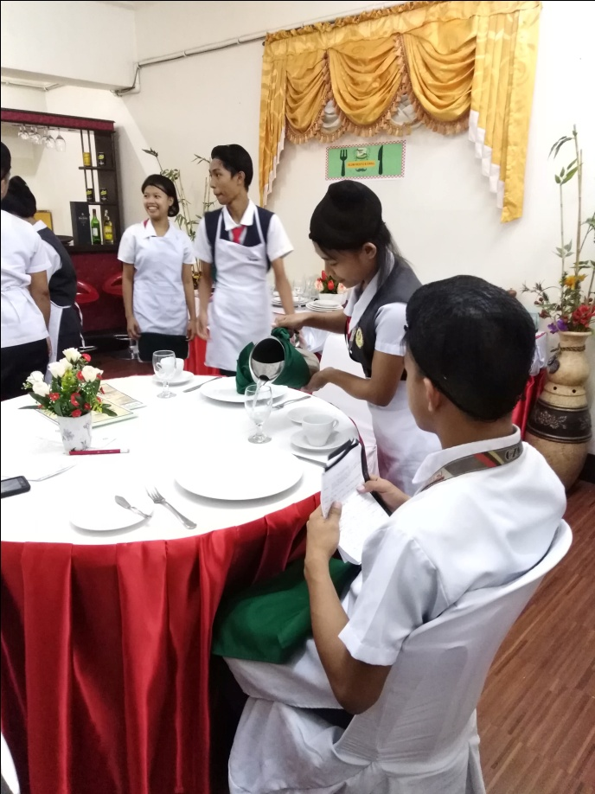
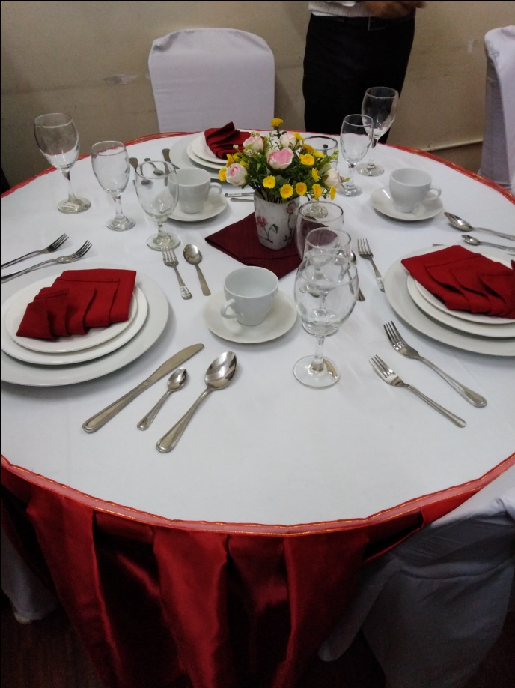
Courses Offered
2. Food and Beverage Services NC II – 356 hours

Slide 15
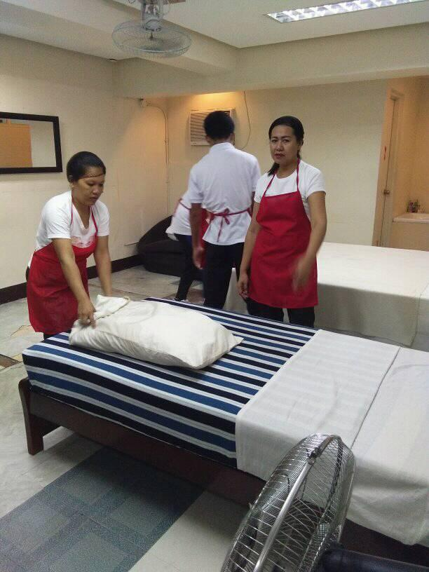
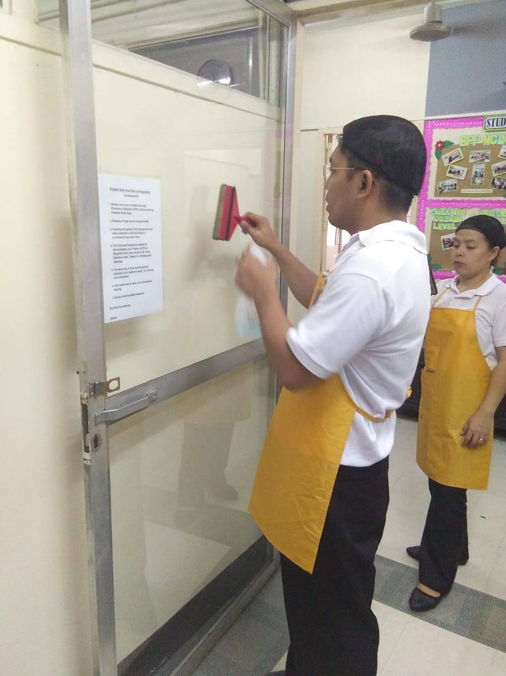
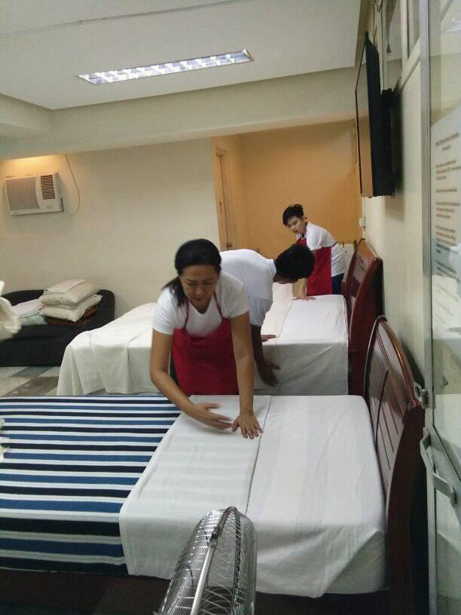
Courses Offered
3. Housekeeping NC II – 436 hours

Slide 16
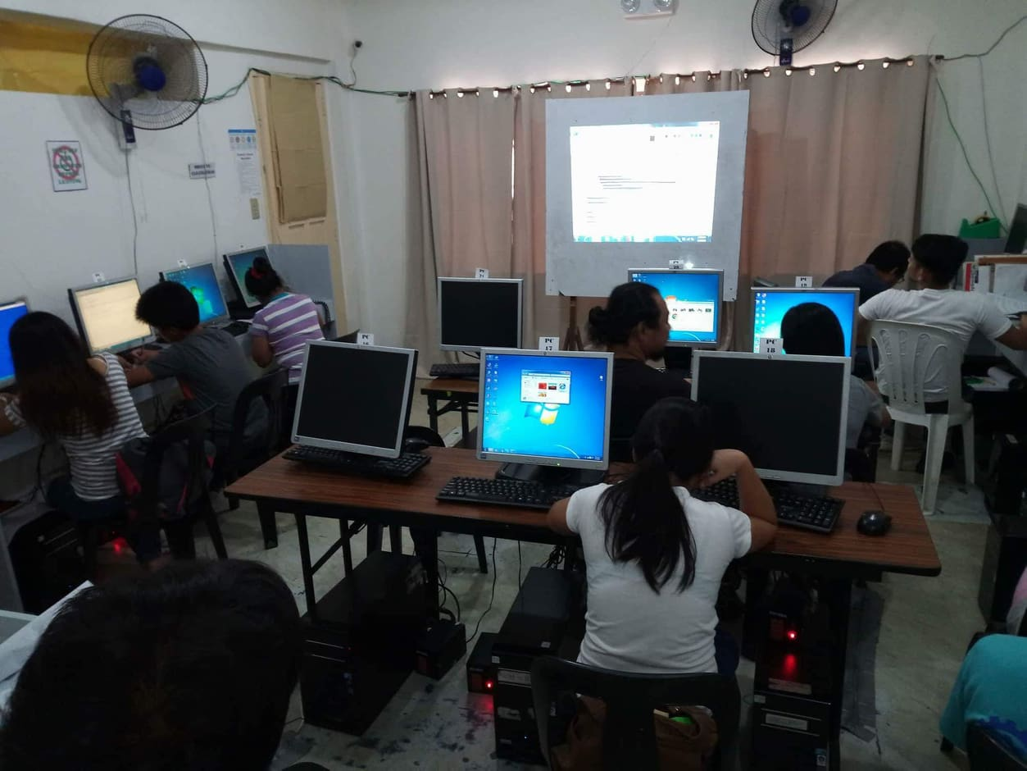
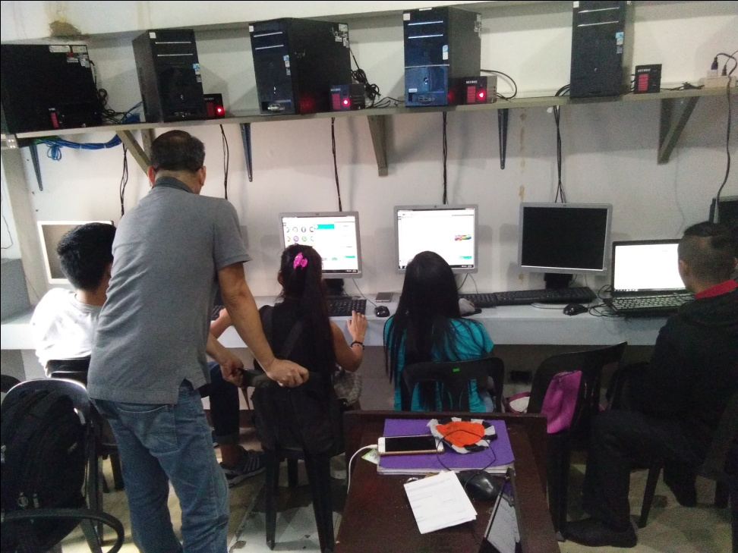
Courses Offered
4. Web Development Level II – 108 hours

Slide 17
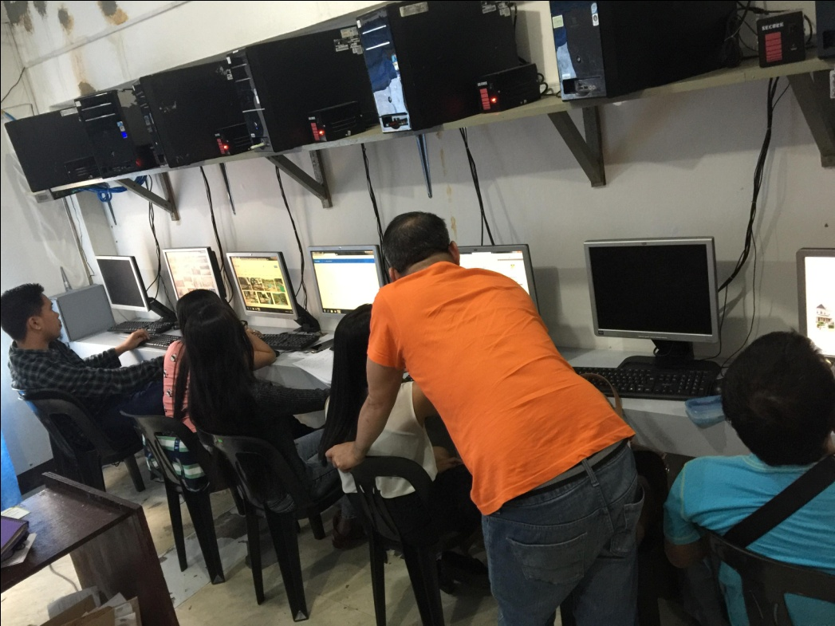
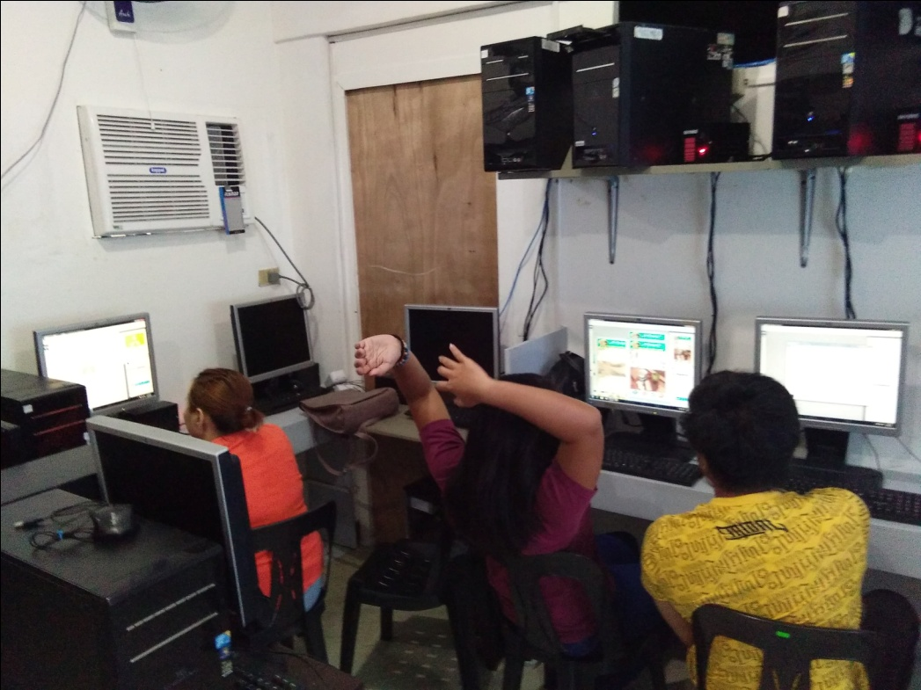
Courses Offered
5. Creative Web Design Level II – 200 hours

Slide 18
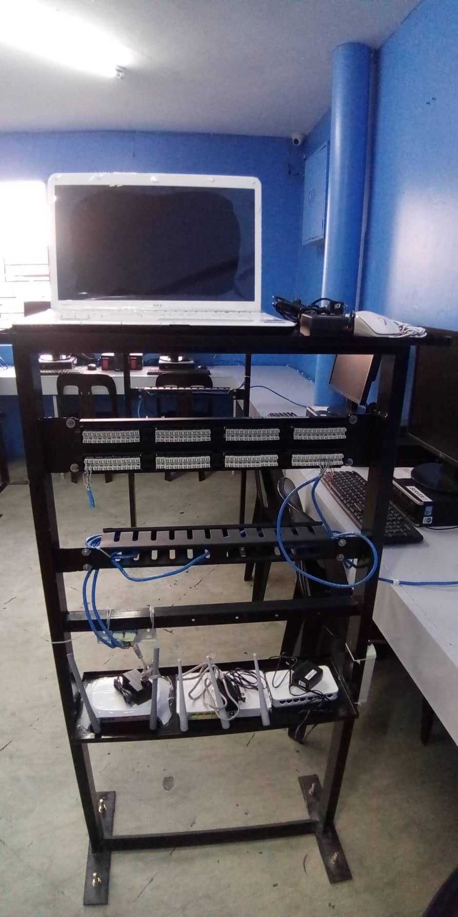
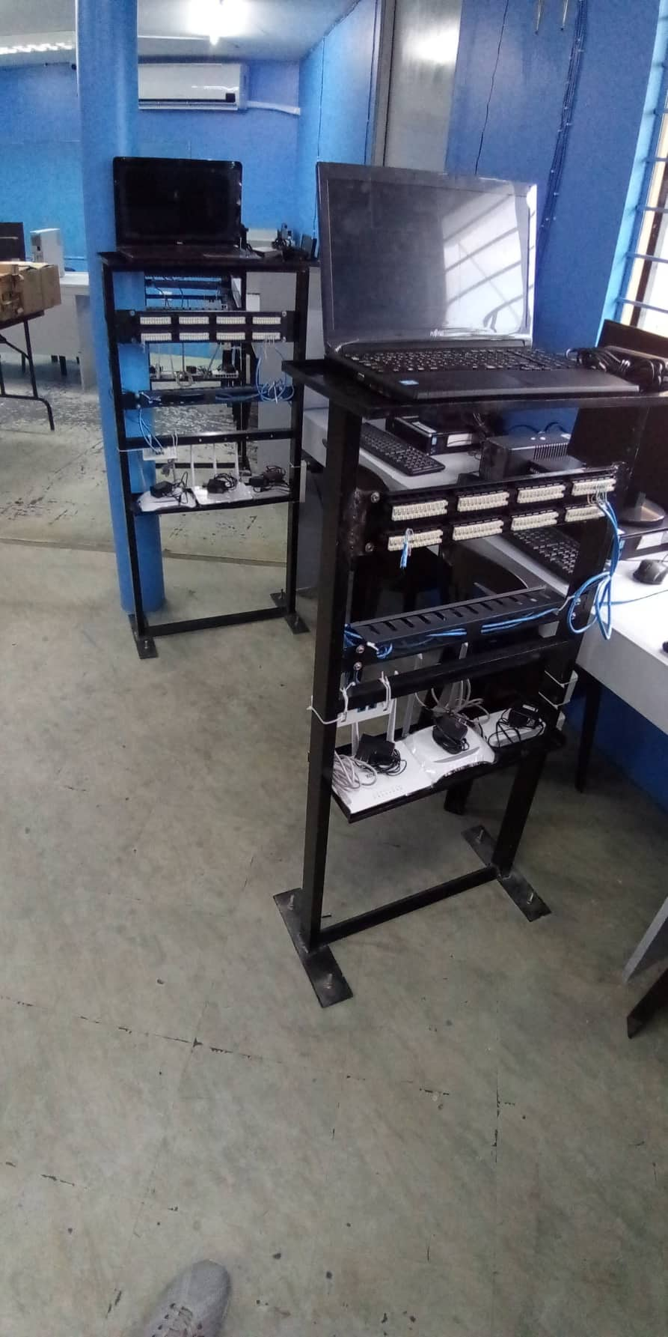
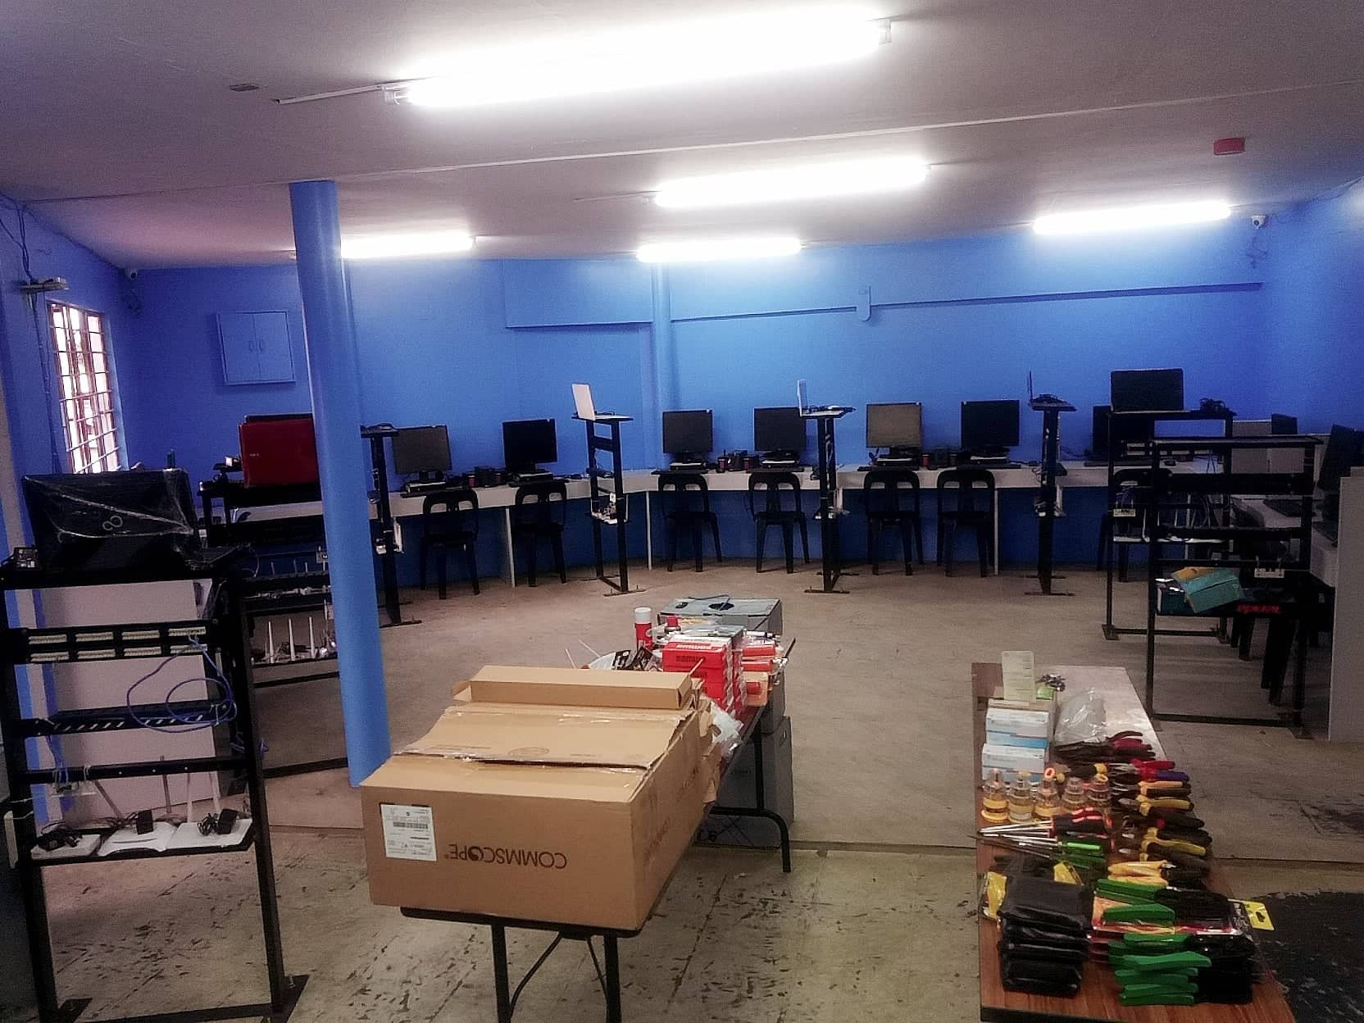
Courses Offered
6. Computer Systems Servicing NC II – 280 hours

Slide 19
Students & Rooms Regulation
Every students will accomplish the Enrollment Form.
All students must attend the Orientation.
Complete all School Requirements needed.
Trainees must finish the Training Duration, otherwise the trainee will pay for training course.
Please come on time.
Wear the required Personal Protective Equipment (PPE) when needed.
Don’t leave your belongings anywhere, the school will not be liable for lost belongings.

Slide 20
Students & Rooms Regulation
NO Bullying, Eating, Smoking & Vandalism inside the classroom.
Keep silence.
Keep your cellular phone in silent mode while classes are ongoing..
Ask permission from the person in-charge if you will get anything in the Tool Room.
Students must wait for the trainer before entering the Laboratory.
Inform your Trainer in advance if you will not come on class.

Slide 21
Students & Rooms Regulation
Always maintain cleanliness.
Throw your garbage properly.
Close the door & unplug all the electric circuit when you leave the room.
Clean As You Go.

Slide 22
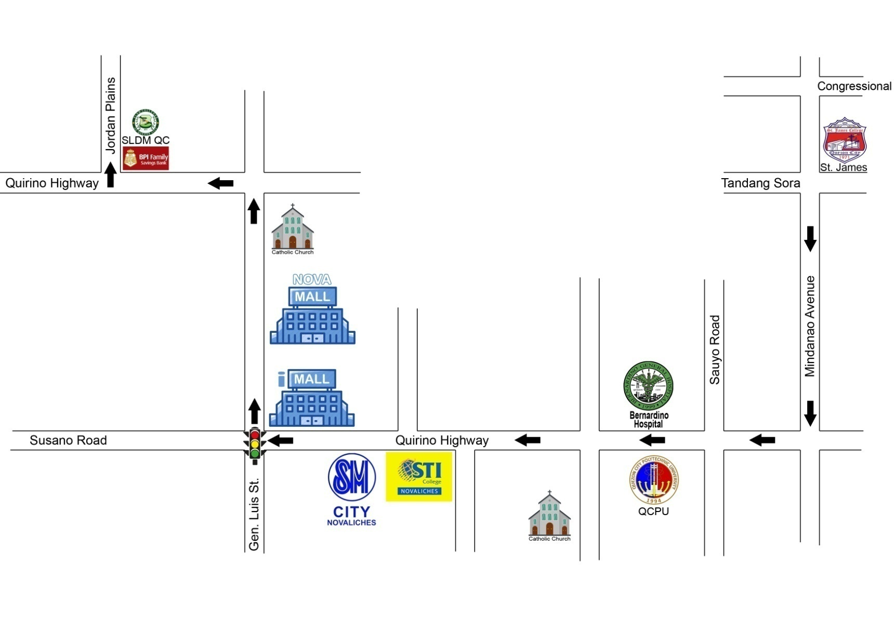
Location
B1 L1 Salvador Ave. cor. Quirino Highway, Jordan Plains, Quezon City
Tel. No.: 292-6536, 552-6398 & 370-3524

Slide 23
Thank you

