Slide 1
紫晶立方 3D打印云服务
联合创始人 张建

Slide 2
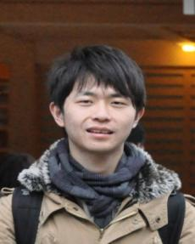
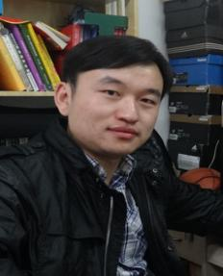
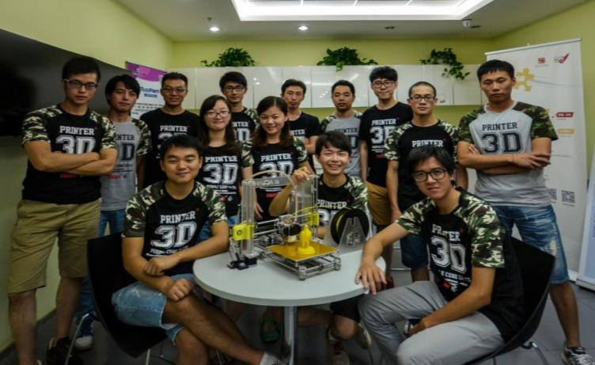
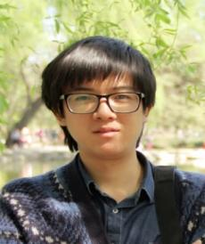
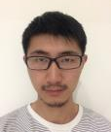
Who are we?
CEO
COO
CFO
CTO

Slide 3
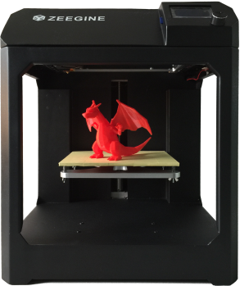
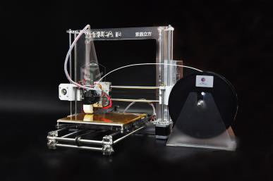
What are we doing?
1. 3D Printers
PRUSA i3
Diy a 3Dprinter
ZEExy
Faster、More stable

Slide 4

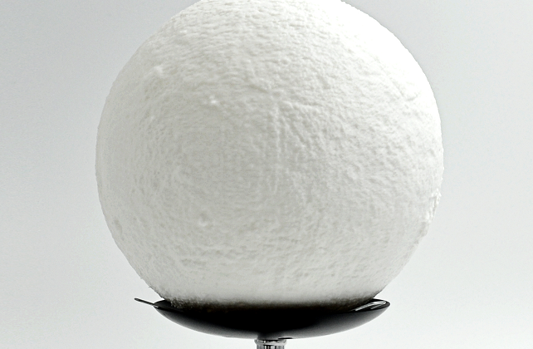
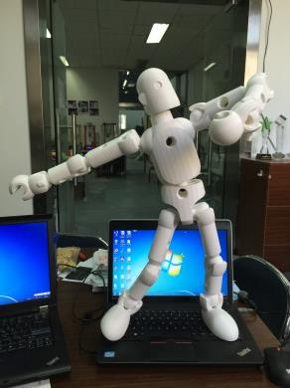
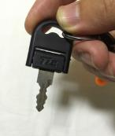
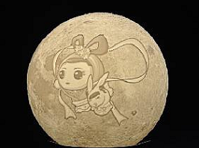
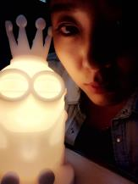
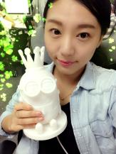
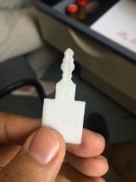
What are we doing?
2. Model Printing Service
Gift、Art ware
Component
Mould

Slide 5
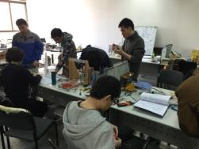
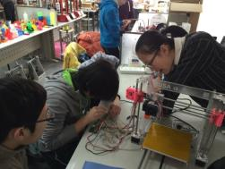
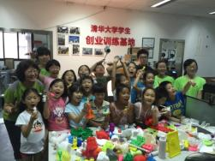
What are we doing?
3. 3D Printing Education
Adults
Youths
Children

Slide 6
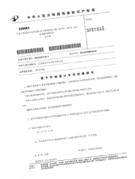
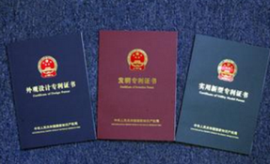
What do we have done?
1000 3D Printers sold
1500 fans gathered
20 patents、software copyrights、brands authorized

Slide 7
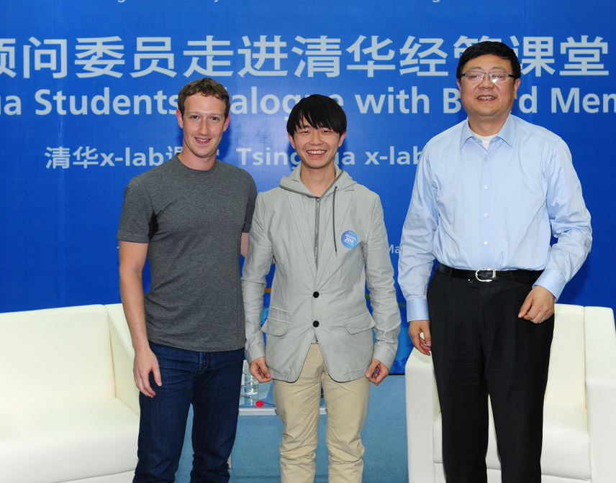
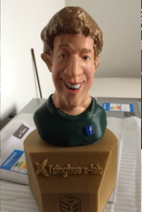
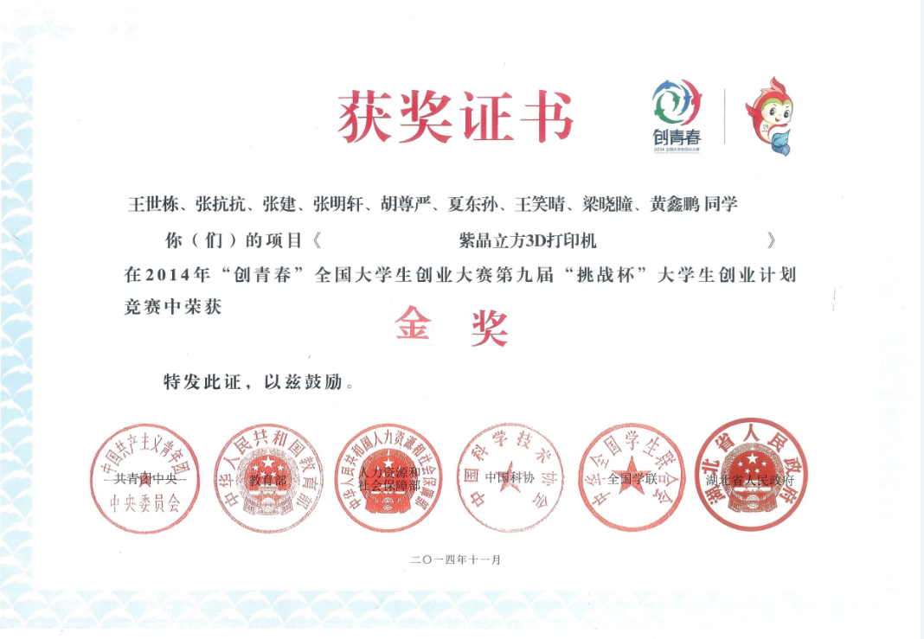
What do we have done?
Concerned by governments and social media
Gain awards at many matches
(From left)
Facebook CEO Zuckerberg
Zeegine CEO Shidong Wang
Ex-headmaster of THU Jining Chen
Gold award at business plan competition in 2014

Slide 8
Thank You For Your Listening

