Slide 1
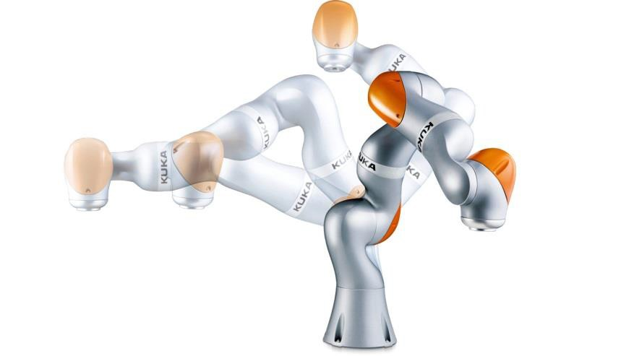
Robots in Production Systems of the Future: Industry 4.0
KUKA机器人与工业4.0
龚轶平
2015年11月29日
中国 上海
Industry 4.0 – Cooperating robots
KUKA Robotics | Steven Hua

Slide 2
KUKA公司简介
中国机器人市场的现状与机遇
KUKA公司的发展方向与社会责任
Industry 4.0 – Cooperating robots
KUKA Robotics | Steven Hua

Slide 3
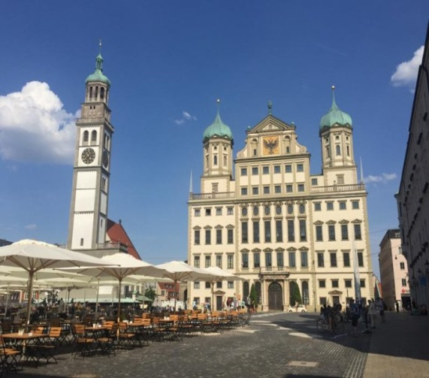
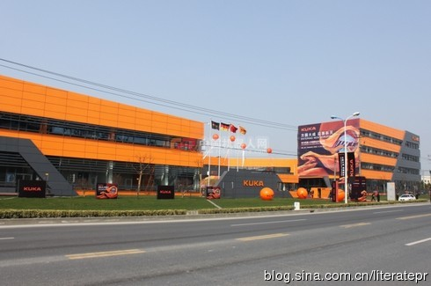
KUKA公司简介—奥格斯堡总部与上海松江工厂
KUKA集团成立于1898年，总部位于巴伐利亚州的奥格斯堡（Augsburg），是全球领先
的机器人及自化生产设备和解决方案的供应商之一。
是全球汽车工业中工业机器人领域的三家市场龙头之一，在欧洲则独占鳌头。
1973 年，KUKA研发了第一台由电机驱动的 6 轴工业机器人；1996 年，由KUKA公司
开发的首个基于 PC 机的控制系统已投放市场。
2000年在上海松江成立了库卡机器人（上海）有限公司。
年产量达到6,000台。
可以提供负载量从3千克至1,300千克的标准工业6轴机器人，机械臂工作半径从635毫米
到3,900毫米。世界唯一可以生产在120KG负重的情况下，重复精度仍达到0.03毫米机器人的
厂商。
库卡机器人、库卡机器人制造、库卡柔性系统制造、莱斯机器人、瑞仕格物流。
Industry 4.0 – Cooperating robots
KUKA Robotics | Steven Hua

Slide 4
Corporate Structure KUKA Group KUKA集团的组织架构
KUKA Robotics
KUKA 机器人
KUKA Systems
KUKA系统
Swisslog
库卡瑞仕格
Industries
工业
Systems
系统
Component 产品
Cell 机器人单元
Solution整体解决方案
Service &
Medical Robotics
服务及医疗机器人
Reis
Reis 机器人（铸造、光伏、焊接系统、电池）
Industrial Robotics
工业机器人
Technical Solutions
应用方案
Automotive
汽车
Aerospace
航空航天
Warehouse Logistics
仓储物流
Healthcare
医疗物流
Integrated software solutions and modular product platform
共享软件平台
Robotics
Expertise
机器人解决方案
Application and industry
Expertise
工业应用解决方案
Systems and process
Expertise
系统及工艺解决方案
Systems and process expertise
系统及工艺解决方案
Global market access
全球支持和协作
2015
KUKA Robotics | Steven
Industry 4.0 – Cooperating robots
KUKA Robotics | Steven Hua
SPD 2015
KUKA Robotics | Bing Kong | Seite 1
Notes:
4
4
Our Vision
We have Robotics with their components to serve the industrial robotics market and service and Medical robotics market
KUKA „Industries“ with Technical Solutions and Reis
Systems in Automotive and Aerospace (Alema)
Integrated software solutions and common product platform.
That‘s KUKA in 2020. Our strategy is being re-oriented accordingly.

Slide 5
Development of Business 业务发展
Articulated robots , China 关节型机器人，中国
+37%
+42%
+39%
CAGR
+x%
2008
2009
2010
2011
2012
2013
2014
The growth rate of KUKA robot China is far ahead of market growth
库卡机器人中国的增长率大幅领先于市场的增长
Industry 4.0 – Cooperating robots
KUKA Robotics | Steven Hua
SPD 2015
KUKA Robotics | Bing Kong | Seite 4

Slide 6
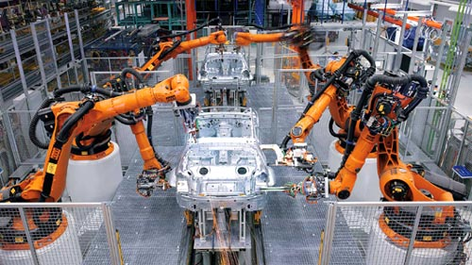
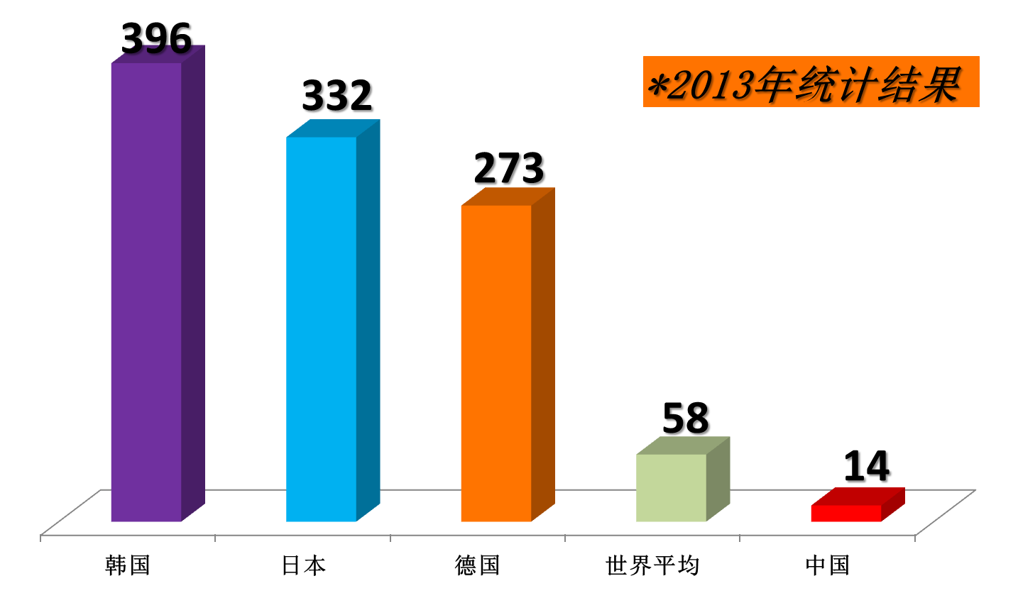
中国机器人市场的现状与机遇
2013年中国产业工人约5,000万人；
每10,000名制造业工人中,机器人的保有量约为14台；
3轴及以上工业机器人销售约36,500台；
2014年，中国一跃成为成为世界上购买机器人数量最多的国家；
2025年工业机器人预计市场销量将达到80万—100万台，以每台10万RMB计算，产值至少达800亿—1,000亿RMB。
2015
KUKA Robotics | Steven
Industry 4.0 – Cooperating robots
KUKA Robotics | Steven Hua

Slide 7
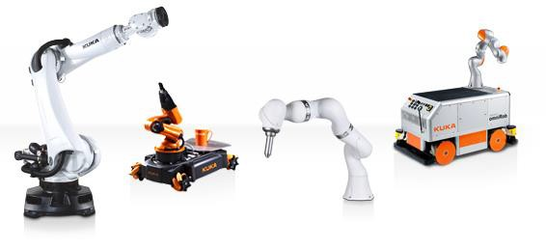
KUKA工业4.0的定义
智慧工厂
主要关注于智慧生产系统及其流程和工艺
智能生产
掌控整个企业的生产物流管理，减少对故障停产的 敏感提高效率
智能产品
实现人机互动、具有反馈功能的产品
Industry 4.0 – Definition of contents 工业4.0的定义-智慧工厂、智能生产、智能产品
2015
KUKA Robotics | Steven
Industry 4.0 – Cooperating robots
KUKA Robotics | Steven Hua

Slide 8
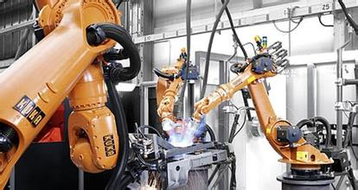
Smart factory /智能工厂
Industry 4.0 – The “black box” factory /工业4.0 –黑盒子工厂
Adaptive production organizes itself autonomously:自适应生产系统自主安排：
What to produce (product) 生产什么（产品）
How to produce (processes) 如何生产（工艺）
Where to produce (sequences) 哪里生产（工序）
Where the parts come from (logistics) 工件从哪里来（物流）
Adaptive production in the “dark factory”:真正无人化工厂里的自适应生产系统
No outside planning required (self-organizing) 无需外部提供生产计划（自主安排）
No outside configuration required (self-configuring)无需外部提供技术要求（自主定义）
No outside logistics planning required (self-sustaining)无需外部提供物流规划（自主计划）
No outside maintenance required (self-healing)无需外部提供维服务（自诊断自愈合）
2015
KUKA Robotics | Steven
Industry 4.0 – Cooperating robots
KUKA Robotics | Steven Hua

Slide 9
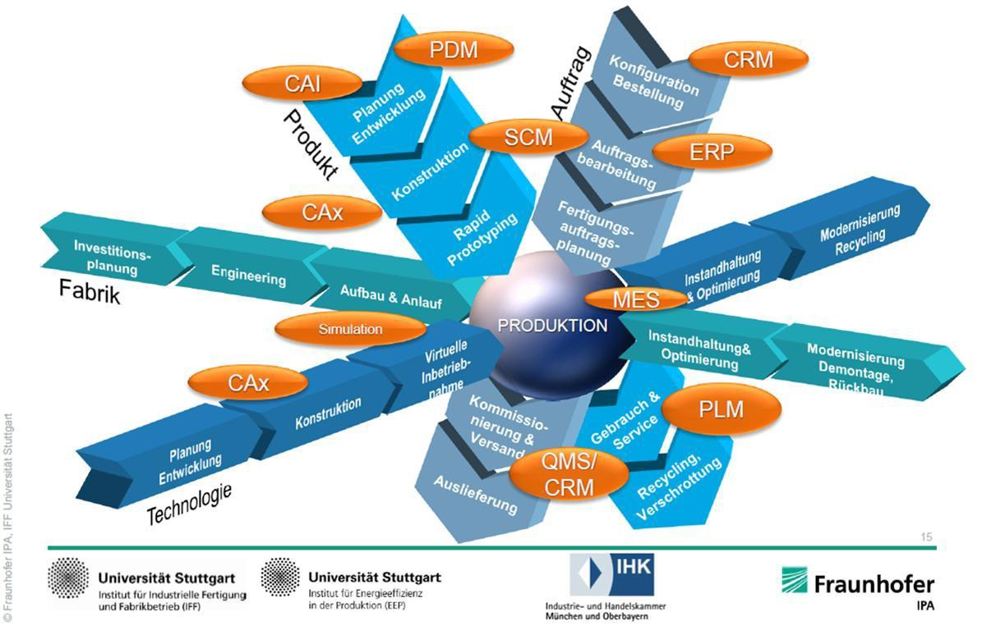
Industry 4.0 - Areas of influence in the production process / 工业4.0-影响生产过程的区域
Industry 4.0 – Cooperating robots
KUKA Robotics | Steven Hua

Slide 10
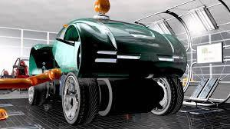
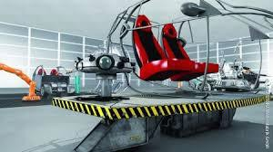
Industry 4.0 – Challenges for robot-based production /工业4.0 –挑战现有的以机器人为主的生产*
The adaptive production controlled by the intelligent product, requires solutions to the following challenges:
机器人在智能产品控制的自适应生产系统遇到以下挑战：
adaptive material flow 自适应的原材料供给
adaptive tool and gripper systems自适应的工具和抓手系统
adaptive joining processes自适应的缝隙接合工艺
adaptive intralogistics 内部物流和供给
adaptive robotics 自适应的机器人
Cooperating 相互的协调
Sensitive触觉
Safe安全
Relocatable易于重新定位
Source: Arena 2036
Industry 4.0 – Cooperating robots
KUKA Robotics | Steven Hua

Slide 11
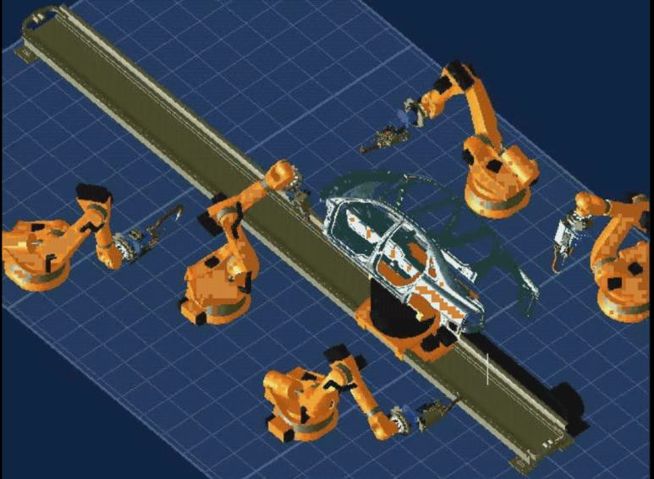
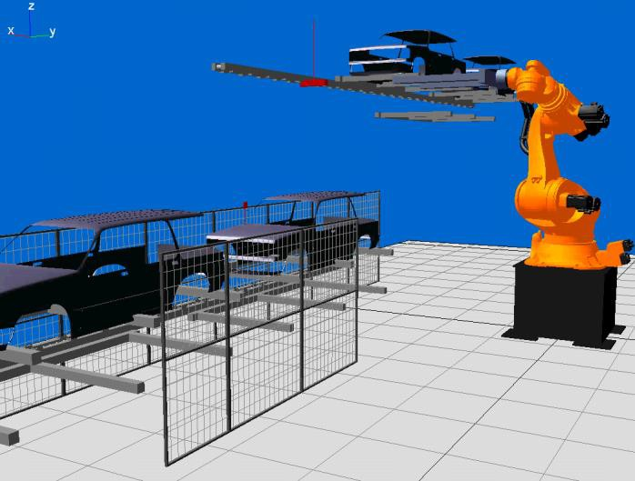
Industry 4.0 – Adaptive production flow with cooperating robots/工业4.0 自适应生产流程与协同机器人
Adaptive concepts are based on flexible production flow – dynamically adapted to the current system configuration:
自适应系统是建立在现有的柔性生产系统流程之上以适应现有的系统配置
the intelligent component transmits the required production sequences to the transfer robots
• 智能的元件输送系统必须按照输送机器人的排布进行生产
component transfer within the production system by cooperating robots产线内的元件输送需要几台机器人协同完成*
the component is processed in the flow of materials by cooperating robots几台机器人协同在原材料物流线中对工件进行加工
accessibility is ensured, as the robots cooperatively position the component确保可达性，机器人群需要对工件进行定位
lift systems are replaced by extremely flexible, extra heavy-duty robots
特别灵活的超持重机器人将取代升降系统*
Industry 4.0 – Cooperating robots
KUKA Robotics | Steven Hua

Slide 12
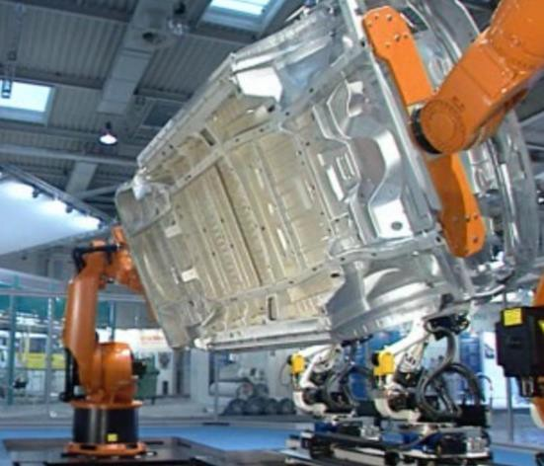
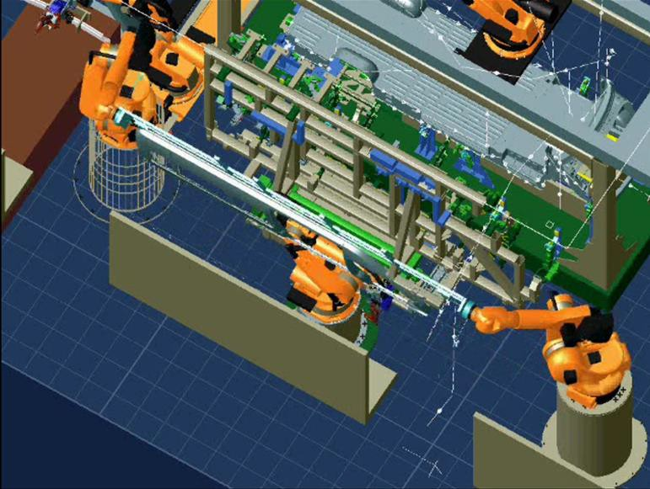
Industry 4.0 – Adaptive component handling with cooperating robots/工业4.0 –协同的机器人群共同适应工件的搬运
Adaptive concepts are based on flexible component handling – dynamically adapted to the shape and weight of the parts to be manufactured:
自适应概念是根据建立在需要加工的零件的外形尺寸之上的柔性物料运输
The intelligent component assigns a group of robots for transfer as needed
智能的物料分配系统 需要一个机器群协同工作
cooperating robots share the transfer of large and heavy components
大型工件的搬运将由几台机器人一起协同分担*
Problems of reach and accessibility are compensated by the individualized positioning of the component
独立的工件定位系统将补偿机器人的有限伸展和可达性的不足
Large components are introduced into the joining process in individualized clamping frames
超大型工件将被引入到接合工艺里面单独进行装夹加工
Industry 4.0 – Cooperating robots
KUKA Robotics | Steven Hua

Slide 13
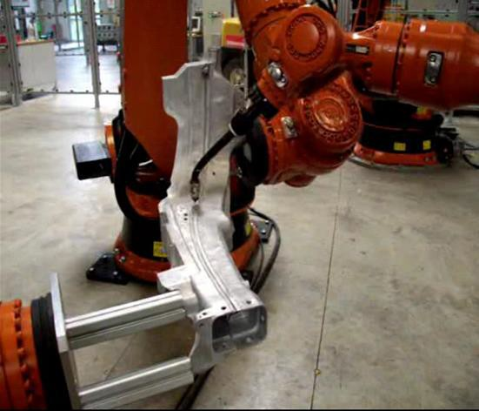
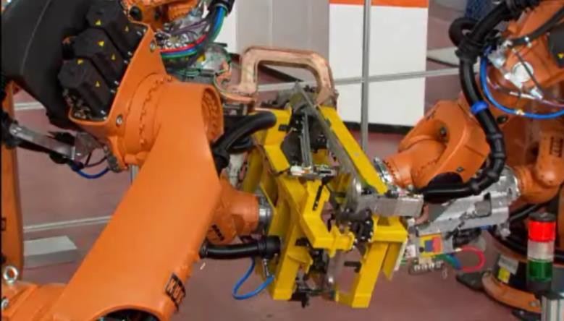
Industry 4.0 – Adaptive component location with cooperating robots 工业4.0-协同机器人工件定位
Adaptive concepts are based on flexible tool and positioning technology – dynamically adapted to the parts to be manufactured: 自适应概念建立在柔性的工具及定位工艺以适应被加工的零件*
the intelligent component communicates the required joining operations to the processing robots
• 智能的工件与接合机器人相互沟通一切信息
there is a decreasing need for clamping and positioning elements for joining components
• 可以减少接合工艺所需的昂贵的夹紧机构和定位元件*
Stationary tools and supports are replaced by flexible gripping
systems carried by robots
• 地面固定式工具和底座将被机器人及柔性抓手替代
positioning optimally adapted to the process allows for longer process times without intermediate steps
• 适应加工工艺的定位系统减少了中间的转运时间，允许更长的加工时间
unproductive transfer times are avoided
• 避免非生产转运时间
Industry 4.0 – Cooperating robots
KUKA Robotics | Steven Hua

Slide 14
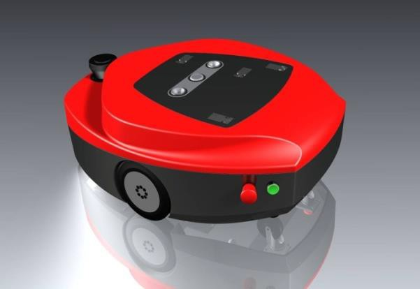
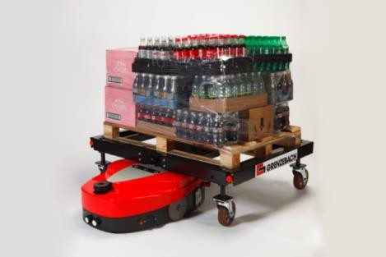
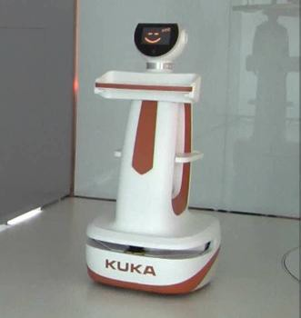
Industry 4.0 – Adaptive intralogistics with mobile logistics robots工业4.0-使用移动物流机器人以适应工厂内部物流
Adaptive concepts are based on flexible logistics – dynamically adapted to the individual production flow and the required components: 自适应概念建立在自动的柔性物流，动态地满足不同的生产流程及相应的物料供应
the intelligent component communicates information to the logistics robots about the required add-on parts, the production location and production time
• 智能的元件与转运机器人沟通所需的其他的附件以及加工位置和节拍*
the logistics and production areas are strictly separated, and mobile robots perform the transfer of components
• 物流仓储与生产单元完全分离，转运机器人负责之间的运输
mobile robots bring the add-on parts to the production area “just in time” and “just in sequence”
• 移动的机器人将所需的其他物料及时有序地运送到位*
autonomous navigation and a general fleet management ensure that everything runs smoothly
• 自动导航与管理数据库平台保证一切井井有条
vision-guided handling robots perform at the assembly location
• 视觉引导的机器人在组装工位进行组装转运*
Industry 4.0 – Cooperating robots
KUKA Robotics | Steven Hua

Slide 15
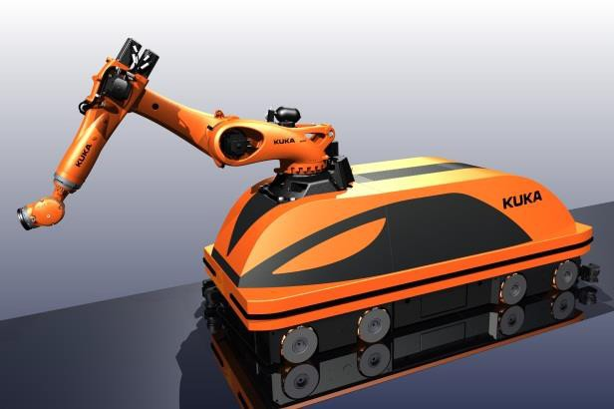
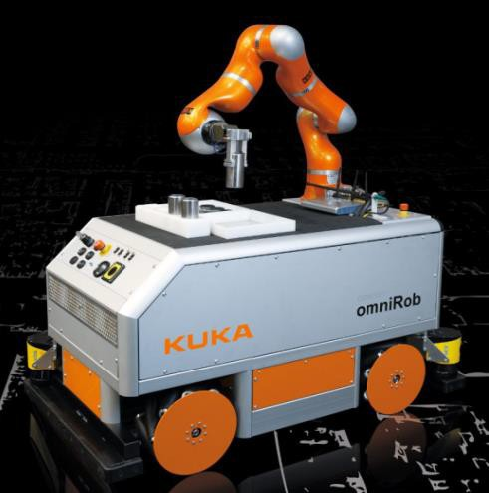
Industry 4.0 – Adaptive processes with mobile processing robots工业4.0-使用移动的机器人 进行自适应加工
Adaptive concepts are based on flexible process technology – dynamically adapted to the required joining sequences: 自适应概念建立在柔性加工技术完全适应相应的接合技术
the intelligent component communicates information to the processing robots about the required processes, joining sequences, production location and production time
• 智能的元件与转运机器人沟通所需的加工手段接合顺序以及加工位置和节拍
stationary processing robots are replaced by mobile processing robots
• 固定是机器人被移动的机器人取代*
the mobile processing robots group themselves into individual processing centers
• 移动机器人在不同的加工单元自动集合*

Slide 16
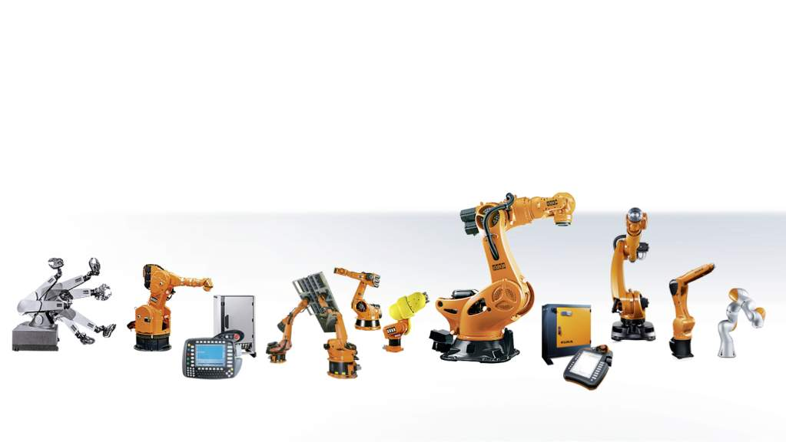
Leadership in innovation for over 40 years 超过40年的行业创新领导者
Firm product platform 坚实的产品平台
1 Robotics pioneer: In 1973, KUKA develops the world’s first industrial robot with six electric motor-driven axes, called FAMULUS.
机器人先锋：1973年库卡开发了世界第一台机电6轴工业机器人FAMULUS。
2 The present-day standard. KUKA develops the world’s first robot without parallelogram. 库卡开发了第一台突破四边形结构机器人。
3 KUKA is the world’s first robot manufacturer to introduce an open PC-based controller. 库卡开发了基于PC的机器人控制系统的机器人制造商。
4 KUKA presents the world’s first robots to cooperate intelligently with one another. 库卡开发了第一台智能合作机器人。
5 World’s first Safe Robot for safe human-machine interaction.世界上第一台安全交互机器人。
6 KUKA TITAN. World’s first robot with a payload capacity of up to 1,300 kg. 世界上第一台负载达1300公斤的机器人。
7 KR C4 – The world’s first controller with integrated
safety concept. 世界上第一台集完全集成安全理念的控制器。
8 With the KR AGILUS series, KUKA is presenting
a comprehensive small robot family. 库卡小型机器人KR Agilus系列：库卡小型机器人家族的新成员。
9 LBR iiwa. World’s first industrial lightweight robot
(sensitive robot) with integrated sensors in every axis.
LBR iiwa，库卡第一台7轴工业轻型灵敏机器人。
1
7
1
2
4
5
9
6
8
3
7
Industry 4.0 – Cooperating robots
KUKA Robotics | Steven Hua
SPD 2015
KUKA Robotics | Bing Kong | Seite 5

Slide 17
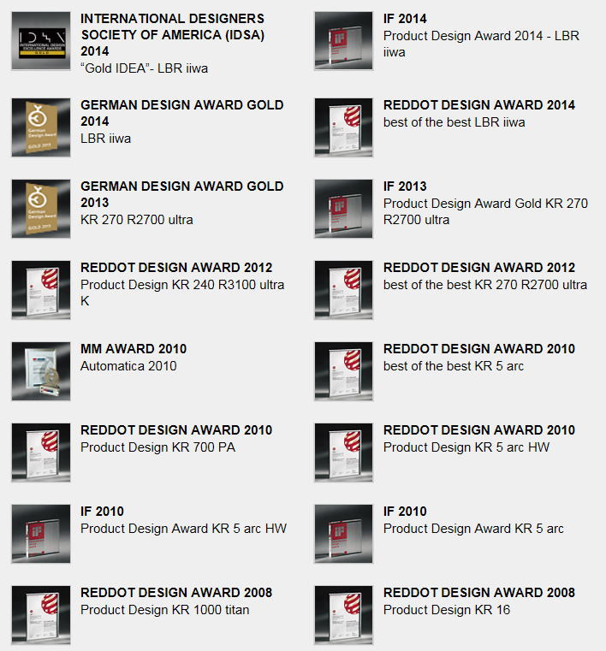
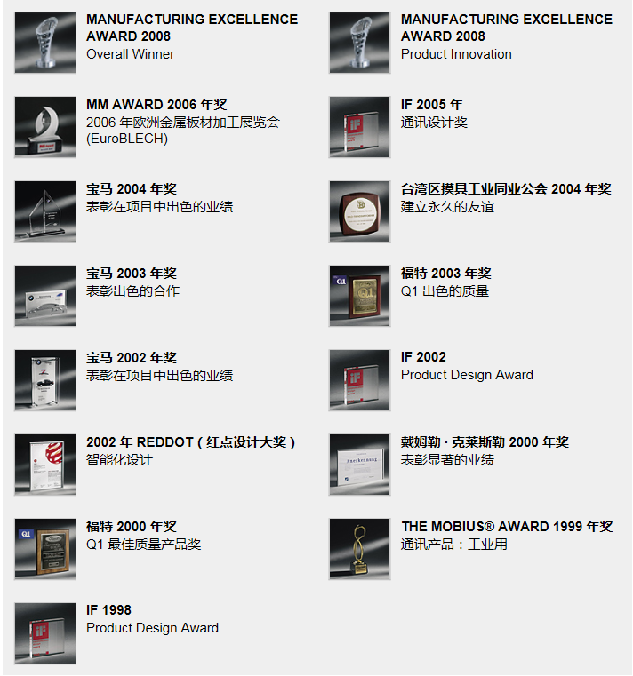
From the world's leading science and technology 智能智造源于世界领先的科技
1998年至今，包括含金量极高的“RED DOT”大奖在内，KUKA共获得31个奖项！
Industry 4.0 – Cooperating robots
KUKA Robotics | Steven Hua

Slide 18
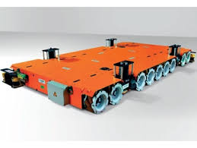
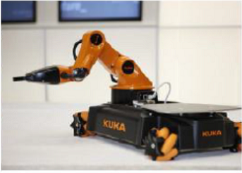
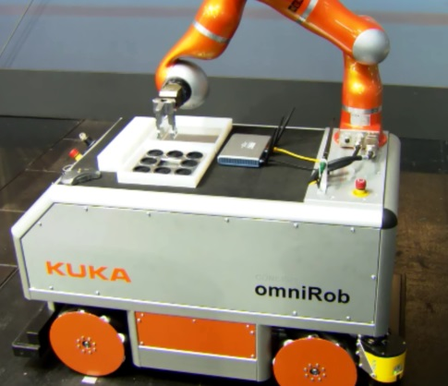
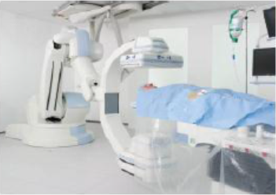
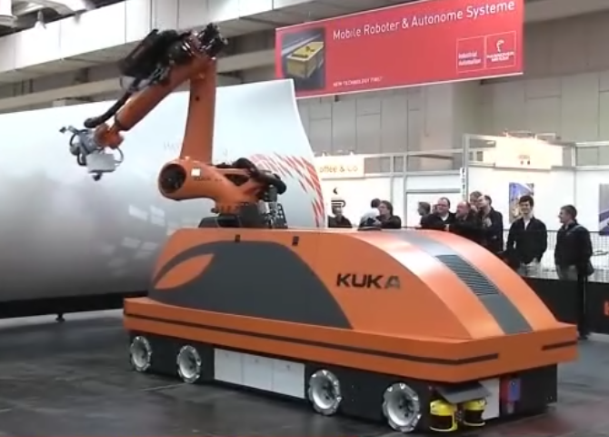
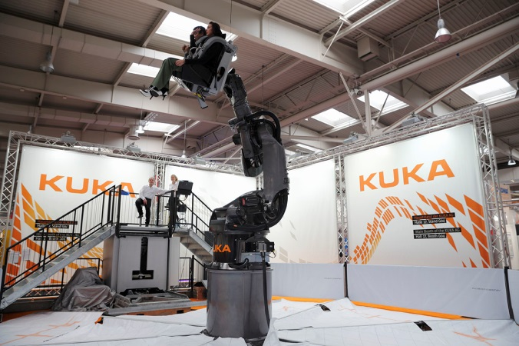
Leadership in innovation for over 40 years 超过40年的行业创新领导者
Creative product platform 创新的产品平台
Industry 4.0 – Cooperating robots
KUKA Robotics | Steven Hua
SPD 2015
KUKA Robotics | Bing Kong | Seite 6

Slide 19
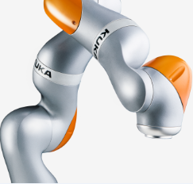
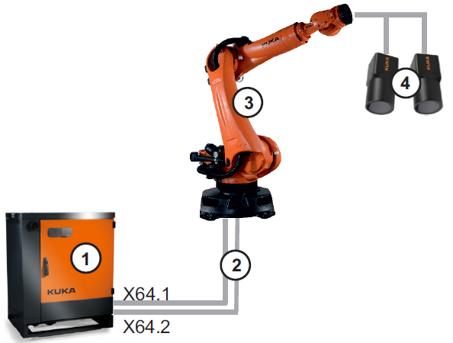
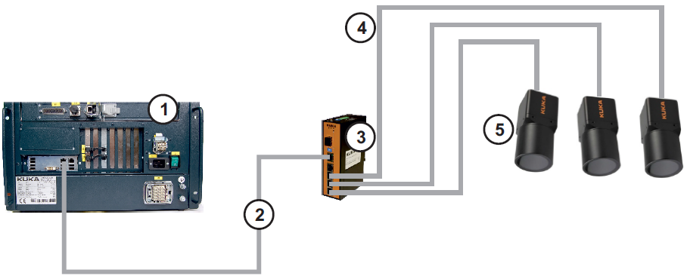
Smart Products--智能产品
•
•
Many basic functions are already provided by KUKA robots
4.0 要求的很多基本的功能库卡机器 已经具备
free cooperation between robots (RoboTeam)
• RobotTeam让机器人相互沟通没有障碍
cooperation between humans and robots (SafeHandling, LBR iiwa)
SafeHandling, LBR iiwa使得机器人与人类一同工作已经成为现实
safe robots (SafeOperation)
• 绝对安全机器人完全满足4.0
sensitive and sighted robots (VisionTech, LBR iiwa)
VisionTech, LBR iiwa保证了机器人的触觉和视觉
搭载智能相机（机器视觉系统）
实现自我识别、自我感应
Industry 4.0 – Cooperating robots
KUKA Robotics | Steven Hua

Slide 20
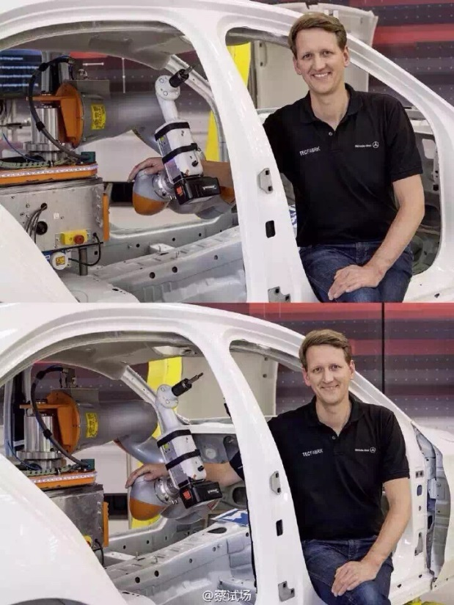
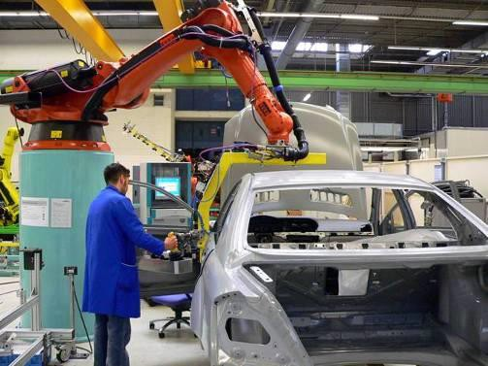
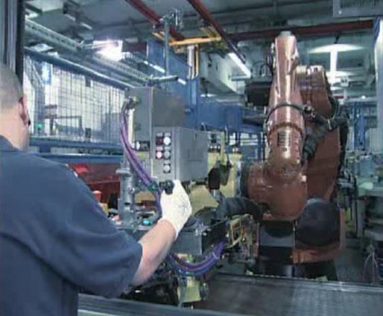
Industry 4.0 – Adaptive cooperation between human and robot工业4.0-人与机器人一起工作相互协调
Adaptive concepts are based on the flexible allocation of production tasks to worker and robot – dynamically adapted to the production steps:
自适应概念建立在柔性的人与机器人同时工作的柔性单元适应生产节奏
if production steps are semi-automated, robots must cooperate with the worker 生产节奏被自动设置后机器人将配合工人以适应生产
In this case, robots autonomously perform subtasks of production sequences in automatic mode
• 在这样的应用中机器人将自动将其他分总成自动加工完成
if manual tasks are planned in the production sequence, the robots cooperate
safely with the worker
• 如果手工操作植入到生产中，绝对安全的机器人将完全按照工人的动作加以配合协调
Industry 4.0 – Cooperating robots
KUKA Robotics | Steven Hua

Slide 21
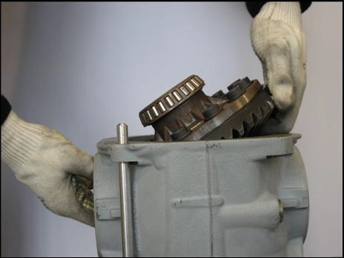
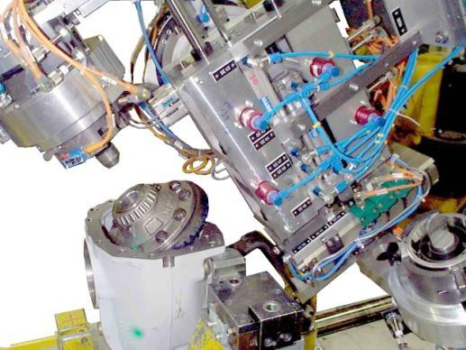
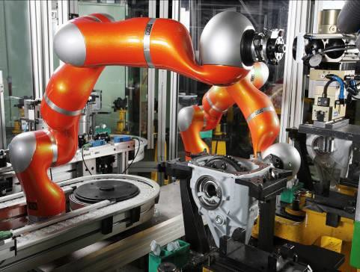
Industry 4.0 – Adaptive sensitivity for all joining application-工业4.0-所有的连接工序都将配有触觉系统
Adaptive concepts are based on individual joining steps – dynamically adapted to sensitivity and accuracy requirements:
自适应概念建立在-根据灵敏度及精度不同要求建立的每一个连接工序中
Manual joining
floating grippers and external sensors enable sensitive joining 浮动抓手在（端拾器）与外部传感器保证触觉组装与连接的精确* the gripper structure and sensors are continuously adapted to
the particular component and require extensive engineering
抓手的结构和传感器的位置要持续地适应特定元件的要求
robot-integrated force/torque sensors in all axes allow for highly sensitive assembly with the simplest gripper system
机器人每个轴都需要集成力、力矩传感器以保证使用最简单的抓具 组装最精确地产品
Inflexible automation
Sensitive automation
Source: Daimler AG (2010)

Slide 22
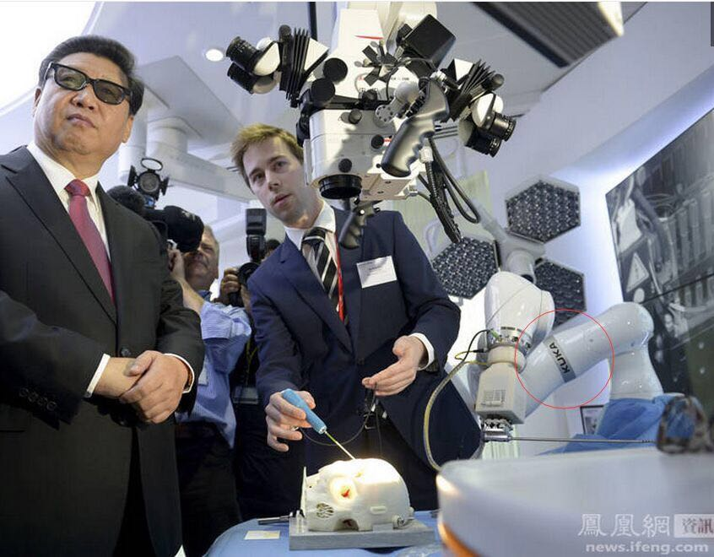
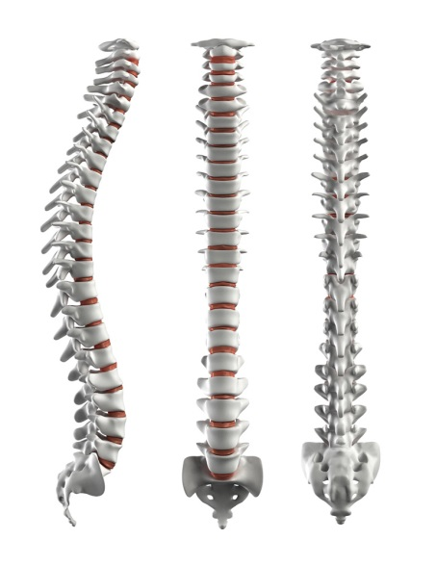
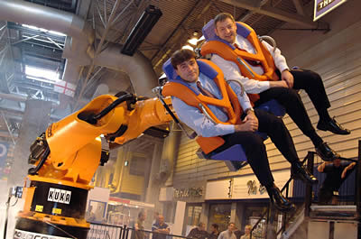
Developing Products/ Applications In An All-around Way---KUKA全面开发新产品和新应用
本月上旬，习近平主席参观英国帝国理工大学实验室。照片中清晰地显示该实验室使用KUKA公司2014年RED DOT大奖获奖产品—“iiwa” 7轴力反馈机器人，进行科研、测试。
KUKA德国总部已经开始研发用于人体脊椎手术的机器人及应用。今后将开发出更多用于复杂手术的机器人。
迪斯尼公司采用KUKA设计的4D模拟游乐机，并将出现在上海川沙迪斯尼乐园
Industry 4.0 – Cooperating robots
KUKA Robotics | Steven Hua

Slide 23

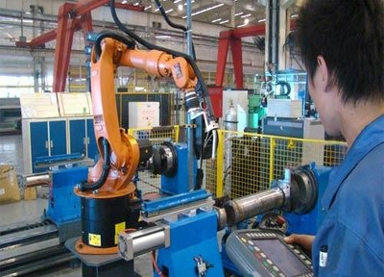
KUKA’s Social Responsibility ---University—Enterprise Cooperation KUKA的社会责任，校企合作，培养人才
今年有45所高校开设了机器人相关的专业，到2020年，预计至少有1,000所高校将会开设机器人专业。KUKA与多家知名高校开展了“校企联合”项目，在以下多方面建立合作，旨在为推进中国的机动化进程，提供更多的、优秀的专业人才。
学员的认证
培训师的认证
培训基地的认证
经相关机器人培训后，学员的就业情况
Industry 4.0 – Cooperating robots
KUKA Robotics | Steven Hua

Slide 24
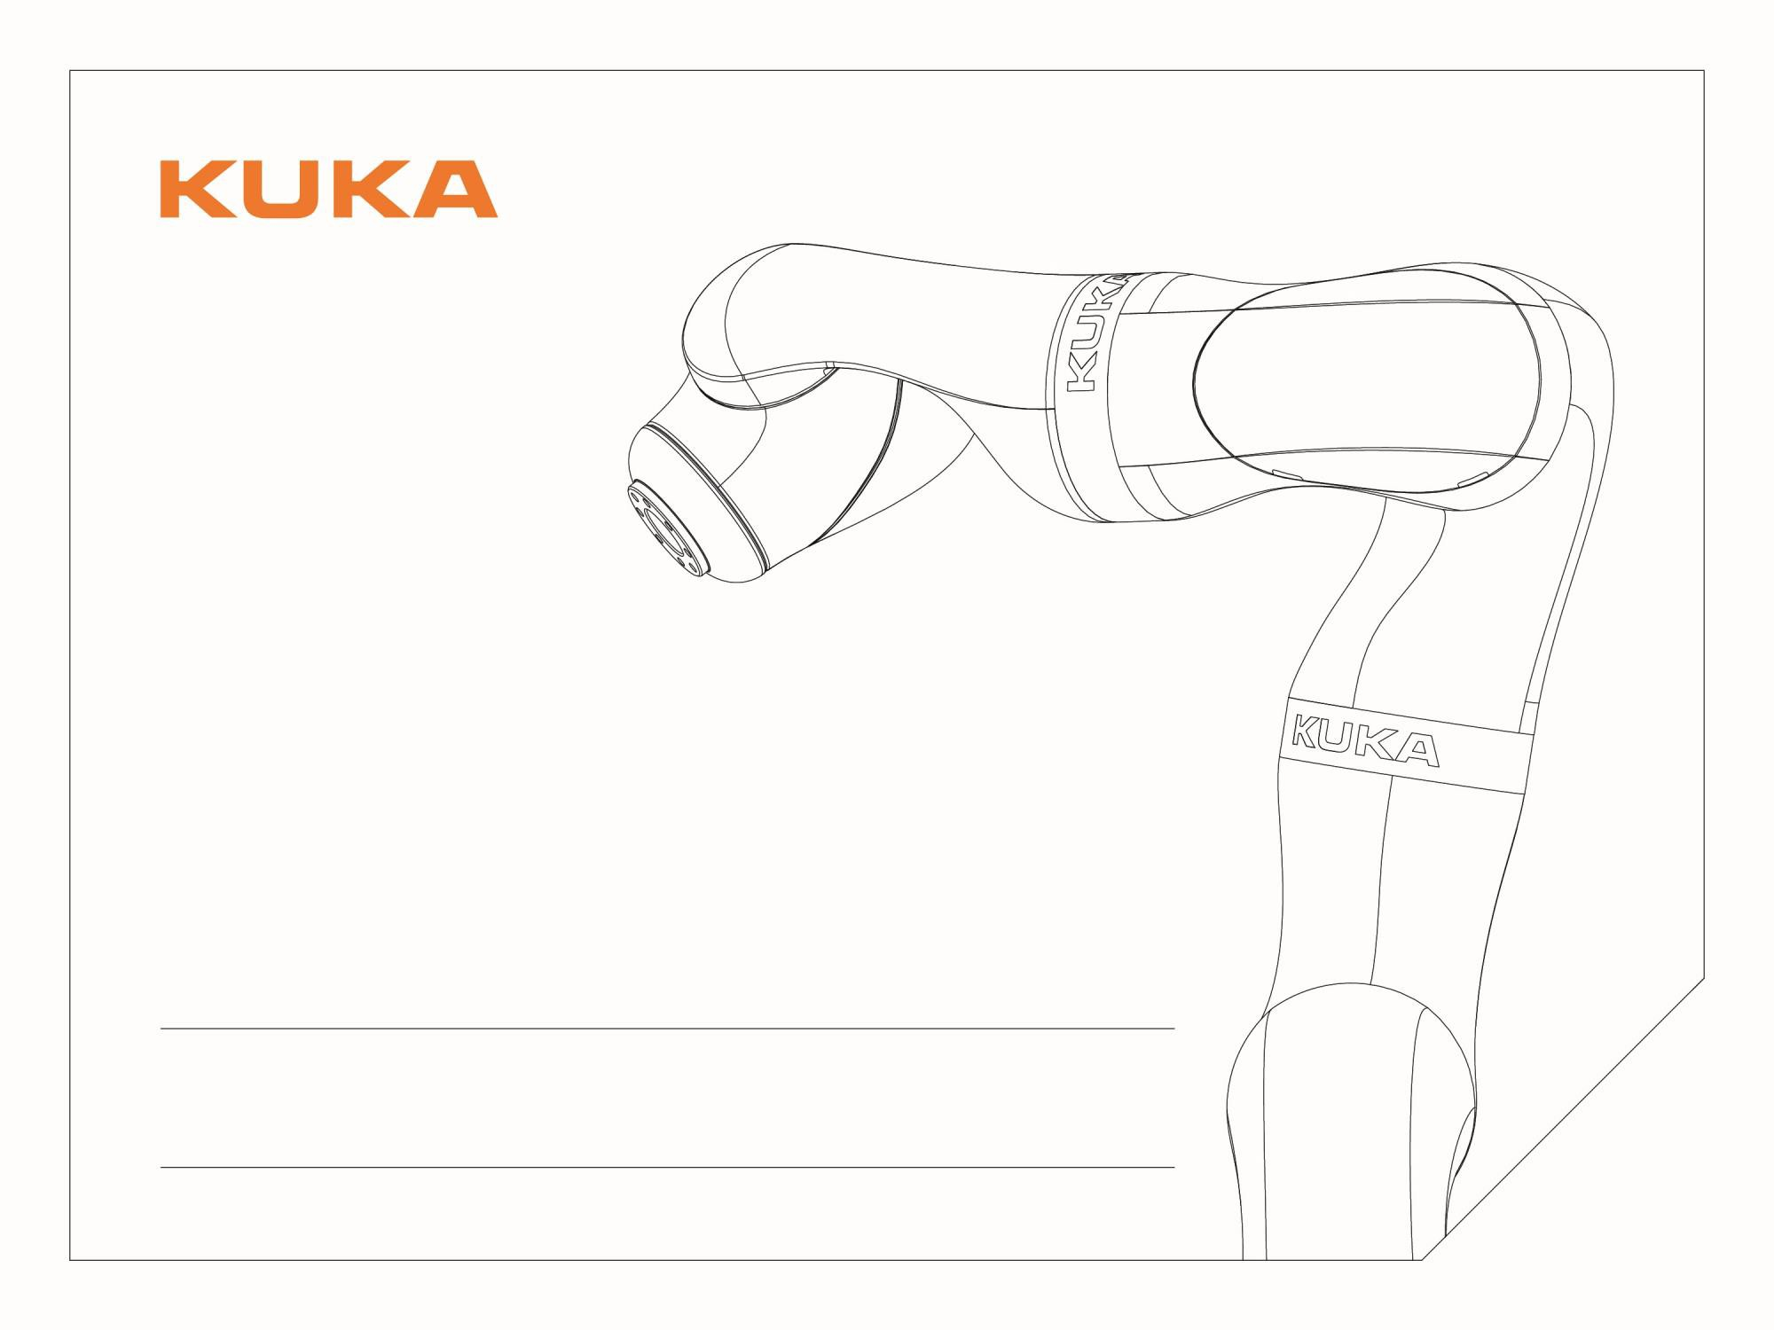


Division Electronics
KUKA Robotics | Division Electronics| 5/1/2015| Page 15 www.kuka-robotics.com
Thank you !

