Slide 1
Codebasics Digital Asset Assistant
Find any asset by meaning — not by filename.
▶ Try the live app: https://codebasicsaipm-capstonedigitalassistant.streamlit.app/
AI PM Capstone 2 | Ushasree Jakilinki

Slide 2

The Problem: Teams Drown in Their Own Content
15+ minutes per search — and it often fails.
20 TB, deeply nested, 10 years old — no catalog of what exists.
Search matches filenames only — “ML” never finds “Machine Learning.”
So teams give up and recreate — duplicated decks, thumbnails, videos.
2,500 searches every day across the team

Slide 3
Discovery: Finding the Real Root Cause
We ran a 5-Whys from the surface complaint down to the true cause.
1
Why does search take 15+ min? It scans a huge, nested drive and matches only filenames.
2
Why does filename search fail? A filename doesn't say what's inside the file.
3
Why is nothing searchable by content? No one ever recorded what each asset is about.
4
Why was that never built? There is no catalog — assets piled up for 10 years.
ROOT CAUSE: Codebasics has no record of what its assets contain, so no one can find work by meaning — and teams recreate what already exists.

Slide 4
The Opportunity We Chose: Semantic Search
Where AI genuinely helps: understand meaning and read inside files — not match characters.
What it DOES (v1)
What it does NOT do
✓ Search decks, PDFs, images by meaning
✕ Edit or generate assets (search only)
✓ Search inside YouTube videos (transcripts)
✕ Index unsupported types (.zip, etc.)
✓ Return the file + location + slide/page
✕ Send content to the cloud (stays local)
✓ Rank by relevance, then recency (newest wins)
✕ Manage permissions (assumed open in v1)
✓ Run locally — free and private
✕ Support non-English content

Slide 5
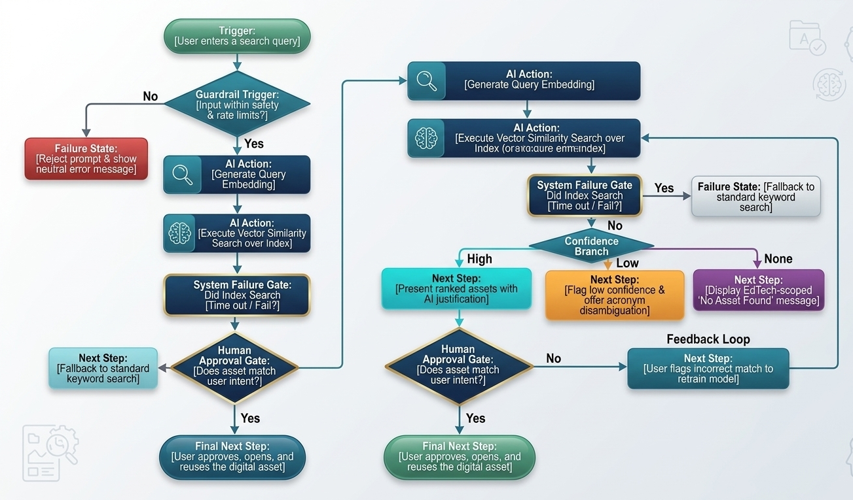
The Solution: Search by Meaning, Locally
Read text inside files & videos
→
Turn into embeddings (local)
→
Store in an on-device index
→
Search + rank + deliver the file
Heavy indexing runs once, offline. Searching is fast and fully local.

Slide 6
It Works: One Search, the Right Asset
Search: power bi thumbnail
what_is_power_bi_thumbnail.png · image
match 0.90
Location: …\Thumbnails_and_Images\what_is_power_bi_thumbnail.png
Delivery: full path + one-click Download (for decks/PDFs: the exact slide/page)
Why it matched: “what is power bi thumbnail”
Also handled live: “machine learning” finds the right decks · searching INSIDE a video by what's said · “biryani” returns a polite “EdTech only” message — never a fake result.
Full live walkthrough in the demo video.

Slide 7
Success Metrics
NORTH STAR
Asset Reuse Rate ≥ 60%
% of searches where someone reuses an existing asset instead of recreating it.
≥ 90%
≤ 2 sec
0
Right asset in top 3 (trust)
Search response (warm, P95)
Fabricated results (guardrail)

Slide 8
Risks & Guardrails
RISK
GUARDRAIL
Hallucination (fake asset)
Retrieval-only — can only return assets that exist.
Privacy (proprietary IP)
Runs locally — content never leaves the machine.
Outdated / wrong match
Show why it matched + rank newest first.
Off-topic / bad input
Below-threshold → “EdTech only”; English-only; rate limit.
Wrong file types
Allowlist — ignore .zip, video files, etc.

Slide 9
Built to Run at $0 — and to Earn Trust
Open-source + local — no per-token cost, no vendor, full privacy.
Cost shaped the design — search, not generation, saves ~$27/mo vs an LLM.
Grounded & safe by design — it only ever returns real assets, and shows why.
Stop searching. Stop recreating. Start reusing.

