Slide 1
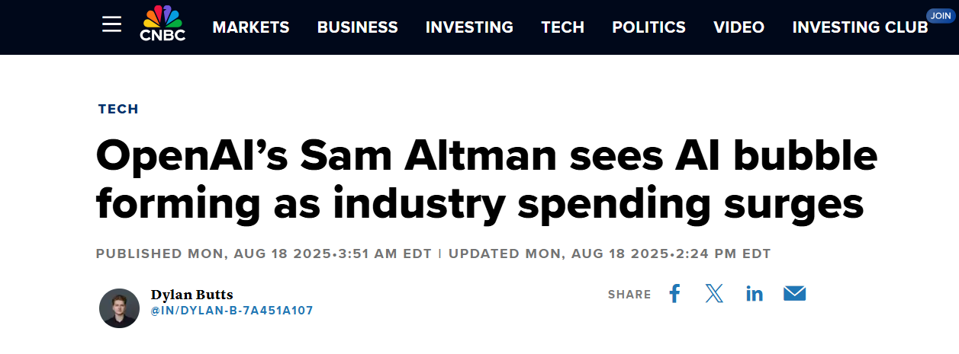
Notes:
https://www.cnbc.com/2025/08/18/openai-sam-altman-warns-ai-market-is-in-a-bubble.html

Slide 2
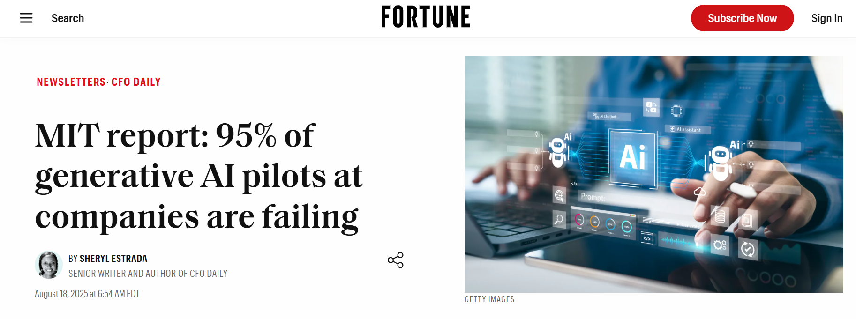
Notes:
https://fortune.com/2025/08/18/mit-report-95-percent-generative-ai-pilots-at-companies-failing-cfo/

Slide 3
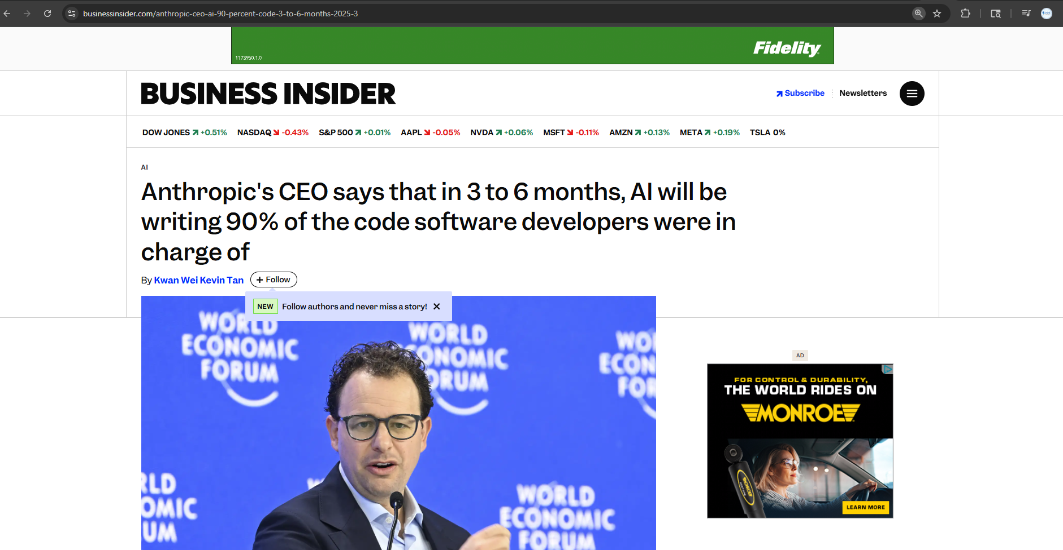
Notes:
https://www.businessinsider.com/anthropic-ceo-ai-90-percent-code-3-to-6-months-2025-3

Slide 4
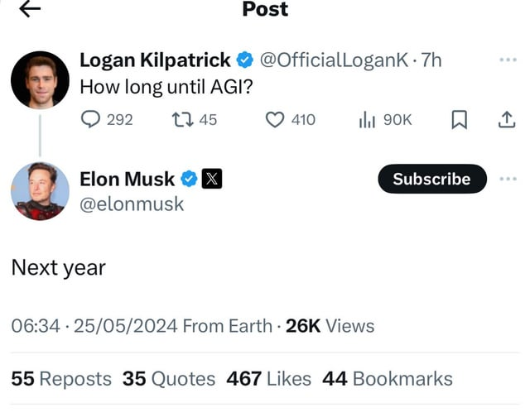

Slide 5
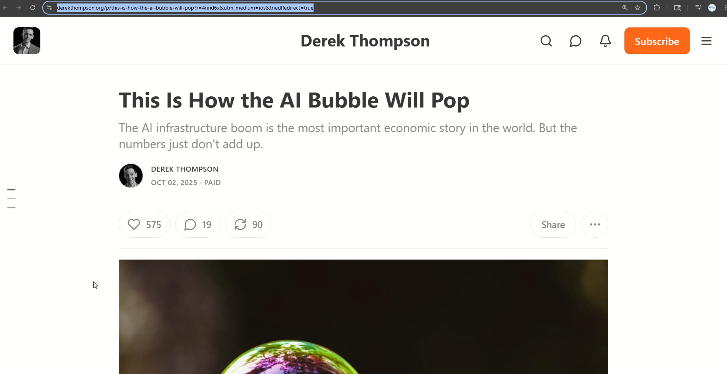
Notes:
https://www.derekthompson.org/p/this-is-how-the-ai-bubble-will-pop?r=4nnd6x&utm_medium=ios&triedRedirect=true

Slide 8
Title 1
Title 2
Font:
Body Text
Saira
Kanit
Color code:
#D6EF3F
#33CC33
#33CC33
#404C78

