Slide 1
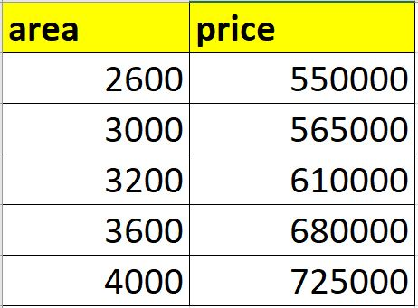
Home prices in Monroe Twp, NJ (USA)
Given these home prices find out prices of homes whose area is,
3300 square feet
5000 square feet

Slide 2
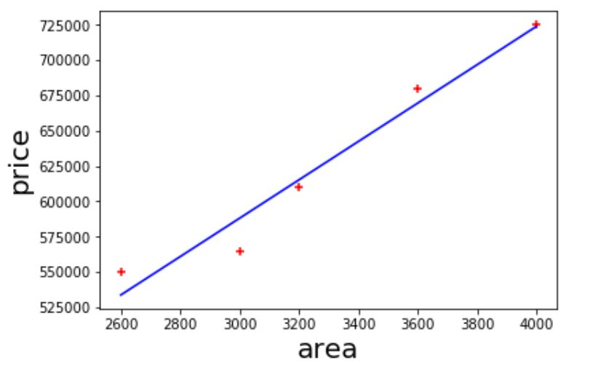

Slide 3
628715
3300

Slide 5
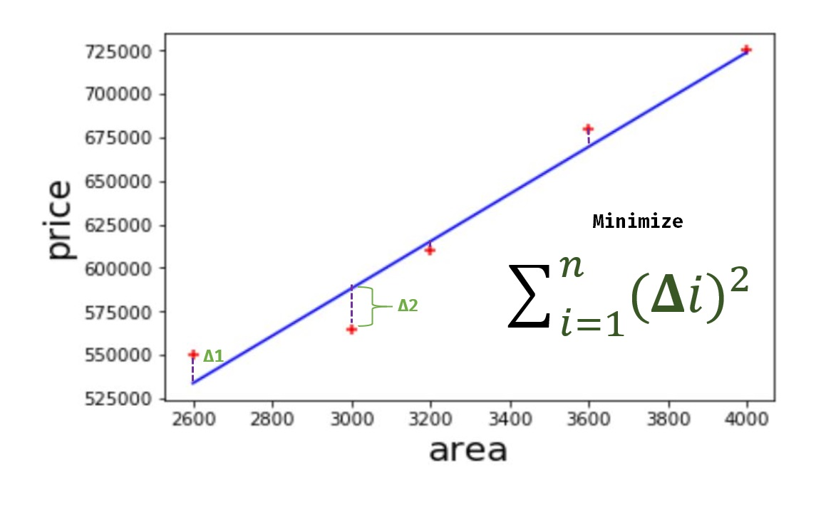

Slide 6
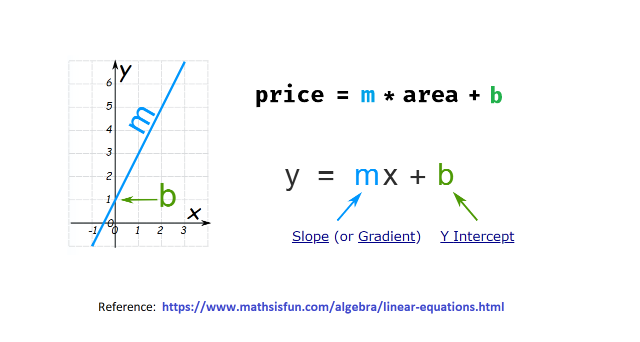

Slide 7

Dependent variable
Independent variable

