Slide 1
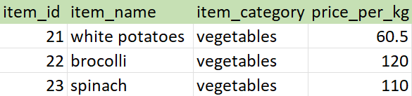
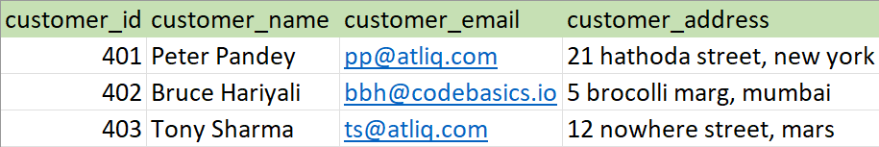
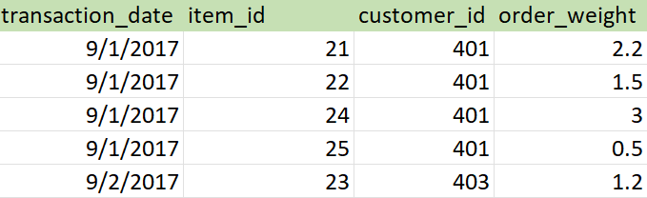
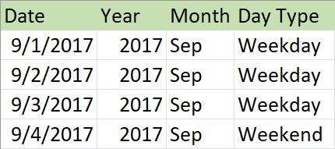

Slide 2
Date
Date
Year
Day Type
Customers
Region
Customer ID
Name
Email
Address
Region ID
Region Name
Code
Sales
Item ID
Customer Id
Date
Order Weight
Product
Platform
Item Id
Item Category
Unit Price
Platform ID
Name
Code

Slide 3
Dimension
Star Schema
Dimension
Dimension
Fact
Dimension
Dimension

Slide 4
Address
Date
Snowflake Schema
Address Id
Street
Zip Code
Date
Quarter
Fiscal Year
Customers
Region
Customer ID
Name
Address ID
Channel ID
Region ID
Region Name
Code
Sales
Channel
Customer ID
Product Id
Date
Sold Quantity
Channel ID
Name
Product
Platform
Product Id
Product Name
Unit Price
Platform ID
Name
Code

Slide 5
