Slide 1
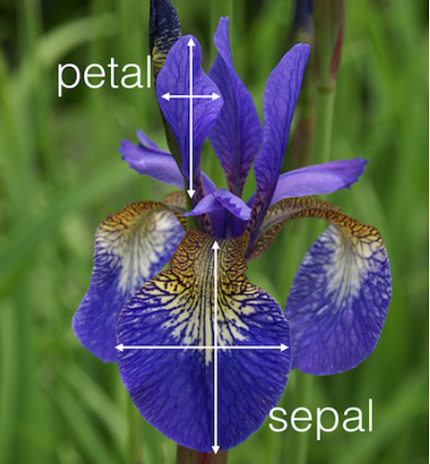

Slide 2
Setosa
Versicolor
Petal
Length
Petal Width

Slide 4
Support Vectors
Margin

Slide 5
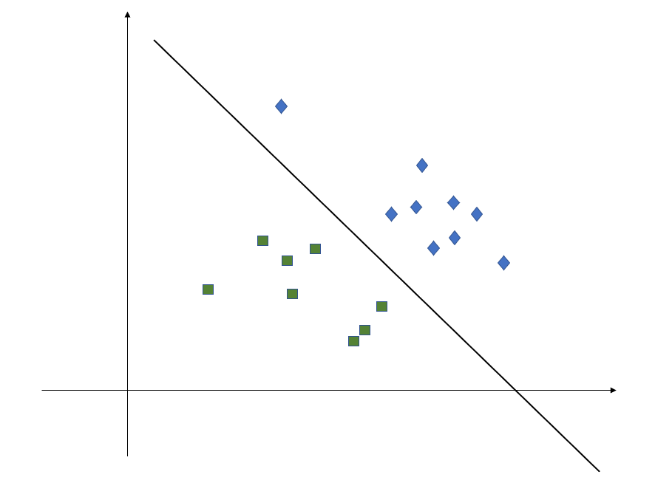
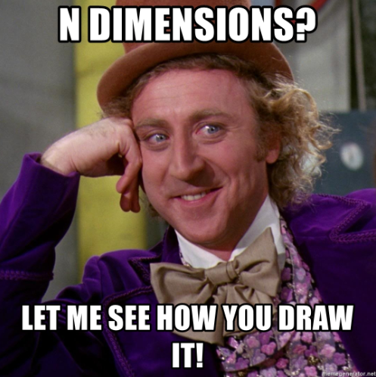
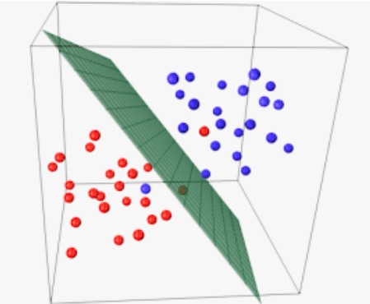
2D
3D
nD
Image Credit: https://appliedmachinelearning.blog

Slide 6
Support vector machine draws a hyper plane in n dimensional space such that it maximizes margin between classification groups

Slide 7
Gamma & Regularization

Slide 8
High Gamma
Low Gamma

Slide 9
High Regularization (C)
Low Regularization (C)

Slide 10
x
y

Slide 11

x
z
${z = x}^{2}+y^{2}$
This transformation
is called kernel

Slide 12
x
y

