Slide 1
What is machine learning?

Slide 2
284029834098 * 845609845960

Slide 3


Slide 4
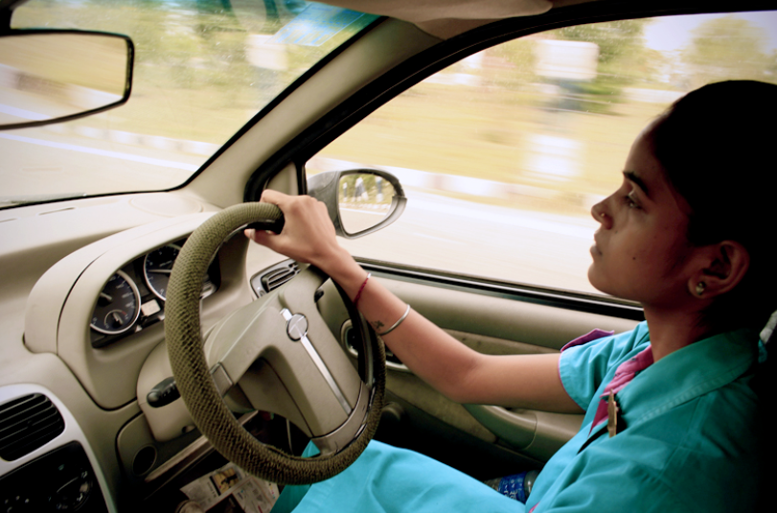

Slide 5
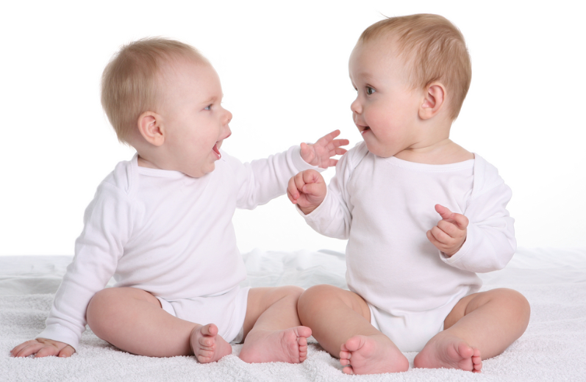

Slide 6
Machine learning is set of techniques to make computers better at doing things that humans (traditionally) can do better then machines

Slide 7
Machine learning involves making machines learn things like humans do

Slide 8
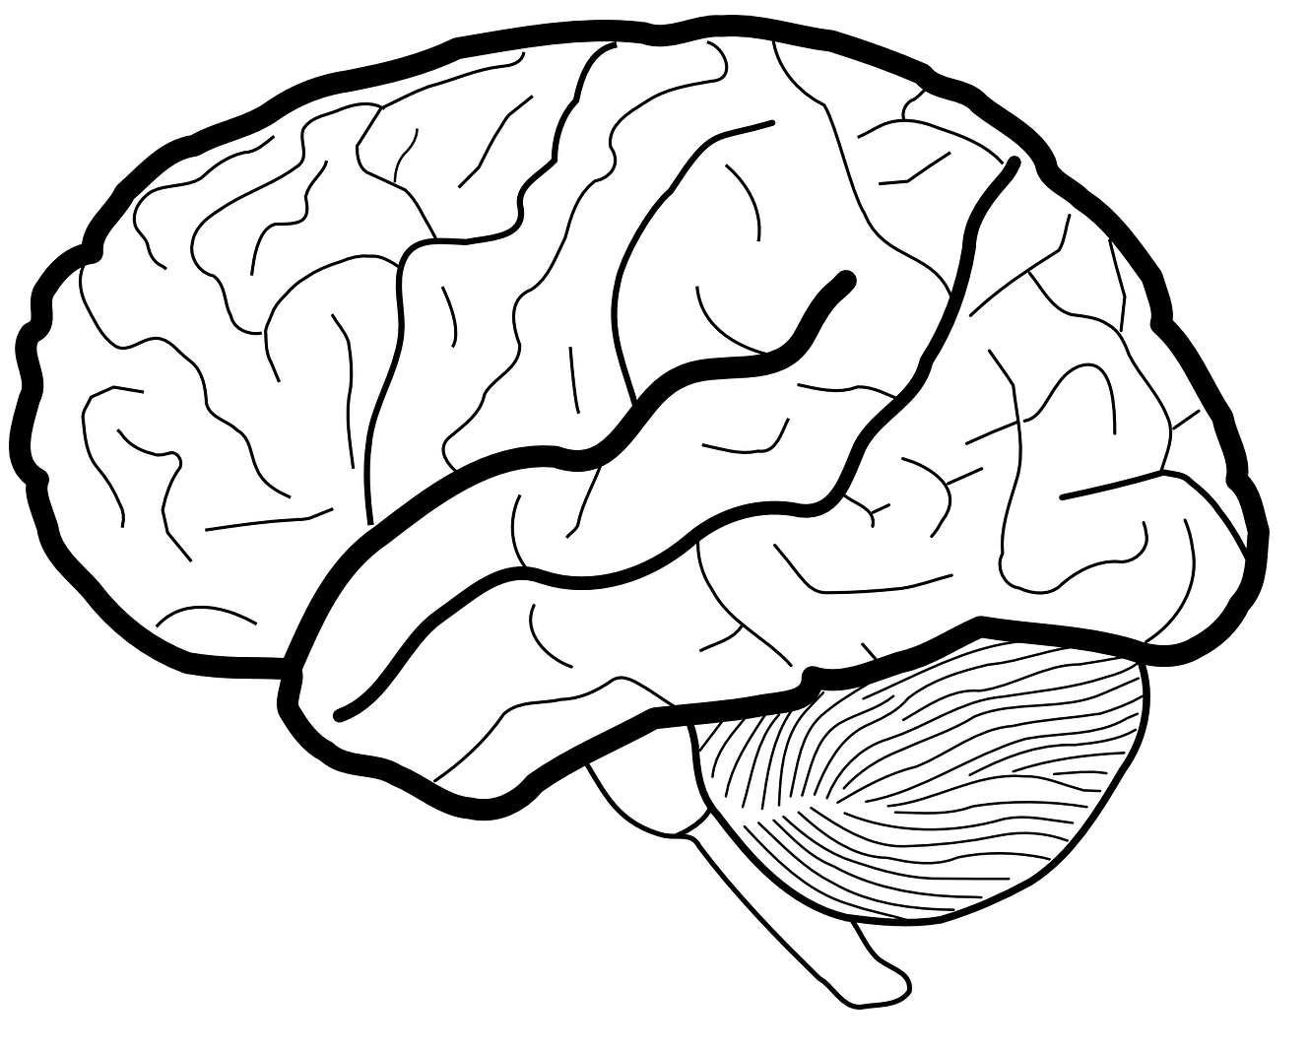
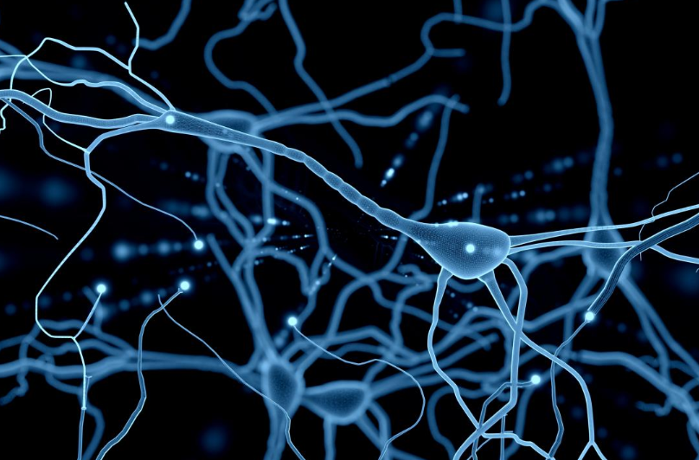
Neurons

Slide 9
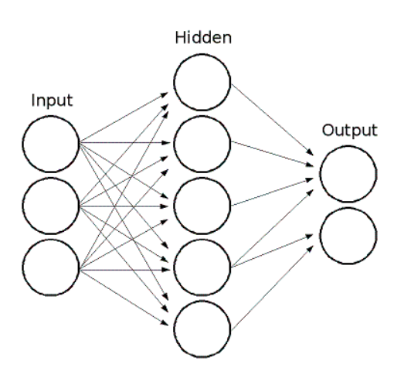

Slide 10
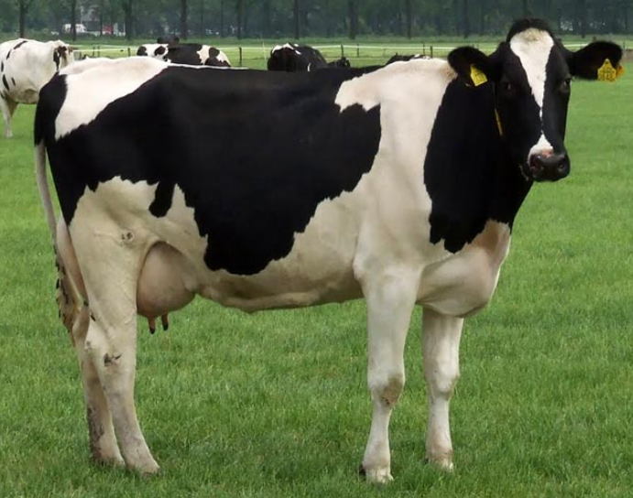
Cow
Car

Slide 11
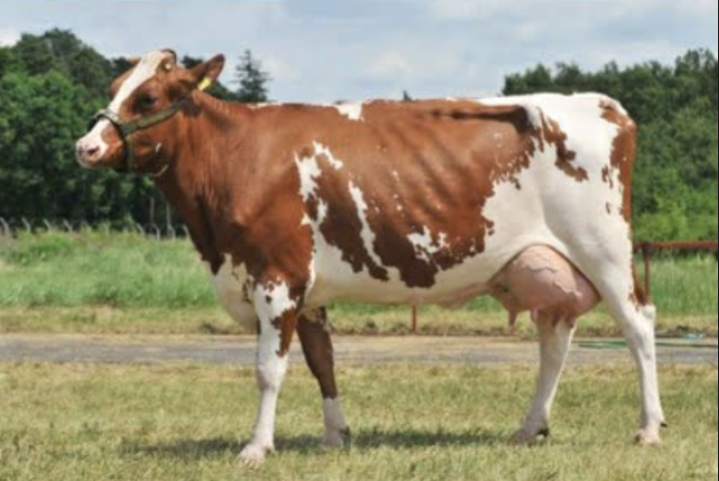
Cow
Car

Slide 12
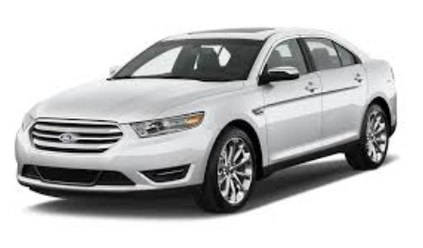
Cow
Car

Slide 13
Set of techniques to extract knowledge from available data and use that knowledge to make decisions

Slide 14
Machine Learning
Deep Learning
Mathematical Models

Slide 15
Machine learning in real life

Slide 16
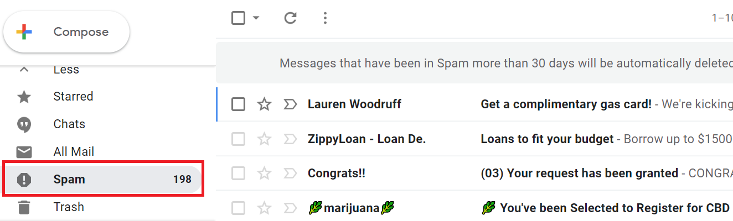

Slide 17


Slide 18
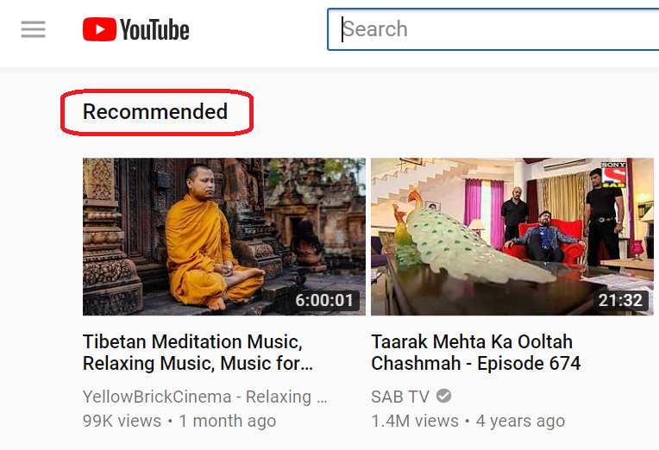

Slide 19
