Slide 1

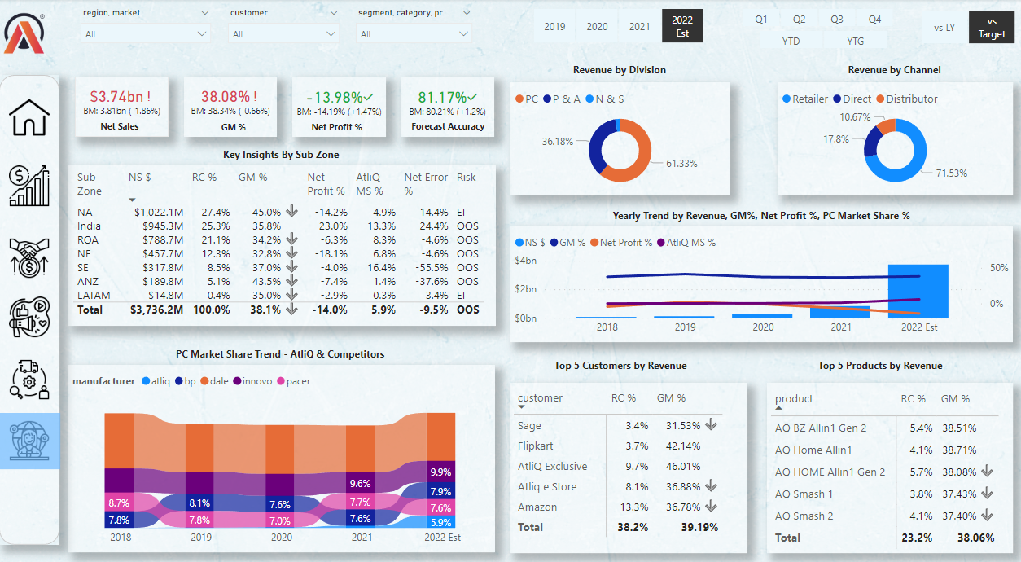
MySQL
Data Import
Data Cleaning
Data Transformation
Derived
Measures

Slide 2
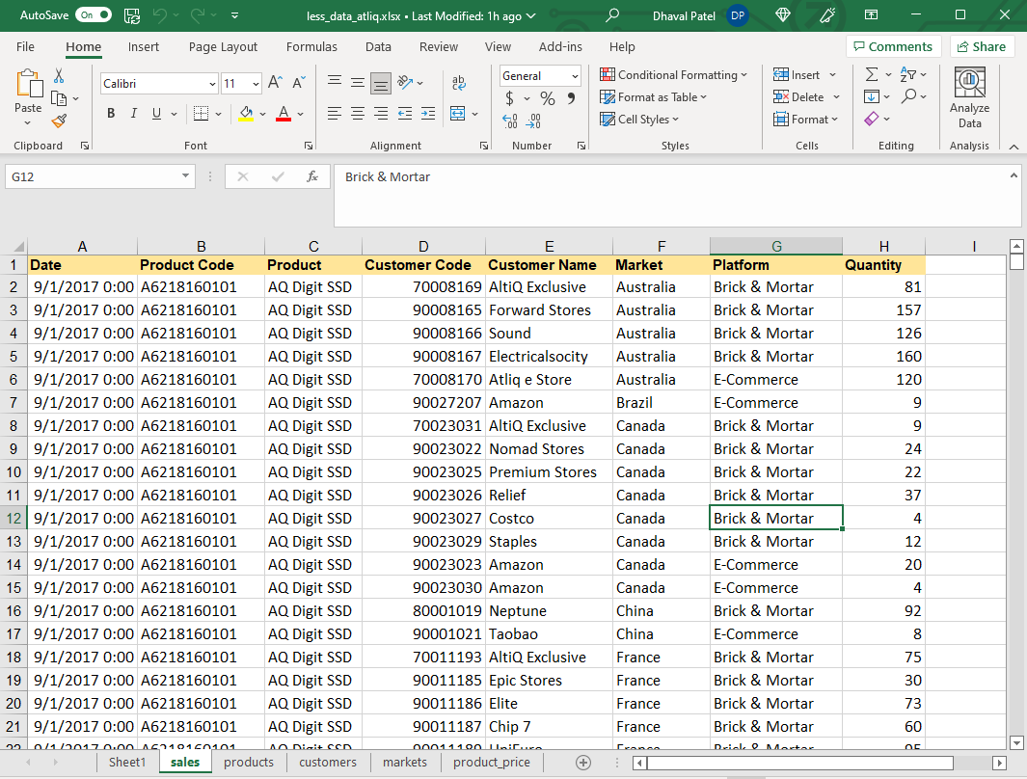

Slide 3


