Slide 1
ASP.NET MVC Bootstrapper
Framework and at the same time project template.
By Alim Ul Karim

Slide 2

Technology
It’s not the cutting edge ever!

Slide 3

Technology
Seems like modern

Slide 4




3-Tier Architecture
Presentation Layer
Business Logic
Data Layer
Software
Seems like modern
browser
WebSite
OS: Linux/Windows Server…
Server: Apache/IIS Web Server…
PHP/.NET Framework/JDK…
SQL Server / Oracle/MySQL
Client Tier/Client Machine
Middle Tier/Application Server
Database Tier/Database Server
Client Tier : Operating System (Windows 95/98, Linux)
Web browser : (Internet Explorer 9.0/Google Chrome)
Components : Flash/.NET/JRE/SilverLight….
Database Tier: MySQL Server/ SQL Server/Oracle etc….
Middle Tier: Linux/Windows operating system
Apache/IIS Web Server
Scripting Engine PHP,ASP etc…
Notes:
You are not giving your presentation to have another meeting. You are there to covey meaning.

Slide 5

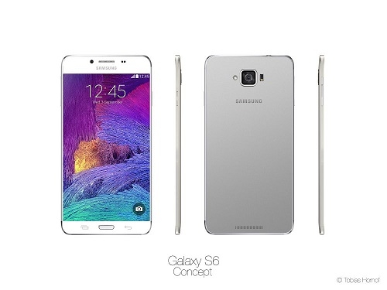
Technology
If we are happy then …

Slide 6
Technology is always a gap.
astray.

Slide 7
Why gap?
3-Tier Pros
Performance
One place change
Codes are more organized
Maintainable
Notes :
Have to use WCF or Services (where 99% time http wins)

Slide 8
Data Access Layer
= Dull
(DAL)

Slide 9
When we are making a system
There are lot of things to consider

Slide 10
One of the most important
UX and UI

Slide 11
Don’t make me think.
Make a system where developers doesn’t have to think much

Slide 12
Don’t make me think.
UX and UI:
Right component for the right work
Focusing area

Slide 13
System Design and Development
Analyzing
System Designing
System Building
Coding
Testing
Production
Maintenance
Thinking area

Slide 14
System Design and Development
Analyzing
System Designing
System Building
Coding
Testing
Production
Maintenance
Thinking area

Slide 15
A balance between work and life.
Every developer’s time and life is important. I always I think how to make it better and efficient.
Focusing area
After all, developers are human not machine.

Slide 16
Getting the best of both worlds.
Productive : Return on Investment (Quick)
Focusing area
Since developers are human not machine.

Slide 17
So what if
We could reduce repeating task that every developer do everyday.
Focusing area
Getting close to the solution.

Slide 18
Efficiency and productivity oppose each other.
Make system efficient
Focusing area

Slide 19
Summarize
Better development rather than 3-tier.
Don’t make me think. (Right tool for the right job).
Thinking areas ie. Better SDLC
Productive thus ROI
Efficient at the time productive
Give a balance to developers life. So that they can achieve their best.

Slide 20
New system
Where machine could solve the repeating task. (This where the machines were invented)
Efficiency should be built in and so on .

Slide 21
New system (making)
We have to modify Visual Studio
Project Templating
T4 templates
Managed Extensible Framework

Slide 22
I started with something and then it became something else. -picaso

Slide 23
Does anyone knows in which system stackoverflow is developed?
ASP.NET MVC 2

Slide 24
ASP.NET MVC 5.3
Controller
Model
View

Slide 25
Developers can work with database in 3 ways.
Code First (by Default)
Code First, Database First, Model First

Slide 26
Code First(Pros)
Portable
Doesn’t need much database logic
Codes fan out everywhere

Slide 27
Code First(Cons)
Need to write a lot of code.
Hard to change data-types in future.
Database doesn’t optimize much.

Slide 28
DB First(Pros)
Write less
Efficient database design
Very much rapid development

Slide 29
DB First(Cons)
Not portable.
Codes doesn’t fan out.
Changing in relationship takes time to sync.

Slide 30
Before diving in I would like to point best practices

Slide 31
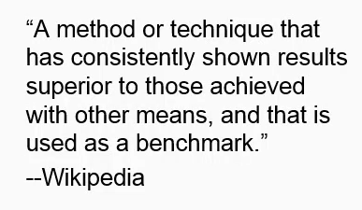

Slide 32
Action speaks louder than words
Enough talk!

Slide 33
Let’s see some demos

Slide 34
We did a lot of optimization in Db as well as writing your own code.

Slide 35
Our Return on Investment
Our main concept of ROI is donation.
It’s an open source system you can download and use it from github.
Maybe in future we will include advertisement concept.

Slide 36
Thank you

Slide 37
Questions ?

