Slide 1
Expression Solver
CSE 115 Project
Solve your math expressions
By Alim Ul Karim & Alvee Rahman

Slide 2
Outline
What is an expression Solver? What it does? (description)
Operators First Look(features)
What is new in this?(features)
Implementation / Examples with Expression Solver Simple
Examples with Brackets / Result
Limitations
Future Plans
Conclusion
Reference

Slide 3
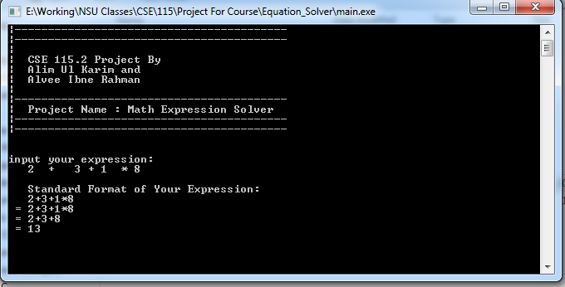
Expression Solver What it does?
It evaluates an expression like shown above and follow the BODMAS sequence.
B for Brackets , O for Or, D for Division , M for Multiplication , A for Addition , and S for Subtraction

Slide 4
Operators First Look (features)
() : Opening"(" and closing")" brackets , user must have to close the bracket and must put a number between brackets.
^ : Power/Exponential Operator, 2^3 = 8
~ : Roots , like 8~3 = 2, 4~2 = 2 , 36~2=6
% : Percentage Operator , 5%10 will be 50 , 3%10 will 30
! : factor, x! , means x(x-1)!
/ : Division Operator
* : Multiplication Operator
+ : Addition Operator
- : Minus/Subtraction Operator
There is no need to use * before any bracket program will automatic understand it.
Expression Solver follows the BODMAS mechanism to simplify a mathematical expressions sequentially as calculator does.

Slide 5
What’s New? (Features)
Expression Solver? There are lot of tools which evaluates expressions (for instance handy calculator, programming languages, operating system calculator etc.) ; so what is new about this?
Nowadays, handy calculators are very powerful and have textbook display however , limitations to all those tools that they can not show the solving process step by step. Regular calculator or programming language can not solve your expression errors but our program can.
After completing any process(operations like +,-, * etc) between numbers, it always displays a user-friendly format. It does not display all numbers with .000… or any point(.) at all, a point will only be displayed where it is necessary.

Slide 6
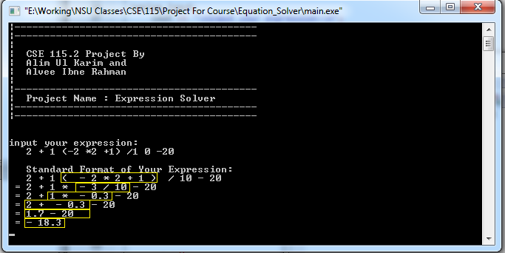
Showing Solving Steps (implementations)
In below image , it shows how our solver solves expressions step by step.

Slide 7
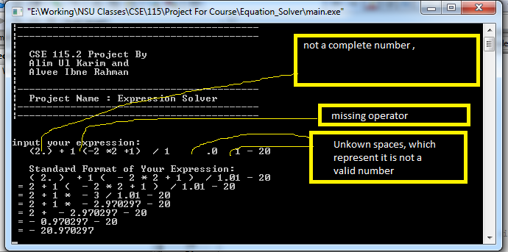
Solving Common Errors
Simple Errors

Slide 8
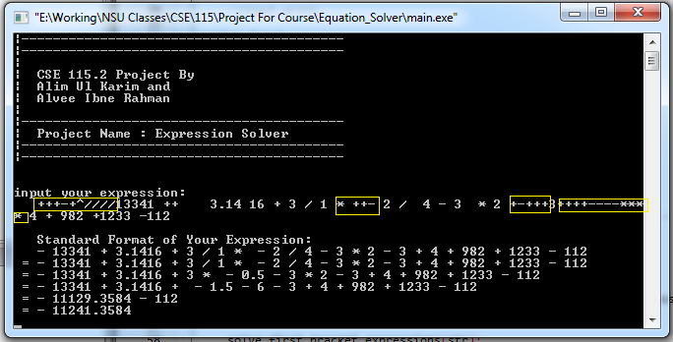
Solving Advance Errors This is not 100% perfect but works anyway
Complex Errors

Slide 9
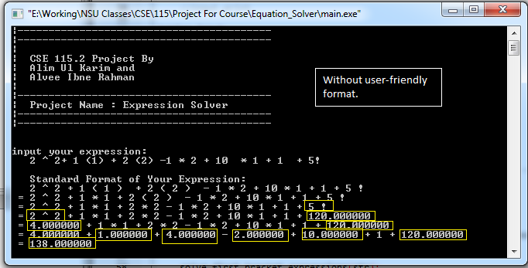
Without User-Friendly Format

Slide 10
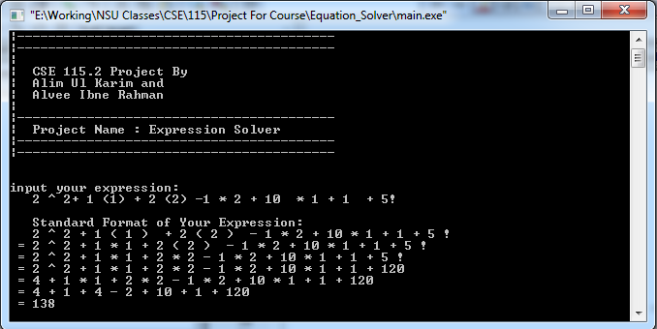
With User-Friendly Format

Slide 11
Examples and Results
5((-2) + 2 ( 2 * (10 + 1) /11 +5) ) = 60
+++-+^////13341 ++ 3.14 16 + 3 / 1 * ++- 2 / 4 - 3 * 2 +-+++3++++----****4 + 982 +1233 -112 = -11241.3584 // complex error example
-4 - 3 *-232 -1*-23-2 = 713
-4 - 3 -232 -1 = -240
-2+2*7+2 = 14
5*(-2+2*7 ) = 60
2^3+3+2*2/5 = 11.8
72(7(2(1)(2/100))) = 20.16 // example with brackets
4 - 982 * 1233 / -112 = 10814.76786 // cal:10814.768278
2 + 1 (-2 *2 +1) /1 0 -20 = 18.3 // both same in handy cal and program
(2.) + 1 (-2 *2 +1) / 1 .0 1 - 20 = -20.970297//simple error example cal : -20.97029703
2 ^ 2+ 1 (1) + 2 (2) -1 * 2 + 10 * 1 + 1 + 5! =138 // both same

Slide 12
Limitations in user-input
Inputted expression can only solve real numbers, so other inputs can not be processed(like a,b,c, $ etc…).
We can not insert any other operator after ‘-’ at first.
Each number must be a range of double data-type :1E-37 to 1E+37 with 10 digits of precision .
Note: Also remember if expression output result outrun the range of double datatype , you will get uncertain results.
Inputted expression can not contain only “()” bracket closing without any numbers in it. You will get uncertain result.
Expression can not process equal(“=”) , &,` sign , it will only remove it, so if you input 2+3=3 it will be 2+33.
Must complete the bracket sequence , or else solver can not process your expression.
Can not use factor (!), roots(~) , power(^) , percentage (%) repeatedly after or before one number.
Can’t use “1+23 + (2-1+1)” will not work. To solve that you have to use “1+23 + 1(2-1+1)”

Slide 13
Limitations in output of process
If expression any output result outrun the range of double datatype , you will get uncertain results.
In non-user-friendly display , sometimes result shows ‘c’ at the end of it. Conversation error from double to char[] using sprintf.
Error existing expressions, can act differently depend of various user-inputs(unanticipated) .
Output results do not show “()” bracket expressions step by step.

Slide 14
Future Plan
We will implement function equations like f(x) = x ^4 + 3x^3 -20 … to find out the real zeros, complex zeros and ending behavior of that function.
We will try to implement constant , user custom variable system , where users can create their custom variable and use it in a function or in a expression.
We can deploy our functions in Dynamic Link Library (DLL) and use it in different platforms like visual basic , c# etc…
We will open a website to publish project as opensource software.

Slide 15
Conclusion
We will try to improve our limitations in future to achieve more success.
This project was assigned to
Alim Ul Karim & Alvee Ibne Rahman.

Slide 16
Reference
We use cplusplus.com as our reference book.
We use our experience and class lectures as a reference to this project.

