Slide 1
Flora Telecom Limited
architecture development.
By Alim Ul Karim

Slide 2
SDLC
Analyze the problem
Feasibility Analysis
Technical analysis
And so on.
System Design - > Database, Index, Automation
System Build -> UI, UX
Programming
Conversion
Production Maintenance
Testing

Slide 3
I started with something and then it became something else. -picaso
Every developers time and life is important. We also think, how to make it better and efficient.

Slide 4
ASP.NET MVC
Controller
Model
View

Slide 5
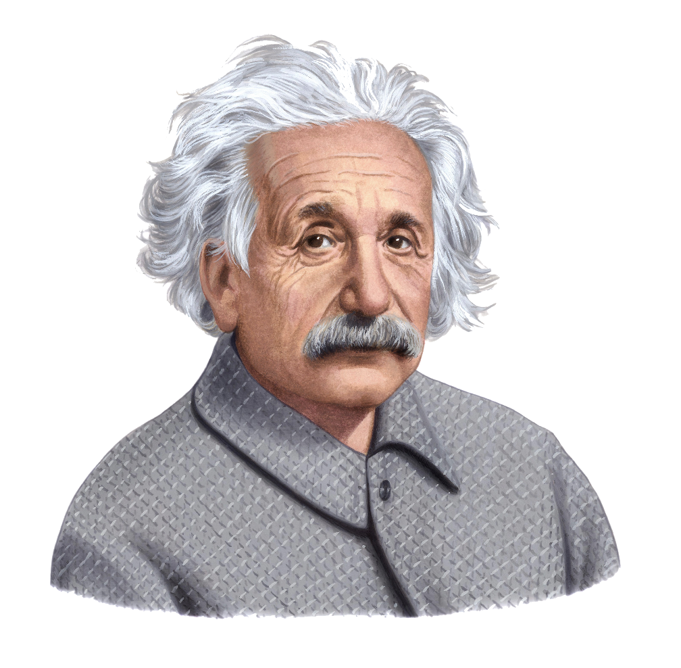
“Education is what
remains after one
has forgotten what
one has learned in school.”
- Albert Einstein
http://bit.ly/USlvnx

Slide 6
Developers can work with database in 3 ways.
Code First (by Default)
Code First, Database First, Model First

Slide 7
Code First(Pros)
Portable
Doesn’t need much database logic
Codes fan out everywhere

Slide 8
Code First(Cons)
Need to write a lot of code.
Hard to change data-types in future.
Database doesn’t optimize much.

Slide 9
DB First(Pros)
Write less
Efficient database design
Very much rapid development

Slide 10
DB First(Cons)
Not portable.
Codes doesn’t fan out.
Changing in relationship takes time to sync.

Slide 11
Let’s see some demo in ASP.NET

Slide 12
Let’s see some demo with our project

Slide 13
We did a lot of optimization in Db as well as writing your own code.

Slide 14
Feasibility Analysis
Feasibility is a very important issue we had to tackle for this project. Since our software is meant with the developer in mind.
Our main concern is to do with operations feasibilty

Slide 15
Feasibility Analysis (Continued)
Operations Feasibility: Keeping in mind that the developers will be able to successfully use our plugins. We did a lot of helpful gestures that will guide developers in choosing which plugin will do the job and where it is. If Developers do face any issue, they can look up to the manual which clearly states which plugin accomplishes which task with an example to clarify further.

Slide 16
Feasibility Analysis (Continued)
Technical Feasibility: This is another area which is critical to our system. Will our plugins be able to support a wide range of system? In order to tackle this, we went to some software developers and showed them the plugin and asked them to implement it.
Results: Over 78% of our test applicants were able to successfully implement it without even looking at the user manual for assistance.

Slide 17
Feasibility Analysis (Continued)
We managed to make the system easy to use, understand, implement and tested on a wide range of systems. This is a continued process has to be said, the more users use it, the more data and feedback we get which will further refine the system.

Slide 18
Return on Investment
Our main concept of ROI is donation.
It’s an open source system you can download and use it from github.
Maybe in future we will include advertisement concept.

Slide 19
Thank you

Slide 20
Questions ?

