Slide 1

Deep learning
Image classification on cifar 10
Albert olivella

Slide 2
Agenda:
Objective:
01
Data Exploration:
02
Data Preprocessing:
03
Build CNN:
04
Improvement Methods:
05
Transfer Learning & Fine Tuning:
06
Conclusions:
07

Slide 3
01
Objective:
Compare two methods to Deep learning image classification:
Build Convolutional Neuronal Network from the start.
Build Convolutional Neuronal Network based in already trained model.

Slide 4
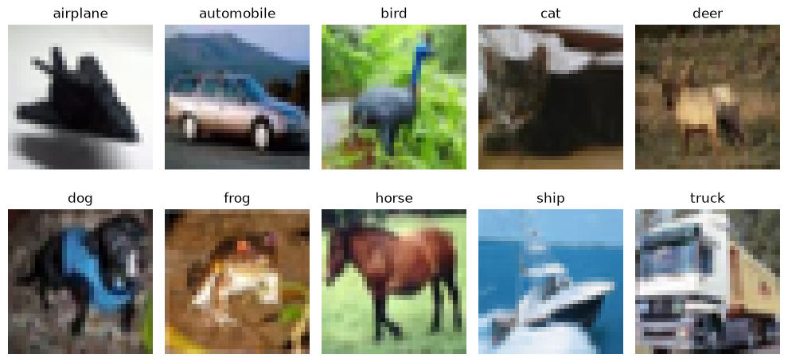
02
Data Exploration:
60000 Images, 32 x 32 pixels.
50000 for train 10000 for test.
10 Classes.
6000 images for class.
Balanced.

Slide 5
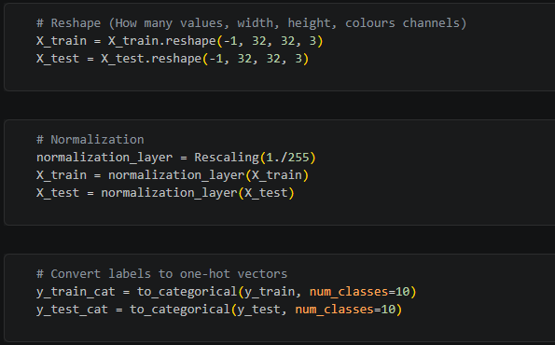
03
Data Preprocessing:
1. Reshape the input images to add the channel dimension expected by CNNs.
Be sure that all the images have the same Height, Width and RGB.
2. Normalize pixel values to the [0, 1] range.
Adam and SGD works better with values close to 0.
Better for Mathematic calculations.
3. Encode the labels using one-hot encoding for categorical classification.
Each class has the same weight.

Slide 6
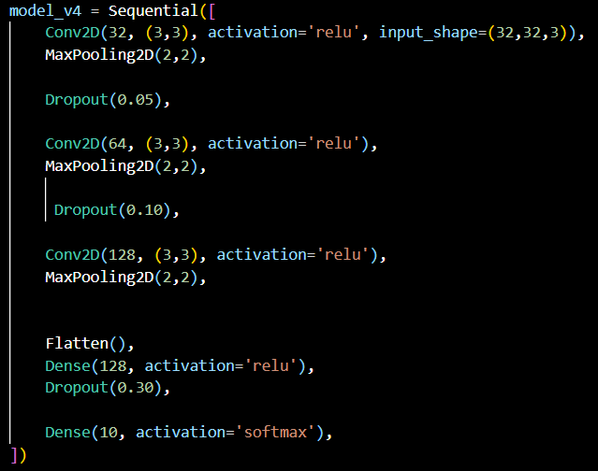
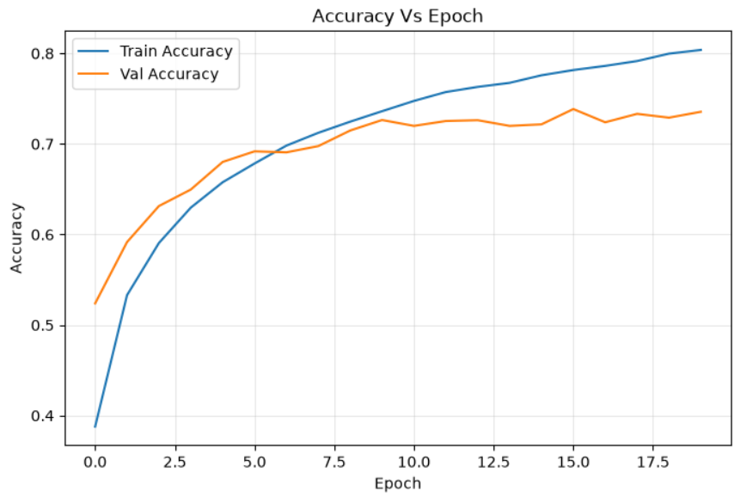
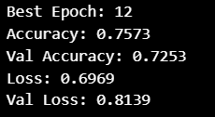
04
Build CNN:
Adam as a Optimizer
First Model Created determines that the model was overfitted.
Adding Dropout in the Convolutional Layers seems that the gap between Acc and Val Acc decrease. [Acc decrease, Val Acc keeps equal]. So, Model needs more time to memorize.

Slide 7
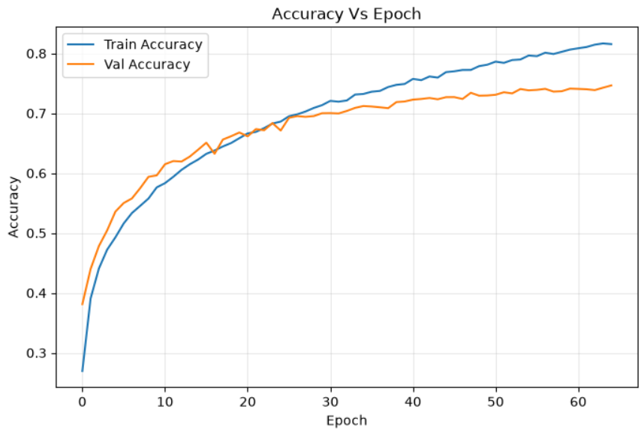
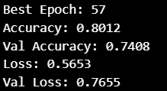
04
Build CNN:
Adam as a Optimizer and Learning Rate = 0.0001 [Default 0.001]
Reducing Learning Rate improves the result [Val Acc] but is overfitted again, it's logic because model needs more epochs until is not improving anymore, so is memorizing.
Trainning progress is slower but more steady
Needs more Epochs to converge.

Slide 8
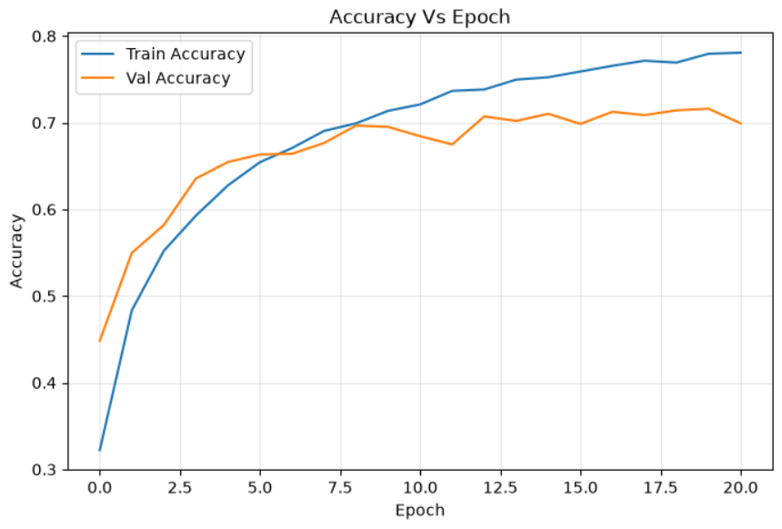
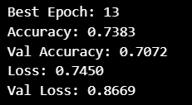
04
Build CNN:
SGD as a Optimizer
SGD doesnt improve the val_accuracy and val_loss as much as Adam optimizer.

Slide 9
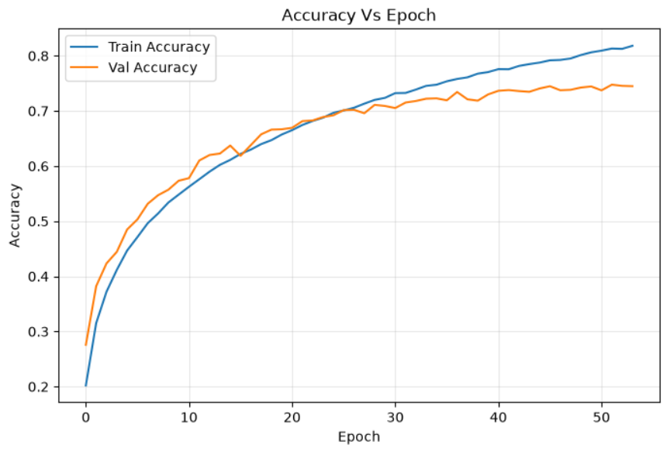
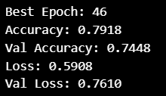
04
Build CNN:
SGD as a Optimizer and Learning Rate = 0.001 [Default 0.01]
The result decreasing Learning Rate in SGD is the same as Adam. Val_Accuracy is better but models goes to Overfitting because the gap becomes greater.
Needs many Epochs, 46.

Slide 10
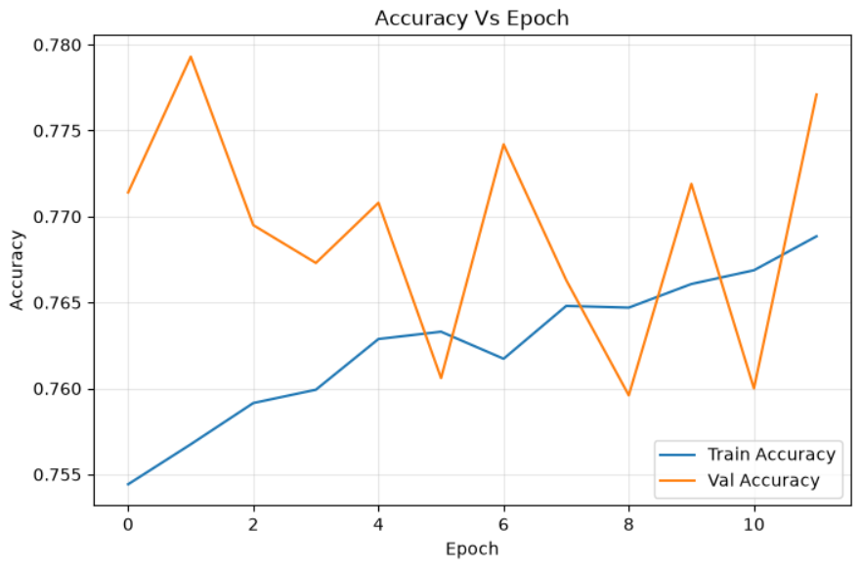
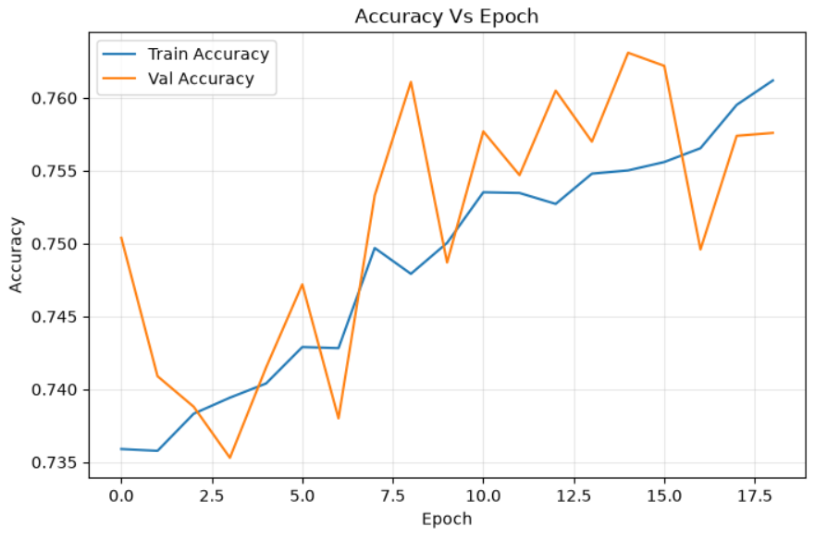
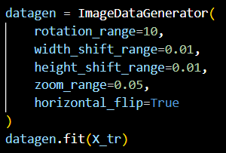
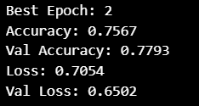
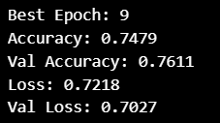
05
Improvement Methods:
Data Augmentation
Adam Vs SGD
Train Accuracy progress is slower, makes sense because in each epoch is seeing new pictures (rotated and with new dimensions).

Slide 11
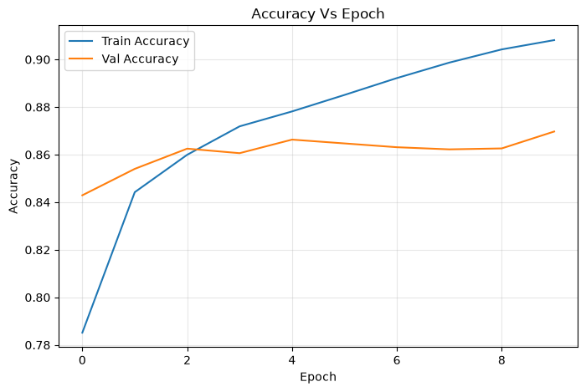
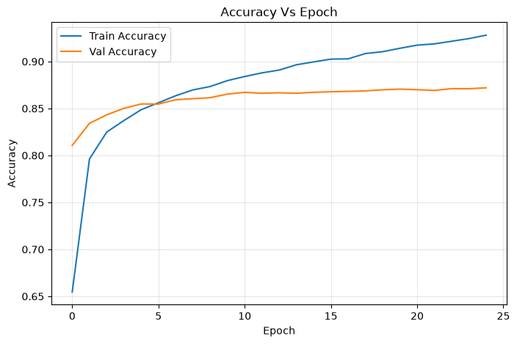
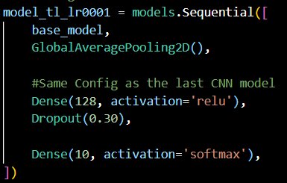

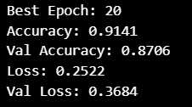
06
Transfer Learning & Fine Tuning:
MobileNetV2 pretrained with ImageNet
Resize images to 128x128 pixels and applied the preprocess_input.
From the beginning val_accuracy is over 80% and this is due to the model has been created using an already trianed model which has been trained with milions of images.
Using lower LR, model needs more epochs, improves the result to 0,91 and starts to be steady after epoch 10. Means that Dense layers are reaching its limit.

Slide 12
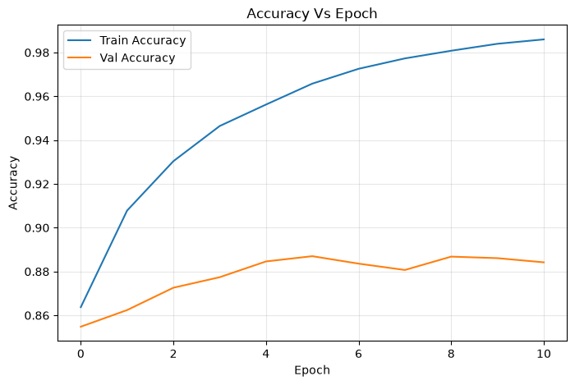
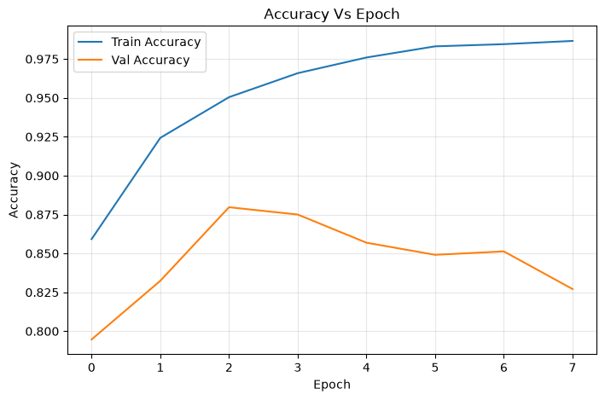
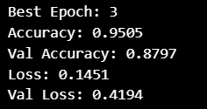
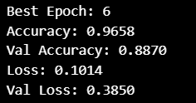
06
Transfer Learning & Fine Tuning:
Model was trained unfreezing Layers of MobileNetV2 and LR 0.0001.
In both experiments there are a big gap between accuracy (0.95-0.97) and val_accuracy (0.88) than any previous experiment, seems logic because MobileNetV2 is a huge Neuronal Network. It wins adaptability but there are risk to go to over adjustment, Thats why the Epochs in both cases are really low.
Unfreeze 10 layers is better than 20 layers, Model converge in les epochs (3 over 6) but starts to get overfitting.

Slide 13
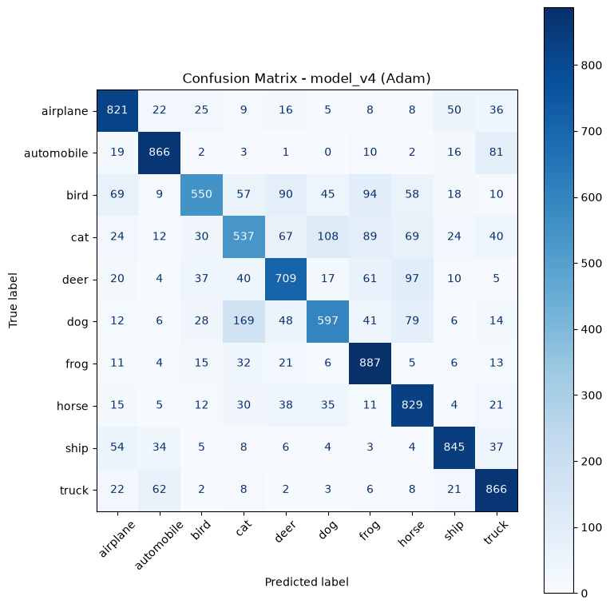
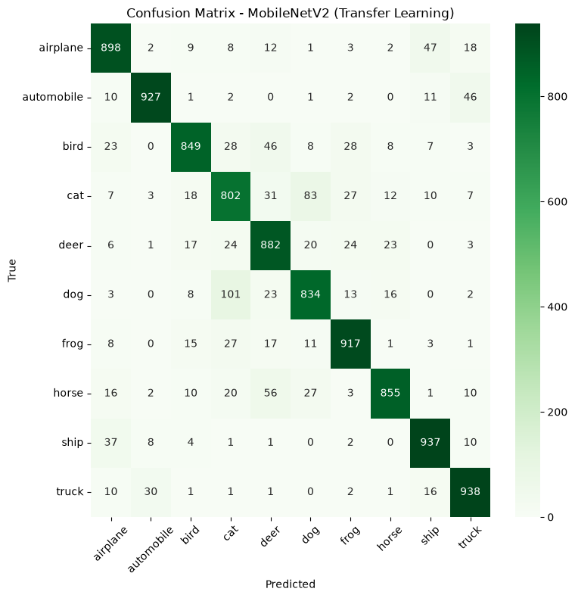
07
Conclusions:
CNN Created Vs Mobile Net.
The model use to predict correctly but there are some confusions between classes.
The model has a big confusion between classes Cat and Dog.
Bird class has confusion with Cat, Deer and Dog.
This confusions are coherent because of our Simple CNN trained with images 32x32.
The model with MobileNet has much better results, confusions between classes has reduced.
Cat and Dog is still the biggest confusión but it has been reduced.

Slide 14
Thank you for your attention.

