Slide 1

Factory Predictive Maintenance
Predicting Mechanical & Electrical failures 30 minutes ahead
Albert Olivella

Slide 2
Agenda:
Objective:
01
Data Exploration:
02
Data Cleanning:
03
Feature Engineering:
04
Modelling & Results:
05
GenAI & Dashboard:
06
Conclusions:
07

Slide 3
01
Objective:
Predict a Mechanical/Electrical failure 30 minutes before it happens:
  Build a synthetic simulator and train per-station ML models (Random Forest vs XGBoost.
  Wrap the results in a GenAI-powered dashboard for real-time decision support.

Slide 4
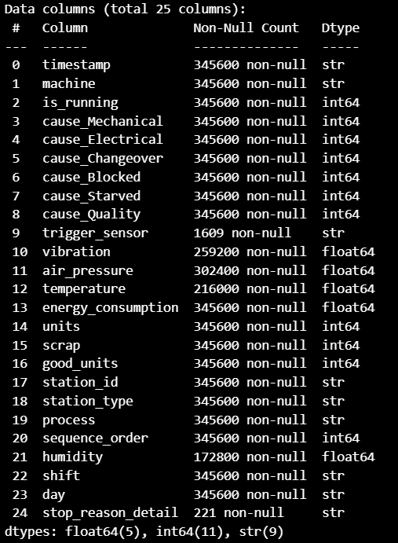
02
Data Exploration:
345,600 rows × 25 columns.
  8 stations × 30 days × 1,440 min/day.
Stations:
  ST1: Robotics – ST4: Assembly – ST7: Inspection.
  ST2: CNC – ST5: Welding – ST8: Packaging.
  ST3: Robotics – ST6: Cooling.
Failures Cause:
  Process Failures: (Out of Scope)
    Changeover, Blocked, Starved, Quality.
  Functionality Failures:
    Mechanical:
      Vibration, Air Pressure, Humidity.
    Electrical:
      Temperature, Energy Consumption.

Slide 5
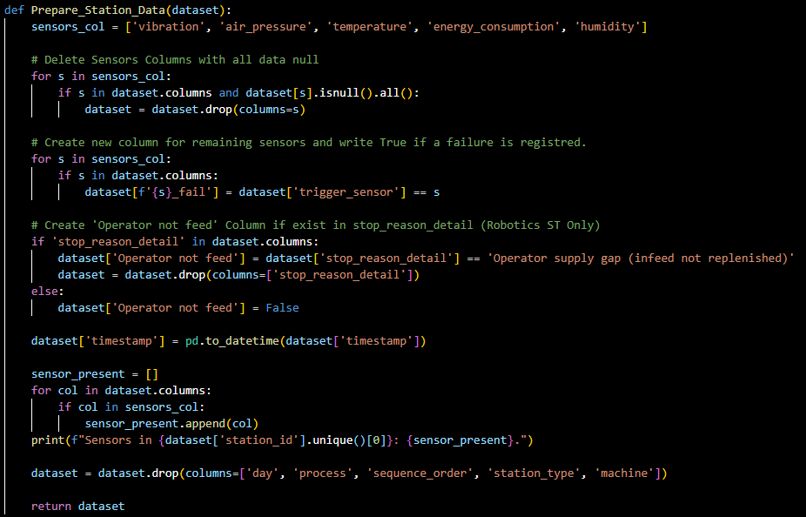
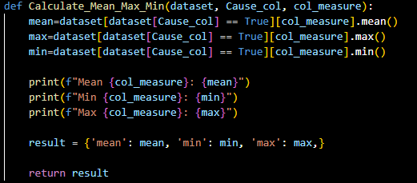
03
Data Cleanning:

Slide 6
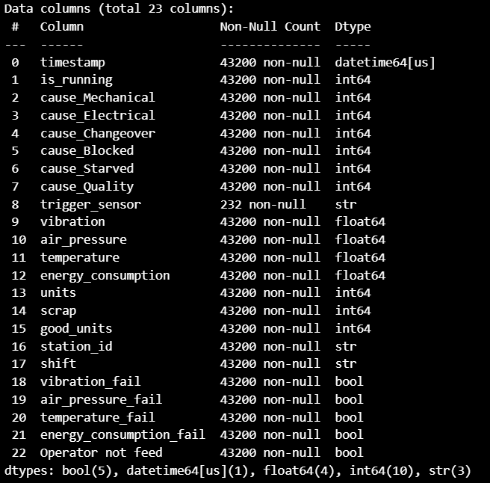
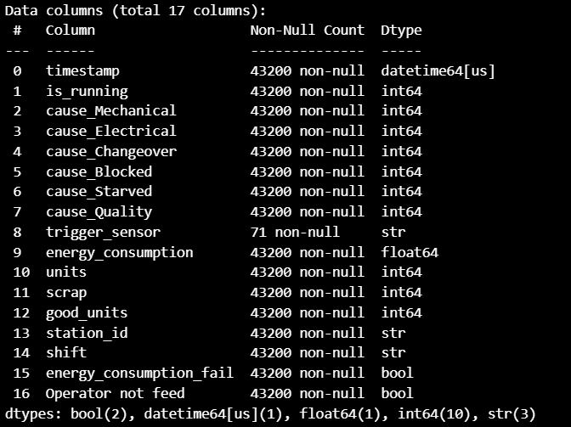
03
Data Cleanning:
Split Initial df to df for each ST.
  Each ST has its owns sensors.
  Feature Sensors not in ST are deleted.
ST1
ST8

Slide 7
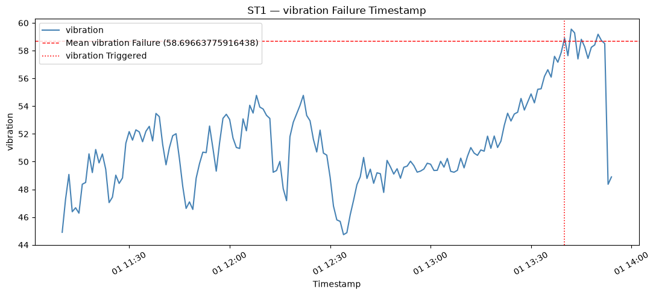
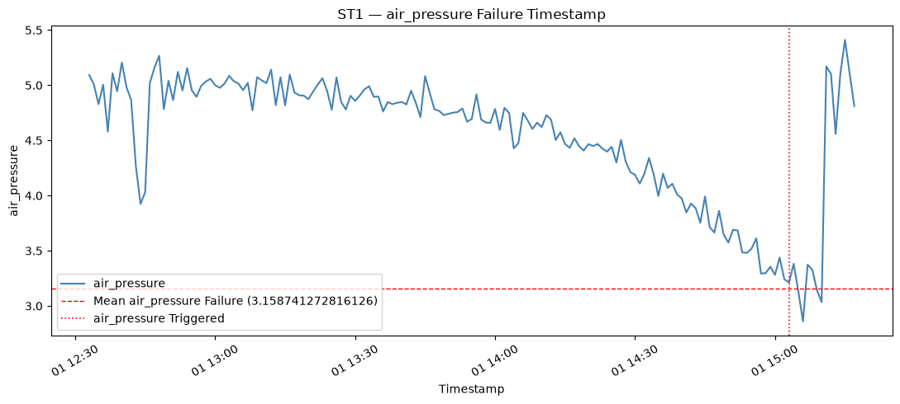
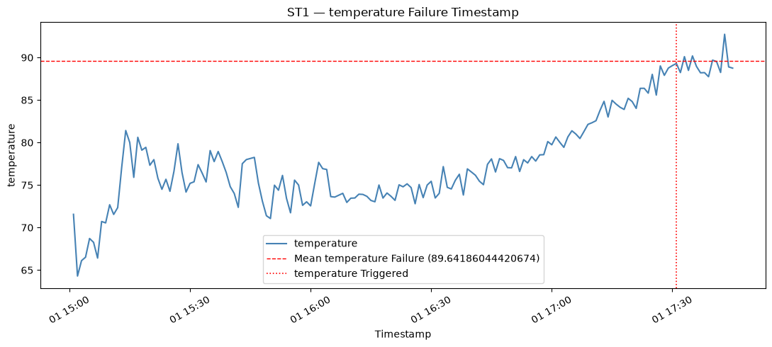
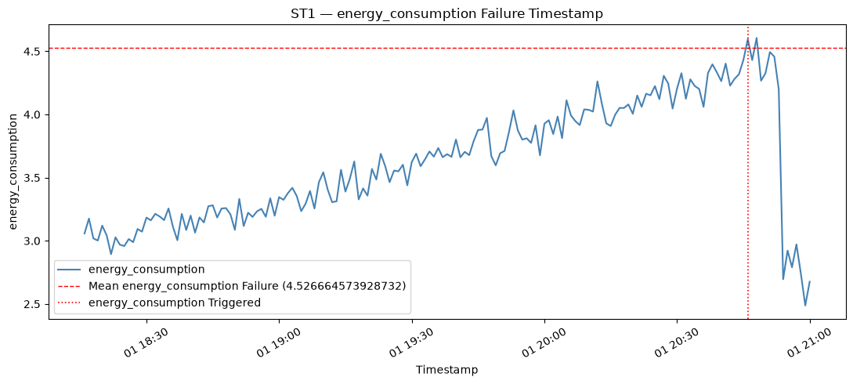
04
Feature Engineering:
Find when the fail is triggered for each ST.

Slide 8
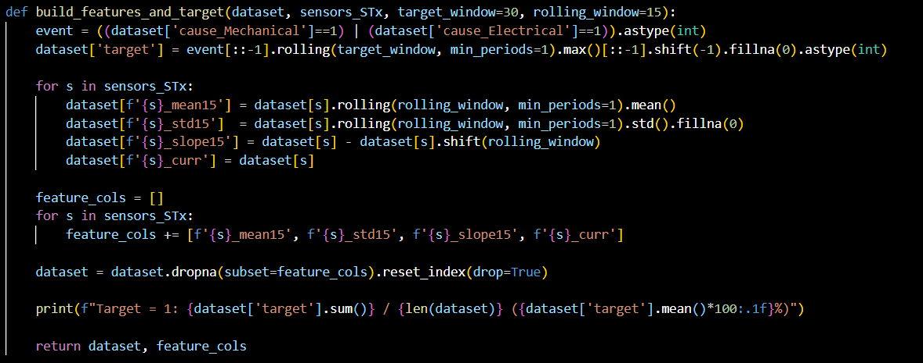
04
Feature Engineering:
Define the target: Look 30 minutes AHEAD, if a failure occurs at any point within that window, target = 1.
  Failure = Mechanical or Electrical Cause.
Build news feature to predict future, reading the sensor behavior from past (15 min before) & present.
  Predictors features: mean15, std15, slope15 and current measure.

Slide 9
05
Modeling & Results:
Random Forest vs XGBoost
Random Forest and XGBoost are the models selected.
  Best options regarding present features.
  Features has different ranges measures, RF and XGB don’t need Normalization.
  RF and XGB works well with unbalanced classes.
  RF and XGB are fast models to train.
Data splitted in 80% Train, 20% Test.
  20% will be used to validate model and for the “Simulation prediction”

Slide 10
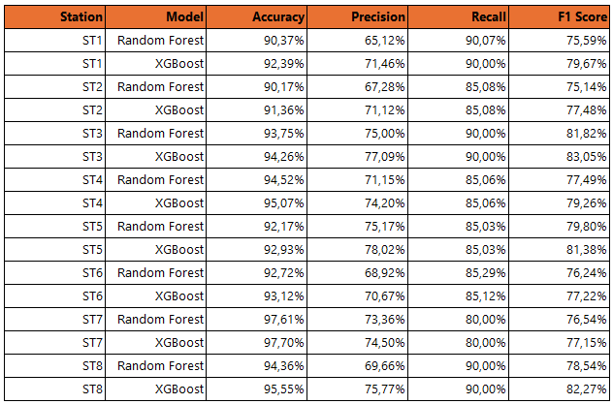
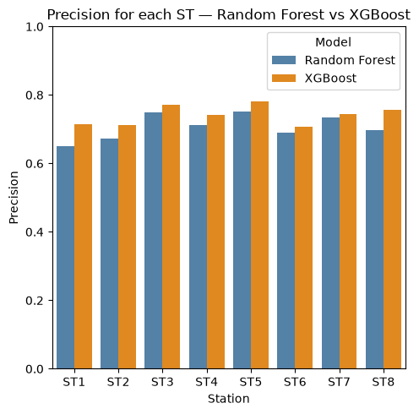
05
Modeling & Results:
Random Forest vs XGBoost
Best model for ST chosen by Recall [Detect TP and FP]
In Production Dept missed failure costs more than a false alarm.
Fix Recall value (80-90%) for ST to focus in the Precision.
Average Accuracy 94.1%, Average Precision 74.1%.
Model Precision between 65-78%, that means 1 over 3 are False Positive alarm.

Slide 11

07
GenAI & Dashboard:

Slide 12
07
Conclusions:

Slide 13
Thank you for your attention.

