Slide 1

Absolute Loader in C
DAYANANDA SAGAR COLLEGE OF ENGINEERING
Department of Computer Science & Engineering

Slide 2
TEAM MEMBERS
1DS20CS145 - Aum S. Patil
1DS20CS146 – Pavan Gowda SN
1DS20CS147 – Prajwal SN
1DS20CS148 – Prasanna Deshpande
Guided By : Prof. Aparna M
DAYANANDA SAGAR COLLEGE OF ENGINEERING
Department of Computer Science & Engineering

Slide 3
ABSTRACT
Implemented an absolute loader in C
Loader loads machine code into memory addresses
Team aimed to gain practical experience in software development
Team developed an understanding of the principle of loading.
DAYANANDA SAGAR COLLEGE OF ENGINEERING
Department of Computer Science & Engineering

Slide 4
TOOLS USED
Code editors (Notepad++, Vim)
IDE (VS Code)
C Compilers (gcc)
DAYANANDA SAGAR COLLEGE OF ENGINEERING
Department of Computer Science & Engineering

Slide 5
INTRODUCTION
Efficient execution of computer programs relies on a well-structured process that transforms human-readable code into machine-executable instructions.
Loading is an integral part of this process, where instructions and data are brought into main memory for execution.
Absolute loaders are a fundamental type of loader that play a critical role in this translation process.
This project implemented an absolute loader using the C programming language.
DAYANANDA SAGAR COLLEGE OF ENGINEERING
Department of Computer Science & Engineering

Slide 6
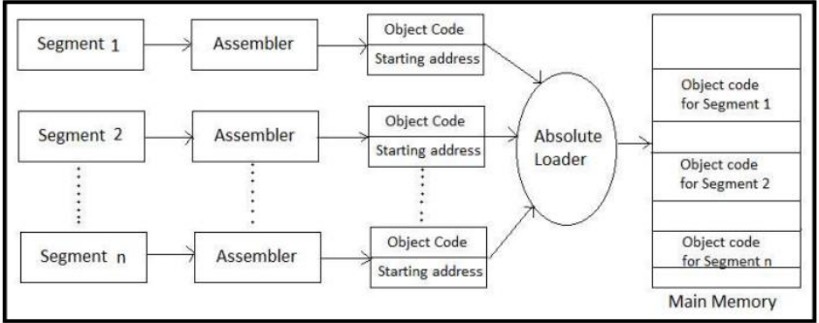
SYSTEM FLOW
DAYANANDA SAGAR COLLEGE OF ENGINEERING
Department of Computer Science & Engineering

Slide 7
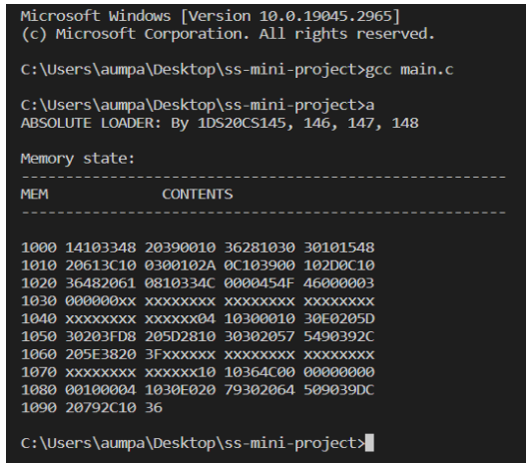
SCREENSHOTS - 1
DAYANANDA SAGAR COLLEGE OF ENGINEERING
Department of Computer Science & Engineering

Slide 8
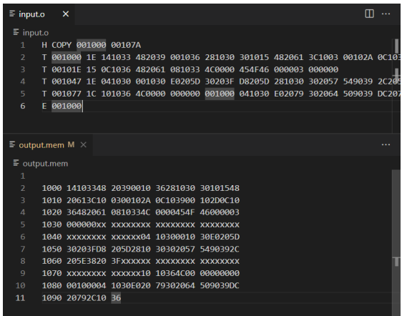
SCREENSHOTS - 2
DAYANANDA SAGAR COLLEGE OF ENGINEERING
Department of Computer Science & Engineering

Slide 9
CONCLUSION
The project provided an opportunity to implement an absolute loader in C.
The loader successfully loads machine code into memory addresses specified in the input file.
Effective design choices, algorithms, and data structures were used to ensure the loader's robustness, efficiency, and accuracy.
The project deepened the team's understanding of the loading process.
DAYANANDA SAGAR COLLEGE OF ENGINEERING
Department of Computer Science & Engineering

