Slide 1
Software Quality Metrics

Slide 2
Software Measurement
S/W measurement can be categorized in two ways:
Direct measures of the s/w process (e.g., cost and effort applied) and product (e.g., lines of code (LOC) produced, etc.)
Indirect measures of the product (e.g., functionality, quality, complexity, etc.)
Requires normalization of both size- and function-oriented metrics

Slide 3
Size-Oriented Metrics (1)
Lines of Code (LOC) can be chosen as the normalization value
Example of simple size-oriented metrics
Errors per KLOC (thousand lines of code)
Defects per KLOC
$ per KLOC
Pages of documentation per KLOC

Slide 4
Size-Oriented Metrics (2)
Controversy regarding use of LOC as a key measure
According to the proponents
LOC is an “artifact” of all s/w development projects
Many existing s/w estimation models use LOC or KLOC as a key input
According to the opponents
LOC measures are programming language dependent
They penalize well-designed but shorter programs
Cannot easily accommodate nonprocedural languages
Difficult to predict during estimation

Slide 5
Function-Oriented Metrics (1)
The most widely used function-oriented metric is the function point (FP)
Computation of the FP is based on characteristics of the software’s information domain and complexity

Slide 6
Function-Oriented Metrics (2)
Controversy regarding use of FP as a key measure
According to the proponents
It is programming language independent
Can be predicted before coding is started
According to the opponents
Based on subjective rather than objective data
Has no direct physical meaning – it’s just a number

Slide 7
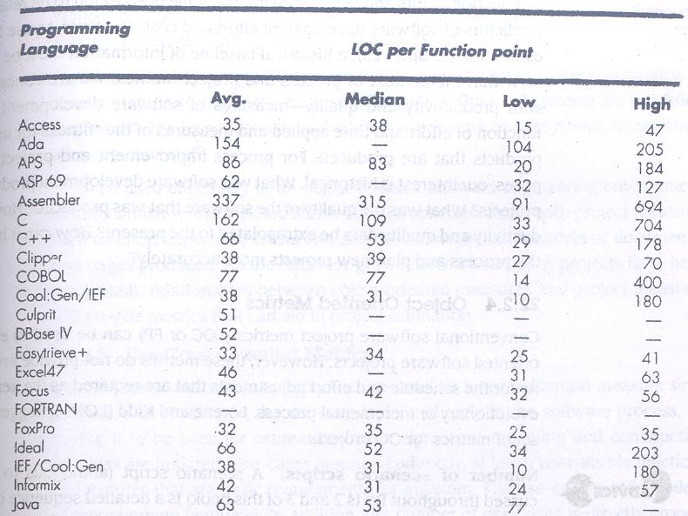
Reconciling LOC and FP Metrics

Slide 8
Object-Oriented Metrics
Number of Scenario scripts
Number of key classes
Number of support classes
Average number of support classes per key class
Number of subsystems

Slide 9
Use-Case Oriented Metrics
The use-case is independent of programming language
The no. of use-cases is directly proportional to the size of the application in LOC and to the no. of test cases
There is no standard size for a use-case
Its application as a normalizing measure is suspect

Slide 10
Web Engineering Project Metrics (1)
Number of static Web pages
Number of dynamic Web pages
Number of internal page links
Number of persistent data objects
Number of external systems interfaced
Number of static content objects
Number of dynamic content objects
Number of executable functions

Slide 11
Web Engineering Project Metrics (2)
Let,
N_{sp} = number of static Web pages
N_{dp} = number of dynamic Web pages
Then,
Customization index, C = N_{dp}/(N_{dp} + N_{sp})
The value of C ranges from 0 to 1

Slide 12
Metrics for Software Quality
Goals of s/w engineering
Produce high-quality systems
Meet deadlines
Satisfy market need
The primary thrust at the project level is to measure errors and defects

Slide 13
Measuring Quality
Correctness
Defects per KLOC
Maintainability
Mean-time-to-change (MTTC)
Integrity
Threat and security
integrity = Σ [1 – (threat × (1 - security))]
Usability

Slide 14
Defect Removal Metrics: Concepts
All defect removal metrics computed from the measurements identified last time:
Inspection reports, test reports, field defect reports.
Used to get different views on what’s going on.
Each metric can be used to tell us something about the development process or results.
Many are amazingly useful, though all have limitations.
Need to learn how to use each tool effectively.
For most defect metrics, filter out minor and cosmetic defects.
Can easily make many metrics look good by finding more or fewer cosmetic problems (level of nitpicking).

Slide 15
Measuring “Total Number of Defects”
Many metrics have parameters such as “total number of defects” e.g. total number of requirements defects.
Clearly, we only ever know about the defects that are found.
So we never know the “true” value of many of these metrics.
Further, as we find more defects, this number will increase:
Hopefully, finding defects is asymptotic over time i.e. we find fewer defects as time goes along, especially after release.
So metrics that require “total defects” type info will change over time, but hopefully converge eventually.
The later in the lifecycle we compute the metric, the more meaningful the results.
If and when we use these metrics, we must be aware of this effect and account for it.

Slide 16
Measuring Size
Many defect metrics have “size” parameters:
The most common size metric is KLOC (thousands of lines of code).
Depends heavily on language, coding style, competence.
Code generators may produce lots of code, distort measures.
Does not take “complexity” of application into account.
Easy to compute automatically and “reliably” (but can be manipulated).
An alternative size metric is “function points” (FP’s).
A partly-subjective measure of functionality delivered.
Directly measures functionality of application: number of inputs and outputs, files manipulated, interfaces provided etc.
More valid but less reliable, more effort to gather.
We use KLOC in our examples, but works just as well with FP’s.

Slide 17
Defect Density
Number of defects / size.
Defect density in released code (“defect density at release”) is a good measure of organizational capability.
Defects found after release / size of released software.
Can compute phasewise and component-wise defect densities.
Useful to identify “problem” components that could use rework or deeper review.
Note that problem components will typically be high-complexity code at the heart of systems.
Defect densities (and most other metrics) vary a lot by domain.
Can only compare across similar projects.

Slide 18
Defect Density: Limitations
Size estimation itself has problems.
“Total Defects” problem.
Criticality and criticality assignment.
Combining defects of different criticalities reduces validity.
Criticality assignment is itself subjective.
Defects may not equal reliability. (User experience problem).
Statistical significance when applied to phases and components.
Actual number of defects may be so small that random variation can mask significant variation.

Slide 19
Defect Detection Efficiency (DDE) & Defect Removal Efficiency (DRE)

Slide 20
DRE Table Example
Phase of Origin
 | Req | Des | Code | UT | IT | ST | Field | Total | Cum.
Req | 5 |  |  |  |  |  |  | 5 | 5
Des | 2 | 14 |  |  |  |  |  | 16 | 21
Code | 3 | 9 | 49 |  |  |  |  | 61 | 82
UT | 0 | 2 | 22 | 8 |  |  |  | 32 | 114
IT | 0 | 3 | 5 | 0 | 5 |  |  | 13 | 127
ST | 1 | 3 | 16 | 0 | 0 | 1 |  | 21 | 148
Field | 4 | 7 | 6 | 0 | 0 | 0 | 1 | 18 | 166
Total | 15 | 38 | 98 | 8 | 5 | 1 | 1 | 166
Cum. | 15 | 53 | 151 | 159 | 164 | 165 | 166
Phase Found
Phase Found
(Illustrative example, not real data)
Phase of Origin

Slide 21
DRE Value
Compute effectiveness of tests and reviews:
Actual defects found / defects present at entry to review/test.
(Phasewise Defect Removal Efficiency: PDRE)
Compute overall defect removal efficiency:
Problems fixed before release / total originated problems.
Analyze cost effectiveness of tests vs. reviews:
Hours spent per problem found in reviews vs. tests.
Need to factor in effort to fix problem found during review vs. effort to fix problem found during test.
To be more exact, we must use a defect removal model.
Shows pattern of defect removal.
Where defects originate (“injected”), where they get removed.

Slide 25
http://groups.engin.umd.umich.edu/CIS/course.des/cis525/java/f00/harvey/DRE_Calc.htm

