Slide 1
UML 2 State Machine Diagrams

Slide 2
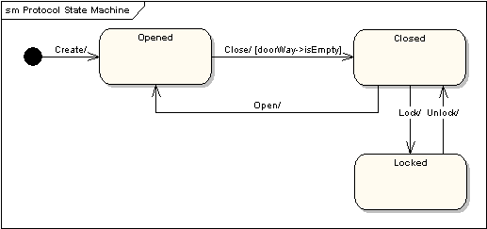
State Machine Diagrams
A state machine diagram models the behavior of a single object, specifying the sequence of events that an object goes through during its lifetime in response to events. As an example, the following state machine diagram shows the states that a door goes through during its lifetime.
The door can be in one of three states: "Opened", "Closed" or "Locked". It can respond to the events Open, Close, Lock and Unlock. Notice that not all events are valid in all states; for example, if a door is opened, you cannot lock it until you close it. Also notice that a state transition can have a guard condition attached: if the door is Opened, it can only respond to the Close event if the condition
doorWay->isEmpty is fulfilled. The syntax and conventions used in state machine diagrams will be discussed in full in the following sections.

Slide 3
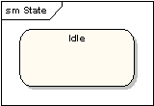
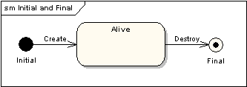
State Machine Diagrams
States - A state is denoted by a round-cornered rectangle with the name of the state written inside it.
Initial and Final States - The initial state is denoted by a filled black circle and may be labeled with a name. The final state is denoted by a circle with a dot inside and may also be labeled with a name.

Slide 4
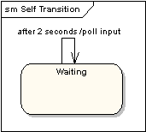
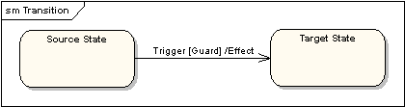
State Machine Diagrams
Transitions - Transitions from one state to the next are denoted by lines with arrowheads. A transition may have a trigger, a guard and an effect, as below.
Self-Transitions - A state can have a transition that returns to itself, as in the following diagram. This is most useful when an effect is associated with the transition.
"Trigger" is the cause of the transition, which could be a signal, an event, a change in some condition, or the passage of time. "Guard" is a condition which must be true in order for the trigger to cause the transition. "Effect" is an action which will be invoked directly on the object that owns the state machine as a result of the transition.

Slide 5
State Machine Diagrams
State Actions - In the transition example above, an effect was associated with the transition. If the target state had many transitions arriving at it, and each transition had the same effect associated with it, it would be better to associate the effect with the target state rather than the transitions. This can be done by defining an entry action for the state. The diagram below shows a state with an entry action and an exit action.
It is also possible to define actions that occur on events, or actions that always occur. It is possible to define any number of actions of each type.

Slide 6
Definitions of an F.S.M.
A finite state machine (FSM) or finite state automaton (plural: automata) or simply a state machine is a model of behavior composed of a finite number of states, transitions between those states, and actions.
A state is a particular set of instructions which will be executed in response to the machine's input.

Slide 7
a state machine is :
An initial state or record of something stored someplace
A set of possible input events
A set of new states that may result from the input
A set of possible actions or output events that result from a new state

Slide 8
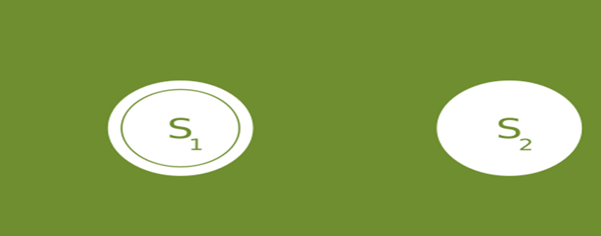
Example of Deterministic State Transition Diagram of a Finite State Machine
A deterministic finite state machine or deterministic finite automaton (DFA) is a finite state machine where for each pair of state and input symbol there is one and only one transition to a next state.
1
1
0
0
Start state
The start state is usually shown drawn with an arrow into s1.
Accept state is the end state and is usually represented by a double circle, shown on the left. S₁ (which is also the start state) indicates the state at which an even number of 0s has been input and is therefore defined as an accepting state.
:

Slide 9
State Transition table
A FSM can also be represented using a ‘State Transition Table’. As shown below: the combination of current state (B) and condition (Y) shows the next state (C).
Current State ---------------------> Condition | State A | State B | State C
Condition X | -- | -- | --
Condition Y | -- | State C | --
Condition Z | -- | -- | --
A state table is essentially a truth table in which some of the inputs are the current state, and the outputs include the next state, along with other outputs.

Slide 10
Important Rule for State Table
Complete state table must include each possible combination of present states and input values, and no such combination may match more than one row of the table.

Slide 11
One-dimensional state tables
Also called characteristic tables, single-dimension state tables are much more like truth tables than the two-dimensional versions.
Inputs are usually placed on the left, and separated from the outputs, which are on the right.
The outputs will represent the next state of the machine.

Slide 12
One Dimension State Table con’t
Here's a simple example of a state machine with two states, and two combinatorial inputs:
S₁ and S₂ represent the single bits 0 and 1, since a single bit can only have two states.
A | B | Current State | Next State | Output
0 | 0 | S₁ | S₂ | 1
0 | 0 | S₂ | S₁ | 0
0 | 1 | S₁ | S₂ | 0
0 | 1 | S₂ | S₂ | 1
1 | 0 | S₁ | S₁ | 1
1 | 0 | S₂ | S₁ | 1
1 | 1 | S₁ | S₁ | 1
1 | 1 | S₂ | S₂ | 0

Slide 13
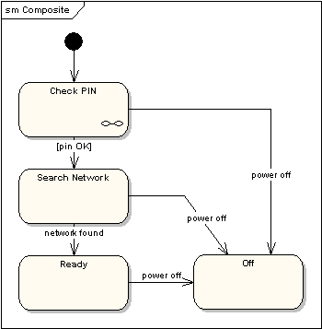
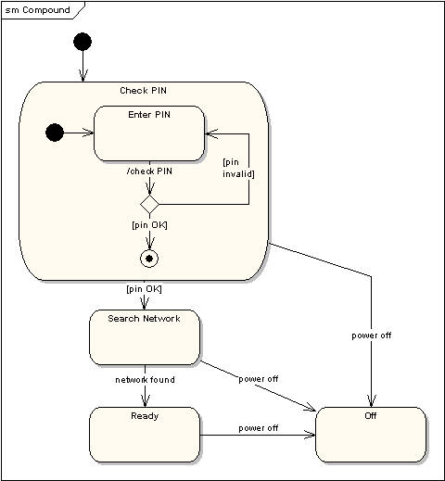
State Machine Diagrams
Compound States - A state machine diagram may include sub-machine diagrams, as in the example below.
Alternative way to show the same information
The ∞ symbol indicates that details of the Check PIN
sub-machine are shown in a separate diagram.

Slide 14
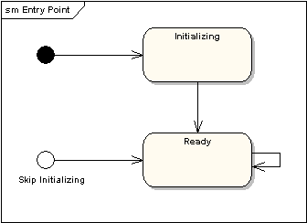
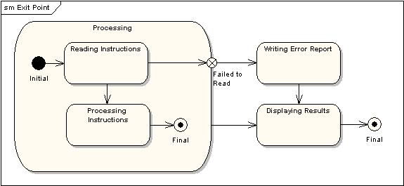
State Machine Diagrams
Entry Point - Sometimes you won’t want to enter a sub-machine at the normal initial state. For example, in the following sub-machine it would be normal to begin in the "Initializing" state, but if for some reason it wasn’t necessary to perform the initialization, it would be possible to begin in the "Ready" state by transitioning to the named entry point.
Exit Point - In a similar manner to entry points, it is possible to have named alternative exit points. The following diagram gives an example where the state executed after the main processing state depends on which route is used to transition out of the state.

Slide 15
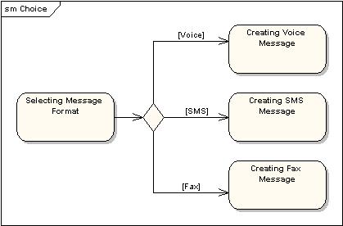
State Machine Diagrams
Choice Pseudo-State - A choice pseudo-state is shown as a diamond with one transition arriving and two or more transitions leaving. The following diagram shows that whichever state is arrived at, after the choice pseudo-state, is dependent on the message format selected during execution of the previous state.

Slide 16
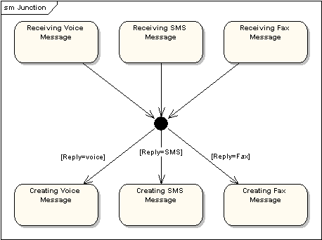
State Machine Diagrams
Junction Pseudo-State - Junction pseudo-states are used to chain together multiple transitions. A single junction can have one or more incoming, and one or more outgoing, transitions; a guard can be applied to each transition. Junctions are semantic-free. A junction which splits an incoming transition into multiple outgoing transitions realizes a static conditional branch, as opposed to a choice pseudo-state which realizes a dynamic conditional branch.

Slide 17
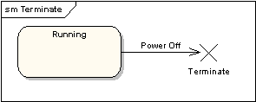
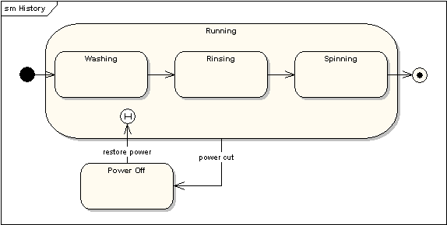
State Machine Diagrams
Terminate Pseudo-State - Entering a terminate pseudo-state indicates that the lifeline of the state machine has ended. A terminate pseudo-state is notated as a cross.
History States - A history state is used to remember the previous state of a state machine when it was interrupted. The following diagram illustrates the use of history states. The example is a state machine belonging to a washing machine.
Notes:
In this state machine, when a washing machine is running, it will progress from "Washing" through "Rinsing" to "Spinning". If there is a power cut, the washing machine will stop running and will go to the "Power Off" state. Then when the power is restored, the Running state is entered at the "History State" symbol meaning that it should resume where it last left-off.

Slide 18
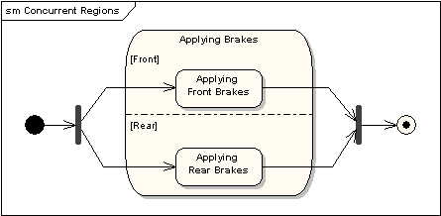
State Machine Diagrams
Concurrent Regions - A state may be divided into regions containing sub-states that exist and execute concurrently. The example below shows that within the state "Applying Brakes", the front and rear brakes will be operating simultaneously and independently. Notice the use of fork and join pseudo-states, rather than choice and merge pseudo-states. These symbols are used to synchronize the concurrent threads.

Slide 19
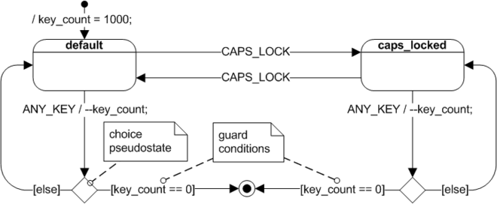

Slide 20
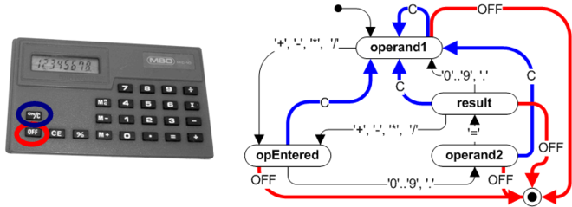
A pocket calculator (left) and the traditional state machine with multiple transitions Clear and Off (right)

