Slide 1

DUAL CLOCK FIFO (ASYNCHRONOUS) USING LAYERED TESTBENCH
Mentor TA : Abhay
Anirudh PES1UG23EC043
Aumkar Ranjan Behura PES1UG23EC066
Chirag V Rao PES1UG23EC081
Harini PES1UG23EC117

Slide 2
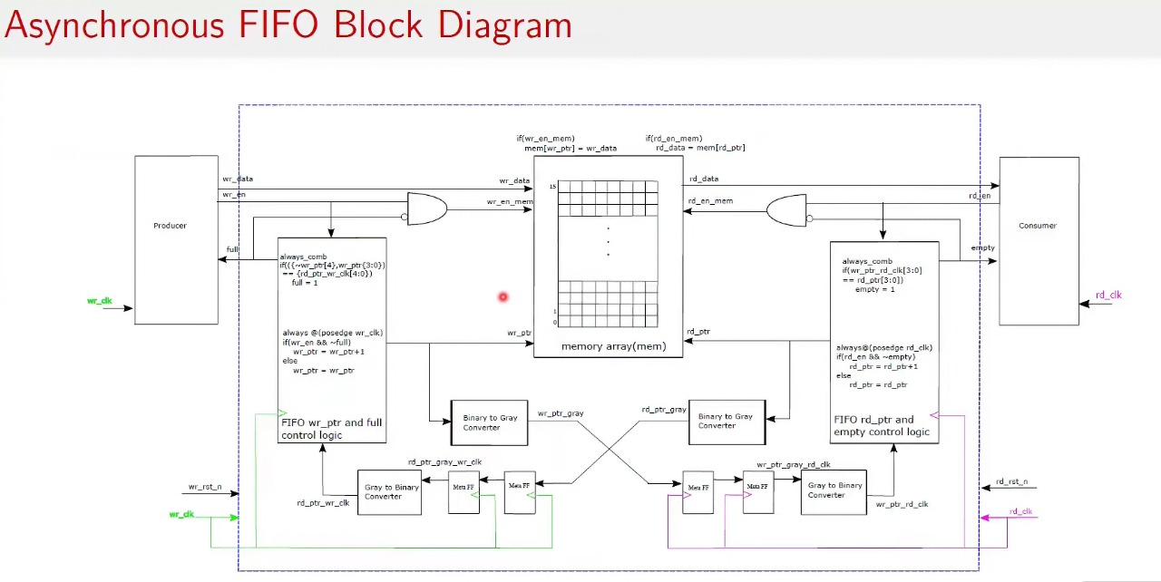
Design

Slide 3
Design
Primary Function and Write Domain (WCLK)
1. Primary Function & Capacity
Goal: To safely and reliably transfer 8-bit data from the Write Clock (wclk) domain to the Read Clock (rclk) domain.
Capacity: The FIFO holds up to 16 data entries (2**4 based on 4 address bits).
Fundamental Role: To bridge the timing and rate difference between the two independent clocks, preventing data loss (overflow) or reading invalid data (underflow).
2. Write Domain Components (wclk)
Data Storage (fifomem): The internal memory array where data is stored. Writes are synchronous to wclk. Reads are combinatorial (asynchronous).
Write Pointer Logic (wptr_full): This module manages data input flow and operates entirely on wclk.
  It generates the memory address (waddr) and the output status flag (wfull).
Synchronization (sync_r2w):
  This component transfers the Read Pointer (rptr) from the rclk domain to the wclk domain, creating the signal wrptr2. This is necessary for checking the Full condition.
3. Full Condition Logic (Overflow Prevention)
Mechanism: The wptr_full module compares the next Gray Write Pointer (wgnext) to the synchronized Read Pointer (wrptr2).
Full Flag: Declared when the address bits match, but the Most Significant Bit (MSB) of the pointers differs.
Meaning: This MSB difference proves the write pointer has wrapped around exactly one more time than the read pointer, meaning the buffer is completely full and the next write would overwrite existing data.

Slide 4
Design
Read Domain (RCLK) and Empty Logic
4.Read Domain Components (rclk)
Read Pointer Logic (rptr_empty): This module manages data output flow and operates entirely on rclk.
  It generates the memory address (raddr) and the output status flag (rempty).
Synchronization (sync_w2r):
  This component transfers the Write Pointer (wptr) from the wclk domain to the rclk domain, creating the signal rwptr2. This is necessary for checking the Empty condition.
5. Empty Condition Logic (Underflow Prevention)
Mechanism: The rptr_empty module compares the next Gray Read Pointer (rgnext) to the synchronized Write Pointer (rwptr2).
Empty Flag: Declared when the next Gray Read Pointer is exactly equal to the synchronized Write Pointer.
Meaning: This means the read pointer has caught up to the write pointer, and there is no valid data left in the FIFO.
6. Clock Domain Crossing (CDC) Safety
Pointers & Gray Code: We use Gray Code Pointers (5 bits wide) instead of standard binary.
  Reason: Gray code ensures only one bit changes per count. This is vital for preventing the sampled pointer from appearing metastable or corrupted when crossing the asynchronous clock boundary.
Synchronization: The pointers are passed through dedicated two-flip-flop synchronizer circuits (sync_w2r, sync_r2w). These circuits are the industry standard way to stabilize signals that cross clock boundaries, dramatically reducing the risk of a fatal timing error.

Slide 5
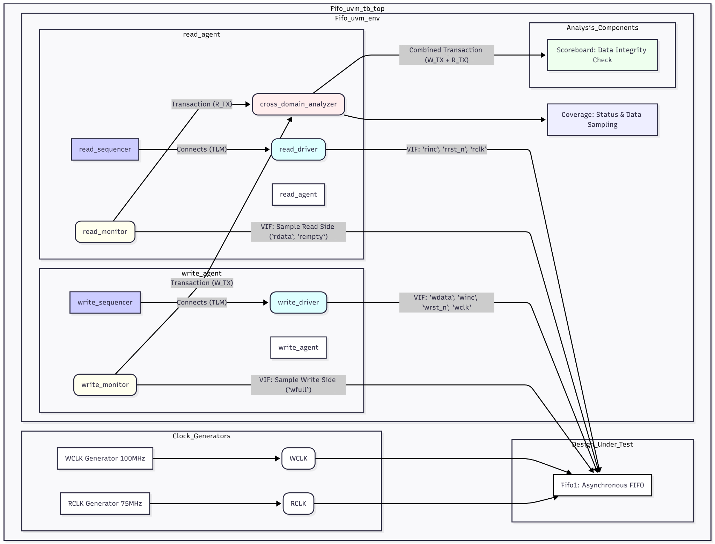
Layered Testbench.
Block Diagram

Slide 6
UVM Testbench Architecture: Verifying the Asynchronous FIFO
Core Challenge: The goal is to verify a dual-clock FIFO, which safely passes data between two independent and unrelated clock domains.
Asynchronous Clock Generation:
The testbench top (Fifo_uvm_tb_top) generates two separate clocks:
  WCLK (Write Clock) at 100MHz
  RCLK (Read Clock) at 75MHz
These two clocks are connected to the Design Under Test (DUT), creating the asynchronous boundary.
The UVM Environment (Fifo_uvm_env):
This is the main container for all verification components.
It is structured to mirror the DUT's clock domains.
Domain-Specific Agents:
write_agent: A complete UVM agent dedicated to the write side. It operates only on the WCLK domain.
read_agent: A complete UVM agent dedicated to the read side. It operates only on the RCLK domain.

Slide 7
UVM Testbench Architecture: Verifying the Asynchronous FIFO
Stimulus Generation (Sequencers):
write_sequencer creates random write transactions (data to be written, wdata).
read_sequencer creates random read "requests" (signaled by rinc).
Driving the DUT (Drivers):
write_driver takes transactions and drives the DUT's write pins (wdata, winc) in sync with WCLK.
read_driver drives the DUT's read control pins (rinc) in sync with RCLK.
Monitoring Bus Activity (Monitors):
Monitors passively watch all VIF signals and capture real-time activity.
write_monitor samples the write bus and status (wfull) and sends Transaction (W_TX) to the analyzer.
read_monitor samples the read bus and status (rdata, rempty) and sends Transaction (R_TX) to the analyzer.
Analysis & Checking (The "Brains"):
cross_domain_analyzer: Collects transactions from both monitors to get a complete picture of all activity.
Scoreboard: Receives combined transactions. Its job is to:
  Model the FIFO's "First-In, First-Out" behavior (like a software queue).
  Check for Data Integrity: Is the data read (rdata) the same as the data that was written?
  Check for Order: Is the data coming out in the correct sequence?
Coverage: Collects statistics to measure how well the DUT was tested (e.g., "Did we test the FIFO-full condition?").

Slide 8
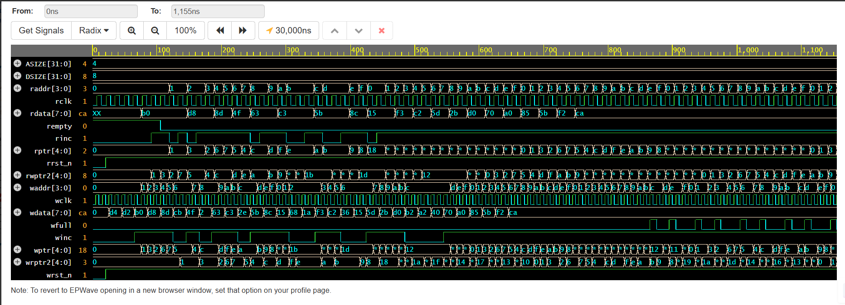
Simulation Waveform
.dut

Slide 9
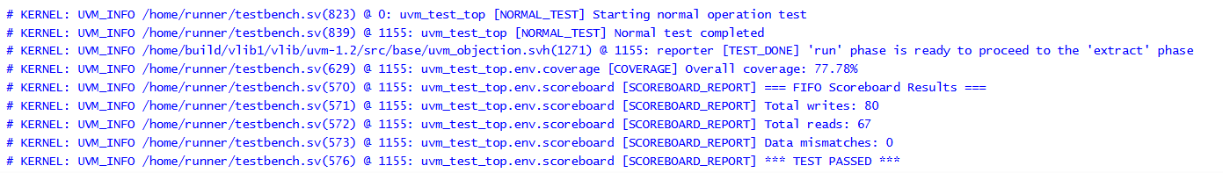
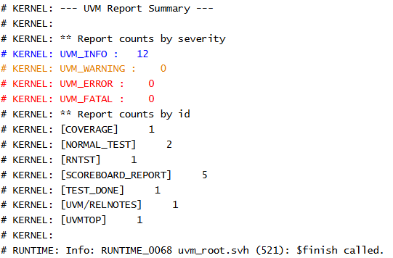
Terminal output

Slide 10
References
Github link of files
https://github.com/aumkarrb/FFVDD_Project_V_Sem/

