Slide 1

Case Study: Bacchus Winery
Presented by Group 1

Slide 2
Group Introduction
Group Members
Jon Green
Taylor King
Austin Moore
Joseph Smith

Slide 3
Summary
Problems:
Is there a gap in expected versus actual delivery of supplies?
Are wines selling as expected? Which distributor carries which wine?
How many hours over the past 4 quarters did each employee work?
Stan and Davis Bacchus are co-owners of family winery that was passed down to them by their father who retired. They are looking to incorporate new business methods and ideas that will help improve overall product and customer service. They currently know the overall ‘yearly snapshot’ of the business, but looking to determine more information around the inventory, distribution and employees. See the problem statements to the right for a better understanding of what they want.
Solutions:
Build a month by month tracker showing the delivery percentages for each supplier.
Show an overall sales tracker for each distributor.
Give a table showing employee’s working hours over the past 4 quarters.
Approach:
Create a SQL Table along with Python code to generate detailed reports that are user friendly and comprehensive for the owners of Bacchus Winery.

Slide 4
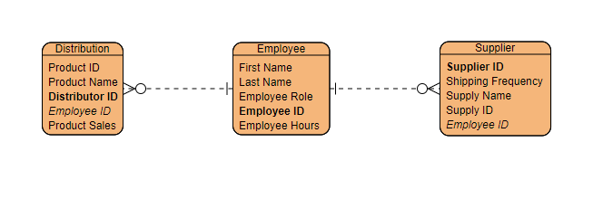
Entity Relationship Diagram(ERD)

Slide 5
Reports Overview
DELIVERY
DISTRIBUTION
EMPLOYEES

Slide 6
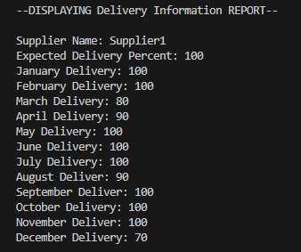
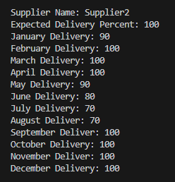
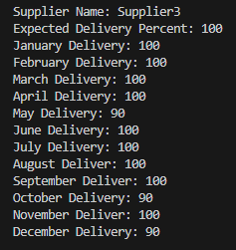
Delivery Tables
Is there a large gap between expected delivery and actual delivery? Show a month by month report of problem areas. Python script runs all three suppliers together; screenshots are separated for ease of viewing. All numbers are based in percentages for deliveries of each month.

Slide 7
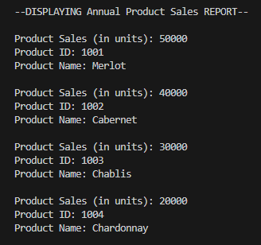
Distribution Tables
Are all wines selling at they thought? Is one wine not selling? Which distributor carries which wine? Product sales are in units and total sales over the past year for each product type. We don’t know what the expected sales for each wine should be at this time, but have the data to show total sales.

Slide 8

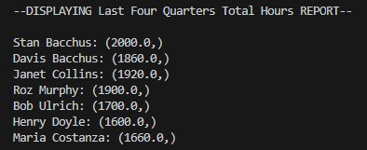
Employee Tables
During the last four quarters, how many hours did each employee work? Hours report shows total hours worked over the past year, but not broken down quarter by quarter in the code above.

