Slide 1
Public blog application
Capstone Project-III

Slide 2
Project Developer’s
19012011064|Aum Jayeshbhai Radia
Class:-CEIT-A
Batch:-AB4
19012011142|Bhavin Kumar Jani
Class:-CEIT-A
Batch:-AB5

Slide 3
Abstract
Public Blog Application integrate blog software to facilitate effective communication with the users of web application.The main reason for making this project or the problem which we saw is that there is not a blog application existance on very ground level and there are very few application which exists but do not have that much facilities for reliable communication between the users, in this we are building this Public Blog application for the users who can simply put there ideas infront of several people by writing a blog other than that theycan also like the ideas of other people and can comment on them.

Slide 4
Introduction
Public Blog Application is a web based application which will be working on the ground level or local level in which normal people can share there ideas and stories by writing a blog, While creating a blog the user can give a super short and appropriate title which suits his ideas or story when the user is publishing his blog along with that the user can also put an image to describe the view and imaginary thoughts of his blog after that user can give a brief introduction about his ideas or story and can post among people.
Talking on the advanced level the user can like the blog posts of other people and along with that they can comment on the other people’s blog application, trust me it’s very easy and simple.

Slide 5
Problem and Weakness of Current System
Lack Of Quality content
No Clear purposes of writing topic
Negative Content
Mixed Content
Bad UI

Slide 6
Requirement Of New System
Only Positive Blog Should Be Posted
Rich UI/UX • Easy Clickables
Simple Image Posting along with blog
Edit Delete Rights To the user
Simple Blog Format

Slide 7
Operational Feasibility
While describing the operational feasibility it is the measure of how well our proposed system solves the problems, So answering it well Our System solves the major problem which is no negative content and simple user experience over users session in pur website. We have tried various technicality and traits to much our proposed system easy and simple.
We have used REST API to fetch the uploaded data from the server effectively along with that we have also used Simple Logic building Skills to develop this project at our best.

Slide 8
Functional Requirements
Public Blog Application Contains several features like Post ,Edit ,Delete ,Like ,Comment, Comment(Edit,Delete), Image Posting by Image URL from Internet.
Public Blog Application usually focuses on user requirements suppose the one who wants to write also wants to read along with that user can be provided like and comment feature to appreciate posts.
We use Javascript to provide the best experience to the user by not posting anything irrelevant only posting good ideas and terminology infront of the other users.
In Public Blog application we delete anonymous users who do not provide right identity as well as they donot post anything over a period of time so there will be no glitch in the entire application.
This system will be very safe and the functionality will be very easy to be used by the user.
The user can access the public blog application from any device wheather it’s Laptop, Monitor or Mobile Phone, The Application is fully responsive.

Slide 9
Non-Functional Requirements
System should be user friendly and easy to use.
System shall provide attractive graphical interface for the user.
System shall allow the developers access to installed environment.
System shall allow the user to update their profile.
User should be helped appropriately to fill in the mandatory fields in case of invalid input.
User Will experience fast performance through out the session.
User Data will safely be saved in the database of system and it will not loss or damage.
Personal Data of the system should not disclose to anyone.
User can access the website across cross-platforms devices and it is web responsive.
System running on one platform can easily be converted to run on another platform.

Slide 10
Tools & Technlogies
Front-End Development:- | React and Handlebars
Back-End Development:- | Node.Js
Database:- | MongoDB
IDE:- | Visual Studio Code
Database Software:- | MongoDB Compass

Slide 11
Hardware & Software Requirements
 | Developer-Side Requirements | Clients-Side Requirements
Software | Operating system is Windows 8 Front End: Javascript ,Handlebars,React Back End: Node.js Database: MongoDB IDE:Visual Studio Code Web Browser Terminal or Command Prompt | Any Operating System any Mobile Device Web Browser
Recommended Hardware | Intel(R) Core(TM) i3 2.40 GHz 6GB RAM or More 256GB SSD Storage + 512 GB HDD Storage | Laptop with Wifi Andriod Or IOS Mobile Phone Having Wifi Minimum 4 GB RAM in mobile and Laptop Good Internet Connection
Minimum Hardware | Intel Core i3 2GB RAM 256 GB HDD Storage | Laptop with Wifi Andriod Or IOS Mobile Phone Having Wifi Minimum 2 GB RAM in mobile and Laptop Good Internet Connectivity

Slide 12
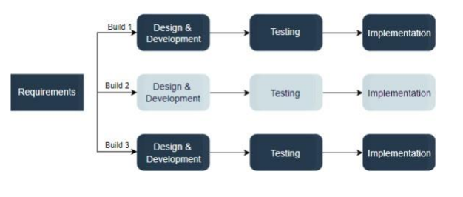
Process Model
For our project we have used Iterative Process Model.

Slide 13
Algorithm in Application
For Making our project “Public Blog Web Aplication we have used the REST API. A RESTful API is an architectural style for an application program interface (API) that uses HTTP requests to access and use data. That data can be used to GET, PUT, POST and DELETE data types, which refers to the reading, updating, creating and deleting of operations concerning resources.
In our project we wanted the user to post the Blog Read and Write the blog Edit and Delete his/her blog along with that we also wanted our users to like and comment on that particular blog.
So for that we have used several methodologies like GET, PUT, POST, DELETE to deal the database and application.
Step-1: Name of the endpoint should be accompanied by the HTTP method.
Step-2:Return standard error codes according to the result of our API.
Step-3:Endpoints name should be plural
Step-4:Routes Should be perfectly Specified
Step-5:Any Port number should be fixed while performing you code

Slide 14
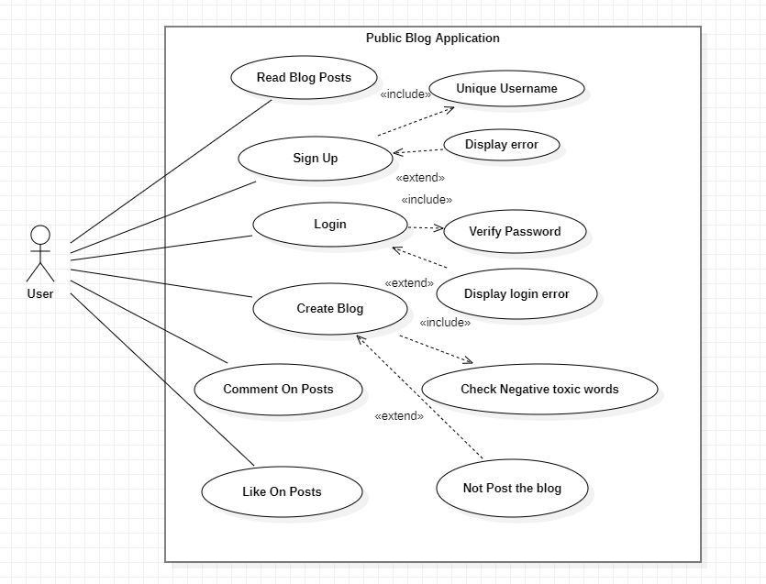
Use-Case Diagram

Slide 15
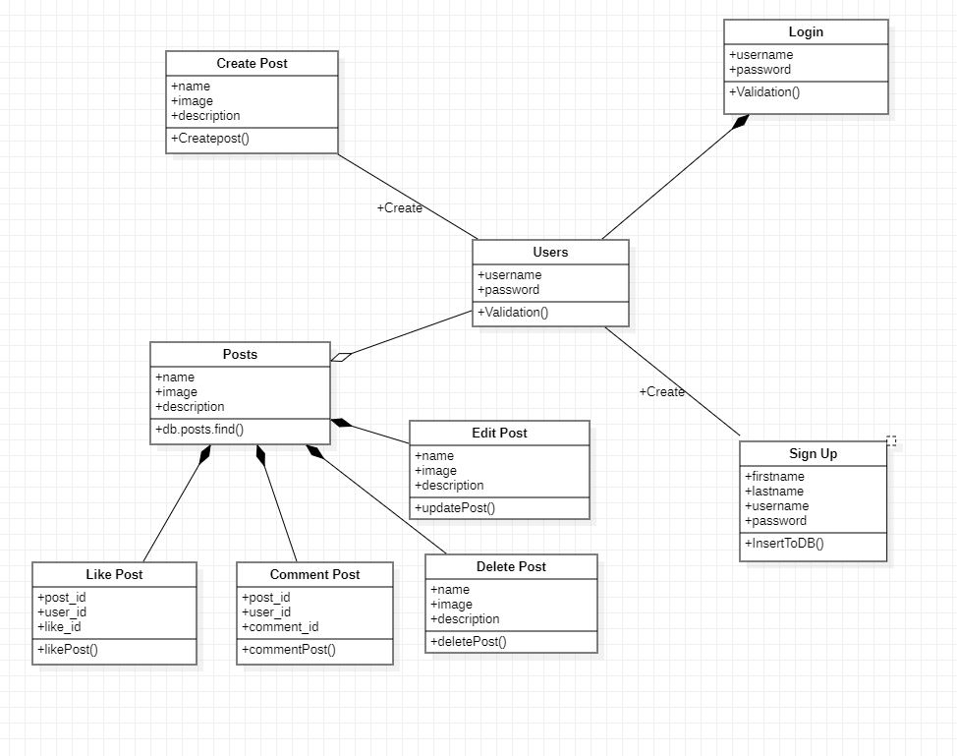
Class Diagram

Slide 16
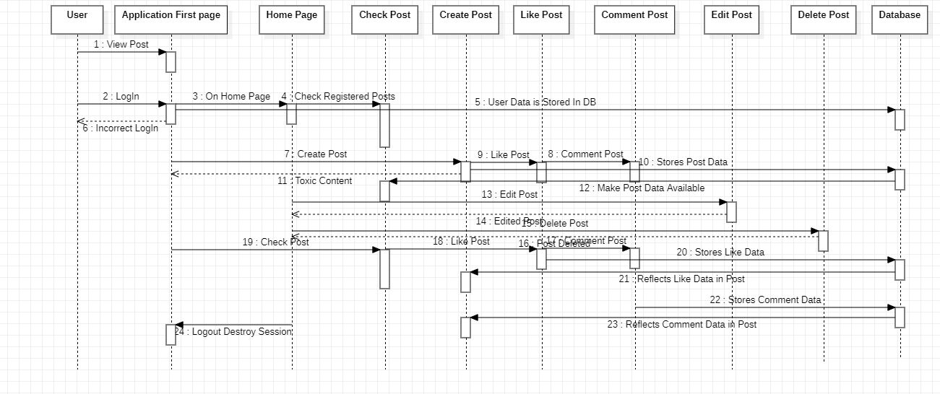
Sequential Diagram

Slide 17
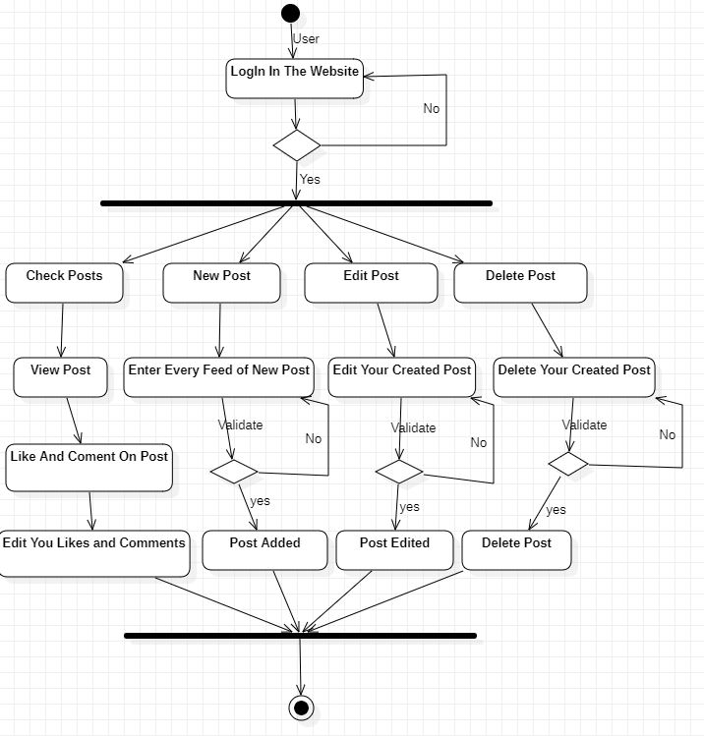
Activity Diagram

Slide 18
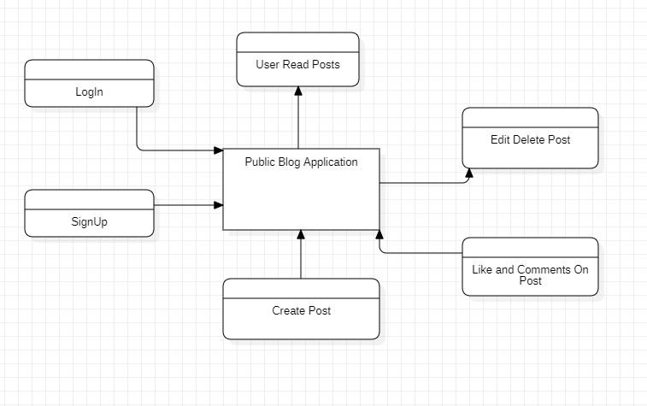
Data Flow Diagram
Level:0

Slide 19
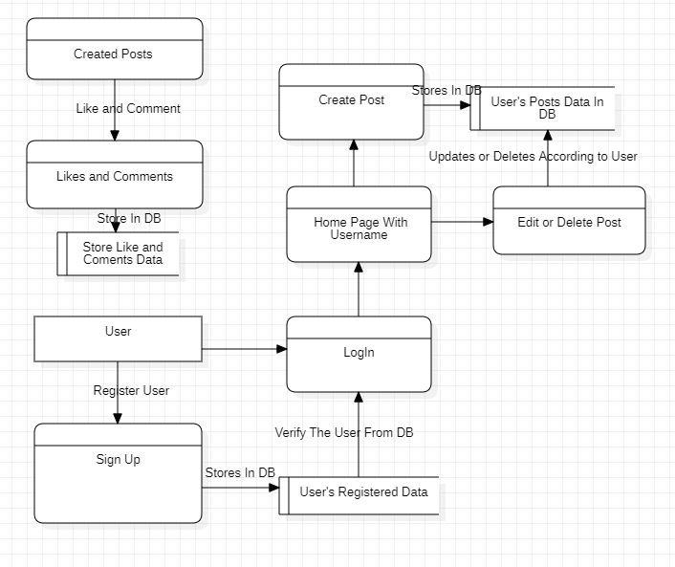
Data Flow Diagram
Level:1

Slide 20
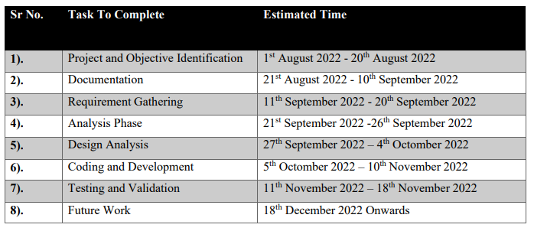
Project Planning

Slide 21
Conclusion
Public Blog Application is a web based application which will be working on the ground level or local level in which normal people can share there ideas and stories by writing a blog, While creating a blog the user can give a super short and appropriate title which suits his ideas or story when the user is publishing his blog along with that the user can also put an image to describe the view and imaginary thoughts of his blog after that user can give a brief introduction about his ideas or story and can post among people.
Describing on the advanced level the user can like the blog posts of other people and along with that they can comment on the other people’s blog application, trust me it’s very easy and simple.
And at the end we would like to conclude that in our project there is much more we can do like we can add more number of functionality by deeply researching on different edges of technologies and we make sure will update and add new features time by time and will surely notify you on regular basis.

Slide 22
Future Work
Talking about the future work we will update the user experience and user interface on monthly basis after deploying our application and after that as our project is Public Blog Application so in this project we can add more number of functionality and features.
The kind of features that we can implement in the future is that like the user who want to write a blog that process can be achieved by simply speaking and the description of the project will go with the flow and will check the content of the blog wheather it is good or bad and according to that user will be able to postthe blog.
Others features that we can implement in the future are like we can set topics drop down list in which user can read the posts accordingly to his or her interest, like lets say the user only likes to read blog on cricket so in this case the user can select the specific topic and in that topic they can read the registred blog of that particular topic easily.
And later on we will provide the user to edit his description by giving the text editor tool in which the user can edit text description by there own very easily, along will that we will also provide the user to add multiple images for posting a single blog post which can make the user readability idea a very clear one.
They main thing that we are going to add in this project is the scalability term which allows thousands of users to use the application on a single parallel time, so we will definetly think to scale our project at our best

Slide 23
References
1. In Our Project “Public Blog Application” to understand the removal of toxicity in the blog content to make the content more efficient and precise we have gained literature survey from.
https://towardsdatascience.com/toxic-comment-classification-using-lstm-and-lstm-cnndb945d6b7986
2. To Understand how to fetch the registered data from the database while dealing with MongoDB I have gone through,
https://www.w3resource.com/mongodb/mongodb-queries-from-collection.php
3. Secondly to learn how a blogging application is built in node,js we have gone across many websites and understood how to make a efficient project by using simple line of code and what databases to use for easily retrevial of the data through the REST API.
https://vegibit.com/node-js-blog-tutorial/
4. Thirdly to know how to add the comment on the blog feature I have learned from,
https://makeschool.org/mediabook/oa/tutorials/reddit-clone-in-node-js/comment-on-post/
5. Now after learning all these things to know about the actual architecture on how to build a great UI(Frontend) so that the user finds it good to use our application I have gone through many blogging websites which are,
https://medium.com/
https://www.blogger.com/about/
https://wordpress.com/
https://www.weebly.com/in/features/start-a-blog

Slide 24
Thankyou
Any-Question’s?

