Slide 1
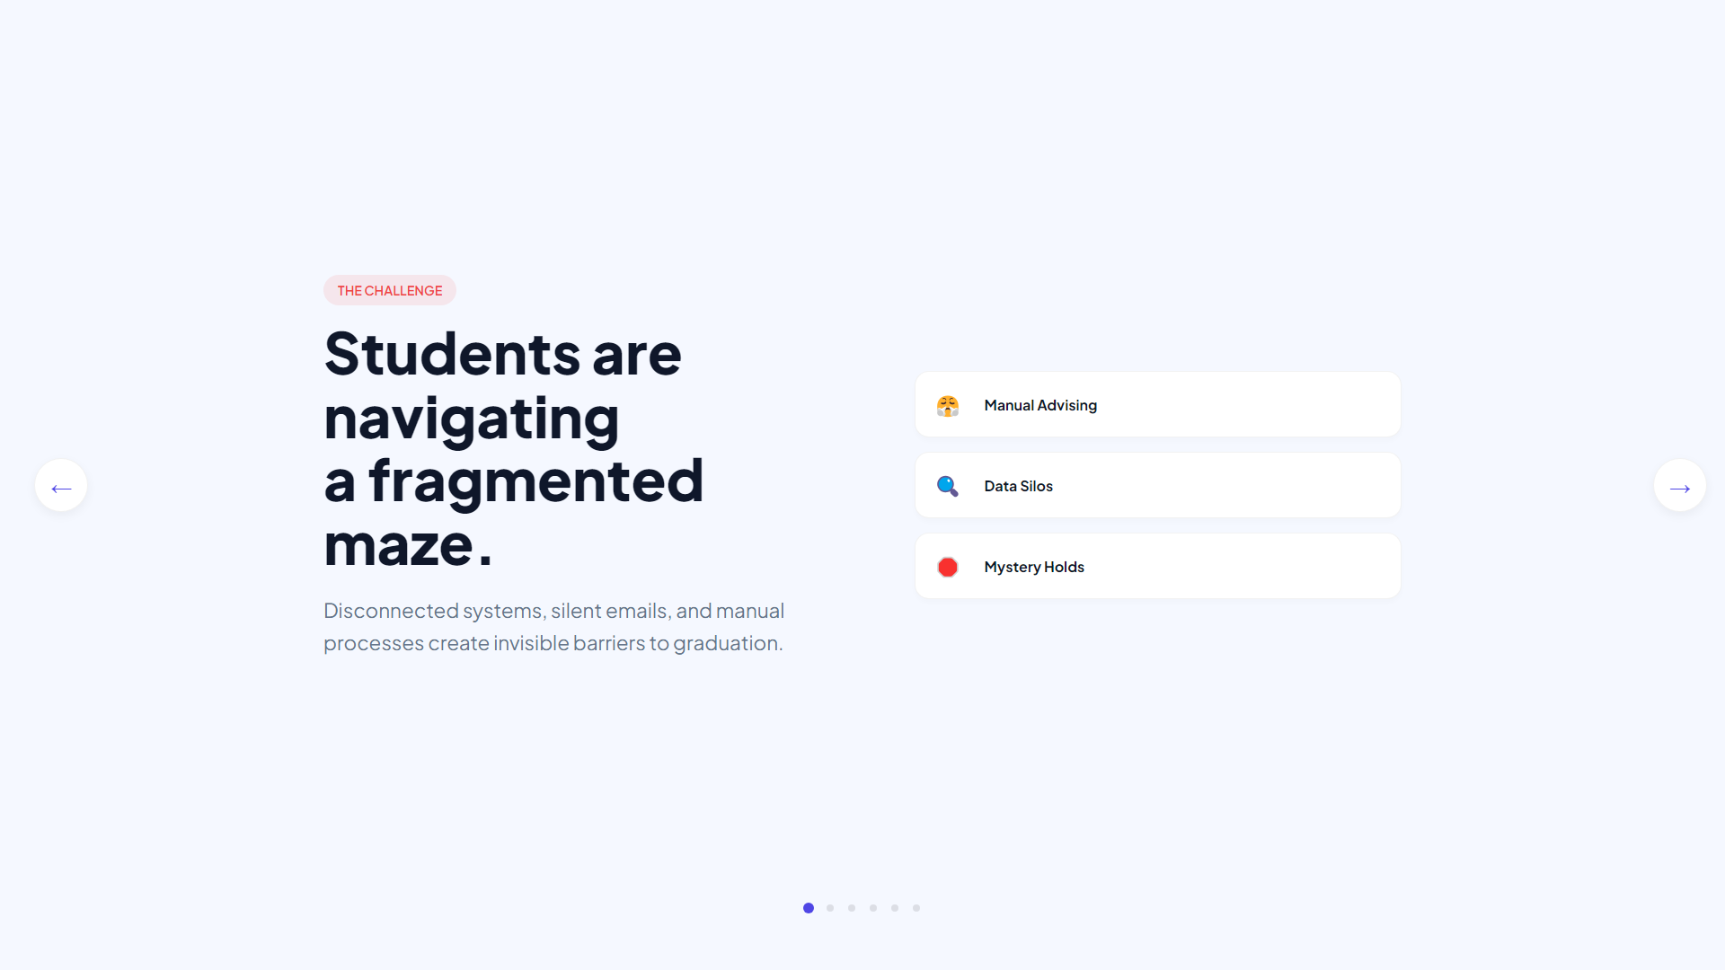
Notes:
THE CHALLENGE
Fragmented Academic Data
Today, universities face an enormous challenge. Thousands of students — each with a unique academic journey... aumtech.ai changes that.

Slide 2
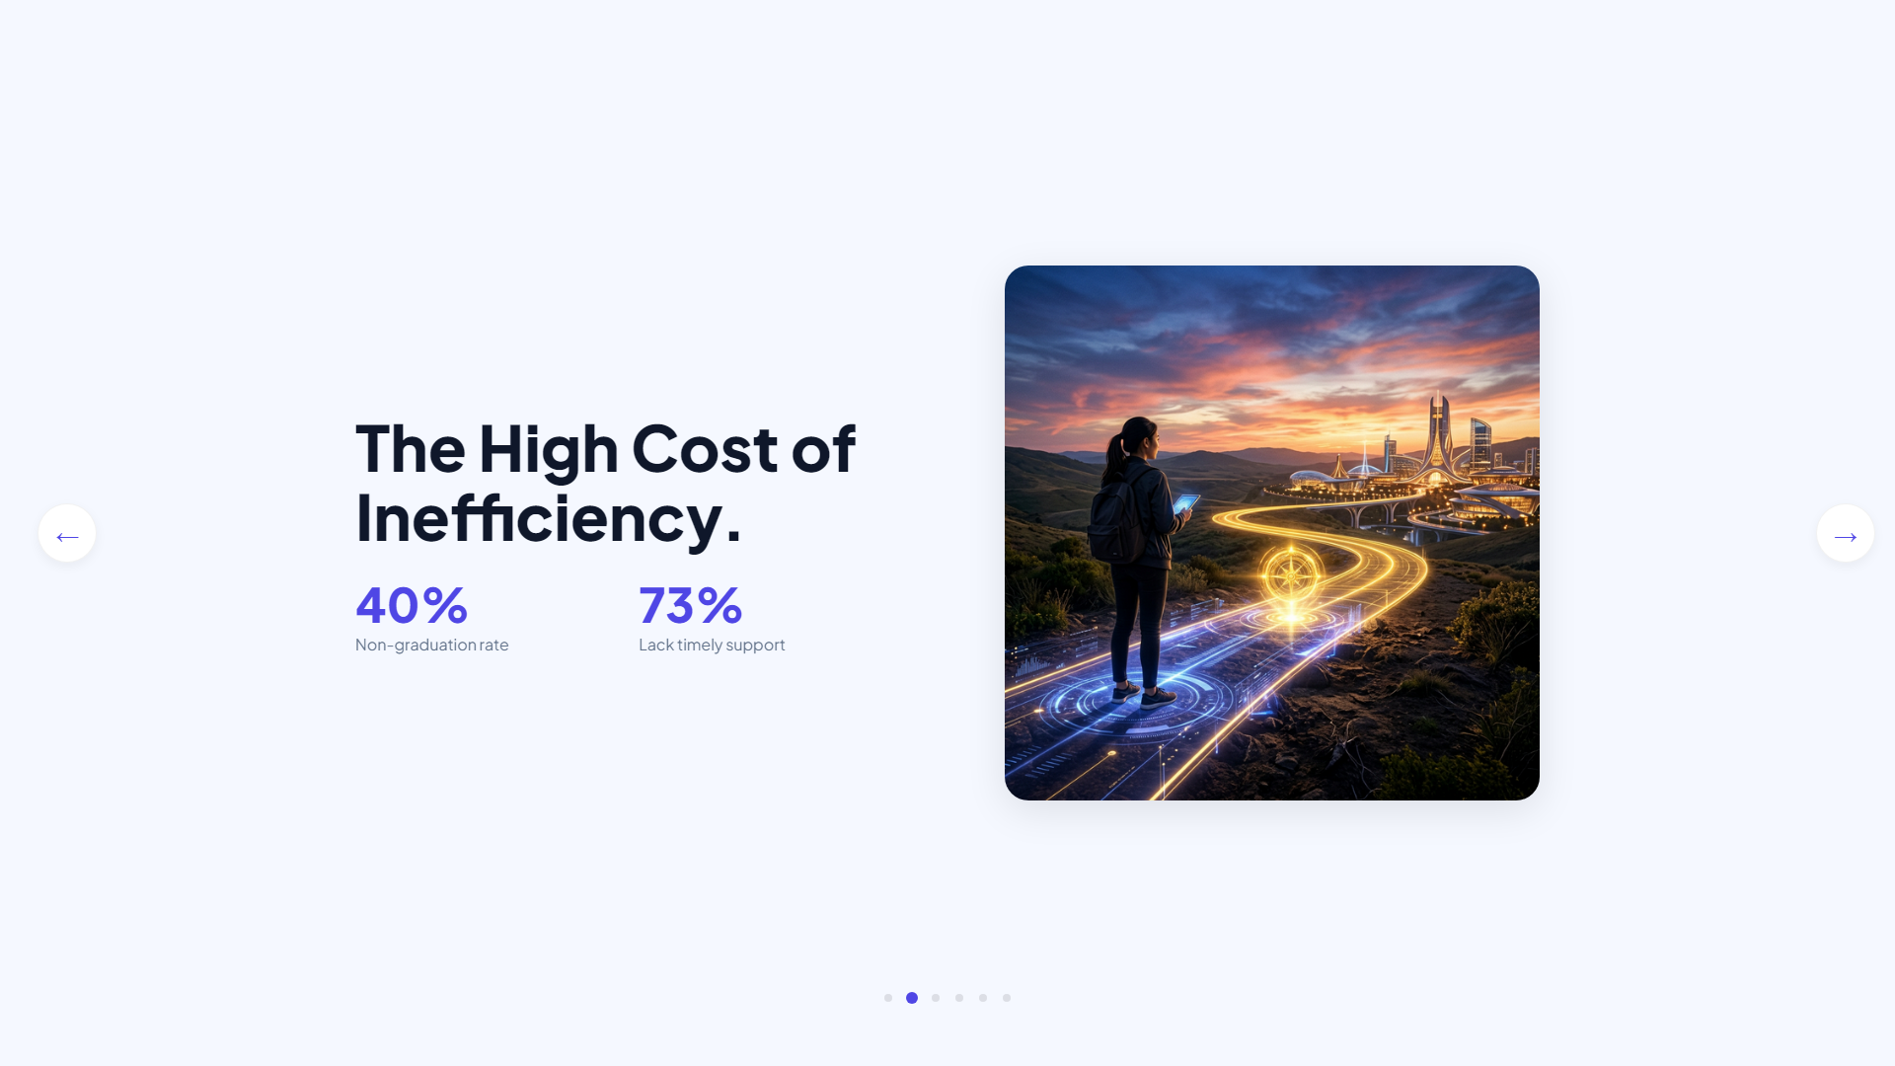
Notes:
THE COST OF INEFFICIENCY
Administrative Overload
Healthcare got diagnostic AI. Legal got contract automation. But the university has been left behind... until now.

Slide 3
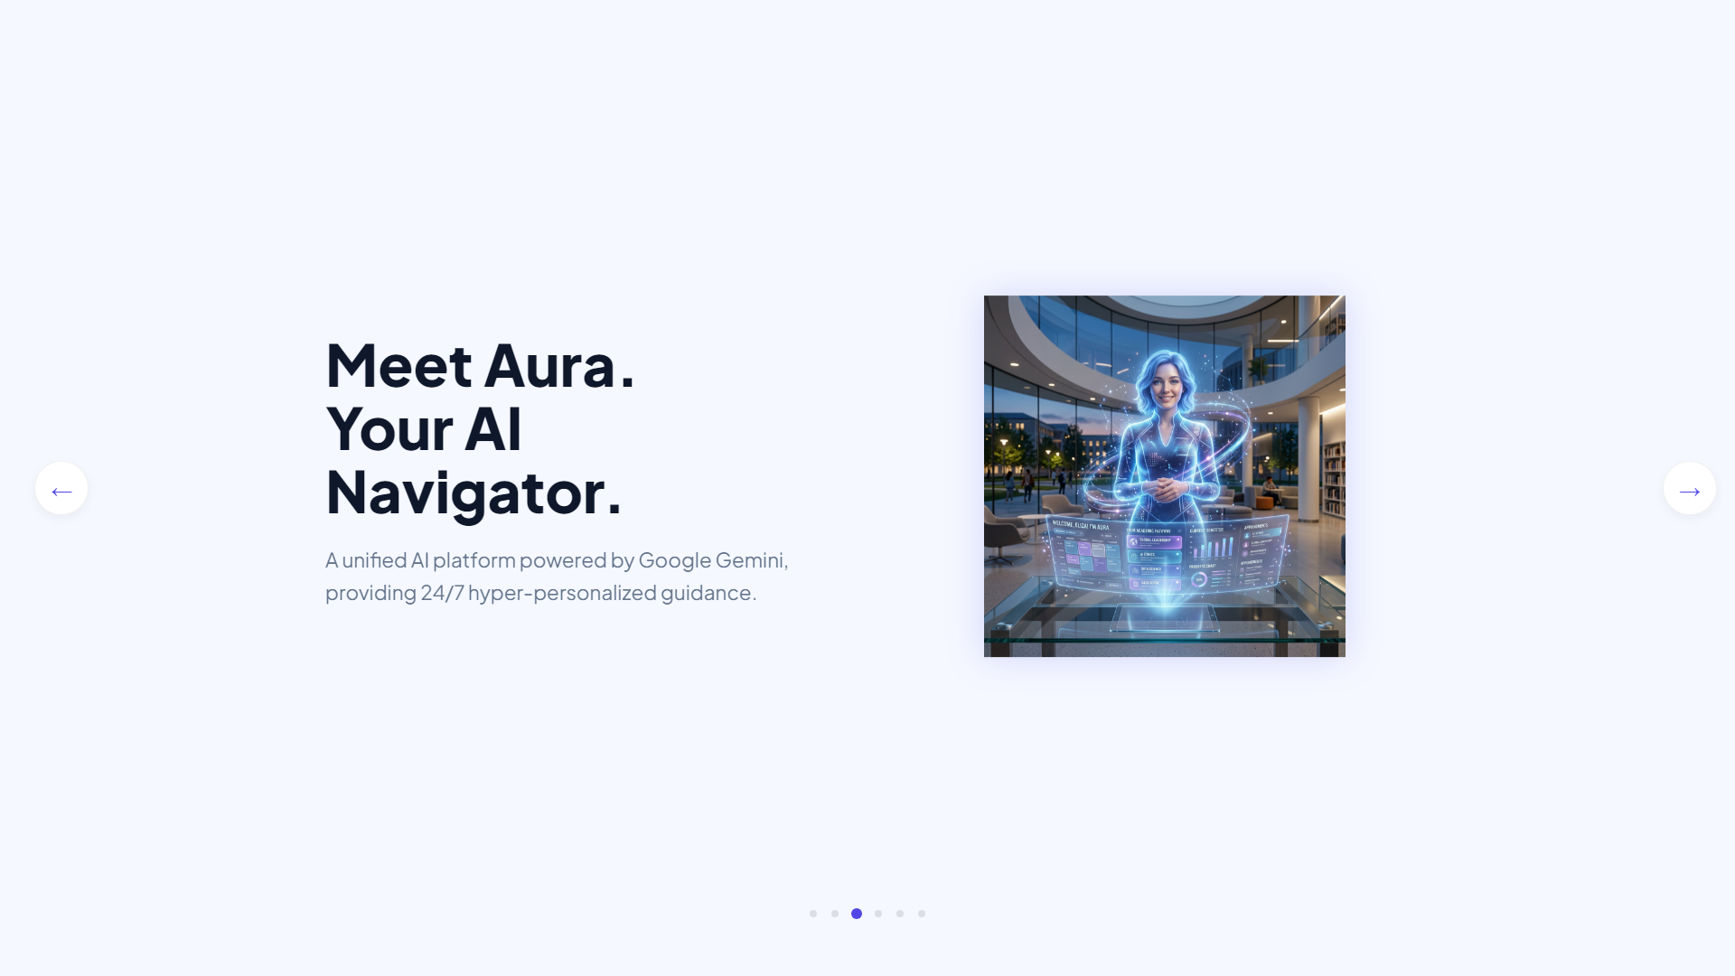
Notes:
MEET AURA
Agentic Student Success
Meet aumtech.ai — the world's first Agentic Student Success Platform. An intelligent academic operating system that thinks alongside every student.

Slide 4
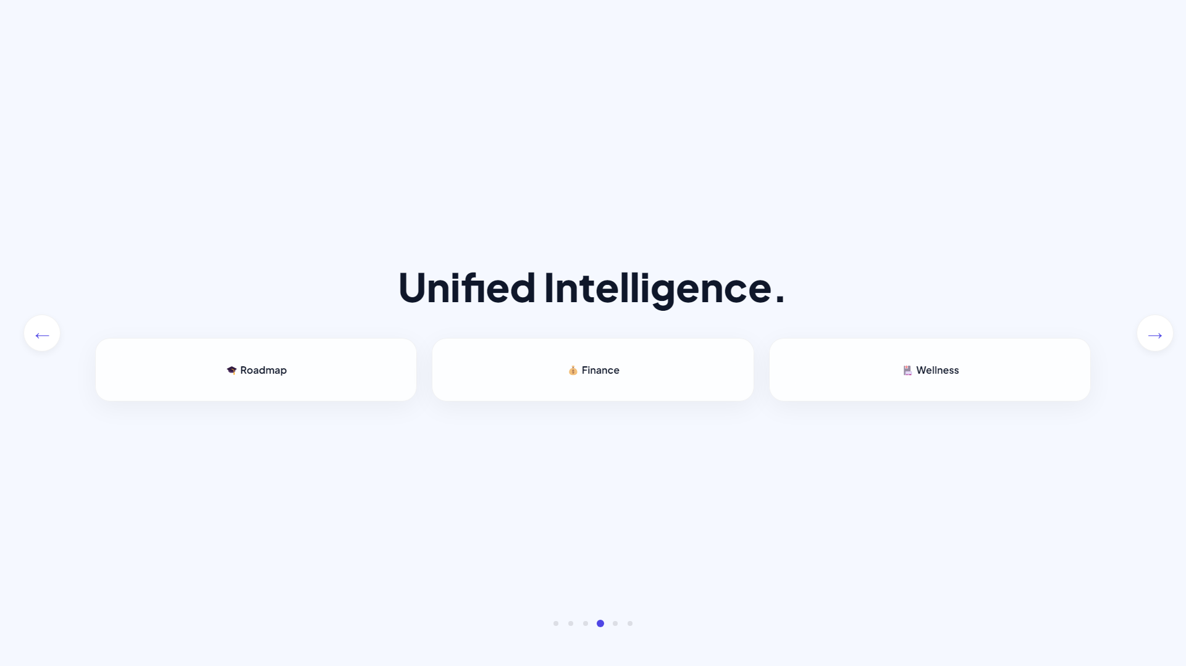
Notes:
ARCHITECTURE
EdNex & Aura
Project EdNex functions as a DataStream conduit, securely normalizing legacy data into a unified cloud hub for Aura's intelligence layer.

Slide 5
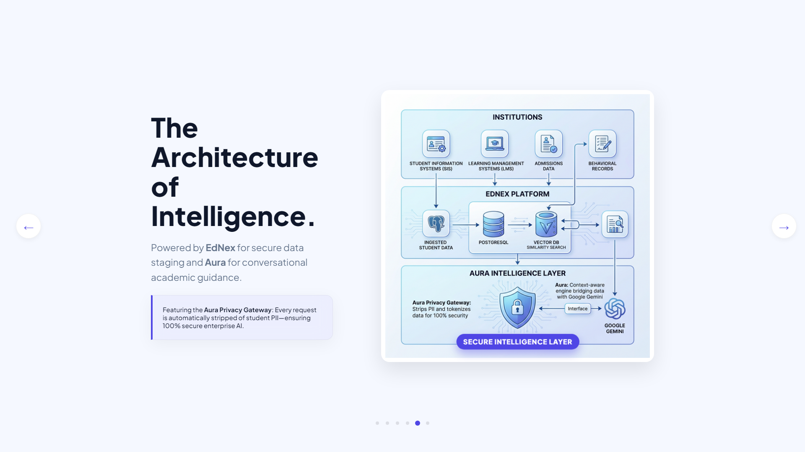
Notes:
PRIVACY & SECURITY
Enterprise Grade AI
Every request passes through our Aura Privacy Gateway, where sensitive student PII is automatically stripped and tokenized.

Slide 6
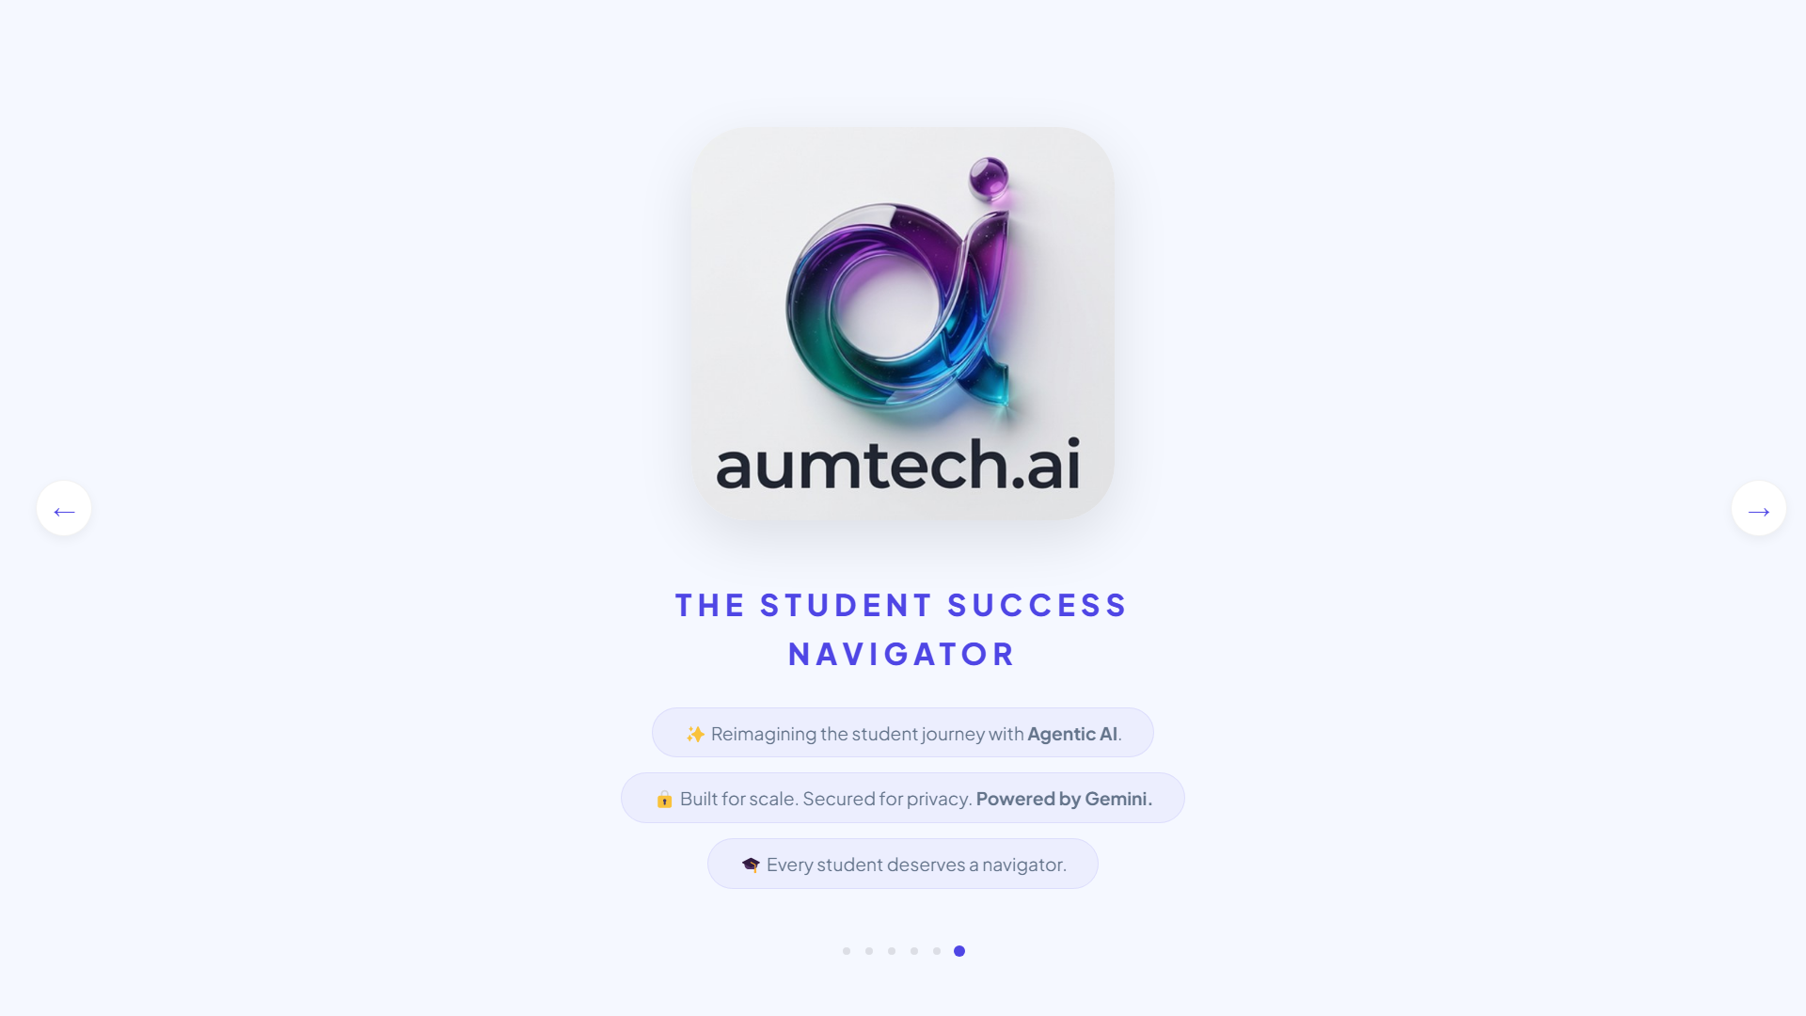
Notes:
LOGIN PAGE
Your AI Navigator Starts Here
The sign-in experience is clean and professional. Students log in with their university credentials.

Slide 7
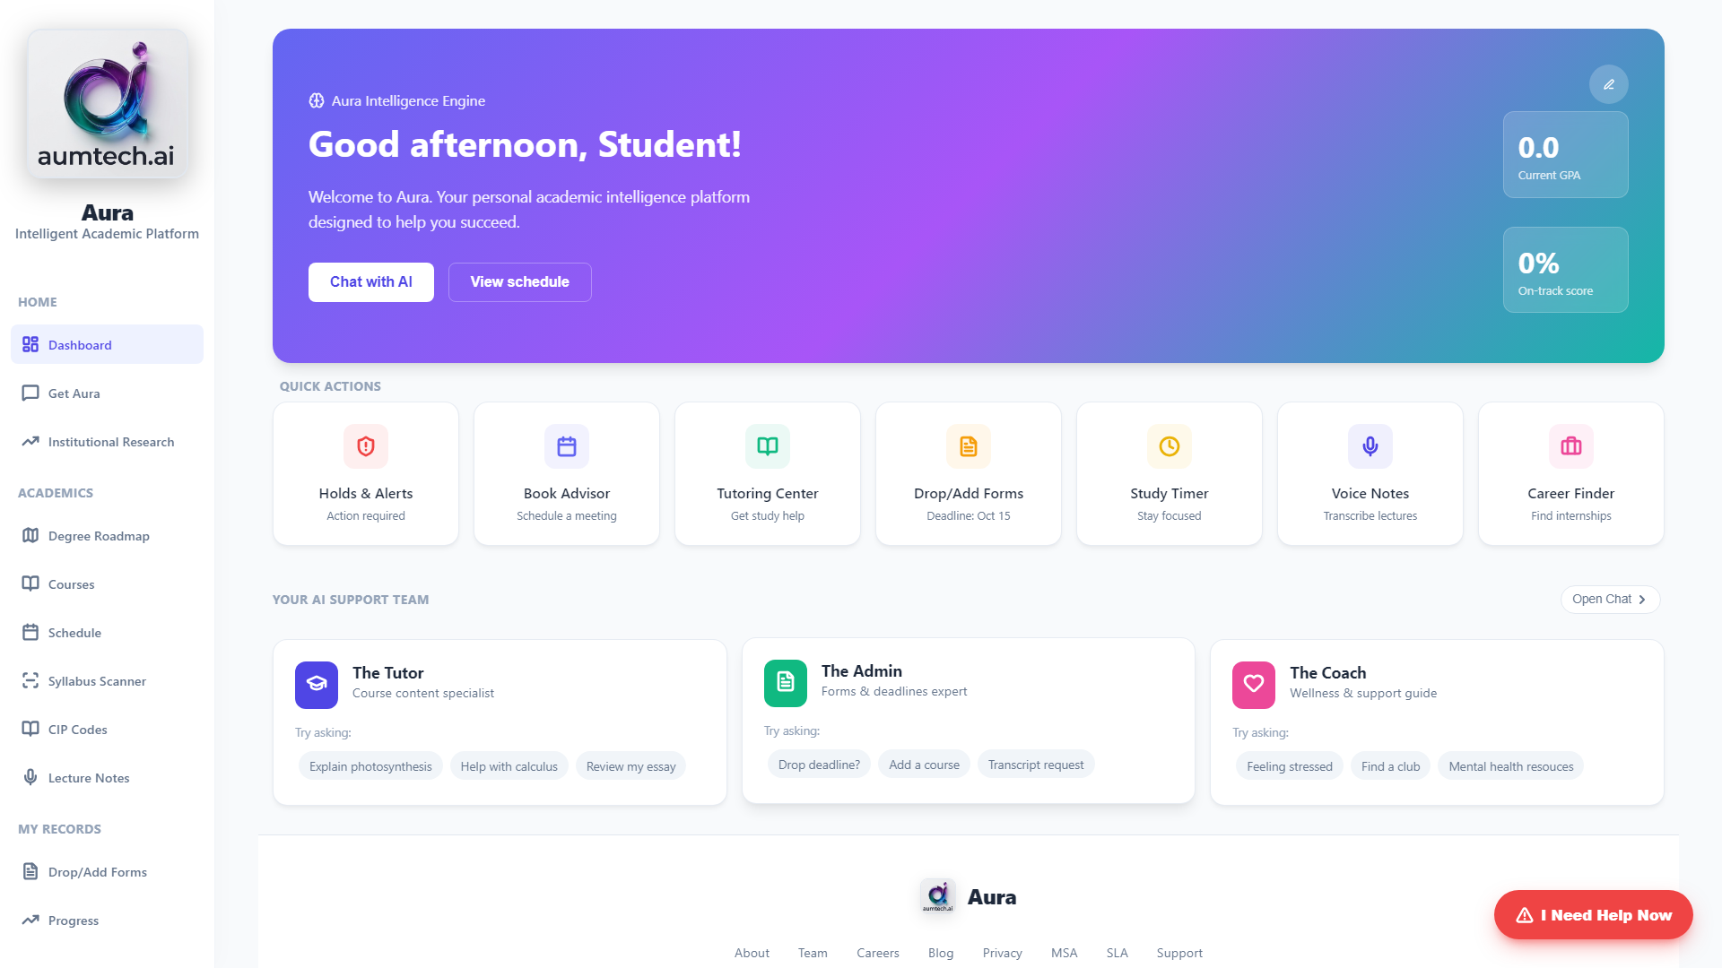
Notes:
PERSONALIZED DASHBOARD
Live Success Metrics
Welcome to the Student Dashboard. The first thing a student sees is a warm, personalized greeting from Aura. The On-Track Score reflects real-time progress.

Slide 8
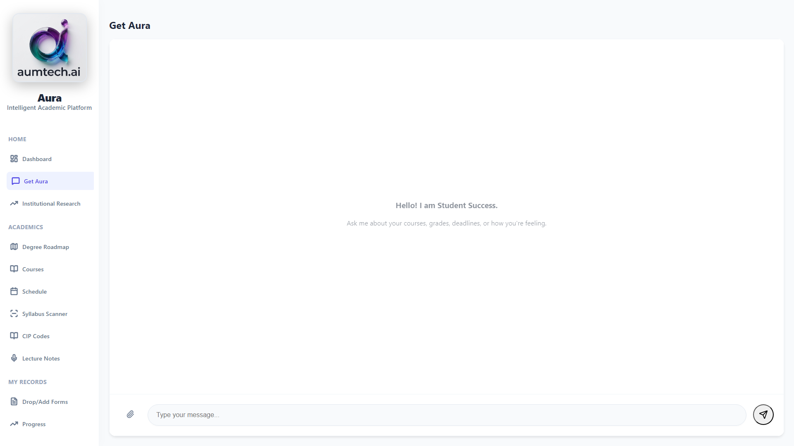
Notes:
GET AURA (AI CHAT)
Conversational Guidance
At the heart of aumtech.ai is Aura — a conversational academic agent powered by Google Gemini. It knows your courses, grades, and calendar.

Slide 9
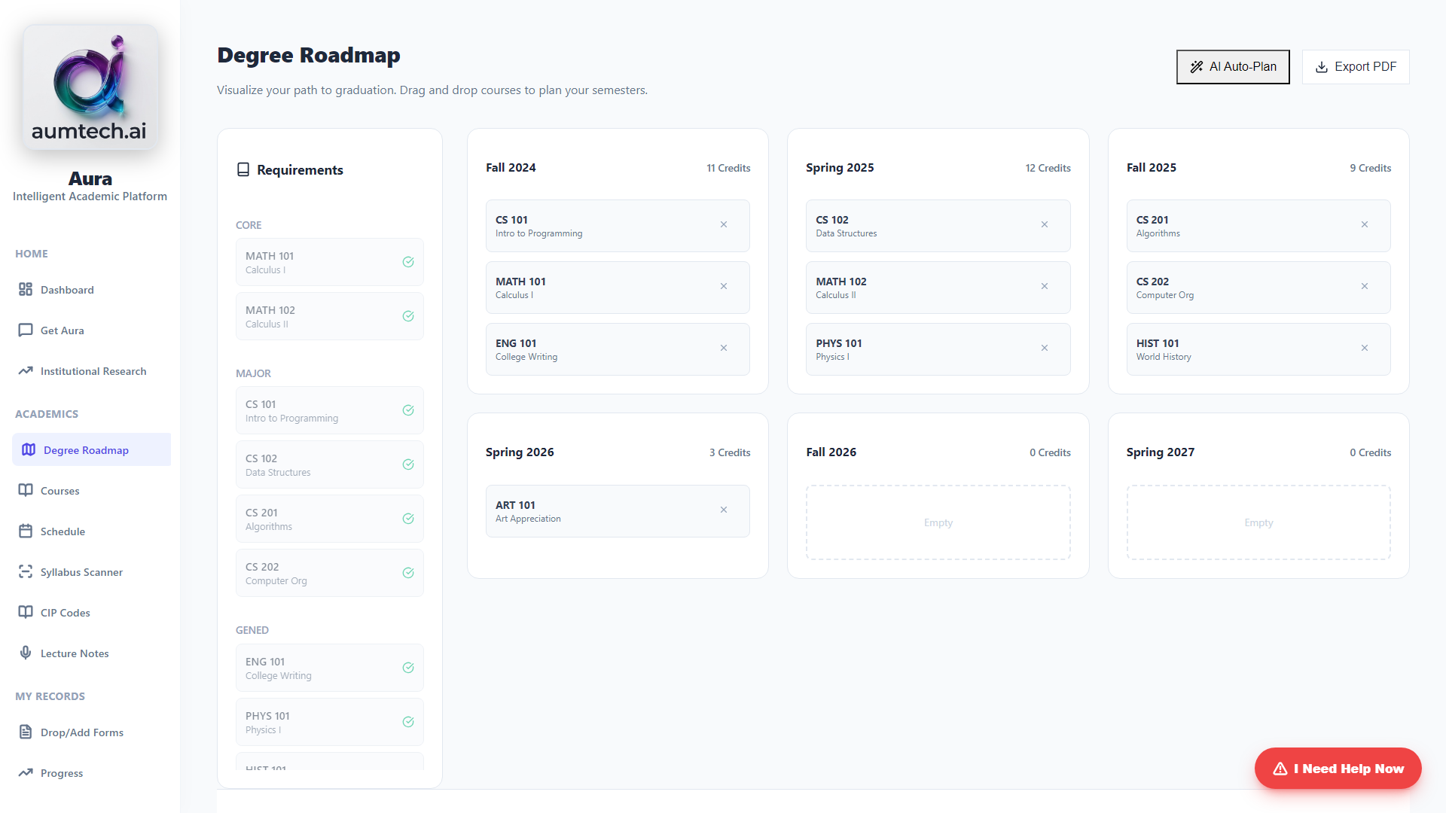
Notes:
ACADEMIC ROADMAP
Courses & Progression
Under Academics, students get a clear view of every course. The Degree Roadmap shows the entire journey visually. No more mysterious holds.

Slide 10
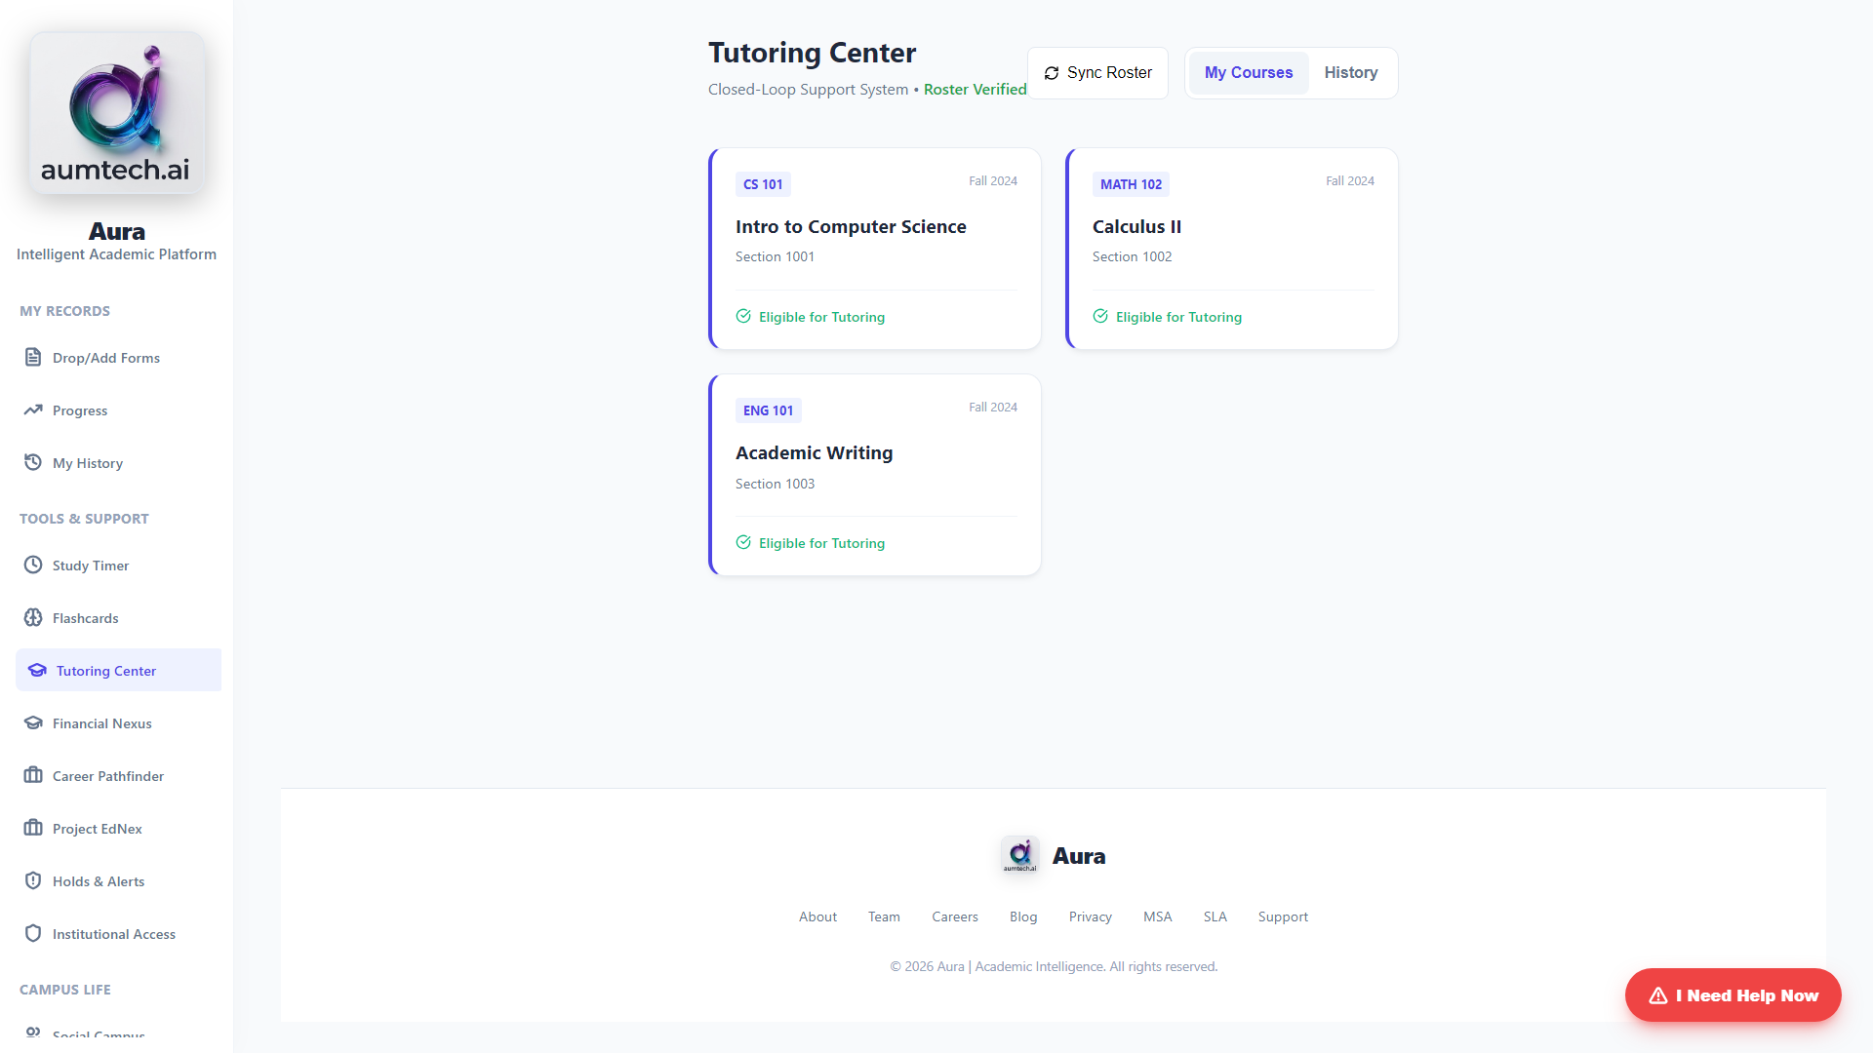
Notes:
TUTORING CENTER
Intelligent Triage
Syncs directly with Canvas/Blackboard. Our AI analyzes triage notes, generates TA briefs, and load-balances sessions in seconds.

Slide 11
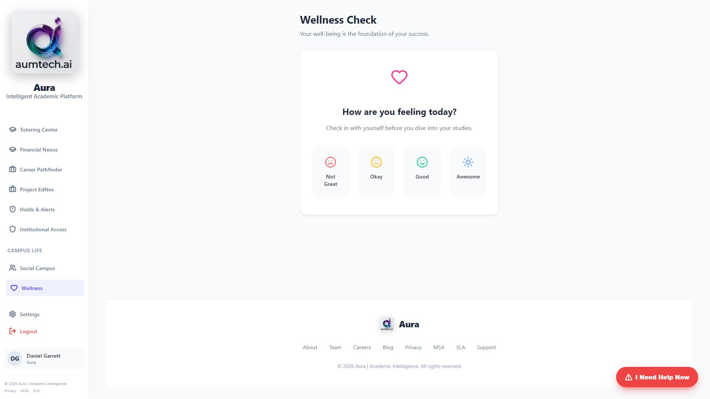
Notes:
WELLNESS & PRODUCTIVITY
The Whole Student
Wellness Check-ins personalize recommendations. The Study Timer provides focus tools integrated into your success metrics.

Slide 12
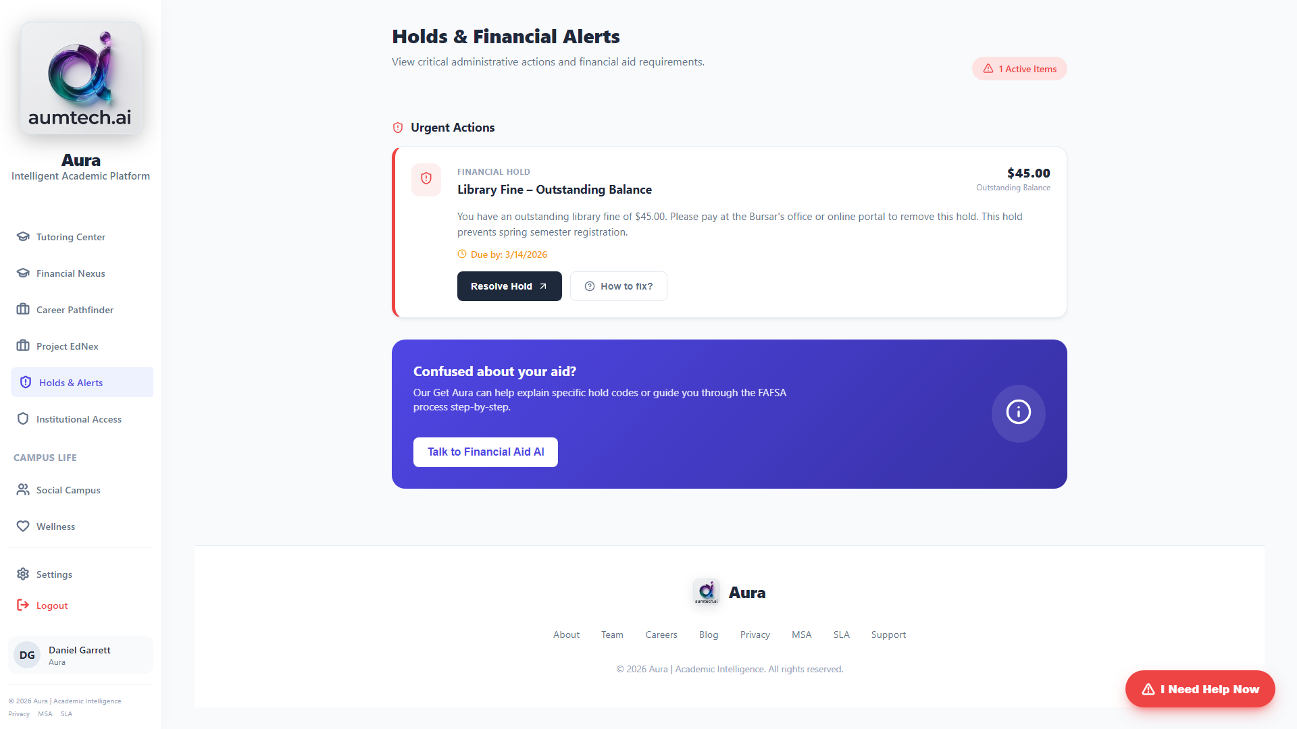
Notes:
HOLDS CENTER
Transparent Resolution
Shows every active hold in plain language: what it is, why it exists, and how much is owed. One click to resolve.

Slide 13
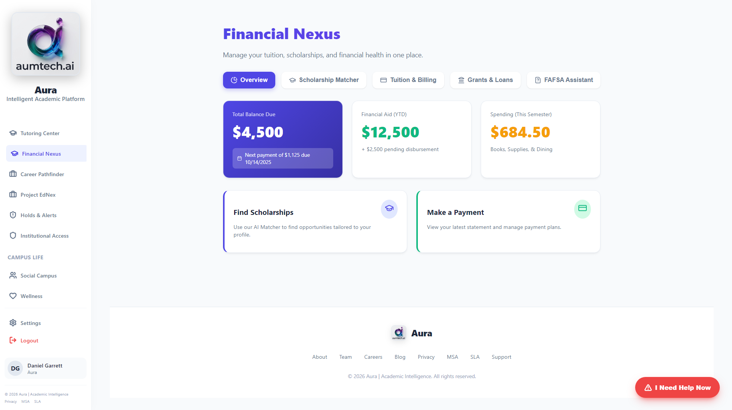
Notes:
FINANCIAL AID NEXUS
Scholarship Matching
Gemini analyzes your GPA, major, and interests against available scholarships. Draft personal statements in seconds.

Slide 14
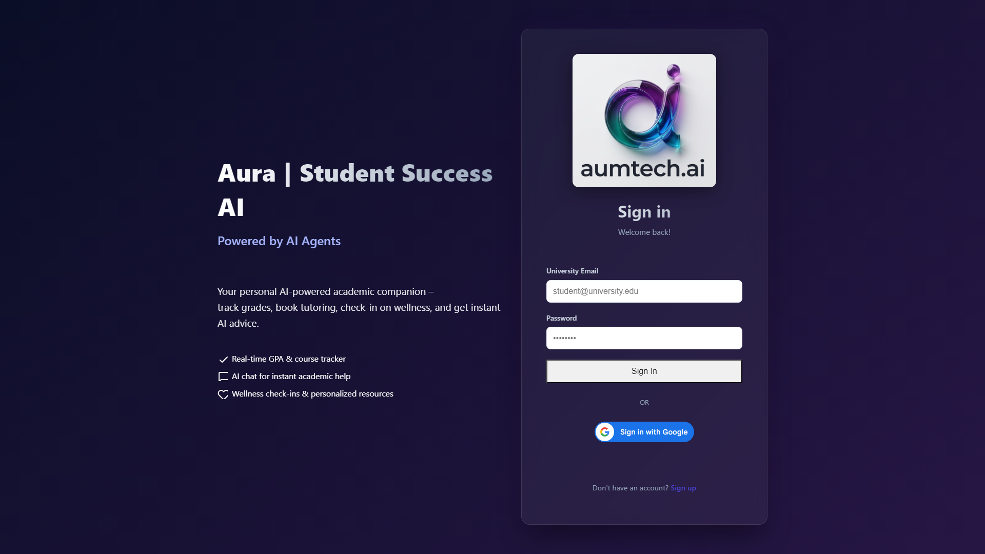
Notes:
INSTITUTIONAL ANALYTICS
Dean's Dashboard
Admins see a live risk dashboard. Launch outreach campaigns in a click. See tutoring demand and TA impact in real-time.

