Slide 1
Problem Statement
Integrating Common Service For Common People
Title : MediPrediction
Subtitle: A Comprehensive Health Monitoring and Prediction Service
Presented by: Aum P. Vashi
Guided by: Prof. Ashish Pandey

Slide 2
Unique Idea Brief (Solution)
Problem:
Difficulty in early detection and management of chronic diseases.
Lack of accessible and personalized health monitoring tools.
Solution:
A web-based health assistant application providing predictive insights for diabetes, heart disease, and Parkinson's disease using machine learning models.
Secure user management with encrypted passwords and admin functionalities.

Slide 3
Features Offered
User Authentication:
Secure login and sign-up.
Admin functionality to view user details with password encryption.
Health Predictions:
Diabetes Prediction.
Heart Disease Prediction.
Parkinson's Disease Prediction.
Interactive User Interface:
Easy navigation through different sections.
User-friendly input forms for health data.
Admin Panel:
Exclusive access for admin to view user details.
Administrative controls for managing users.

Slide 4
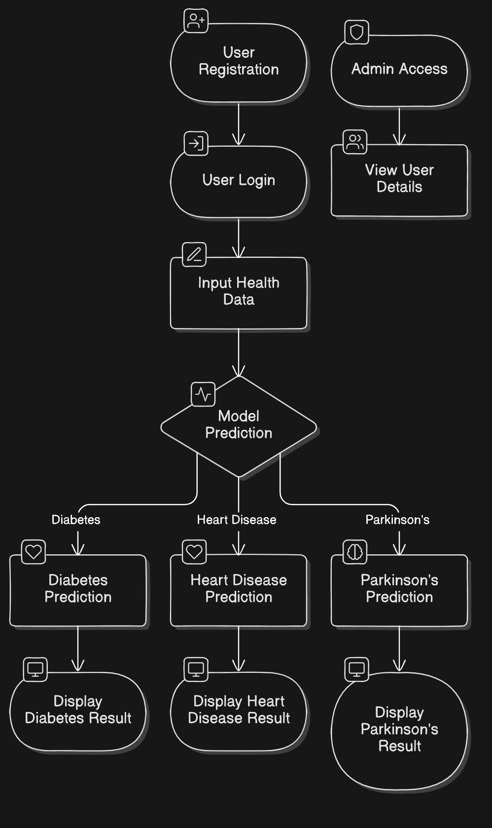
Process flow
User Registration:
New users sign up by providing necessary details.
Passwords are securely hashed before storing.
User Login:
Users log in with their credentials.
Health Prediction:
Users input health-related data.
Machine learning models predict health conditions based on input.
Result Display:
Predictions are displayed with appropriate messages.
Admin Access:
Admin can view user details and manage the database.

Slide 5
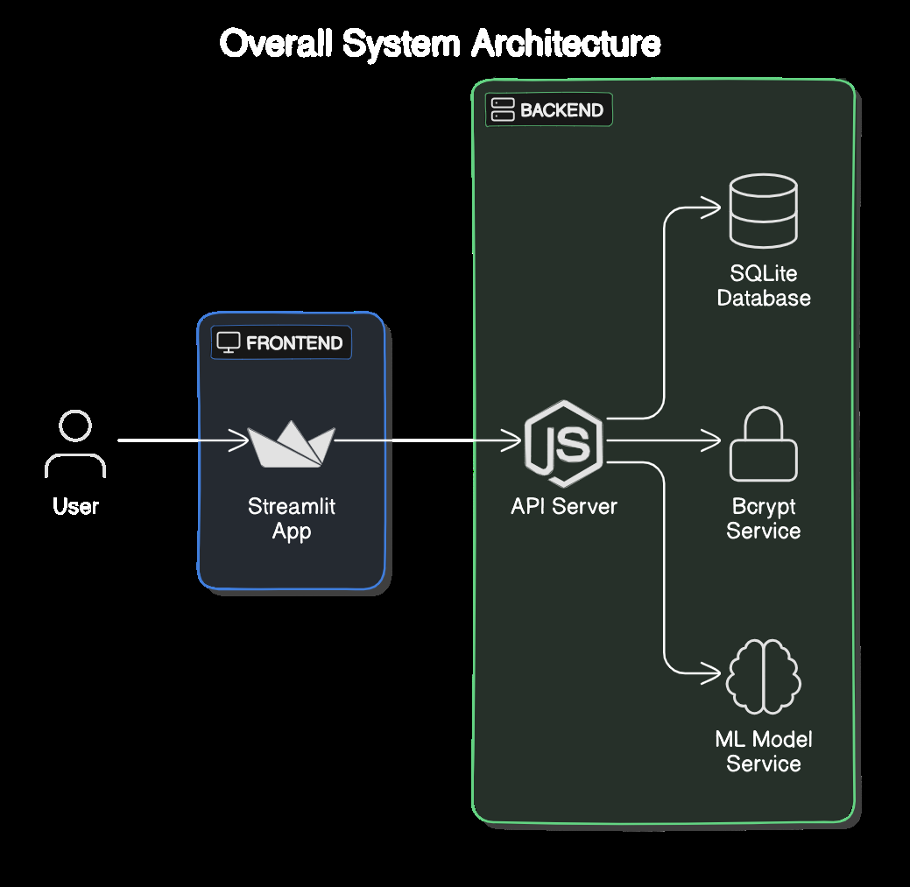
Architecture Diagram

Slide 6




Technologies used
Streamlit:
For building the interactive web application interface.
SQLite:
For database management.
Bcrypt:
For secure password hashing.
Python:
For backend logic and machine learning model integration.
Machine Learning Models:
Pre-trained models for diabetes, heart disease, and Parkinson's disease prediction.

Slide 7
Conclusion
Summary:
The Health Assistant Application provides an accessible and secure solution for early detection and management of chronic diseases.
It combines user-friendly interfaces with powerful machine learning models.
Future Enhancements:
Integration with wearable devices for real-time health monitoring.
Expansion to predict more health conditions.

Slide 8
Thank You

