Slide 1
W
E
L
C
O
M
E

Slide 2


Muhammad Aun
22-NTU-CS-1280
FREELANCER app is a platform, as we can understand through its name “Freelancer”, designed for the selling and buying the professional services. It is works as a digital workplace where the business client can post a job and freelancers can show there expertise and can bid on the jobs and then can give the description about their bids and the time under which he/her can do that job. The client chooses any of the bids of the freelancers of like it and that job will be assigned to that freelancer (just like winning the tenders).

Slide 3



PURPOSE
FREELANCER app is a platform, as we can understand through its name “Freelancer”, designed for the selling and buying the professional services. It is works as a digital workplace where the business client can post a job and freelancers can show there expertise and can bid on the jobs and then can give the description about their bids and the time under which he/her can do that job. The client chooses any of the bids of the freelancers of like it and that job will be assigned to that freelancer (just like winning the tenders).
Clients
Freelancers
Connecting clients and freelancers
for professional services.
Muhammad Aun
22-NTU-CS-1280

Slide 4
PURPOSE
Clients
Freelancers
Connecting clients and freelancers
for professional services.

Slide 5

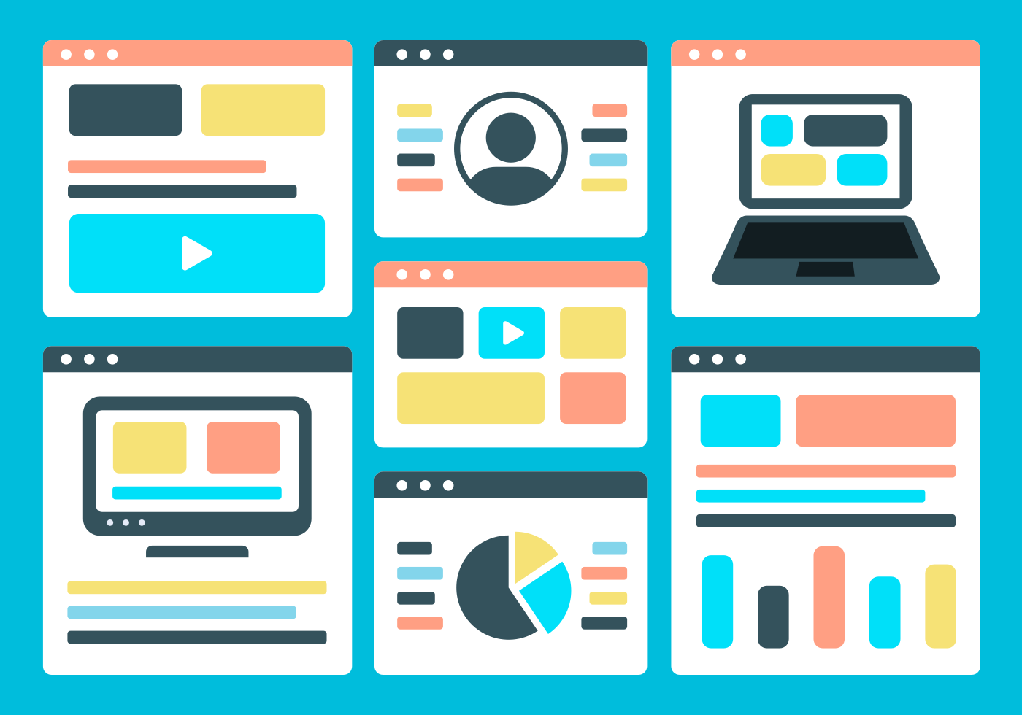

OBJECTIVES
Provide a seamless interface for
job posting and bidding
1
Ensure secure communication
and payment
2
Facilitate trust through reviews
and ratings
3

Slide 6

OBJECTIVES
Provide a seamless interface for
job posting and bidding
1
Ensure secure communication
and payment
2
Facilitate trust through reviews
and ratings
3

Slide 7
OBJECTIVES
Provide a seamless interface for
job posting and bidding
1
Ensure secure communication
and payment
2
Facilitate trust through reviews
and ratings
3

Slide 8
User registration and login
1
Project management
3
Job posting and bidding process
2
Payment handling and dispute resolution
4

Slide 9
INTERFACE
Focus on user-friendliness and responsiveness.
Separate interfaces for clients, freelancers, and admins.
Consideration of accessibility standards

Slide 10

COMMUNICATION
FLOW
Overview of user interactions (e.g., client-freelancer messaging).
Notifications via email and in-app alerts.
Real-time updates using WebSocket connections.

Slide 11


The system should scale horizontally to accommodate increasing user traffic.
Database should support sharding and replication for high availability.
CDN should be used to deliver static assets like images and scripts efficiently.
Scalability

Slide 12

SECURITY
Implement SSL/TLS to ensure secure data transmission.
Data encryption (AES-256) for sensitive information like passwords and payment details.
Role-based access control to prevent unauthorized actions.
Ensure compliance with GDPR and other data protection regulations.

Slide 13

USABILITY
The interface must be user-friendly and intuitive for both clients and freelancers.
The design must support accessibility standards.
Provide multilingual support for global users.

Slide 14

AVAILABILITY
& RELIABILITY
The platform should have an uptime of 99.9%.
Implement failover mechanisms to ensure continuous availability during server failures.
Backup and disaster recovery systems must recover data within 1 hour of any failure.

Slide 15
MAINTAINABILITY AND EXTENSIBILITY
The codebase should follow industry-standard coding practices and be modular for ease of updates.
APIs must be versioned to support future enhancements without disrupting existing users.
The platform should allow easy integration with third-party services.

Slide 16

COMPLEXITY
The platform must be compatible with the latest versions of popular browsers.
Ensure mobile responsiveness across devices with varying screen sizes.
The mobile app should support Android and iOS.

Slide 17

Any Question
?

