Slide 1

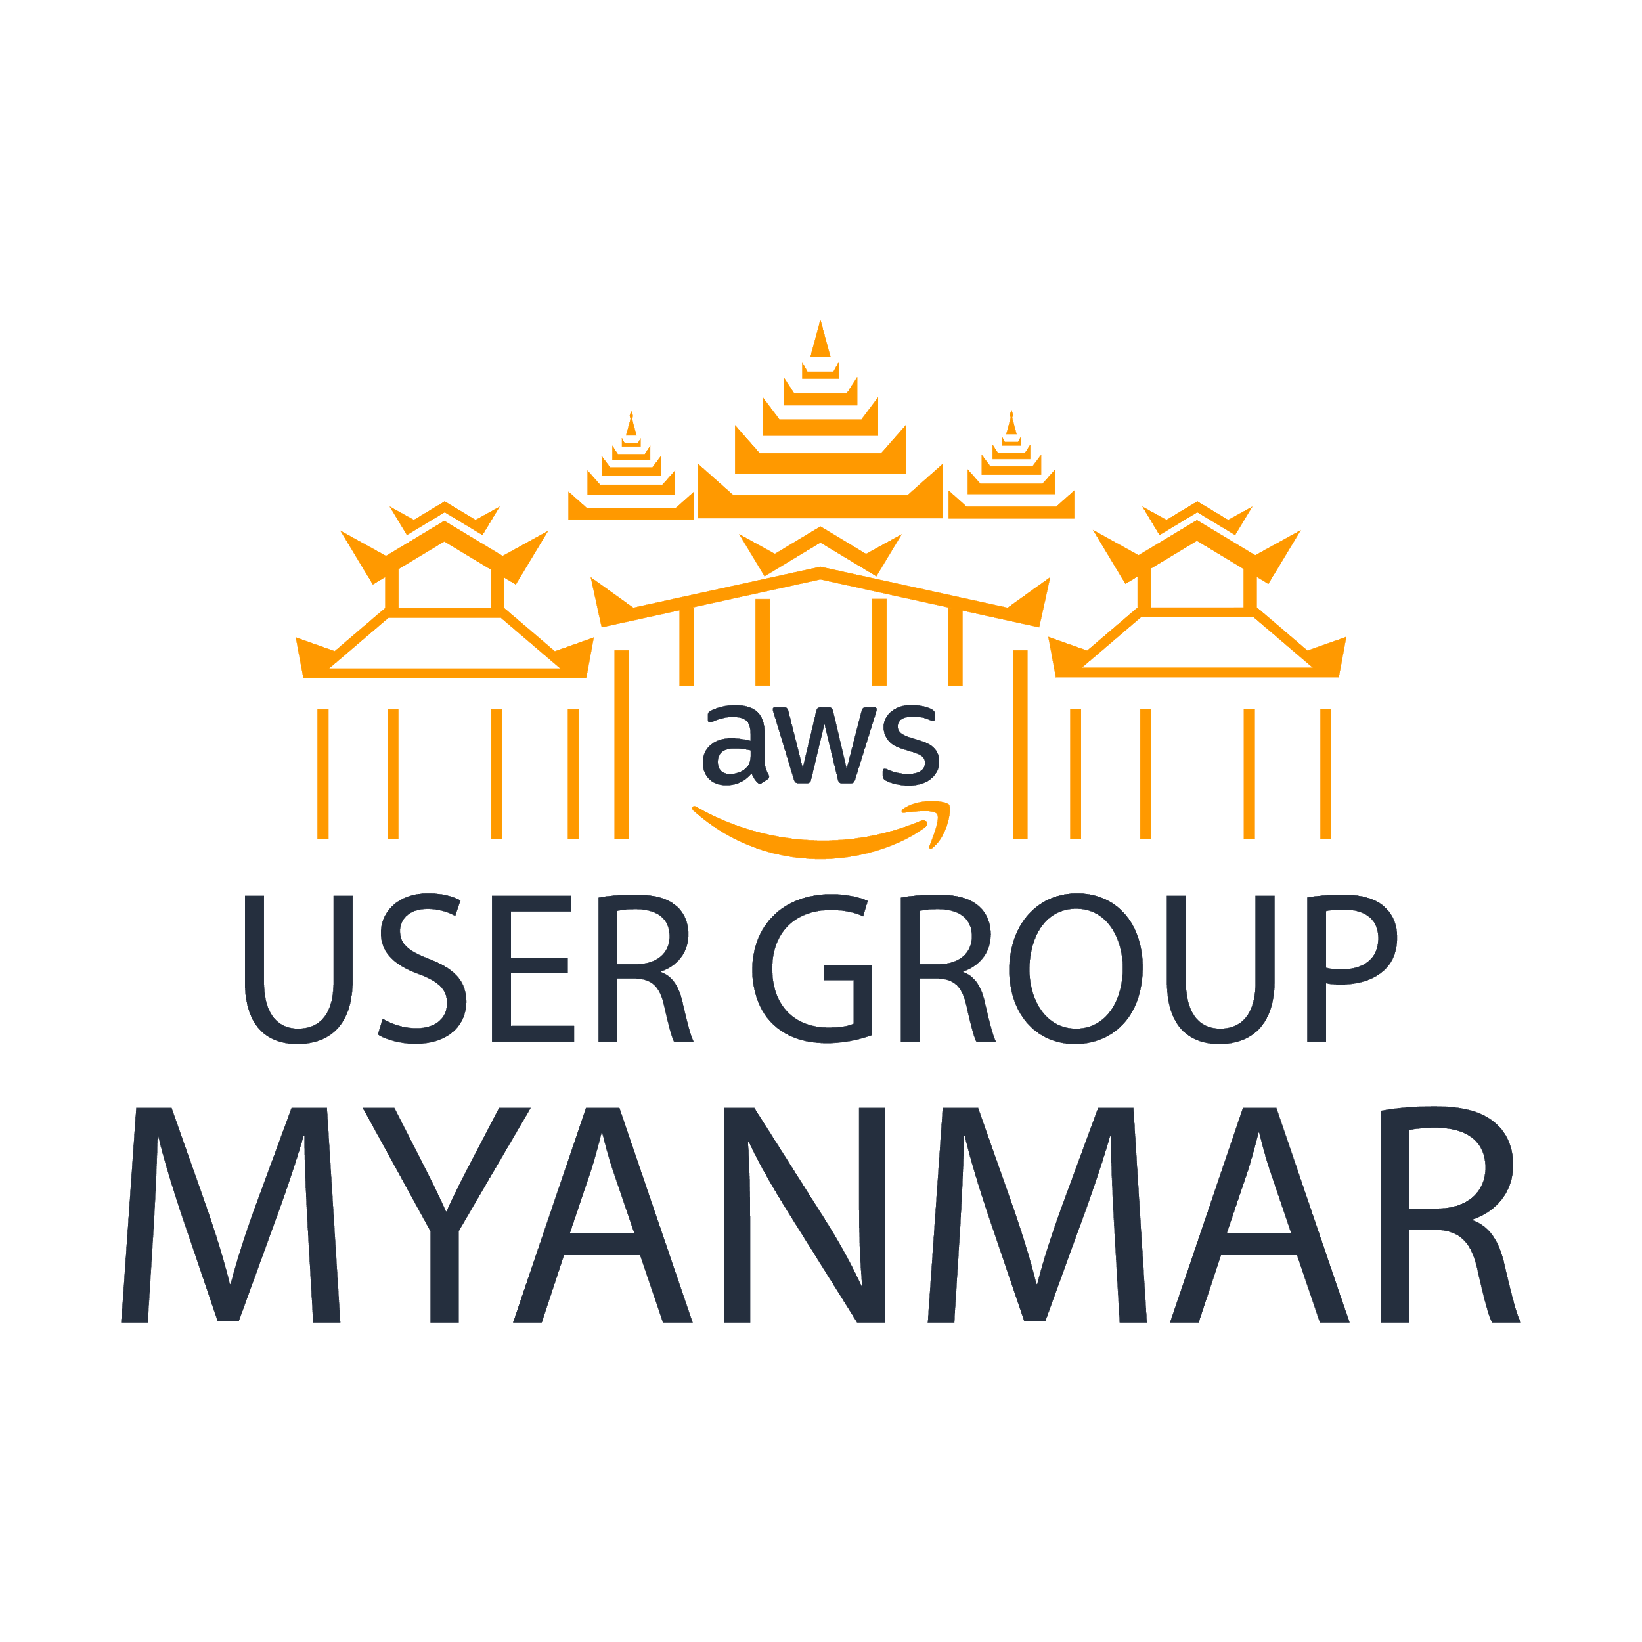
Established in 17th November, 2018
Logo Palace Gate represents the Gate of the Knowledges in Myanmar.
AWS User Group Myanmar

Slide 2

Cloud Security and Logging
AWS User Group Myanmar

Slide 3
Aung Myint Myat
Assoc. Security Engineer
Passionate about Technology
Hobby in Aquascaping
About Me
AWS User Group Myanmar

Slide 4
Cloud Security
AWS User Group Myanmar

Slide 5
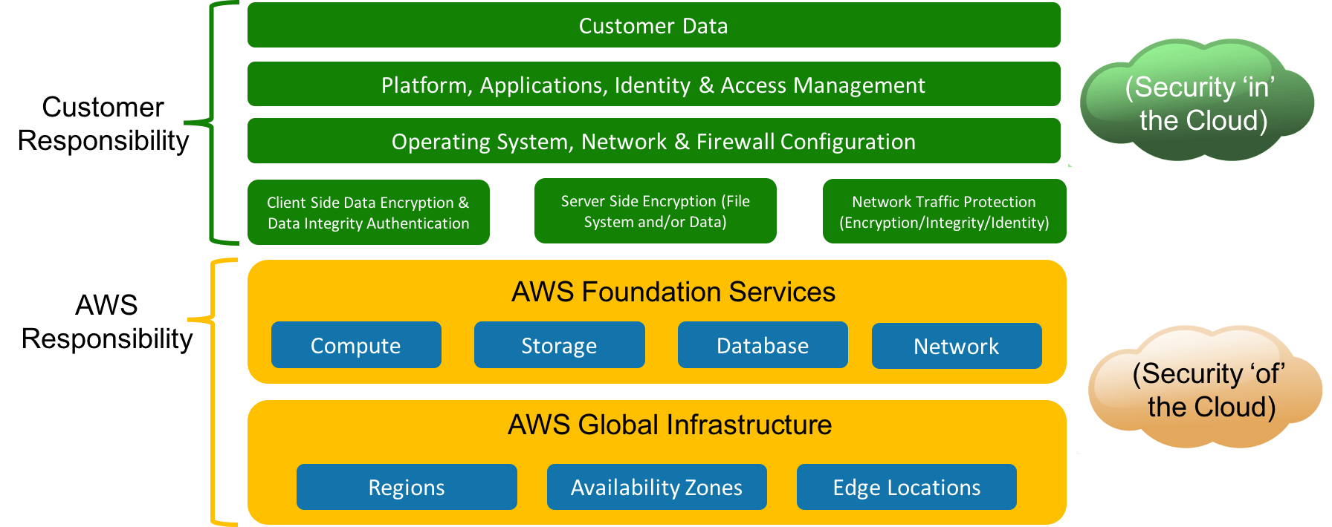
Share Responsibility Model
AWS User Group Myanmar

Slide 6





AWS Security Solutions
Identity | Detective Controls | Infrastructure Protection | Data Protection | Compliance
IAM AWS SSO Amazon Cognito AWS Directory Service AWS Resource Access Manager | Amazon Security Hub Amazon GuardDuty Amazon Inspector Amazon Detective | AWS Shield AWS WAF Firewall Manager | Amazon Macie AWS KMS CloudHSM Certificate Manager | AWS Artifact
AWS User Group Myanmar

Slide 7
Fine Grained Access IAM
Users
- Federation, SAML, Management Policy
Groups
- Group Policy
Services
- Least privilege access
Roles
- For instances and function.
AWS User Group Myanmar

Slide 8


Organization SCP
Organization Master Account
Organizational Accounts
Resources Accounts
Developer Accounts
AWS User Group Myanmar

Slide 9
Protecting Credentials
Least privilege user access
MFA on the root account
Password Policy
No API keys in source control
Temporary credentials via STS
AWS User Group Myanmar

Slide 10
Security at all Layers
AWS User Group Myanmar

Slide 11
Physical Layer
    AWS manage the physical security.
    It is security of the cloud.
AWS User Group Myanmar

Slide 12
Network Layer
    VPN related
    Subnets, route tables, NACL, security groups
    Limit the public subnet
    Load Balancers, Bastion Hosts
    External Connectivity for management
    - VPN Gateway or Direct Connect
AWS User Group Myanmar

Slide 13

System Layer
    OS based firewalls
    Remove unused packages
    Remove direct access
    Patch Management
    Amazon Inspector
    Golden Images
Amazon Inspector
AWS User Group Myanmar

Slide 14



Data Layer
    User Authentication
    Access Control
    Encryption
    - Data In-Transit (SSL/TLS, VPN/IPSEC, ssh)
    - Data At-Rest (KMS, SSE-C)
CloudHSM
KMS
AWS Certificate Manager
AWS User Group Myanmar

Slide 15
Enable Traceability
AWS User Group Myanmar

Slide 16
Detective Controls
    Integrate auditing controls
    Capture and analyze logs (Logging)
AWS User Group Myanmar

Slide 17

Cloud Logging
What is Cloud Logging?
Identifying and collecting data sources in the cloud that are worthy of analysis.
AWS User Group Myanmar

Slide 18
Logging Process
Discover
Collect
Analyze
What data sources?
What is the value?
How to collect?
AWS User Group Myanmar

Slide 19
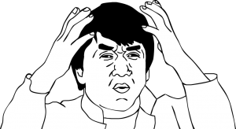
Discover
Identify and locate the log sources.
Document the log sources in our AWS environments.
Log Sources :
AWS infra logs – CloudTrail logs, VPC Flow Logs,
AWS service logs – S3, Load Balancers, CloudFront, Lambda
Host Based logs – Security, Application logs, Syslogs, Performance Monitoring
AWS User Group Myanmar

Slide 20


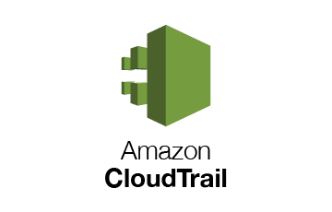


Collect
Different types of log collections.
- Some needs to install agents.
- Some have central logging frameworks.
- Container logging with Amazon Log Driver or Sidecar monitoring container.
Ingesting into Event Management Platforms.
For example: Elastic Stack
AWS User Group Myanmar

Slide 21

Analyze
Point of the collection is to do something with it.
We must analyze the data with the help of event management platforms.
Some ideas to do analysis on collected logs.
Too many failed or successful log ins.
Impossible geolocations difference.
Sensitive data where it doesn’t belong.
Unauthorized logins.
Change of accounts, groups and policies.
Large amount of file accessed.
Standard user behavior and application analytics.
AWS User Group Myanmar

Slide 22
Case Study
Capital One Breach (Between March & July 2019)
The unauthorized user accessed data stored in S3 belonging to Capital One.
He exfiltrated data and stored in github under name, Paige Thompson.
He boasted about the data theft online.
Someone outside of the Capital One noticed the data theft and notify the responsible disclosure email address at Capital One.
AWS User Group Myanmar

Slide 23
Technical Details
EC2
S3 Bucket
Metadata Service
Web Server
Service Role
AWS Infrastructure
Direct access
No access
Attacker
AWS User Group Myanmar

Slide 24
Technical Details
The attacker found a SSRF vulnerability in Web Application inside EC2.
The vulnerability leads to the metadata service which is internal to EC2.
The metadata service (running on 169.254.169.254) leaks the credential keys related to the service roles assigned to the ec2 instance.
The EC2 had a role to access the s3 backup so that the attacker get access to the bucket.
AWS User Group Myanmar

Slide 25
Reflecting with S.R.M
The credentials in the metadata service of the EC2 instances belong to the AWS. It is security “of” the cloud.
The metadata service which is internal to ec2 was never accessible from public.
Data stored in S3 belongs to Security in the cloud.
The Web server in the ec2 instance needs to be configured securely by Capital One. It is security “in” the cloud.
AWS User Group Myanmar

Slide 26
Reflecting with Cloud Logging
Discover
  Web Application Logs
  S3 Server Access Logs
  AWS CloudTrail Logs
  Collect
  Application log shippers (eg. Filebeat)
  S3 log collectors
  Analyze
  Attack pattern in Web App logs.
  Unusual source location in S3 access logs.
  Use of access key and token in cloudtrail logs.
AWS User Group Myanmar

Slide 27
Demo
AWS User Group Myanmar

Slide 28
References
  https://docs.aws.amazon.com/vpc/latest/userguide/flow-logs-s3.html
  https://docs.aws.amazon.com/AmazonS3/latest/dev/cloudtrail-logging.html
  https://docs.aws.amazon.com/AWSSimpleQueueService/latest/SQSDeveloperGuide/sqs-logging-using-cloudtrail.html
  https://docs.aws.amazon.com/awscloudtrail/latest/userguide/cloudtrail-create-a-trail-using-the-console-first-time.html
AWS User Group Myanmar

Slide 29
Thank you!
AWS User Group Myanmar

