Slide 1
Python RegEx
Class 4-2

Slide 2
RegEx Module
Python has a built-in package called re, which can be used to work with Regular Expressions.
import re

Slide 3
RegEx Functions
Function | Description
findall | Returns a list containing all matches
search | Returns a Match object if there is a match anywhere in the string
split | Returns a list where the string has been split at each match
sub | Replaces one or many matches with a string

Slide 4
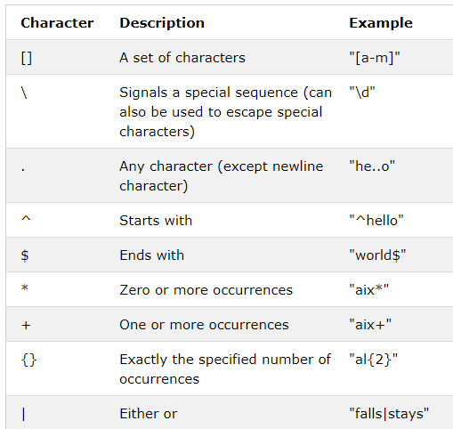
Metacharacterss

Slide 5
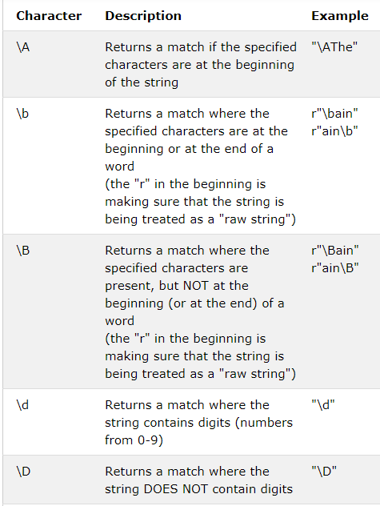
Special Sequences

Slide 6
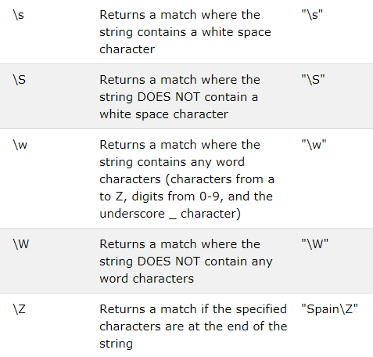

Slide 7
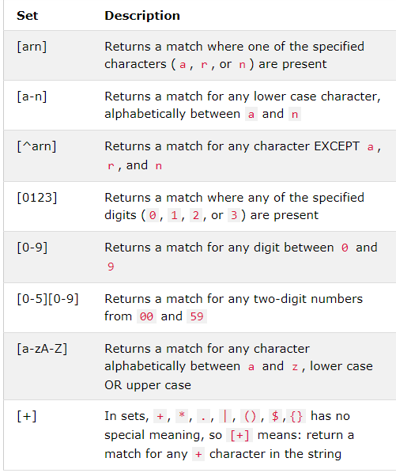
Sets

Slide 8
findall()
import re txt = "The rain in Spain" x = re.findall("ai", txt) print(x)

Slide 9
search()
import re txt = "The rain in Spain" x = re.search("\s", txt) print("The first white-space character is located in position:", x.start())
Match Object
.span() returns a tuple containing the start-, and end positions of the match. .string returns the string passed into the function .group() returns the part of the string where there was a match

Slide 10
split()
import re txt = "The rain in Spain" x = re.split("\s", txt, 1) print(x)

Slide 11
sub()
import re txt = "The rain in Spain" x = re.sub("\s", "9", txt,2) print(x)

Slide 12
HW
Practice Practice and Practice

