Slide 1


SPARK BASED SEARCH ENGINE
Rabin Banjade
Aunkong Azim

Slide 2






Search Engines
Definition: A program that searches for and identifies items in a database that correspond to keywords or characters specified by the user, used especially for finding particular sites on the World Wide Web.
The different types of search engines are
Crawler based search engines
Directory based search engines
Hybrid search engines
Meta search Engine

Slide 3
Challenges
Large amount of documents to process
Amount of documents is increasing day by day
Huge computation requirement for processing and querying
The type of data is also changing like : search is done on videos, images and hence more challenges

Slide 4
Project Goal
Develop a search engine based on spark
Given a query, the output should be the document that closely matches to the query.
Pre processing and query processing will be done using spark
2. Provide a web based UI for the search engine

Slide 5
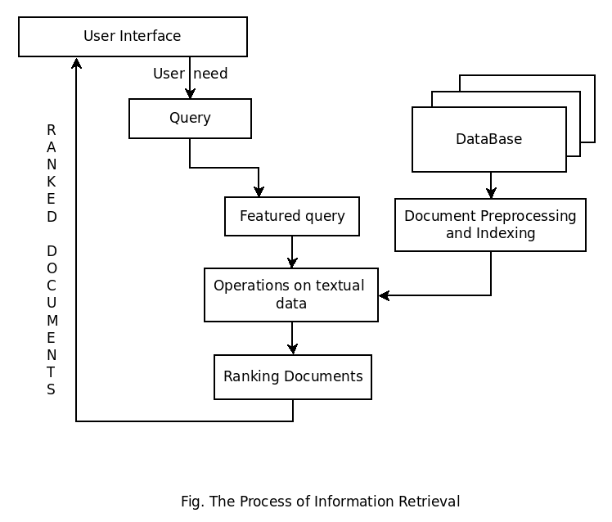
Search engine architecture

Slide 6
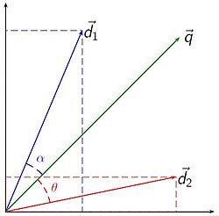
Vector Space model
Given vectorized representation of each documents D1,D2 finding document that is most relevant to the vectorized representation of query.
Cosine similarity to calculate similarity between documents

Slide 7

TF- IDF representation of documents
TFIDF, short for term frequency–inverse document frequency
TF represents number of times a word appears in a document
IDF is an offset that helps to adjust the fact that some words might appear in many documents.

Slide 8
TF- IDF representation of documents
Consider a document containing 100 words wherein the word cat appears 3 times. The term frequency (i.e., tf) for cat is then (3 / 100) = 0.03. Now, assume we have 10 million documents and the word cat appears in one thousand of these. Then, the inverse document frequency (i.e., idf) is calculated as log(10,000,000 / 1,000) = 4. Thus, the Tf-idf weight is the product of these quantities: 0.03 * 4 = 0.12.

Slide 9
Methodology
Preprocessing Datasets : University of Memphis(10000 documents) & Wikipedia(size > 50 GB)- Processing the dump files to structure the data(Crawling)
Build inverted index for the documents using spark functionalities
Use spark to produce relevant results based on ranking of documents using Spark

Slide 10
Experiments and Results
Evaluation will be based on precision and recall.
This is a well known experiment and functionalities of Apache spark will be hugely helpful in building the application.

