Slide 1
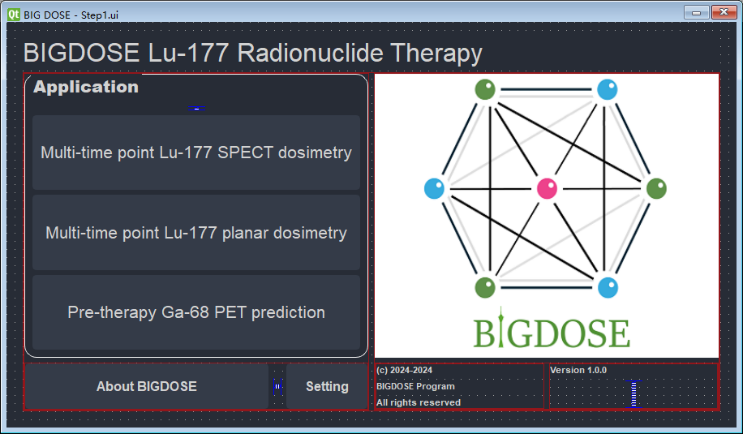

Slide 2
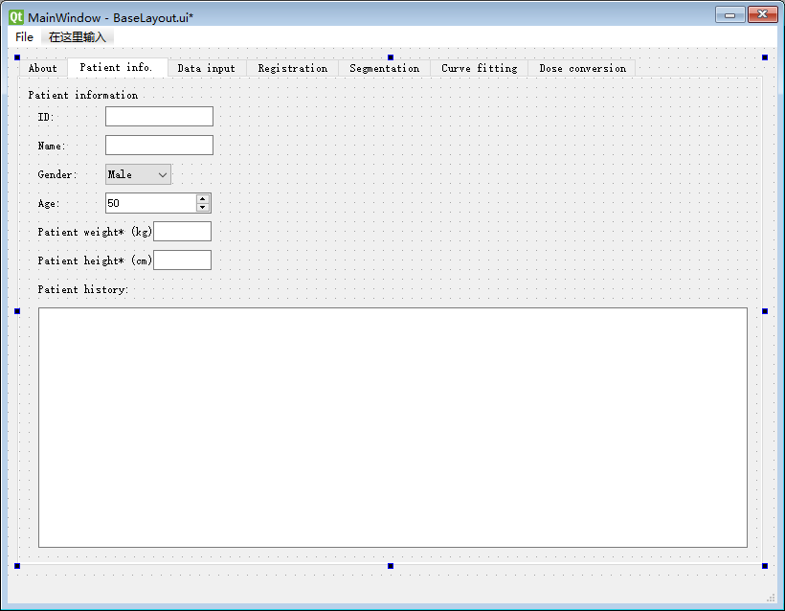

Slide 3
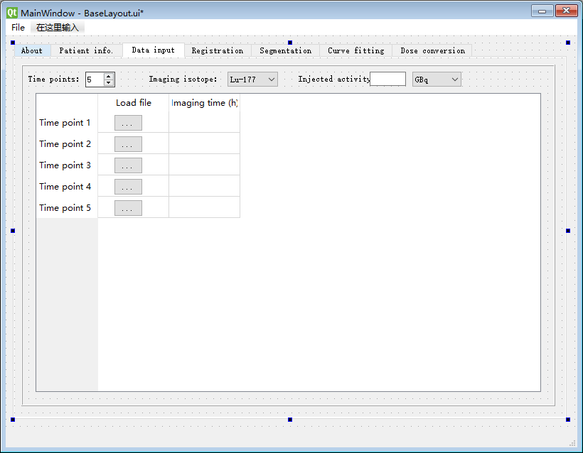

Slide 4
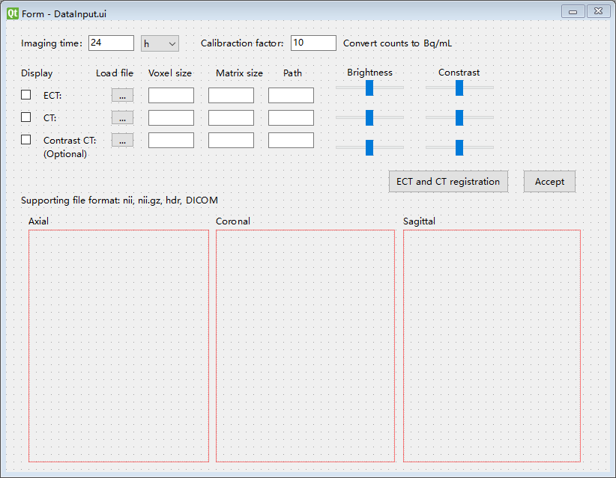

Slide 5
Flowchart of multi-time point Lu-177 SPECT dosimetry
Data input
Multiple SPECT scans (scan time, calibration factor) and corresponding CT scans
SPECT/CT Registration
In the same time point, SPECT and CT registration
In the different time point, multiple SPECTs or CTs registration
Organ based dosimetry
Organ/tumor map
Curve fitting
Dose conversion
Voxel based dosimetry
Voxel S value kernel convolution
Voxel based curve fitting
Dose map

