Slide 1
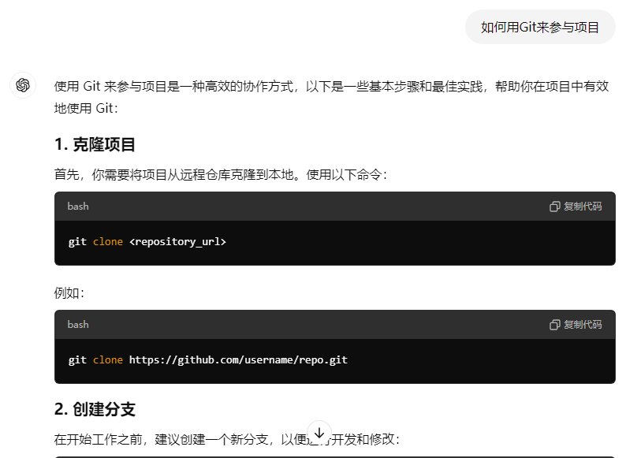
Instructions using Git to share file
BIGDOSE url: https://github.com/flybitcone/BIGDOSE_Lu177
This is a private responsibility. Please send your GitHub email to me and I will add you to collaborators
How to using Git?
1. Clone the project to local disk
git clone https://github.com/flybitcone/BIGDOSE_Lu177
2. Create your branch
git checkout -b your_branch_name
3. Push your modify
git add .
git commit -m "描述你的更改"
git push origin your_branch_name
Make sure each time when you work, you are working on the latest version of BIGDOSE software.
If you meet program problems, try ChatGPT, it is useful

Slide 2
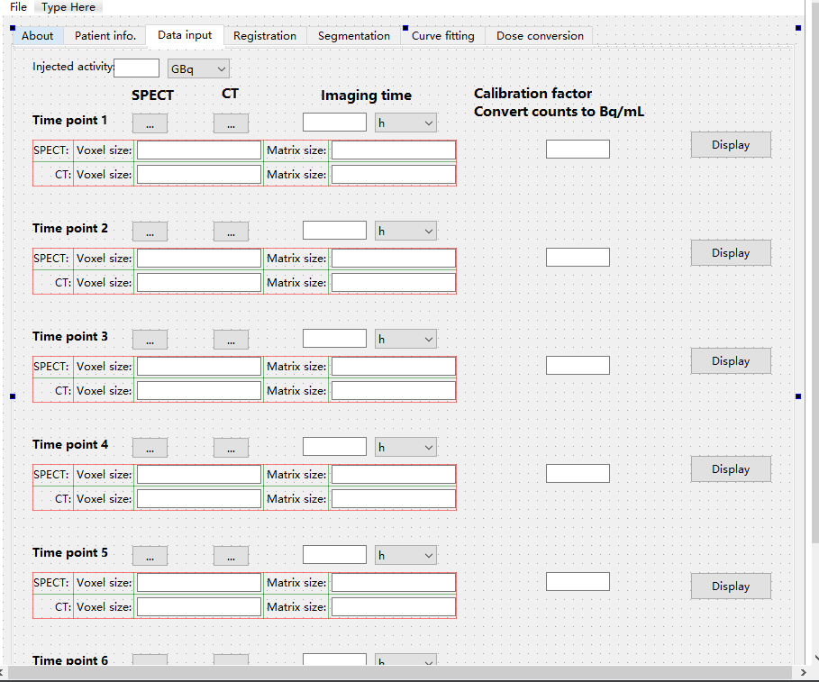
Something needs to fix
Activity 和input box too narrow
Spacing too large
Spacing too large

Slide 3
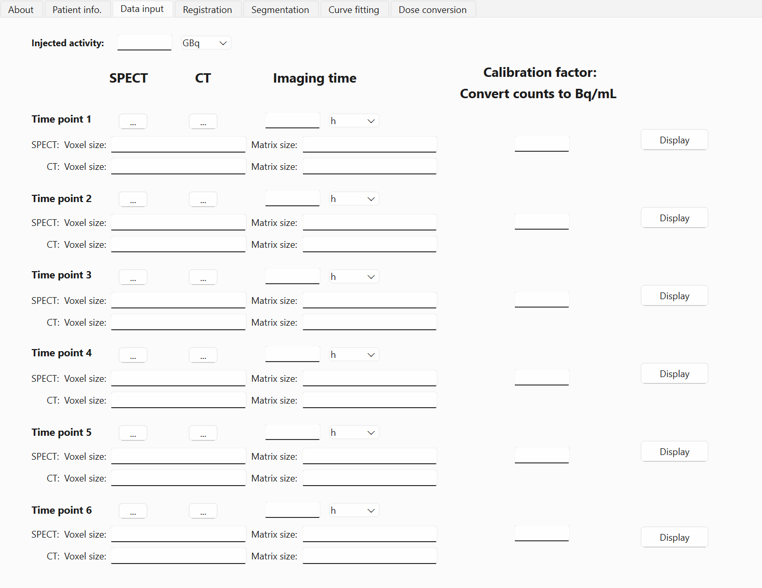
Adjusted UI

Slide 4
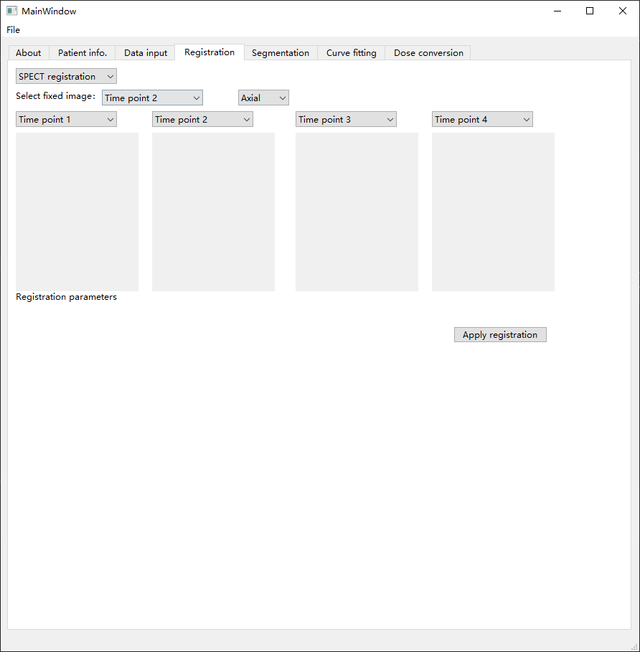

Slide 5
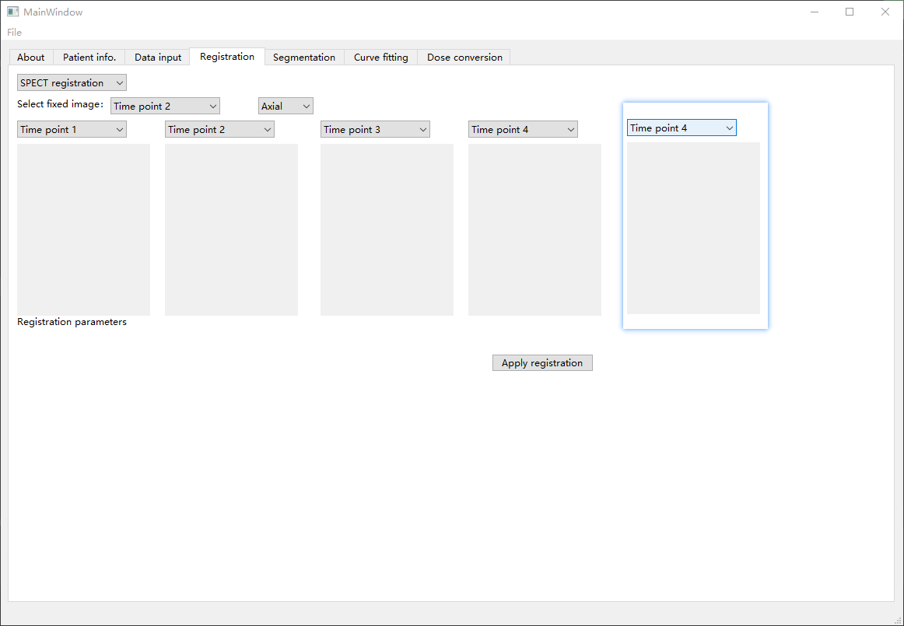
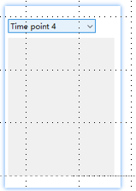
CT registration
Cornol
Before regi
After regi

Slide 6
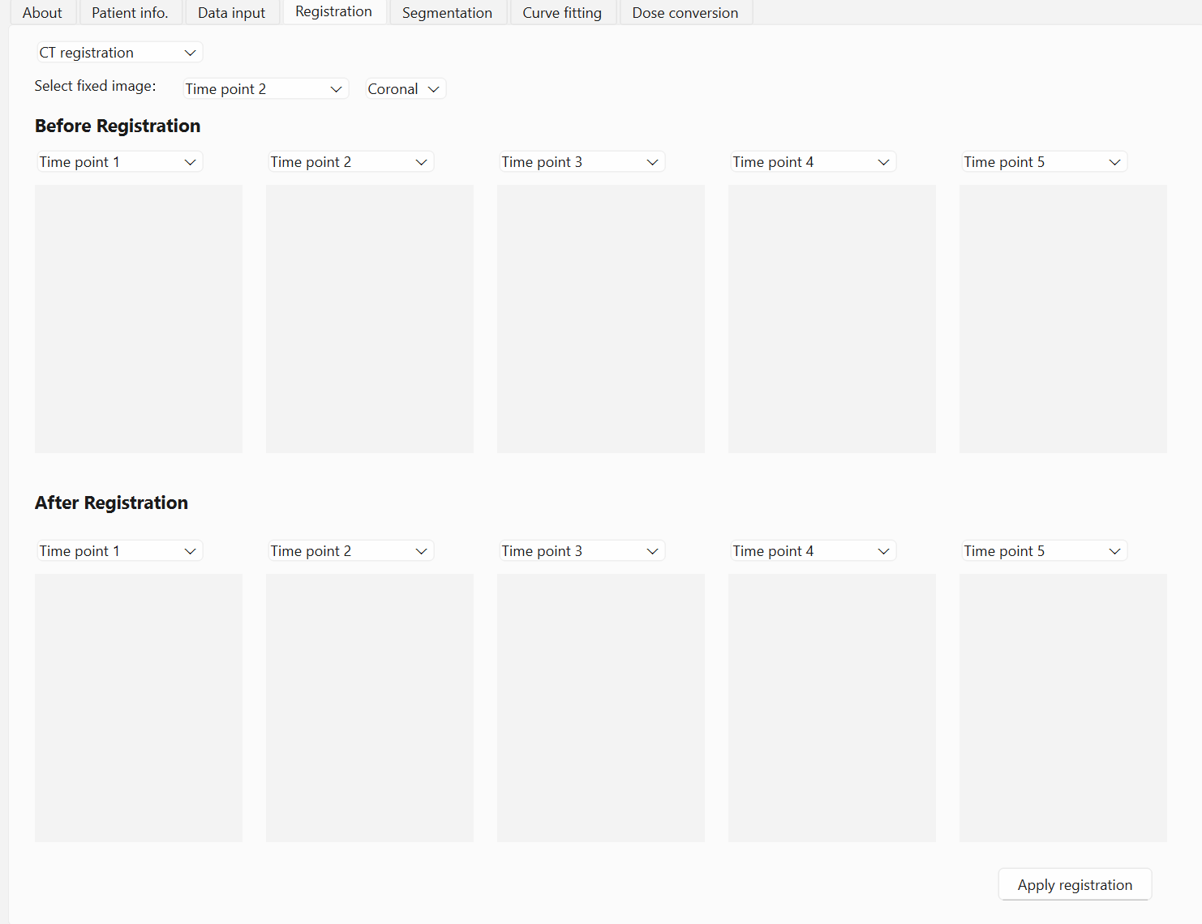
Adjusted UI

