Slide 1
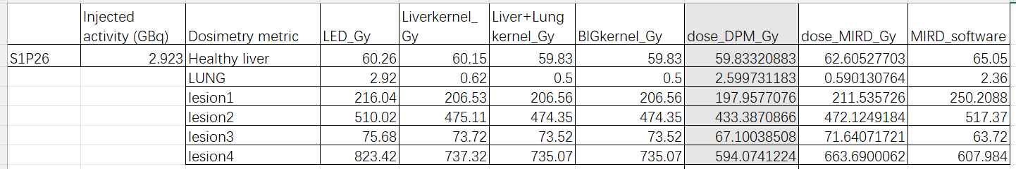

Slide 2
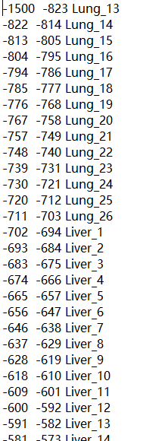
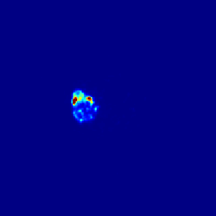
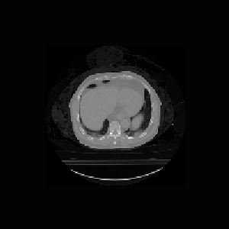
Y90 dosimetry calculation process
1. Y90 PET image, scale the total counts to injected activity
Now, the image voxel unit is XXX GBq/voxel
2. CT image with a translation table
Translate the CT unit from HU to materials
(Resample process not change the HU)

Slide 3
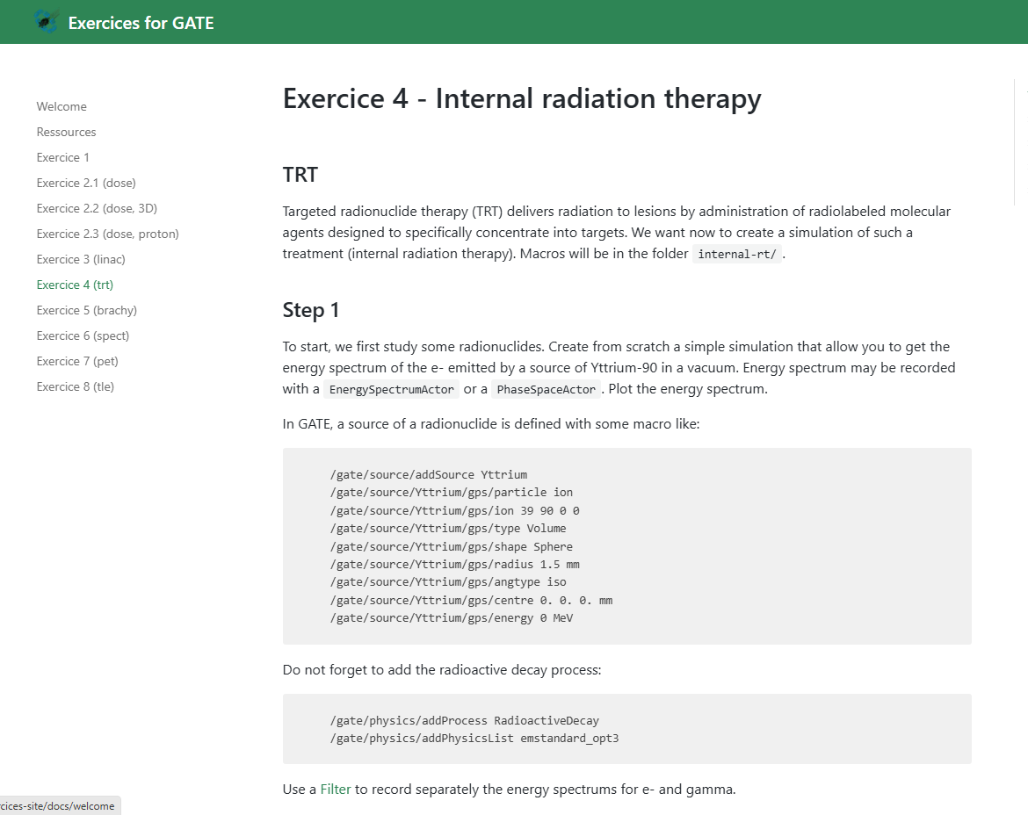
3. Gate internal dosimetry model
Exercice 4 - Internal radiation therapy · Exercices for GATE (in2p3.fr)

Slide 4
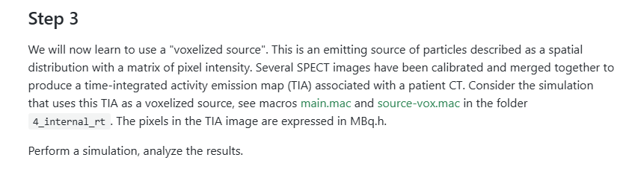
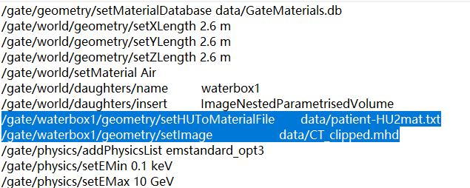
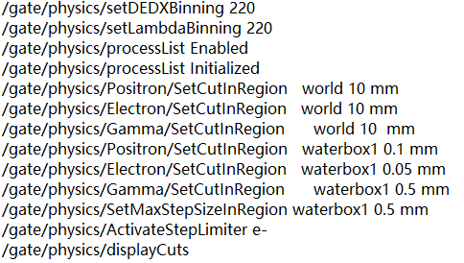

Slide 5
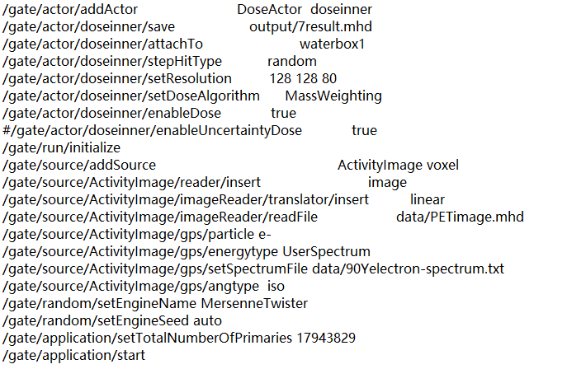

Slide 6
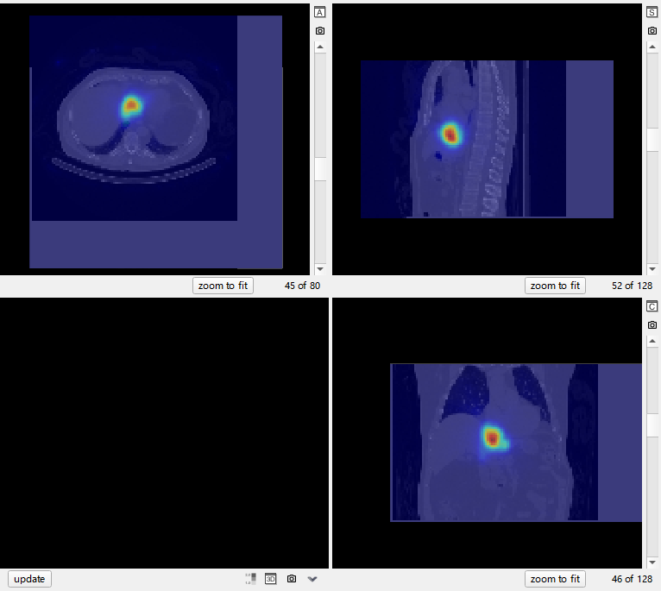
4. Integrate to get the final dose map

Slide 7
Can be used as reference result
MIRD method (soft ware)
Voxel_S_value (self generated kernel VS web site kernel)
Image based MC (Gate)
MIM result (MC, MIRD)

