Slide 1

Traditional Tumour Segmentation
Global & ROI Thresholding and Otsu Methods
Date: August 21, 2025

Slide 2
Agenda
Introduction & Objectives
Segmentation Methodology
Data & Pre‑processing
Results & Performance
Discussion & Conclusions

Slide 3
Segmentation Methodology
Global Threshold
ROI Threshold
Otsu Threshold
Compute a single threshold based on the maximum intensity in the entire image and segment voxels above a fraction ‘p’ of this maximum.
Restrict the search to a region of interest around the tumour, compute I_{max} within that region and threshold accordingly.
Unsupervised algorithm that chooses the threshold maximising the between‑class variance of the intensity histogram.
thr = p × I_{max}
thr_{ROI} = p × I_{max,ROI}
maximise σ^2_{between}(t)
[1] [2] [3]

Slide 4
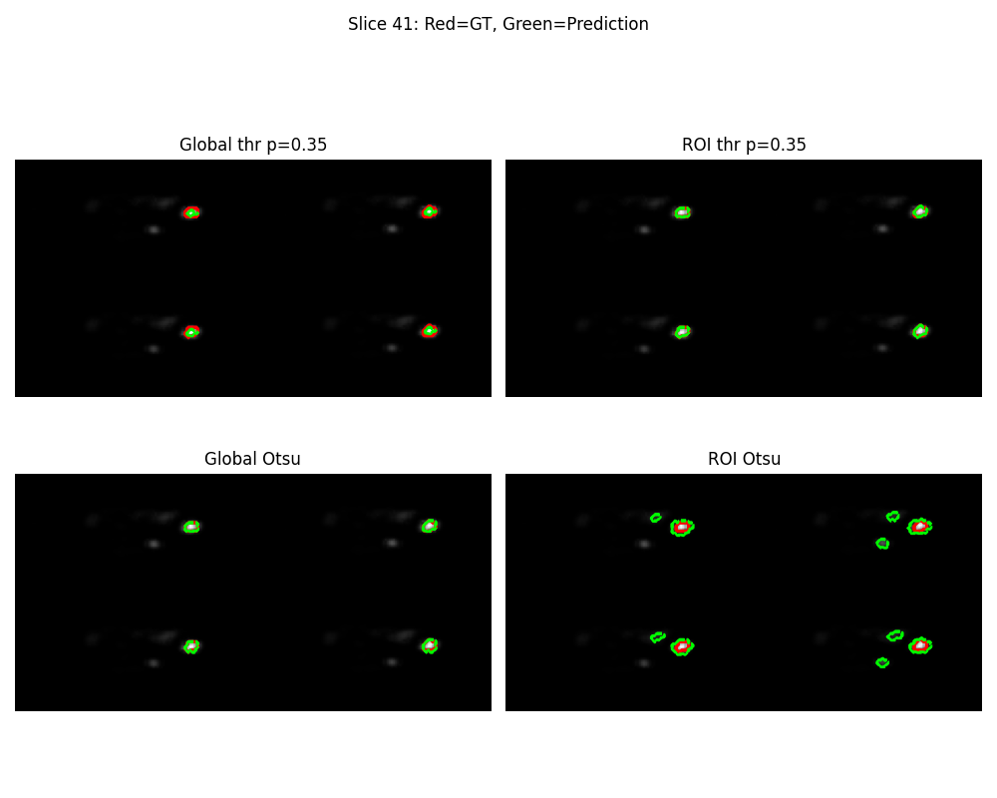
Data & Pre‑processing
Dataset
• 3D PET SPECT scan of a single patient (116×116×232 voxels).
• Voxel spacing: 4.42 mm, isotropic.
• Ground‑truth tumour mask (binary).
• ROI approximated via bounding box around the mask (margin 10 voxels) due to missing ROI file.
• Ground‑truth volume ≈ 42.7 mL.
SPECT slice with ground truth (red) and predictions (green)
[4] [5]

Slide 5
Results & Performance
Method | p | Dice | Pred Vol (mL)
Global thr | 0.35 | 0.232 | 63.0
ROI thr | 0.35 | 0.950 | 44.0
Global Otsu | 0.17 | 0.357 | 194.1
ROI Otsu | 0.09 | 0.110 | 723.3
Highest accuracy achieved by ROI threshold at p=0.35. Global threshold and Otsu methods underperform due to background uptake.
[1] [3] [5]

Slide 6
Discussion & Conclusions
Key Observations
• ROI thresholding clearly outperforms global methods. The limited search space suppresses background uptake and yields a Dice of 0.95 at p=0.35.
• Global thresholding struggles because the maximum intensity originates from physiological uptake outside the tumour region.
• Otsu’s method fails in the presence of skewed intensity distributions, selecting thresholds that over‑segment healthy tissue. Future Work
• Incorporate more realistic ROIs using anatomical priors or automatic bounding boxes.
• Apply adaptive or multi‑thresholding schemes that account for local contrast variations.
• Validate on larger patient cohorts to understand variability across tumours.
[2] [6]

